Slide 1



2025 HIV Prevention Road Map baseline survey: Results Review and Milestones
Accra, Ghana
15 February 2024

Slide 2
OUTLINE
Introduction
The GPC Prevention RoadMap 10 Points Action Plan
Roadmap Survey and Baseline Report 2023
Process of Stakeholder Review
Stakeholders Feedback, Identified Gaps, and Priority Actions

Slide 3
The Global HIV Prevention Coalition (GPC) Road Map is a 10-step action plan for getting countries’ programmes on track to meet their HIV prevention targets for 2025 and end the public health threat of AIDS by 2030
Based on the 2021 UN Political Declaration on HIV and AIDS to provide effective HIV prevention services to 95% of people at risk of HIV infection and thereby contribute to reducing new HIV infections by more than 80% in 2025 compared to 2010
Using tools design by UNAIDS, countries assess their progress/state of implementation of the 10 action points through Surveys involving stakeholders and report to GPC/UNAIDS
Results further reviewed and priority actions developed by in-country teams for implementation and improvement

Slide 4
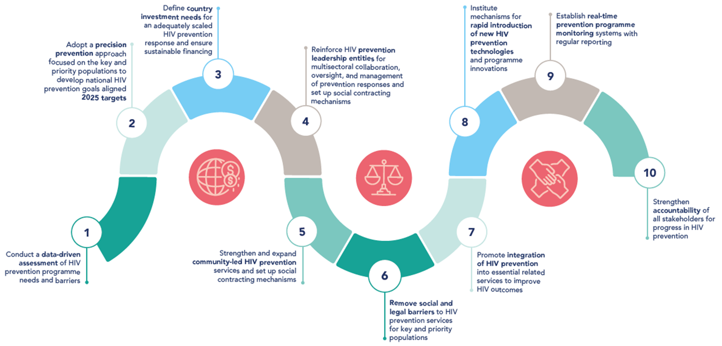

Slide 5
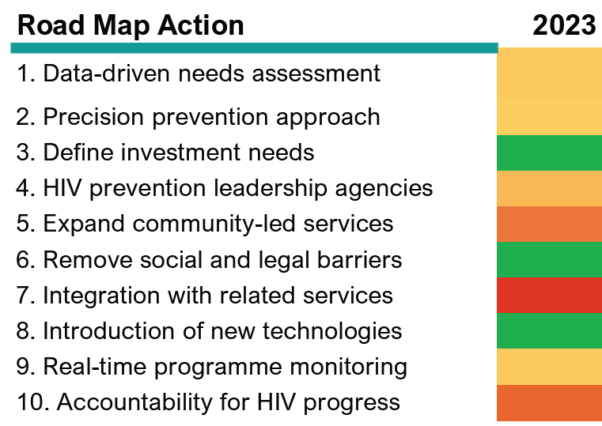


Baseline status of Ghana 10 HIV Prevention 2025 Road Map Actions

Slide 6
Stakeholders were divided into three groups to:
- Reflect on Road Map survey and baseline results,
- Articulate gaps across the relevant prevention pillars,
- Draft priority actions for 2024 onwards
- Draft milestones aligned with 2025 Road Map,
- Define the what, how and who,
- Identify technical resources and support needed

Slide 7
Results: Stakeholder Feedback

Slide 8



Road Map Action Point 1: HIV prevention needs assessment
Gaps and Priority Actions Identified
Gaps
National HIV prevention needs assessment not available at subnational level
No targets for HIV prevention
KP fallout due to the bill on “Promotion of Proper Human Sexual Rights and Ghanaian Family Values”
There is currently no policy on the use of Naloxone for harm reduction interventions
No consolidated annual program of work for all HIV interventions
Priority actions
Develop an HIV prevention needs assessment for subnational levels
Develop HIV prevention targets at regional and district levels
Intensify advocacy on right to health of KP community
Train healthcare workers on full care treatment for KP community
Intensify priority/targeted care access for KPs ( online services)
Bring all HIV prevention actors under one umbrella (Reorganize, reconstitute the technical working groups. Encourage the technical working groups to National body to be proactive in bringing together actors through review meetings)

Slide 9
Milestones Proposed: HIV prevention needs assessment
Milestones/Priority Actions | Timeline | How: Mechanism Who: Responsible entity
Develop an HIV prevention assessment for subnational levels PSAT tool to be adapted and applied at the regional level. Form a small group at the regional level to conduct an assessment. | Mid year 2025 | Review and adaption of existing prevention assessment tools by end of 2024 – GAC Apply the tools at regional and subnational levels by June 2025 - GAC/NACP Dissemination of the response by end of 2025 - GAC
Develop HIV prevention targets at regional and district levels Start from the regional level. | 4th Quarter 2024 | Consultants/TA –GAC and UNAIDS

Slide 10
Road Map Action Point 2: Precision HIV prevention approach
Gaps and Priority Actions Identified
Gaps
Dissemination of the National strategic plan nationwide. Appears on the GAC website only.
Accessibility with disability challenges not being addressed
Adaptation from Global AIDS Strategy into the national and subnational AIDS Strategy
Limited subnational targets for HIV prevention
Priority actions
Prioritization of the next National Strategic Plan. Current one is 2021-2025
Acceleration plan to complete the various hanging country documents including mid-term review of NSP, KP SOP.
Packages for AGYW to be prioritized

Slide 11
Milestones Proposed: Precision HIV prevention approach
Milestones/Priority Actions | Timeline | How: Mechanism Who: Responsible entity
Dissemination of the revised NSP targets based on the mid-term review | By the end of June 2024 | How: Hybrid Stakeholder engagement Document must be available online Who: GHS/NACP and GAC
Prioritization of the next National Strategic Plan. Current one is 2021-2025 (2026-2030) | By the end of 2025 | How: End term review of the current NSP Engagement with consultant, stakeholders, Validation, dissemination Who: GAC and supporting partners
Accelerate completion of the various documents- KP SOP, stigma index 2.0 | KP-SOP: By end of April 24 Stigma index: By end of Feb 24 | How: Stakeholder engagement Who: SPH/NACP How: Validation and dissemination Who: GAC How: Validation and Dissemination Who: NAP+, WAPCAS and its partners
Strategic plan for AGYW to be prioritized | By the end of 2024 | How: SBC strategy with emphasis on Social media strategies Who: GAC and partners

Slide 12
Road Map Action Point 3: Defining country investments for scaled HIV prevention response
Gaps and Priority Actions Identified
Gaps
Need for granulated budget breakdown of plan to achieve 2025 HIV prevention targets
Priority actions
Granulated budget breakdown to inform/be informed by the plans in achieving the 2025 HIV prevention targets and beyond.

Slide 13
Milestones Proposed: Defining country investments for scaled HIV prevention response
Milestones/Priority Actions | Timeline | How: Mechanism Who: Responsible entity
Granulated budget breakdown to districts and regions across Ghana | Q4 of 2025 | How: As part of the development of NSP Who: GAC
Pursue diversified resource mobilization approaches and partnerships | End of 2025 | How: Multistakeholder engagement Who: GAC, MOH/GHS

Slide 14
Road Map Action Point 4: Reinforcing multi-sectoral HIV prevention leadership
Gaps and Priority Actions Identified
Gaps
Limited resources to fund the multi-sectoral collaboration oversight and management of the national HIV prevention response.
Competing priorities of the multi-sectoral HIV prevention response team.
The current national multi-sectoral approach does not include all the relevant actors in the HIV prevention response.
No existing criteria to develop milestones
Inconsistent quarterly review meetings to review HIV prevention status and data
Priority actions
Pursue diversified resources and partnerships to fund the multi-sectoral collaboration oversight and management of the national HIV prevention response.
The HIV prevention coalition should be more representative of the relevant actors in the HIV prevention response.
Community-led organizations should be empowered to lead the HIV prevention response.
Establishing criteria to develop and document milestones for evaluating progress on HIV prevention response.
Re-institute Quarterly Coordination meetings to review HIV Prevention status and data

Slide 15
Milestones Proposed: Reinforcing multi-sectoral HIV prevention leadership
Milestones/Priority Actions | Timeline | How: Mechanism Who: Responsible entity
Pursue diversified resources and partnerships to fund the multi-sectoral collaboration oversight and management of the national HIV prevention response. | 2026 | GAC
Re-institute Quarterly Coordination meetings to review HIV Prevention status & data | Quarterly starting now | GAC
Develop consolidated workplan and share in the first month of the year to guide planning | December of every year. | GAC / All Partners
Develop a framework to clearly state the roles of various IPs & partners | Current one (1) to be developed and should be by March 2024 | GAC to coordinate with all agencies in HIV

Slide 16
Road Map Action Point 5: Strengthening and expanding community-led HIV prevention services
Gaps Identified
Gaps
Community-led HIV prevention services are not holistic, they are donor and agenda driven
No targets set for increasing the proportion of HIV services delivered by community-led organizations
Top-down approach to HIV prevention progamming where this is dependent on government and donors.
Priority actions
Develop a data repository on community HIV Service including data on prevention
Develop a country specific strategy on community HIV Prevention that includes key actors & their roles with clear activities including an operational plan
Get it high-level, covering a cross-cutting platform
Different aspects of community approaches are implemented at different levels and scale and all need to be brought to the table so there is a Representative voice
Cultivating a community practice on HIV prevention needs to reflect the “Let Communities Lead” Mantra

Slide 17
Milestones Proposed: Strengthening and expanding community-led HIV prevention response
Milestones/Priority Actions | Timeline | How: Mechanism Who: Responsible entity
Develop a data repository on community HIV Service including data on prevention | End of 2024 | PPMED / GHS, GAC
Develop a country specific strategy on community HIV Prevention that includes key actors & their roles with clear activities including an operational plan | July 2024 | GAC / UNAIDS

Slide 18
Road Map Action Point 6: Addressing social and legal barriers to services for key and priority populations
Gaps and Priority Actions Identified
Gaps
Fragmented references in the Policy
No documents in place for some priority populations
SoPs and NSPs are light on social, legal and structural barriers to services for key and priority populations
Priority actions
Standardise documents to especially address KP Populations in the context of KP work/SoPs
NSP needs to incorporate structural issues and plans for addressing social and legal barriers and consolidate changes for all priority populations
Need social protection and legal focal points
Engage Parliamentary Select Committee on Health on “the Bill”

Slide 19
Milestones Proposed: Addressing social and legal barriers to services for key and priority populations
Milestones/Priority Actions | Timeline | How: Mechanism Who: Responsible entity
Develop a consolidated guideline document for addressing social, legal, barriers to with sections on the different groups | December 2024 | Rev Dr Ken Danso NACP SI team Dr Adu-Gyamfi Clinical care
NACP to build a coalition (TWG) to lead routine sessions, town-halls, to raise visibility on addressing social and legal barriers to services for Key and Priority Populations – with the NSP |  | NACP

Slide 20
Road Map Action Point 7: Promoting integration to improve HIV outcomes
Gaps and Priority Actions Identified
Gaps
The integration of the various health conditions alongside HIV are present but they are in progress and in some aspects inconsistent
There is an underlying issue of health coverage for testing of these conditions that is lacking
Priority actions
Fast tracking the process of integration
Addressing the cost component of these health conditions
Integration of family planning in PMTCT services to avoid unwanted pregnancies

Slide 21
Milestones Proposed: Promoting integration to improve HIV outcomes
Milestones/Priority Actions | Timeline | How: Mechanism Who: Responsible entity
Integration of FP and HIV | By end of 2025 | How: Advocacy for the inclusion of FP in NHIS benefit package Who: MOH, NAP+, M2M, other stakeholders and partners
Integration of MNCH and HIV | By end of 2025 | How: Advocacy for the inclusion of MNCH into HIV services Who: MOH/GHS, M2M
Merging of Hepatitis and HIV services (It is parallel as it stands) | By end of 2025 | How: Advocacy for effective integration Who: MOH/GHS
Integration of Mental Health into HIV care | By end of 2025 | How: Advocacy for effective integration Who: MOH/GHS
Integration of NCDs into HIV services | By end of 2025 | How: Advocacy for effective integration Who: MOH/GHS
Improvement of TB/HIV integration | By end of 2025 | How: Advocacy for the improvement, migration of cost onto NHIS Who: MOH, NTP, CSO

Slide 22
Road Map Action Point 8: Introduction of new HIV prevention technologies and programme innovations
Gaps and Priority Actions Identified
Gaps
Periodic shortages of ARVs makes it difficult for multi-month dispensing
Close expiry of HIV commodities
Priority actions
The country is to implement the action plans for the new HIV technologies and programme innovations like CAB-LA, vaginal ring
Local production

Slide 23
Milestones Proposed: Introduction of new HIV prevention technologies and programme innovations
Milestones/Priority Actions | Timeline | How: Mechanism Who: Responsible entity
Acceleration of rollout of Vaginal ring and long acting PrEP regimen | By the end of 2025 | How: multi-stakeholder engagement Who: MOH/NACP
Improvement of commodity security to avoid shortages | By the end of 2025 | How: Multistakeholder engagement Who: MOH/GHS
Sharing of milestones |  | How: Through multistakeholder engagement Who: MOH/GHS/NACP

Slide 24
Road Map Action Point 9: Establishment of real-time programme monitoring
Gaps and Priority Actions Identified
Gaps
No sub-national score card/tool
Priority actions
Develop a sub-national score card/tool

Slide 25
Milestones Proposed: Establishment of real-time programme monitoring
Milestones/Priority Actions | Timeline | How: Mechanism Who: Responsible entity
Develop a sub-national score card/tool | Mid 2025 | Review and adaption of existing prevention score card tools by end of 2024 – GAC Apply the tools at regional and subnational levels by June 2025 - GAC/NACP Dissemination of the response by end of 2025 - GAC

Slide 26
Road Map Action Point 10: Strengthening accountability mechanisms of all stakeholders
Gaps and Priority Actions Identified
Gaps
All interventions are unmarked in the accountability framework of the roadmap (no accountability framework)
Priority actions
Develop action plans to implement all the interventions in the accountability framework of the 2025 HIV Prevention Map.
Develop and monitor an accountability framework that is infused in government and community leadership, transparency and sustainability.

Slide 27
Milestones Proposed: Strengthening accountability mechanisms of all stakeholders
Milestones/Priority Actions | Timeline | How: Mechanism Who: Responsible entity
Develop an accountability framework (Develop action plans to implement all the interventions in the accountability framework of the 2025 HIV Prevention Map) | End of 2024 | How: Technical Assistance (Consultant) Identify and leverage on existing meetings of the various bodies and embedding accountability briefings and dialogues in line with the accountability framework Who: UNAIDS/GAC

Slide 28
Recommendations
Collaboration with key partners such as PEPFAR and The Global Fund is essential during the development of methodology tools for HIV prevention programs.
Ensure comprehensive coverage of Harm Reduction and Disability Inclusion interventions within HIV prevention programs.
Enhance visibility and engagement of the existing multi-sectoral HIV Prevention Working Group to ensure stakeholders understand its mandate and objectives.
Strengthen knowledge sharing and coordination among organizations working on HIV prevention to avoid working in silos.
Future surveys should gather evidence on the integration of HIV prevention programs with other health conditions and ensure consistency nationwide.
Develop a detailed breakdown of the HIV prevention budget to inform planning, coordination, and alignment with the National Strategic Plan.

Slide 29
Recommendations
7. Establish an acceleration process considering low overall prevalence but high incidence among key populations, including legal challenges faced by certain groups.
8. Consider consultancy to address specific challenges related to adolescent girls and young women, and develop a foundation of clear data for proposed social media strategies.
9. Accelerate the assessment and establishment of HIV prevention responsive structures.
10. Review global policies/strategies for integration into primary health care and universal health coverage.
11. Link new HIV technologies and program innovations to existing strategies like condoms and PrEP as part of scale-up efforts.

Slide 30
THANK YOU

