Slide 1
Overview of programmatic priorities, latest guidance, trends, and tools for AGYW programming:
Orientation and action planning workshop of New Global HIV Prevention Coalition Countries
Kigali, Rwanda, 24 – 26 October 2023
Souad Orhan

Slide 2
HIV prevalence among AGYW in priority countries, 2022
N- Adult prevalence (15-24) (Percent) Female

Slide 3
HIV incidence among AGYW in new GPC countries, 2022
Incidence category | Incidence range
Low | (<3)
Moderate | (3 – <10)
High | (10+)
N- Incidence (15-24) (Per 1000) Female

Slide 4
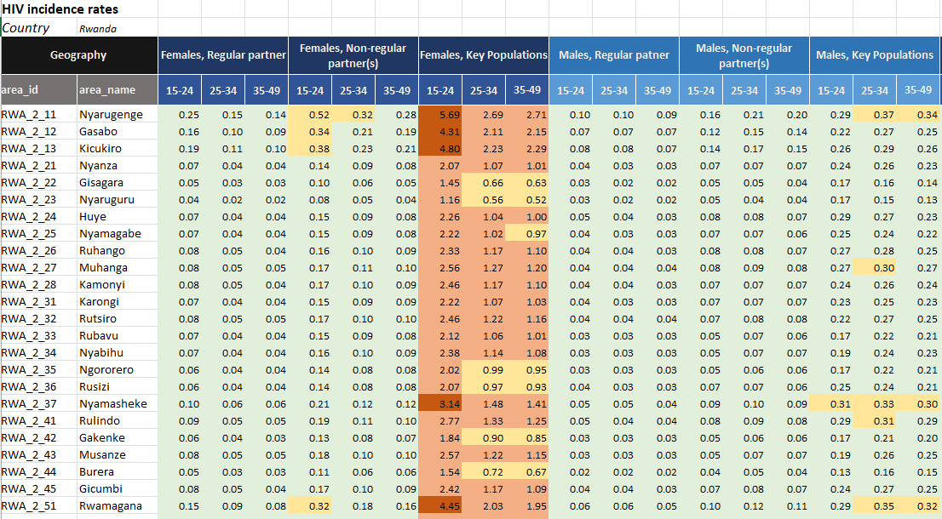
Sub-national incidence levels disaggregated by sex, age, and risk
(per 100 person years)
Incidence category | Incidence range
Low | (<0.3)
Moderate | (0.3 – <1.0)
High | (1.0+)
Very high | (3.0+)
Figure: National summary of district estimates in Rwanda

Slide 5
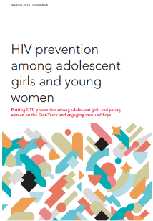
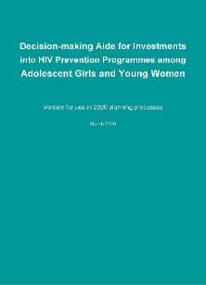
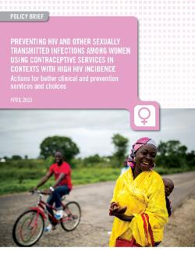
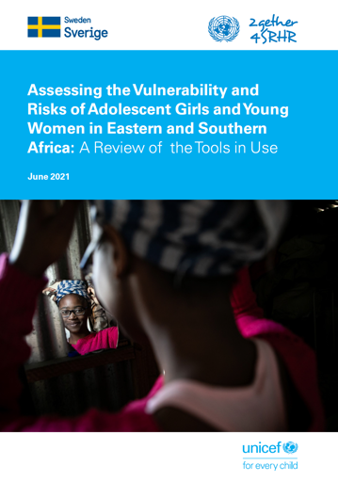
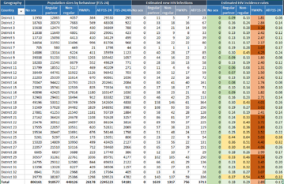
Guidance and tools – in chronological sequence: A location-population approach for HIV prevention with AGYW
Programming guidance on HIV prevention among adolescent girls & young women (2016)
Decision-making aide for investments into HIV prevention programs (2020) – Updated in 2023
Preventing HIV and other STIs among women using contraceptive services (2020)
Review of risk assessment tools (2021)
Operational aid on developing population size estimates of adolescent girls & boys, young women & men at higher risk of HIV (UPCOMING)
Sub-national population size estimates

Slide 6
Options MENU
Dimension of
change
HIV prevention
outcomes
Menu options
Impact
Condoms
Fewer partners/ more partner choice
(less risky partners)
School-based prevention
(in context of comprehensive sexuality education)
Norms, know how, skills
Core prevention programs
Interpersonal communication
Reduced
HIV incidence
Support choices of young
women who have agency
Pre-exposure prophylaxis
Safer sex negotiation (condom use)
HTS, ART, VMMC for men
Biological factors
Policy, legal change
Community mobilization
Reduce susceptibility
and transmissibility
Consistent use of ARVs for prevention (ART, PrEP, PEP)
Synergistic
effects on education, GBV, gender norms, SRHR
Multi- and new media
Policy & structural action
Cash transfers / incentives
Gender norms & GBV prevention
Structural factors
More men go for HIV/health services (HTS/ART & VMMC)
Sexual and reproductive health and rights
Enhance agency among
young women
Enhanced leadership

Slide 7
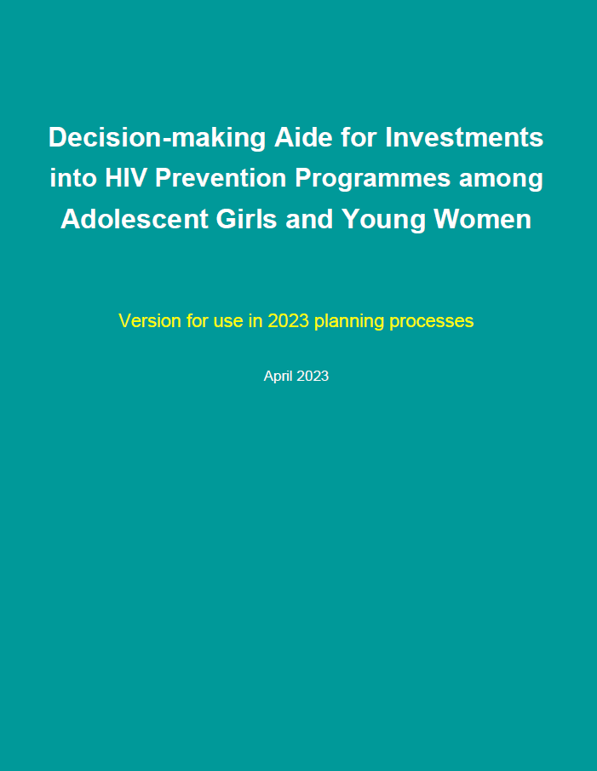
Goal of the AGYW Decision-Making Aide
To assist countries in deciding what packages should be provided, by whom, to whom and where
  Focusses on the optimization of the size of the packages depending on the incidence level and vulnerability and looking at the main programme delivery platforms
  Structured into 9 steps

Slide 8
Step 1: Review HIV incidence patterns
Review the country’s HIV incidence patterns, which should be disaggregated by age, sex, location and risk category
Differentiate subnational areas by levels of HIV incidence
Step 2: Identify the size priority populations
Use the population size estimation tool

Slide 9
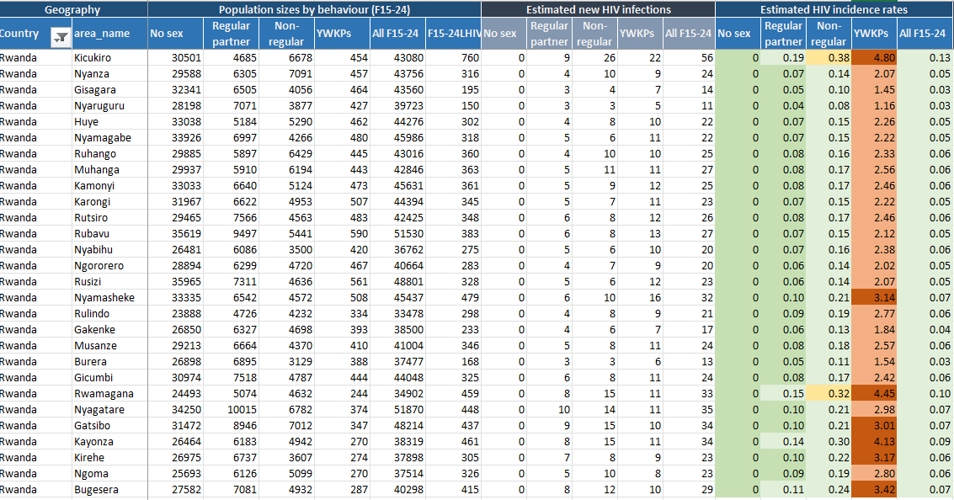
Using sub-national estimates disaggregated by risk for informing programmes

Slide 10
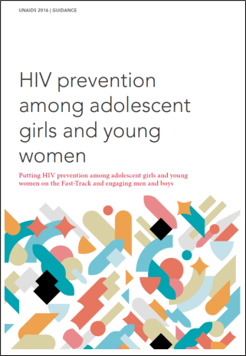
Step 3: Consider other vulnerability factors
Structural factors
Harmful social and gender norms
Low secondary school attendance
Lack of economic empowerment
Labour migration and spousal separation
Barriers to SRH services
Orphanhood
Child sexual abuse
Gender-based violence incl early marriage
Marriage patterns
Behavioral
Age-disparate sex
Multiple partnerships
Sex work and sexual exploitation
Transactional sex
Early sexual debut
Gaps in knowledge and limited personalized risk perception
Biological
Gaps in viral suppression among male partners
Biological susceptibility of women and adolescent girls
Low prevalence of male circumcision
STIs and other co-infections
Harmful practices potentially increasing HIV acquisition (eg. intra-vaginal)

Slide 11
Step 4: Review available programs and service coverage
Health, Education, Community Programs
  What program elements are already available
  What coverage levels

Slide 12
Step 5: Define HIV prevention packages per category
You may use the proposed packages in the prioritization matrix as a starting point.
Set programmatic coverage targets for HIV prevention in locations with moderate, high and very high incidence. Targets should be tracked for different age groups (e.g., 15-19 and 20-29) as overall coverage might mask lower coverage in one age group.
Efforts to scale up prevention among adolescent girls and young women can build synergies with broader efforts in the area of HIV prevention, HIV, SRHR, adolescent and women’s health and well-being, GBV prevention and response, social protection and other development activities.

Slide 13
Dedicated focus of AGYW prevention programmes: Health & education platforms

Slide 14
Step 6: Define a management mechanism
Local governments would typically convene the management mechanism, usually under an HIV Prevention and/or AGYW technical working group
Step 7: Define the role of delivery platforms (i.e., settings to reach AGYW) and develop a simple delivery system
In line with the defined HIV prevention packages (health services, schools, community platforms)
Actively involve young women (including as staff and champions)
Collaborate closely with the local AIDS office, health facilities, schools and other partners operating in the area

Slide 15





Delivery platforms for scaling up programs for adolescent girls, young women and men in settings with high HIV incidence:
Health sector platforms
(facilities, mobile services)
National (new) media platforms supporting demand generation and normative change
Youth-friendly services (trained providers, conducive hours, …)
Access to SRH/HIV services (incl. HIV/STI risk assessment, condoms, VMMC, HTS/ART, PEP, PrEP, GBV, cervical cancer screening, HPV vaccine…)
Integration of HIV into family planning & STI services,
Sub-national AIDS office
Makes it happen (leadership, financing)
Convenes monthly progress review (all platforms)
Follows through on problem-solving
Involves other sectors as needed (e.g. social & economic support, empowerment, keep girls in school, …)
Legend:
Yellow font … primary focus of HIV funding
White font … complementary health & development funding (potentially with contribution of HIV funding)
Education platforms
(schools, universities)
Community platforms
(lead NGO/CSOs)
Dedicated HIV prevention campaigns
(prevention knowledge, risk perception, self-efficacy, prevention methods, skills, GBV) with referrals/links to services
(Accelerated) Comprehensive sexuality education
Community mobilization & interpersonal communication on basic HIV prevention knowledge, risk perception and on transforming HIV related community & gender norms
Community-based demand generation and outreach HIV prevention services (condoms, self-tests for young women & male partners)
Active PrEP demand generation (for young women at highest risk)

Slide 16
Step 8: Develop a costed operational plan
Based on the targets and defined packages and operating procedures
The resources available in the country (domestic and external funding) should fully cover the proposed programme implementation.
Step 9: Develop an M&E plan
Should be linked to the results framework and anchored within broader national health information systems, assists with tracking and regularly reviewing progress towards results
Should ideally also include an evaluation component looking at measuring and linking the implementation of the packages to changes in the epidemic

Slide 17
HIV prevention among adolescent girls and young women: what have we learned
Need for more systematic approach to prioritization & programming
  Based on HIV incidence estimates, vary intensity of programmes in locations with different levels of HIV incidence
  Intensive prevention for populations with highest HIV incidence (key populations and adolescent girls, boys, women and men in very few locations,) – this includes PrEP and regular community outreach/empowerment plus all basic prevention & treatment options)
  Basic lower cost prevention options (condoms, VMMC where applicable, testing & treatment plus basic demand generation using cost-efficient channels) for other settings with moderate HIV incidence
Define clear theory of change (which outcomes in terms of prevention behaviours will lead to reduced HIV incidence). Accompanied by programme monitoring
Ensure coordination and stewardship
Engage AGYW throughout

Slide 18


THANK YOU
THANK YOU!

