Slide 1
Cost and Impact of Scaling Up EIMC in Southern and Eastern Africa using the DMPPT 2.0 Model
Emmanuel Njeuhmeli, MD, MPH, MBA
Senior Biomedical Prevention Advisor and
Co-Chair PEPFAR Male Circumcision Technical Working Group
Office of HIV/AIDS / Global Health Bureau,
US Agency for International Development

Slide 2
Hypothetical Historical Impact of EIMC
What if South Africa had 80% MC prevalence from the beginning of the HIV epidemic?

Slide 3
What If South Africa Had 80% MC Prevalence from the Beginning of the HIV Epidemic?
Analyze the HIV epidemic using the South Africa Goals model
Baseline scenario
MC prevalence as recorded in National Communication Surveys 2009 and 2012
80% scenario
MC prevalence is 80% for all years
Notes:
We were interested in looking to see what the epidemic in South Africa would have looked like if it had had 80 percent male circumcision prevalence from the beginning of the epidemic. We used the Goals model that was set up for South Africa and created 2 scenarios, one with the MC prevalence as actually recorded and one with 80 percent MC prevalence in all years. We projected the numbers of people living with HIV .
You can see that in the baseline scenario, there are about 5 million people living with HIV in 2012. (The model projection is slightly lower than the UNAIDS estimate of 6 million. We are in the process of recalibrating the Goals model & will update the slide when this is completed) . In comparison, if 80% of males had been circumcised since the beginning of the epidemic, we would be looking at only a million people living with HIV in the country. In other words, if male circumcision had been at 80% coverage from the beginning of the epidemic then there would be 4 million fewer people living with HIV in South Africa than there are today.

Slide 4
EIMC Impact on HIV Incidence

Slide 5
South Africa: Incidence Reductions in the Population by Age of Clients
Notes:
You saw this graph in the previous presentation. Each line represents a circumcision strategy targeting only that age group. The reductions in incidence are in the entire population, not just in that age group. The age group listed in the legend is only who is getting circumcised. The model is tracking the males who are circumcised as they age over time. Each line represents the reduction in incidence comparing the scale-up strategy depicted compared with no scale up.
Here you can see that the impact of circumcising infants (yellow EIMC line) is delayed compared with circumcising adults and adolescents, and that it takes a long time for the impact of circumcising infants to catch up with the impact of circumcising older age groups. Eventually if we project out long enough, the yellow line will cross the green line at the bottom and end up with about the same overall impact as circumcising 10-14 year olds, or a slightly greater impact.

Slide 6
How does adding EIMC affect the program?
What will be the cost and impact of introducing EIMC into an existing adult and adolescent VMMC program?

Slide 7
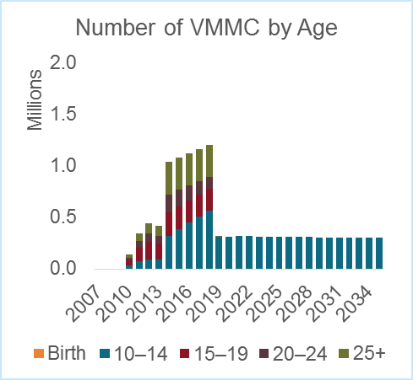
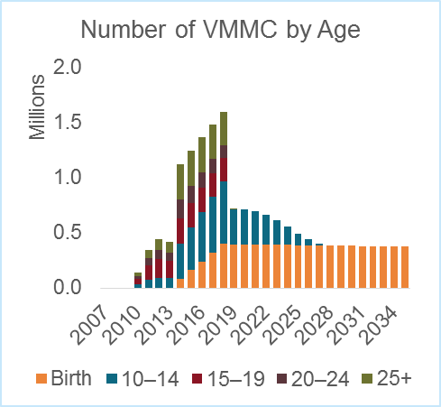
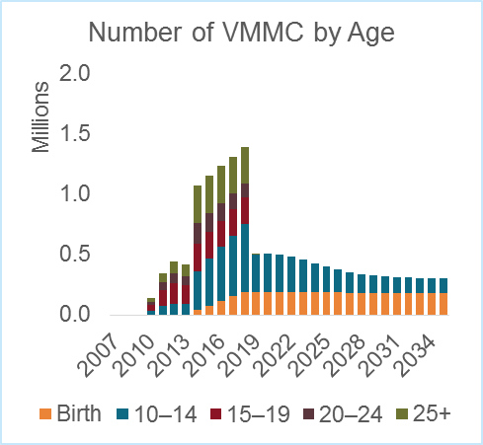
Three Scenarios: South Africa
Scale up to 80% coverage among 10–34-year-olds
Scale up to 80% coverage among 10–34-year-olds + 80% EIMC
Scale up to 80% coverage among 10–34-year-olds + 40% EIMC
Notes:
The following slides are using the DMPPT 2.0 model, projecting between 2013 and 2050. So here in the panel on the left, we’re scaling up to 80 percent coverage for 10 to 34 yr olds over five years, and maintaining that coverage into the future.
And in the panel in the middle, scaling up to 80 percent coverage for that group plus 80% among the infants and maintaining that coverage into the future.
In the panel on the right, scaling up to 80 percent coverage for adults and adolescents plus scaling up to 40% among infants, and maintaining that coverage into the future.
When you scale up adolescent and adult VMMC and you reach 80 percent coverage in five years, after that five years the maintenance will be focused on circumcising 10 to 14 yr olds forever. If you introduce EIMC to that scenario, then after 12 years you will have saturation among 10 to 14 year olds, and the maintenance phase will be a long term program focused on neonates.

Slide 8
Adding EIMC in South Africa Increases Impact by 3%, Decreases Cost by 9% (2013–2050)
EIMC cost 50% of adult VMMC unit cost
South Africa | 10–34 | 10–34 + EIMC | % difference
Infections averted* | 1.8 million | 1.8 million | 3%
# MCs | 15 million | 20 million | 29%
Total cost* | $1.9 billion | $1.7 billion | -9%
% infections averted* | 44% | 45%
VMMCs per infection averted* | 9 | 11
Cost per infection averted** | $2,034 | $1,959 | -4%
2013–2050
Scale up to 80% from 2013–2018; maintain at 80% through 2050
Fixed-cost VMMC by age
No replacement of baseline MCs
Discount rate = 3%
*not discounted; **both HIV infections averted and costs discounted
Notes:
The cost-effectiveness of introducing EIMC into an existing adolescent/adult program will depend on the ratio of the cost of EIMC to the cost of adult/adolescent VMMC. There are very little data available about the cost of EIMC in Sub-Saharan Africa, and what data are available are relatively weak, so we have conducted a sensitivity analysis with a range of relative unit costs, as suggested by the few studies that have been done.
In this slide we assumed that the cost of EIMC is 50% of the cost of the adult VMMC. Over the period 2013-2050, the introduction of EIMC in South Africa will increase the impact, that is infections averted, by 3 percent. It Increases the number of MCs by 29 percent, and decreases the cost by 9 percent.

Slide 9
Comparison Across Countries % change when adding EIMC to a VMMC strategy targeted to clients ages 10–34
EIMC cost 50% of adult VMMC unit cost
% change when adding EIMC | Malawi | South Africa | Swaziland | Tanzania | Uganda
Infections averted* | 1% | 3% | 3% | 4% | 2%
# MCs | 45% | 29% | 24% | 58% | 46%
Total cost* | -6% | -9% | -12% | 4% | -5%
Cost per infection averted** | 0% | -4% | -5% | 7% | 1%
*not discounted; **both HIV infections averted and costs discounted
2013–2050
Scale up to 80% from 2013–2018; maintain at 80% through 2050
Fixed-cost VMMC by age
Discount rate = 3%
Notes:
When the cost of EIMC is 50% of the cost of adult and adolescent VMMC, the total cost of the program when adding EIMC to the adult/adolescent strategy decreases slightly, except in the case of Tanzania, where it increases slightly. This is even though the total number of circumcisions is higher when adding EIMC. Under these assumptions, cost per infection averted is similar when comparing a program only focusing on adults and adolescents to one that also includes EIMC.

Slide 10
At what cost does the cost-effectiveness of EIMC equal that of adolescent VMMC?
Notes:
Now I’m going to introduce a different kind of analysis from what we’ve presented so far. We wanted to examine at what EIMC unit cost the cost effectiveness of EIMC would be equal to that of adolescent VMMC.

Slide 11
Lifetime Cost-effectiveness of Neonatal vs. Adolescent MC
Scenario: An infant and a 15-year-old are circumcised at the same time; impact is calculated over the lifetime of each
Cost-effectiveness is a function of
Mortality
Discount rate (infections averted are discounted)
Baseline MC prevalence among adolescents
Notes:
This is different from the DMPPT 2.0 modeling where we look at cohorts of people circumcised over time. For this analysis, we considered a scenario in which an infant and a 15 year old are circumcised at the same time. The impact is calculated over the lifetime of each of them.
In this analysis, the cost effectiveness is a function of mortality and the discount rate— infections averted are discounted. The costs are not discounted because in this analysis both the infant and the 15 year old are being circumcised at the same time. And it’s also a function of the baseline prevalence of MC among adolescents.

Slide 12
Cost Ratio at which Lifetime Cost-effectiveness is Equal for EIMC and Adolescent VMMC
Unit cost of EIMC as a percentage of adolescent VMMC unit cost
Country | Baseline MC among 15–19-y.o. | Discount rate
 |  | 0% | 3% | 5% | 7% | 10%
Malawi | 11% | 82% | 53% | 39% | 30% | 20%
South Africa | 31% | 65% | 42% | 31% | 23% | 15%
Swaziland | 4% | 86% | 55% | 41% | 31% | 21%
Tanzania | 40% | 53% | 34% | 26% | 19% | 13%
Uganda | 22% | 69% | 44% | 33% | 25% | 16%
Notes:
What we show in this slide is the cost ratio at which the lifetime cost effectiveness is equal for EIMC and adolescent VMMC. The percentage depicted in the table is the unit cost of EIMC as a percentage of the unit cost of adolescent VMMC.
For South Africa, for example, if the discount rate is 3 percent, and EIMC cost is 42% of the adolescent VMMC cost, the lifetime cost effectiveness will be equal. You can see in this slide that this cost point depends on the discount rate that you’re assuming as well as the baseline MC coverage. For countries with a lower baseline MC prevalence such as Malawi and Swaziland, at a 3% discount rate, if the cost of EIMC is around 50% of the cost of adolescent VMMC then the lifetime cost effectiveness of both EIMC and adolescent VMMC will be equal. For countries like South Africa and Tanzania with higher baseline MC prevalence, the relative cost of EIMC must be lower in order for the lifetime cost effectiveness of EIMC and adolescent VMMC to be equal.

Slide 13
Broader Context
Cost-effectiveness is only one consideration for countries in determining whether/when to introduce EIMC
Some other considerations
Individual health
Other benefits of EIMC
Rate of adverse events
Public health
Program implementation considerations
Sustainability of program
Required human resources
Integration into existing health system
Cultural considerations, acceptability
Human rights

Slide 14
Conclusions (1)
If South Africa had 80% MC prevalence from the beginning of the epidemic, 1 million fewer people would be living with HIV, and the adult HIV prevalence would be around 2%.
The decision of whether to introduce EIMC will determine the age of clients that will need to be circumcised during the sustainability phase of the program.
Without EIMC, the sustainability phase will focus on 10–14-year-olds
With EIMC, the sustainability phase will focus on neonates
It is possible to have a mixed sustainability phase with adolescents and neonates

Slide 15
Conclusions (2)
Adding EIMC slightly increases the impact of MC, but depending on the demography of the country, it can substantially increase the required number of circumcisions . However, in most cases it decreases the total cost of the program if the cost of EIMC is 50% that of adult/adolescent VMMC.
Cost and cost-effectiveness of introducing EIMC depend on
The relative cost of EIMC vs. adult/adolescent VMMC
Baseline MC prevalence in the country
The discount rate used
Notes:
Not shown: Delaying or slowing the introduction of EIMC extends the duration of the adolescent VMMC program, but does not substantially change the impact or cost of the overall program.

Slide 16
Thank you!
The Health Policy Project is a five-year cooperative agreement funded by the U.S. Agency for International Development under Agreement No. AID-OAA-A-10-00067, beginning September 30, 2010. The project’s HIV activities are supported by the U.S. President’s Emergency Plan for AIDS Relief (PEPFAR). It is implemented by Futures Group, in collaboration with Plan International USA, Futures Institute, Partners in Population and Development, Africa Regional Office (PPD ARO), Population Reference Bureau (PRB), RTI International, and the White Ribbon Alliance for Safe Motherhood (WRA).
The information provided in this document is not official U.S. Government information and does not necessarily represent the views or positions of the U.S. Agency for International Development.

