Slide 1

Guideline development at WHO
Rebekah Thomas
Guidelines Review Committee Secretariat

Slide 2
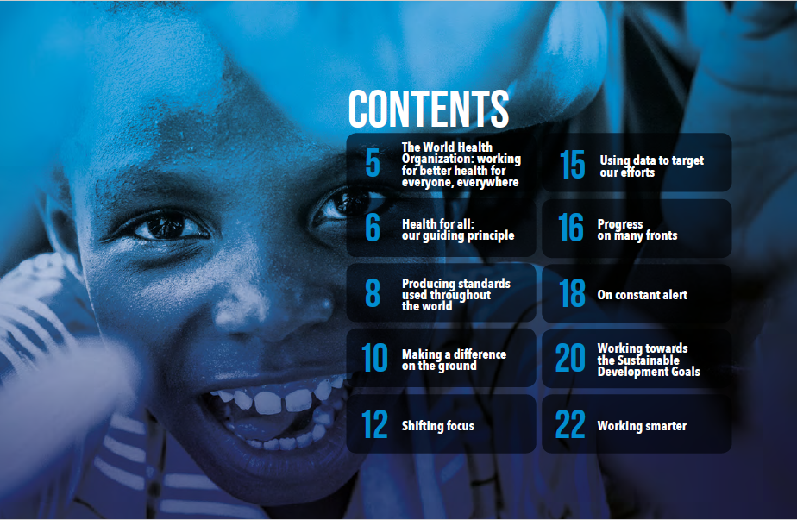

Slide 3
What is a WHO guideline?
“A WHO guideline is any document, whatever its title, that contains WHO recommendations about health interventions, whether they be clinical, public health or policy interventions.”
”A recommendation provides information about what policy-makers, health-care providers or patients should do. It implies a choice between different interventions that have an impact on health and that have ramifications for the use of resources.”

Slide 4

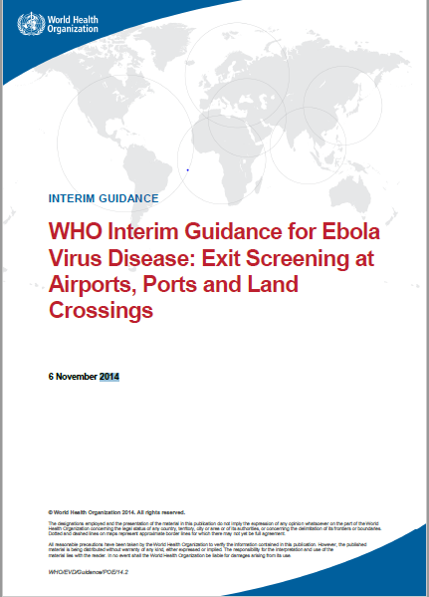

Types of guidelines at WHO
Standard
Compiled or consolidated
Rapid advice guideline
Interim
Notes:
Standard
Full systematic review and guideline development process
6 months - 2 years
Compiled or consolidated
Existing GRC-approved recommendations
Rapid advice guidelines
Compressed and abbreviated process in response to public health emergency
1 - 3 months
Interim
Standard or rapid advice guideline processes prompted by new evidence or public health need; Often narrow scope
Anticipate short shelf-life: follow with standard guideline

Slide 5

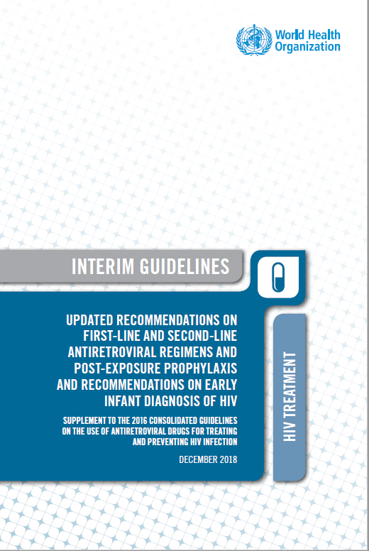


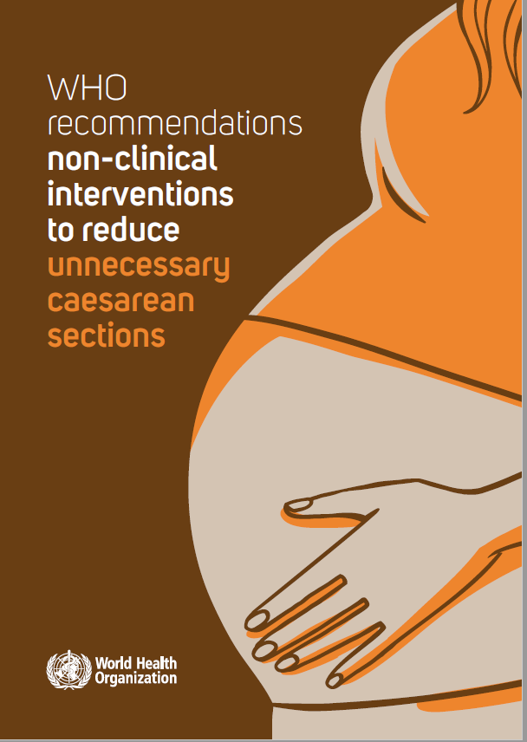
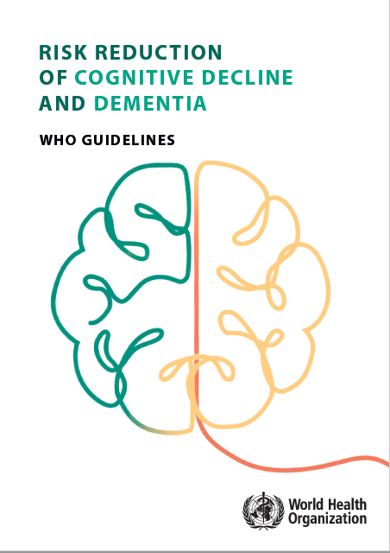

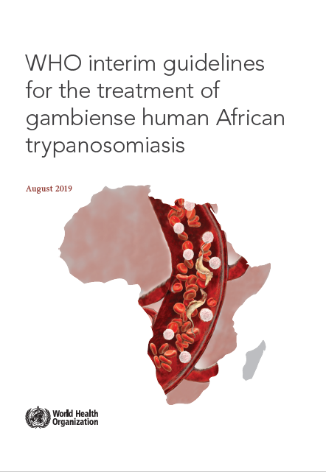
Notes:
1. SLIDE 5: What do we mean when we refer to guidelines?
While lots of documents may provide recommended courses of action, As noted earlier, a guideline is “any document, whatever its title, that contains WHO recommendations about health interventions, whether they be clinical, public health or policy interventions.”
Clinical questions might include choosing between drug A or drug B in the treatment of disease, such as recent guidance on multidrug resistant TB, or antiretroviral regimens for HIV, or to assess the efficacy of a new diagnostic test.
Public health questions include topics such as setting limits for environmental noise exposure, or recommended sugar intake, issues around diet and physical activity, or international travel and health while..
Policy interventions can include guidance on supporting women, or children who have experienced violence, how to encourage breastfeeding practices, or how to communicate to populations around risks in emergency settings, such as following the outbreak of ebola in West Africa as well as how health care services are organized, such as task shifting.

Slide 6
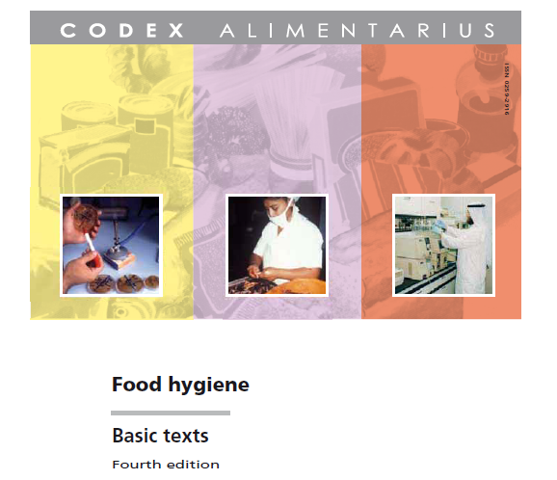
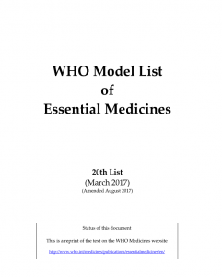
What is NOT a WHO guideline?
Food standards
Pharmacopia
Standard operating procedures
Evidence synthesis without recommendations
‘How to' manuals.

Slide 7
Five draft categories for N&S statements were identified
STATEMENT TYPE | PURPOSE OF STATEMENT | METHODS/INPUTS INTO DEVELOPING THE STATEMENT
GOAL-SETTING | Set goals or targets | Data Other information (public health priorities and feasibility)
RECOMMENDATIONS AND POLICIES | Tell the user what to do; can be explicit (actionable) or higher-level (policy statements) | Evidence (systematic review or not) of benefits and harms other considerations
IMPLEMENTATION GUIDANCE AND TOOLS | Tells the end-user how to implement a recommended intervention/process | Experience Evidence
DATA COLLECTION GUIDANCE AND TOOLS | Tell the end-user what information to collect and how; how to analyze, synthesize data | Experience Evidence
CLASSIFICATIONS AND STANDARDS | Sets thresholds or standards; establishes categories or labels; makes assessments based on threshold(s) | Systematic review of benefits and harms dose-response mechanistic and animal data Acceptability, feasibility, logic

Slide 8
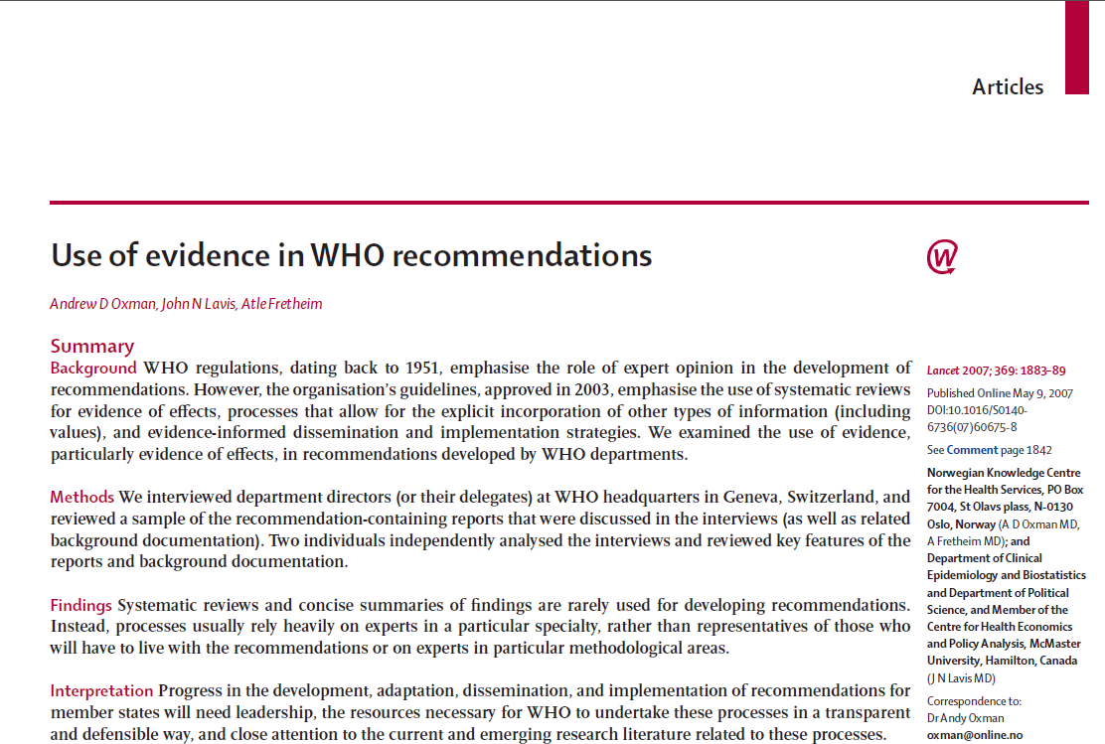
Pre-2007: Use of evidence in WHO recommendations
“...none reported using concise summaries of findings ...for the most important outcomes (benefits, harms, and costs) of each option being considered...”
Notes:
Good Old Boys Sat Around a Table – GOBSAT
This fairly widespread criticism in turn led to the establishment of the GRC.
1. Clarified guideline development methods by distinguishing between different types of guideline.
2. Adopted more systematic methods for evidence-appraisal
3. Adopted more transparent methods for decision-making
GRC would be a standing Committee of 30 members drawn from internal staff at HQ and regional level, and 5 external experts. They would convene monthly to review all WHO guidelines to ensure they meet the highest contemporary standards of evidence appraisal. Members would sit for a 3 year term.

Slide 9




WHO Guideline Development
Process
      Review
      (Guideline Review
      Committee)
“to ensure that WHO guidelines meet the highest international standards and contain trustworthy and implementable recommendations”.
      Technical
      support
      Quality appraisal for impact

Slide 10
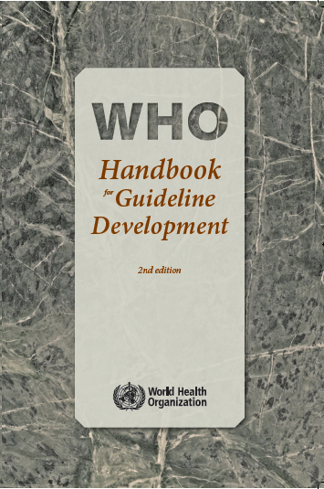
Principles behind guideline development
Sound scientific, ethical principles and practices
Evidence is:
  Relevant (applicable to the key question at hand);
  Compliant with ethics and human rights standards and ethics;
  High quality (“best”) available based on an assessment of the risk of bias;
  Publicly-available;
  Transparent in terms of methods used for searching, retrieving, summarizing and assessing the evidence, and the rationale for decisions on selected approaches and methods, and for each recommendation must be clear.

Slide 11


Required elements of WHO Guidelines
Scope and target audience: fit for purpose
  Who wants it? Who needs it? What is the gap?
Expert group composition
Management of declarations of interest
Evidence identification and synthesis
  Systematic and comprehensive evidence retrieval, synthesis
  Assessment of certainty of the body of evidence for each question
Transparent and systematic evidence-to-decision making
      Benefits and harms
      Equity, feasibility, acceptability, human rights, cost-effectiveness, societal considerations
Usable: relevant, applicable, user-friendly

Slide 12



Guideline development process
Scope the guideline
Consider logic models
Consider all relevant evidence for decision-making
Set up guideline panel and external review group
Manage declarations of interest
Formulate PICO/SPICE or other questions
and select outcomes
GRC approval - Proposal
GRC Secretariat support
Evidence retrieval, assessment, synthesis
Appraise certainty of the body of evidence
GRC approval -
PICO, GDG, DOI
Formulate recommendations
Include explicit consideration of:
      - Benefits and harms
      - Resource use/feasibility
      - Health equity/non-discrimination
      - Human rights/sociocultural acceptability
GRC approval
Final guideline
Disseminate, implement
Evaluate impact
Notes:
12

Slide 13
Contributors and their role

Slide 14

Contributors to WHO guidelines
Steering Group
- WHO/UN
- Provide declarations of interest
Methodologist
- Technical expert evidence & guidelines
- Provide declarations of interest
Observers
- Institutions/
individuals
- Do not participate
- Do not provide declarations of interest
Systematic review team
- Technical experts on evidence review methods
-Provide declarations of interest
External Reviewers
- Technical experts & other perspectives
-Provide declarations of interest
Guideline Development
Group

Slide 15
Public engagement and involvement:
Spectrum of approaches
Notification
Consultation
Comment/
feedback channel
Participation
Approach
Level of engagement

Slide 16
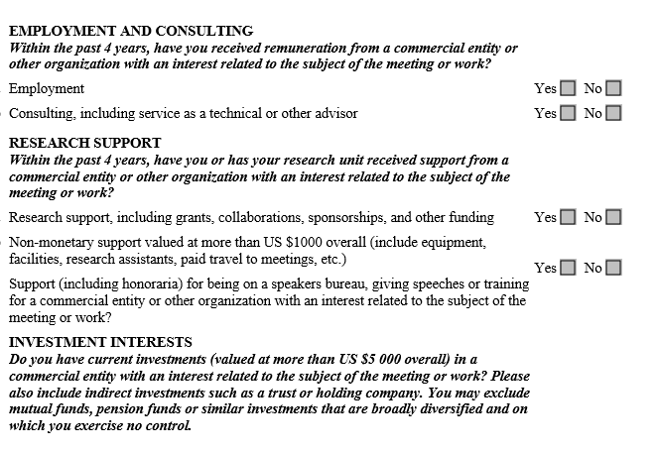
Declaration of interests of external contributors (revised 2014)
Declared interests
Due diligence
Public posting of GDG member biographies

Slide 17
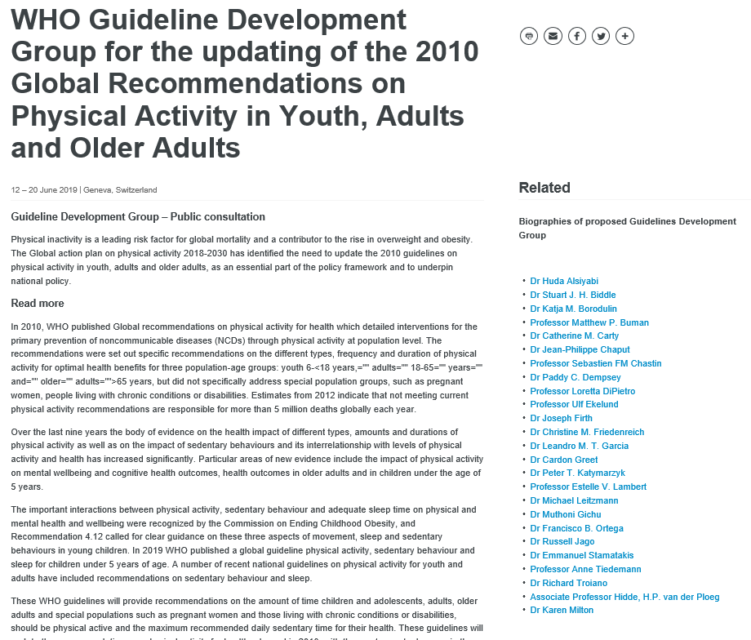
Declaration of interests of external contributors: Public posting of biographies (14 days)

Slide 18
Evidence retrieval, assessment and synthesis
and formulation of recommendations

Slide 19

Evidence retrieval, assessment and synthesis and formulation of recommendations
To “reach agreement on a common, sensible approach to grading 1) quality of evidence and 2) strength of recommendations.”

Slide 20
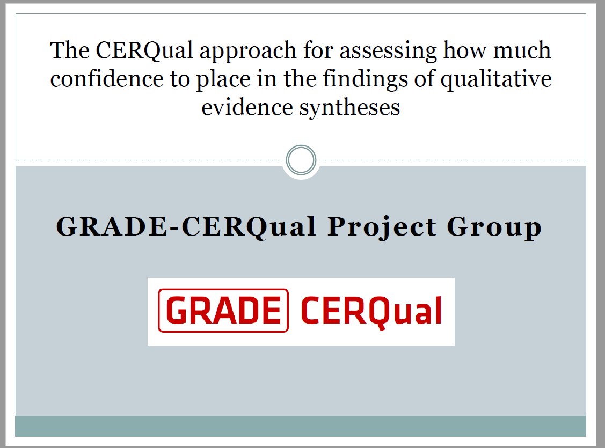

Lewin S, Glenton C, Munthe-Kaas H, Carlsen B, Colvin CJ, et al. (2015) Using Qualitative Evidence in Decision Making for Health and Social Interventions: An Approach to Assess Confidence in Findings from Qualitative Evidence Syntheses (GRADE-CERQual). PLoS Med 12(10): e1001895. doi:10.1371/journal.pmed.1001895
http://journals.plos.org/plosmedicine/article?id=info:doi/10.1371/journal.pmed.1001895

Slide 21

Consider all relevant evidence and factors for decision-making ( WHO-INTEGRATE)
Clinical /population health (2004) | Clinical /population health | WHO – INTEGRATE framework
 | Problem
Benefits | Desirable effects
Harms | Undesirable effects
 | Certainty of evidence
Values and preferences | Values
 | Balance of effects | Balance of health benefits and harms
Resource considerations | Resources required | Financial and economic considerations
 | Cost effectiveness
 | Equity | Health equity, equality, non-discrimination
 | Acceptability | Human rights and socio-cultural acceptability
 | Feasibility | Feasibility and health system considerations
 |  | Societal impact
Rehfuess &
Stratil

Slide 22
Rules of Procedure:
Group decision making
WHO recommendations should be based on consensus
Defined as general agreement among the decision makers
Minor disagreements can be addressed in the Remarks Section of the guideline
Voting can be used as a tool to achieve consensus
If consensus cannot be reached, voting can be used
2/3 majority, anonymous or hand-raising, Chair’s discretion
Notes:
Voting is discouraged, consensus is strongly preferred

Slide 23
Recommendation format
Recommendation
“At primary health-care facilities, health workers should provide general nutrition counselling to caregivers of overweight children aged less than 5 years (strength of recommendation: conditional; very low quality evidence).”
Justification remarks
GRADE Evidence profile
Quality assessment of the body of evidence.
Evidence to decision framework
Strength assessment of the recommendation.
Implementation consideration
Research priority
Guideline: Assessing and managing children at primary health-care facilities to prevent overweight and obesity in the context of the double burden of malnutrition - 2017

Slide 24
Summary: WHO Guidelines…
Meet the highest quality standards for evidence-based guidelines
Focus on UN Member States’ and end-users’ needs
  Address the right questions
  Optimize usability
  Diverse stakeholder input into key development steps
Are based on high-quality systematic reviews of all relevant evidence
Use GRADE, which provides an explicit approach to:
  Assessing the quality of the evidence across studies and outcomes
  Translating evidence to recommendations
Incorporate multiple processes to minimize bias
All judgments and decision-making are transparent and explicit

Slide 26
What constitutes a norm and standard product?
Scientific and technical normative products
information products which are scientific or technical in nature (versus based on legal or ethics frameworks or conventions)
tell the end-user what or how to do an action or to deliver an intervention (versus products which are descriptive such as providing data on burden of disease or health trends).

Slide 27
Principles
Assignment of methodologies is based:
On the types of questions/purpose that the information product or specific statements address
The 5 identified pathways:
STATEMENT TYPE | PURPOSE | METHODS/INPUTS INTO DEVELOPING THE STATEMENT
Goal setting statements | Set goals or targets | Based on data and other information such as public health priorities and feasibility
Recommendations and policies | Contains statements that tell the user what to do; can be explicit (actionable) or higher-level (policy statements) | Specific recommendations require a systematic review of the evidence on benefits and harms, at a minimum (and data informing other evidence-to-decision considerations); high-level policy statements must be based on evidence of benefits and harms and other considerations but a systematic review may not be required.
Implementation tools and guides | Provide tools or guidance which tells the end-user how to implement a recommended intervention or process | Usually based on a recommended intervention; based on experience and evidence.
Tools and guides for data collection | Describe what information to collect and how | Guidance is based on evidence and on direct experience* with effective and efficient data collection.
Classifications and standards | Classifies products or substances into categories such as those that are deemed essential or hazardous, or which meet pre-defined standards | Based on systematic reviews of benefits and harms (but not usually on other contextual considerations as are not context specific); hazard identification based on systematic reviews of the evidence on harms, dose-response, mechanistic and animal data

Slide 28
Recommendation format
Recommendation
“At primary health-care facilities, health workers should provide general nutrition counselling to caregivers of overweight children aged less than 5 years (strength of recommendation: conditional; very low quality evidence).”
Justification remarks
“It should be first noted that these recommendations do not represent comprehensive guidance on assessment and management of all children at risk of overweight and obesity. They do, however, start by addressing one population – children presenting to primary health-care facilities – for which there is already a system for training and clinical management (IMCI) that is implemented in many countries.”
GRADE Evidence profile
Quality assessment of the body of evidence.
Evidence to decision framework
Strength assessment of the recommendation.
Guideline: Assessing and managing children at primary health-care facilities to prevent overweight and obesity in the context of the double burden of malnutrition - 2017

