Slide 1
Women’s Engagement— Couple Communication
Glory Mkandawire
Bridge II
JHU/CCP Malawi
Partners:
Save the Children
International HIV/AIDS Alliance
Pact Malawi
Local Partners
1
Notes:
Emmanuel: Could you remove the “Monitoring, Reporting and Quality of Services” at the bottom of Jason Title?

Slide 2
Background
BRIDGE II formative research and literature review findings showed:
Lack of couple communication as a factor that makes men and women go outside of marriage for sexual satisfaction
Family value was an important element of influence on individual behavior
Partner reduction viewed as a good strategy toward HIV prevention
BRIDGE II developed the “Tasankha” (We choose/Choices) Mass Media Campaign to strengthen risk reduction, individual/couple efficacy and collective efficacy
First phase focused on strengthening risk reduction, individual/couple efficacy, and collective efficacy.
Building on first phase, second phase of the campaign focused on linking people to services such as VMMC, PMTCT & HTC.
2

Slide 3
Strategic Approaches
Creating an enabling environment at national level through Tasankha (Choices) Campaign and Chenicheni Nchiti? (What is the reality?) radio program
Mobilizing communities to address HIV/AIDS issues affecting their communities
Building capacity of community structures to facilitate engagement
Creating dialogue among couples and communities using transformative tools, community activities and national forum
Linking communities to various HIV prevention services
3

Slide 4
Approach: Couple Communication
Starting local (community):
Use local personal stories/diaries
Making it global (radio) through:
Reality radio
National dialogue on couple communication
Taking the global back to local (community discussions):
Build capacity of local structures
Use transformative tools
Use community-wide events
All reflect same issues as radio … while radio reflects community voices
Localizes the discussion to community level
Addresses the importance of couple communication in making decisions and choices around so many health issues
4

Slide 5
Approach: Women’s Engagement
Women’s engagement is part of overall community engagement.
Community entry process following the Community Action Cycle (CAC) to build partnerships with and capacity of community structures, and ensure engagement and ownership.
Community Action Groups (CAGs)—members of community-based organizations (CBOs)—lead process of identifying key issues to be addressed.
The whole community (men and women) then comes to an agreement and prioritizes three key issues.
CAGs develop plans to address the priorities.
5

Slide 6
How to Stimulate Open Dialogue: Couple Communication
In FBOs, couples trained as counselors lead discussions with a group of couples or individual couples using the counseling guide.
Community facilitators lead small group discussions using transformative tools:
Easier for women to take part in discussions in a small group.
Real stories, games and role plays to stimulate discussion.
Provides an avenue for women and men to talk openly.
Community wide events (interactive drama, open days, discussion forums):
Provides a forum for sharing testimonials from real couples.
Helps to openly address sensitive issues around infidelity.
Traditional leaders lead the process through speeches and by being an example.
CBO networks support individual CBOs and Community Referral Agents through supervision and monitoring.
6

Slide 7
Women’s Engagement, Couple Communication and Linking to Services
With women’s support and couple communication, men find it easier to take advantage of voluntary medical male circumcision (VMMC) and other services.
Men find it easier to talk about VMMC with their partners.
Men find support post VMMC from their partners.
Women see the need to talk about VMMC because they also benefit—reduced risk of cervical cancer.
Community Referral Agents engage individuals and couples, and link them to various services including VMMC, HIV testing and counseling (HTC), prevention of mother-to-child transmission of HIV (PMTCT).
Women’s engagement and couple communication help to increase protection for couples who choose not to go for VMMC through:
Joint decision-making, making positive choices
Increased HTC uptake and access of risk reduction measures
Increased protection among couples
7

Slide 8
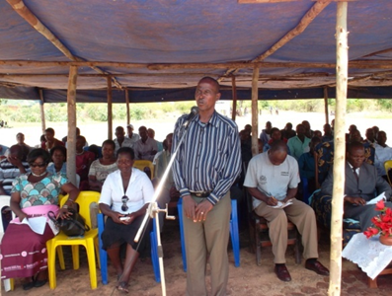
Success Story
“Due to encouragement from my wife, I went for VMMC and now I can testify publicly to my people that it is very nice… and apart from minimizing the risk of HIV infection, it also add up to sexual satisfaction.”
Traditional Authority Kaduya, Phalombe.

Slide 9
Success Stories
“I was afraid because people said the wound would not heal because it’s one way of family planning. However, due to encouragement from my wife, I decided to go for circumcision … everything is alright now.” said Weston Maganga. And the wife said “I decided to encourage my husband to minimize the risk of cervical cancer because I fear it a lot” Enelesi Maganga.
Weston & Enelesi Maganga, Phalombe
Fibby Mwangala used to attend BRIDGE II VMMC demand creation activities and always told her husband about the benefits of VMMC. Last week on 31st May 2013 Fibby’s husband, John, went for VMMC and had this to say: “meanwhile together with my wife we are nursing our wound after check up and the support I am receiving from my wife is overwhelming.”
Fibby and John Mwangala, Phalombe

Slide 10
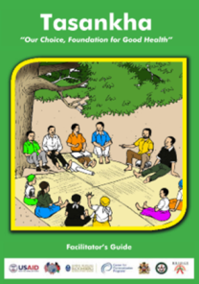
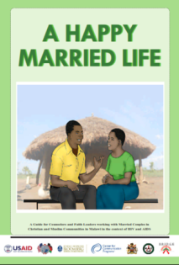
Transformative Tools
Tasankha Discussion Guide:
A modular, interactive and participatory guide that promotes couple and community dialogue.
Covers 10 topics including couple communication, multiple concurrent partnerships (MCPs), PMTCT, HIV testing and VMMC.
Uses small discussion groups of men and women.
A Happy Married Life:
A guide for counselors and faith leaders working with married couples in Christian and Muslim communities in the context of HIV and AIDS.
Covers topics such as couple communication, sex in marriage, sex outside marriage, conflict resolution and management.
Uses small discussion groups of couples.
10

Slide 11
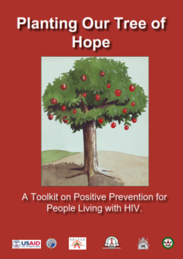
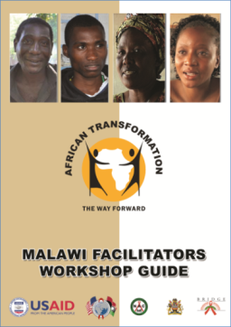
Transformative Tools
Planting Our Tree of Hope: A Toolkit on Positive Prevention for People Living with HIV (PLHIV):
Helps PLHIV develop interpersonal communication skills to address issues, such as discordance and protecting oneself and one’s partner, and identify doable actions that will help them, their partners and families to live healthy and productive lives.
African Transformation:
Enables communities to explore how gender norms and social roles shape the lives of men and women.
Adapted from Uganda, includes Malawian profiles on MCP, VMMC, social roles, gender-based violence and intergeneration sex.
11

Slide 12
Research: Couple Communication
BRIDGE II endline research to evaluate effects of couple communication:
Include questions that ask specifically about communication with partner, topics discussed, frequency and how couple communication affected their relationship.
Explore relationship between the above communication variables to exposure to BRIDGE II including HIV preventive behaviors such as multiple partnerships, condom use, HIV testing and VMMC.
Conduct mediation analysis to understand the role that couple communication had on the relationship between BRIDGE II exposure and HIV prevention behaviors.
12

Slide 13
Summary
Women should be part of the larger community engagement process to ensure women’s open communication with their partners.
Using real stories, and interactive and participatory methodologies stimulate discussion and help couples identify ways of addressing difficult issues such as trust, fear of infidelity, etc.
Women’s engagement and couple communication help mutual decision-making and linkage to various services including VMMC and HTC.
13

Slide 14
Contact Information
Email: gmkandawire@malawibridge.org
Phone numbers:
265 (0) 1 750 733
265 (0) 992 961 826
Thank You!
14

Slide 15
Acknowledgments
PEPFAR for funding the project
Implementing partners
Collaborating partners
Ministry of Health
National AIDS Commission
15

