Slide 1

Demand Creation 101 for
Voluntary Medical Male Circumcision
An Introductory Training Tool
December 2019

Slide 2
Acronyms
ANC Antenatal clinic
ART Antiretroviral therapy
DHS Demographic Health Survey
GIS Geographic information system
HIV Human immunodeficiency virus
HTS HIV testing services
HCD Human-centered design
ICT Information and communication technology
IEC Information education and communication
IPC Interpersonal communication
MC Male circumcision
OPD Outpatient department
PITC Provider initiated HIV testing and counselling
PrEP Pre-exposure prophylaxis
SBCC Social and behavior change communication
SM Social marketing
STI Sexually transmitted infection
VMMC Voluntary medical male circumcision
VCT Voluntary counselling and testing

Slide 3
Purpose and Objective of this
Orientation Package
Serves as a resource to the organizations supporting demand creation for voluntary medical male circumcision (VMMC) and offers a basic introduction, including step-by-step recommendations on how to design, develop, improve, implement, and evaluate demand creation activities
Serves as a tool to conduct basic training in demand creation for VMMC

Slide 4
Intended Audience
Program managers working in VMMC programs
Organizations implementing VMMC programs
U.S. government staff supporting implementation of VMMC programs
Ministry/government staff with involvement in VMMC programs
* This training resource is intended for use in conjunction with the country’s communication strategy for VMMC

Slide 5
Outline
VMMC Background
Understanding Demand Creation
Designing Demand Creation Programs
  Analysis
  Strategic Design
  Development and Testing
  Implementing and Monitoring Demand Creation Approaches
  Evaluating and Re-planning
Resources & References

Slide 6
VMMC Background

Slide 7
VMMC Background
Male circumcision (MC) is the surgical removal of the foreskin under aseptic conditions
MC has been scientifically proven to reduce risk of heterosexual HIV transmission from women to men by approximately 60%
UNAIDS has set a target of ensuring access to combination prevention options, including VMMC, to at least 90% of people at risk of HIV by 2020
MC also reduces the risk of sexually transmitted infections (STIs) and reduces the risk of cervical cancer in female sexual partners
VMMC is a cost effective intervention for reducing new HIV infections in generalized epidemics
Success of VMMC programs is dependent on maintaining effective demand creation that is well coordinated with service delivery
Notes:
VMMC has also been shown to reduce the risk of other sexually transmitted infections (STIs)

Slide 8
Understanding Demand Creation

Slide 9
Access ≠ Demand
Availability of a high quality service does not assure uptake
Target populations must:
  Know about it
  Understand it
  Accept it
  Want it
How do we get there?

Slide 10
What is Demand Creation?
Demand creation (also referred to as "demand generation") is the practice of increasing awareness of and desire to obtain a certain commodity or service (e.g., a health service like VMMC) among an intended audience (e.g., eligible males in East and Southern Africa)
Demand creation can leverage multiple communication disciplines, including social and behavior change communication (SBCC), social marketing (SM), and human-centered design (HCD)
Demand creation uses evidence-based communication to encourage target audiences to seek VMMC or to motivate influencing audiences to provide similar encouragement for VMMC
Demand creation for VMMC follows the client across the VMMC continuum, from awareness to mobilization through recovery, and then advocacy

Slide 11
What is Demand Creation?
VMMC demand creation goes beyond simply raising awareness or providing information; it must empathize with males, understand and address their barriers and enlist key motivators to convince them to seek VMMC and connect them with the service point!

Slide 12
Aims of Demand Creation for VMMC
Increase general awareness of VMMC among target populations including primary and secondary audiences
  Accurate and appropriate information about MC can address misconceptions and myths about the procedure
Empathize with the priorities, norms, and difficulties of target populations
Address barriers to VMMC uptake in contextually relevant ways, informed by research, situational, and behavioral analyses
Connect men to VMMC services

Slide 13
Common Barriers to VMMC
Individual/Personal Barriers
Socio-Cultural Barriers
Structural Barriers
Fear of pain/injection
Fear of complications
Fear of HIV test
Sexual abstinence during healing time
Low perception of HIV risk
Length of healing time
Lack of partner and family support
Low health seeking behavior
Cultural practices
Religious beliefs
Perceived threat to masculinity
Myths and misconceptions:
  After male circumcision foreskin can
  be used for witchcraft purposes
  One experiences constant pain
  during the healing process which is difficult to manage
  Male circumcision can cause loss of potency
  The penis is less sensitive during sex after being circumcised
Distance to the VMMC site
Availability of VMMC services
Cost (e.g. transportation cost, lost wages cost)
Poor coordination at national/ district or provincial level
Lack of policy and guidelines on how service delivery partners coordinate with the demand creation partner
This list is not exhaustive but includes the most common barriers which have been informed by research and programmatic experience.

Slide 14
VMMC Motivators
Reduced risk of contracting STI and HIV
Improved hygiene
Health benefits for sexual partner(s)
Perceived improved sexual experience and performance
Availability of services
Social support from partner and family members
Cultural and religious injunction
Community support for HIV prevention
Notes:
Formative research has shown these as the primary motivators for VMMC.

Slide 15
Knowledge Check

Slide 16
Why do we conduct demand creation services for VMMC?
A. Increase awareness
B. Address barriers
C. Link men to services
D. All of the above

Slide 17
Designing Demand Creation Programs

Slide 18
Designing Demand Creation Programs
In this training we refer to the P-Process to guide design and implementation of the VMMC demand creation program
The P-Process, developed by the Johns Hopkins Center for Communication Programs under the Health Communication Partnership, provides a useful framework to develop demand creation communication
The P-Process provides a step-by-step outline of strategic communication from planning and design to execution and impact measurement
The P-Process is used to develop communication programs addressing a wide range of topics such as encouraging safer sexual behavior to prevent HIV transmission, promoting child survival, etc.
Notes:
The P-Process is key to designing successful communication strategies to strengthen public health worldwide

Slide 19
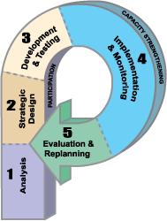
The P-Process
Five steps in strategic communication:
Step 1: Analysis
Step 2: Strategic Design
Step 3: Development and Testing
Step 4: Implementation and Monitoring
Step 5: Evaluation and Re-planning
RESOURCE: Details on the P-Process can be found at https://healthcommcapacity.org/hc3resources/the-p-process/

Slide 20
The P-Process
Three cross-cutting concepts* are embedded in the P-Process, which, when integrated into the strategic process, ensure that social and behavior change communication (SBCC) approaches are most effective:
  SBCC theory: provides the steps of the P-process itself
  Stakeholder participation: concept that feedback from the intended audience should be part of the design process
  Continuous capacity strengthening: concept that demand creation should build the community’s understanding and capacity to meet its health needs
*Human-centered design(HCD)/design thinking is not explicitly included in the P-Process but they are overlapping and complementary. Some key concepts derived from HCD are integrated into these P-process slides to help participants benefit from this key discipline.

Slide 21
Step 1: Analysis
  Situation Analysis
  Audience Analysis & Segmentation

Slide 22
Situation Analysis
First step is to understand the problem, the people, culture, existing policies and programs and available communication channels
  Frame a problem/develop a problem statement
  What factors are inhibiting the desired change?
How can we get more adult married men to see VMMC as a benefit to their relationship and not a threat?
This marker shows where in the P-process we are

Slide 23
Situation Analysis
Much of the information needed for situation analysis is already available from existing data like DHIS, sociological and epidemiological studies, and past program experiences
  Mapping tools can help you determine which geographic areas have larger numbers of uncircumcised men
  Data can only tell part of the story—ensure as many team members as possible have spent time with real members of the target audience, immersed in their worlds, to gain a more authentic understanding of the lives of the people you are trying to reach.
RESOURCES: Details on immersion and situation analysis can be found at
https://www.designkit.org/methods/23
https://www.thecompassforsbc.org/how-to-guides/how-conduct-situation-analysis

Slide 24
Situation Analysis
You may need to conduct additional experiential or formative research to understand audience needs and priorities
  This can be done through immersion, focus group discussions, key informant interviews, short surveys, or using existing data where VMMC programs have been running for some time
  Information to be collected may include: age, education level, marital status, psychographics, barriers, motivators, etc.
  When time and/or funds are limited or not available, you may want to consider if another organization can get the research done faster, or if more informal methods can be used to achieve quicker results (e.g., gathering insights from mobilisers)

Slide 25
Audience Analysis
The process of defining and describing target audiences, starting with potential VMMC clients (primary audience) and extending to key influencers (secondary audience), such as female partners, peers, community leaders, and even the media
Provides a better understanding of the target audience(s)
Helps segment the audience, gather more information about the target audience, and develop profiles to better understand the audience
When available, leverage already existing data to further understand the audience and determine where critical information gaps exist
RESOURCE: Details on audience analysis can be found at https://www.thecompassforsbc.org/how-to-guides/how-do-audience-analysis

Slide 26
Primary and Secondary Audiences for VMMC
Primary audience is the main target audience for the MC communication
Secondary audience is the group(s) of people that influence the knowledge, attitude and behaviors of the primary audience. This group is very critical in drawing more men to come for VMMC services
Primary Audiences
Uncircumcised males aged 10-14 years, 15-19 years, 20-24 years, 25-30+ years
Secondary Audiences
Female partners of the eligible males for VMMC including wives and girl friends
Mothers/fathers/ guardians
Circumcised male adults (who can encourage peers to undergo VMMC)
Traditional leaders
Religious leaders
Traditional circumcisers
Health care providers
Employers
Government officials
Journalists and media
Notes:
Each target group will be different and will have different viewpoints of the same issue
Knowing each of your audiences and talking with each will help define and refine your messages
you might break your audience up by age range (10-14,15-19, 20-29,30+) or
Each segment will require messages that resonate with that group.
How many segments you target will depend on your budget and goals

Slide 27
Audience Segmentation
The goal of audience segmentation is to identify unique groups of people within larger populations that share similar interests, attitudes, needs, and behaviors
Segmenting the target audience(s) into smaller groups based on similar needs, preferences, and characteristics will help inform the design of demand creation materials that best address each segment’s shared values (needs), motivations, and barriers
  You only need as many segments as there are groups that need substantially different messages
For example, while your country’s VMMC program may broadly target uncircumcised males aged 15 to 49, this group is too diverse not only on demographic characteristics, but also in terms of barriers and motivators to VMMC; addressing them as one group is likely to be unsuccessful
RESOURCE: Details on audience segmentation can be found at https://www.thecompassforsbc.org/how-to-guides/how-do-audience-segmentation

Slide 28
Audience Segmentation
An audience can be segmented by any number of characteristics that are relevant to the program
For VMMC segmentation characteristics can include, but are not limited to:
  Age: important demographic characteristic for segmentation; different age groups have different barriers and motivators for VMMC
  Geographical location: rural versus urban
  Education level
  Relationship status: being married or not married, those in long-term, committed relationships often consider VMMC from a different perspective than single men who are abstinent or in casual relationships.
  Employment status and type: can influence when men are able to come for circumcision
  Sociological and psychological factors: attitudes, values, and beliefs
  Intention to circumcise within the next year
  Circumcising and uncircumcising cultural background
  Risk behaviors: programs can also consider segmenting men based on similar risk behaviors that put them at greater risk for HIV, e.g., multiple partners, concurrent partners, condomless sex, paid sex, alcohol and drug use, STI history, HIV+ sex partner(s)
Notes:
Much of the information needed to understand the audience may already exist in-country. However when examining the characteristics, if there are any gaps relevant to the audience additional research may be needed.

Slide 29
Developing an Audience Profile
Once you understand your audience, it will be easier to empathize with them, which in turn helps to develop messages they can believe in and trust
This is easier done if you focus on a single person who is representative of the target audience and develop a profile (one profile per segment)
Ensure that profiles reflect typical patterns of thoughts, feelings and values for the entire audience segment
Demand creation messages that address the patterns of thoughts, feelings and values of the target population are more appealing and more likely to be effective
!
TIP: Audience profiles can become too general or stereotypical if you have not spent time in prospective clients’ lives/worlds – immersion can help you bring an audience profile to life.

Slide 30


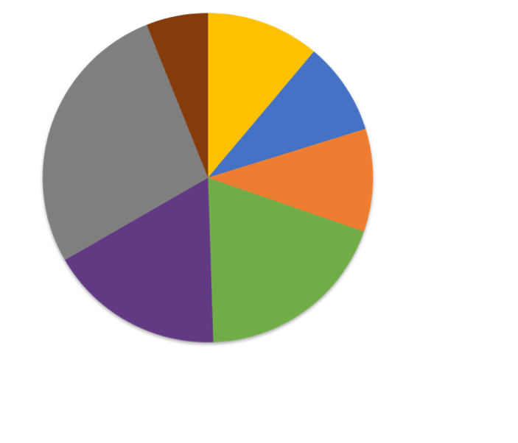

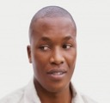



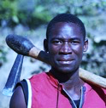
Segment Prioritization: Seven Segments
INDIFFERENT REJECTERS
TRADITIONAL BELIEVERS
Large potential (27%), but hard to crack; absence of motivation and almost no concerns or fears, but could be reached via advocates in the community.
Small potential (6%), no need in support; have very high commitment driven by tradition.
27%
6%
SOCIALLY SUPPORTED BELIEVERS
11%
Moderate potential (11% of uncircumcised men), but high commitment and likelihood to advocate to wide audience; need to overcome some dissonance issue.
SCARED REJECTERS
9%
SELF-RELIANT BELIEVERS
Large potential (17%) but low motivation and strong concerns , including fears and embarrassment – need a lot of support.
17%
Moderate potential (9%), but easy conversion to action and highly likely to act as advocates for friends and to some extent other men.
10%
19%
KNOWLEDGEABLE HESITANTS
FRIENDS DRIVEN HESITANTS
Moderate potential (10%), but the key barrier is concern in safety which reduce motivation – increase of their commitment is relatively easy by addressing their issues.
Large potential (20%), but rather low motivation and need in additional assurance in need of VMMC. But can be easily converted by strong advocacy around them.
Base: all uncircumcised men, n=1189
Notes:
This is an example of how Zambia segmented their male population for MC. The percentages here reflect the proportion of the uncircumcised population that each segment represents, i.e. the “friends driven hesitants” segment represents 20% of uncircumcised Zambian men.

Slide 31
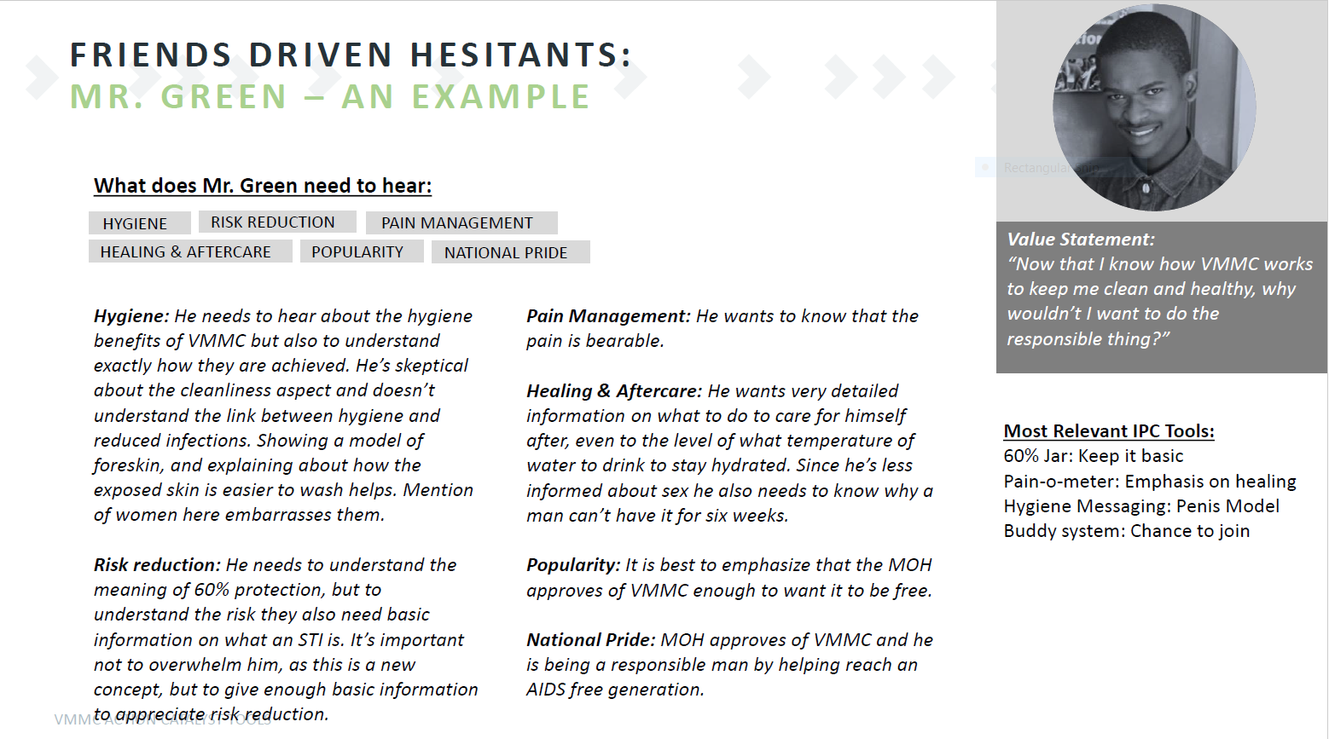
Example of Audience Profile – Zambia
Notes:
This is an example of a risk persona developed in Zambia.
For an example of an audience strategy matrix see page 26 of Kenya’s Communication Strategy: https://www.malecircumcision.org/sites/default/files/document_library/T11.Communication_Strategy%20for%20VMMC%20in%20Kenya.pdf

Slide 32
Knowledge Check

Slide 33
TRUE or FALSE?
The goal of audience segmentation is to identify similar groups of people within larger populations that share different interests, attitudes, needs, and behaviors.
False. The goal of audience segmentation is to identify unique groups of people within larger populations that share similar interests, attitudes, needs, and behaviors.
TRUE
FALSE

Slide 34
Step 2: Strategic Design

Slide 35
Strategic Design
This step focuses on designing communications that drive demand that can be met by available VMMC service delivery
During this stage:
  Establish communication objectives
  Determine information to convey to the identified audiences
  Determine best communication channels for reaching them
  Determine program approaches to use
  Develop implementation plan
  Develop M&E plan
Successful health communication and demand generation interventions are grounded in sound behavioral and communication theory

Slide 36
Applying Conceptual Framework Models in VMMC Demand Creation Programs
A conceptual framework for VMMC demand creation can demonstrate how programming can tackle issues around male circumcision (i.e., barriers and motivators)
The most common theories used in VMMC demand creation programs are:
  Behavior change theories: provide a roadmap for how VMMC candidates may journey from unawareness or apathy towards the awareness, commitment to, and action of seeking services
  Socioecological theory: shows the multifaceted and interactive effects of personal and environmental factors that determine behavior; it illustrates how VMMC demand creation can support change at multiple levels
Notes:
Behavior change models do not provide guidance on how message content should be delivered (e.g. print, radio, social media, etc) or how media is accessed and used among the intended audience. Communication theories such as Media Richness Theory and Gratification Theory can provide additional guidance

Slide 37
Applying Conceptual Framework
Based on these two theories, a user-centric behavior model was developed to unify, systematize, and strengthen the behavior change strategy
In this training, we will refer to the user-centric behavior model which is a combination of the stages of change model and socioecological model
TIP: Many behavioral frameworks exist, and like this one, most focus on breaking down the steps in an individual’s journey from unawareness to action or after-action related to one specific health seeking or other behavior (names of steps or stages vary by model/framework, but the meanings are similar). Understanding or “mapping” a client’s journey to VMMC is important because it reveals the different stages at which demand creation can help accelerate their progress towards seeking VMMC, and helps you focus on determining what intervention might be most appropriate at each stage.
!

Slide 38
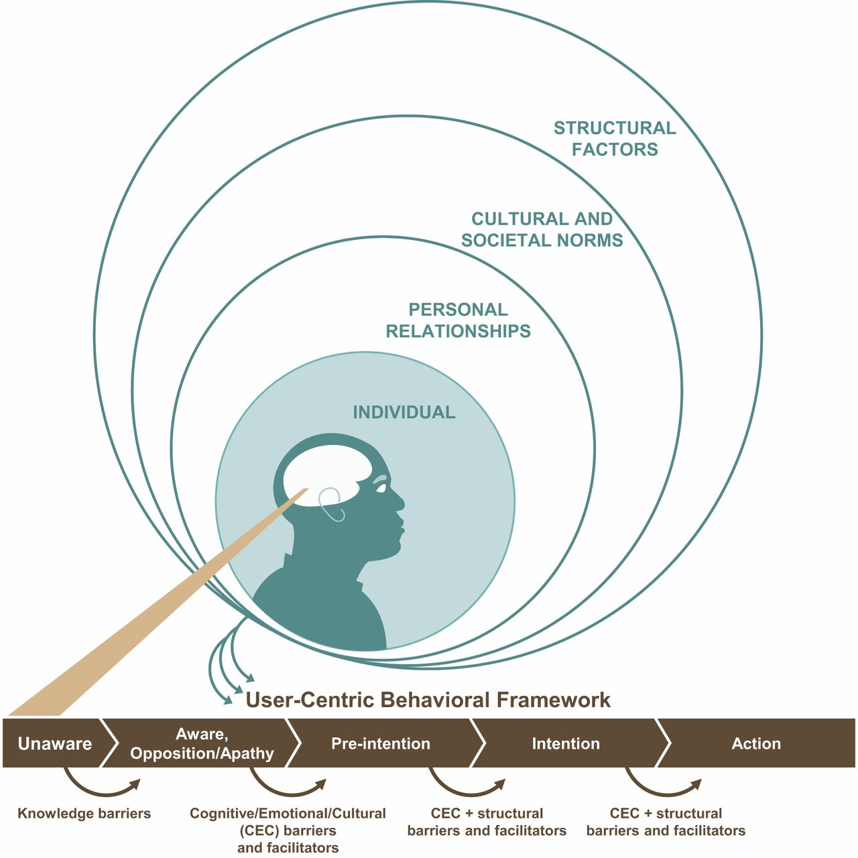
User‐Centric Behavioral Framework for Voluntary Medical Male Circumcision
A “user-centric” framework, describes the steps in a typical client’s progression to changed behavior, with a focus on the individual’s perceived VMMC values and needs
Individual decisions and needs are influenced by internal and environmental factors
Sema K Sgaier et al. Glob Health Sci Pract 2015;3:209-229

Slide 39
User‐Centric Behavioral Framework for Voluntary Medical Male Circumcision
At each step, internal factors (e.g., cognitive and emotional) as well as environmental ones (e.g., cultural factors or issues around service delivery) influence the individual’s immediate needs and wants, which, in turn, govern subsequent actions
By using a user-centric model, you tackle individual and other external factors affecting a man’s decision to go for VMMC while at the same time understanding the stages which a man goes through as he makes his decision
  Different factors are at play during different stages of the VMMC journey; to be most effective, the influencer should attempt to determine which stage the man is in so as to know what issues to focus on
It is important that programs consider evidence about individual/personal, social cultural and structural barriers to VMMC to develop and refine their demand creation strategies

Slide 40
Examples of Barriers Faced in “Preparation” Stage for MC
STAGE | BARRIER THEME | SPECIFIC ISSUE | CAMPAIGN MESSAGES
Preparation (similar to “Intention” stage in User Centric Model (Sgaier et al)) | Anticipated financial loss | He believes he will lose wages due to leave taken for the procedure and recovery, and cost of transport | If available, provide information about food vouchers or financial compensation to recover some expenses Communicate exactly how many days men will need to be away from work as men may overestimate loss of wages—usually 2 days
 |  | He is worried about the cost of the medical circumcision | It is a free and safe service
 | Distrust | He may feel pressured by his romantic partner and worry she has ulterior motives for asking him to circumcise | Reduce focus on partner-driven messaging Focus on mutual benefits, such as hygiene and better sexual performance Do not focus on HIV and STI reduction which implies infidelity
 |  | He is worried that no one has been honest with him about the pain of MMC | Everyone has a different pain threshold Play on the concept of masculinity Even babies and boys do it The many benefits outweigh the short-term pain Medically circumcised men and mobilizers can share their personal experiences with pain Address specific pain concerns of the individual
Annotated excerpt: Genesis Analytics. South Africa Demand Generation Implementation Guide, May 2018

Slide 41
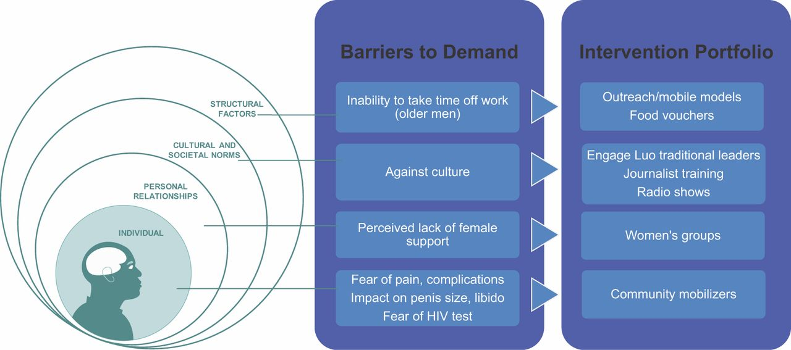
Kenyan Application of User-Centric Model
Sema K Sgaier et al. Glob Health Sci Pract 2015;3:209-229

Slide 42
Additional Theories and Guidance to Inform Strategic Demand Creation Design
Behavior change models do not provide guidance on how message content should be delivered (e.g., print, radio, social media) or how media is accessed and used among the intended audience
  Communication theories such as Media Richness Theory and Gratification Theory can provide additional guidance
If your country has a national communication strategy for VMMC, it is likely based on a behavioral framework and can provide additional guidance on priority target audiences, messaging, and useful channels and strategies

Slide 43
Knowledge Check

Slide 44
The user-centric VMMC behavioral model is a combination of which two theories?
A. Diffusion of Innovation and Health Belief Model
B. Stages of Change and Social Ecological Model
C. Media Richness Theory and Theory of Reasoned Action

Slide 45
Step 3: Development and
Testing
  Message Development, Test Driving & Pretesting

Slide 46
Developing Demand Creation Materials
At this stage, information from the Situation Analysis and Strategic Design steps can be used to create actual demand creation materials
Select Channels
Develop Messages
Draft Creative Brief
Prototype Ideas
Develop Materials
Pretest Materials
Produce Final Materials
Steps when adapting existing materials

Slide 47
Select Channels
  Select the channels you wish to target to reach your audience (e.g., radio, IPC, small group discussion) taking into consideration your audience profile and data, e.g., on media use habits. Channels:
    Interpersonal communication (IPC)
    Community
    Mid-media (posters, billboards) and mass-media (TV, radio)
    Digital and social media
Select Channels
Develop Messages
Draft Creative Brief
Prototype Ideas
Develop Materials
Pretest Materials
Produce Final Materials

Slide 48
Develop Messages
For effective message communication, the following should be considered:
  Clear: The message should be clear and completely understandable by your audience—don’t beat around the bush
  Consistent: Ensure that the message is consistent across all the channels
  Credible/correct: Be transparent and tell the truth (e.g., male circumcision provides partial protection from HIV)
  Concise: Stick to the point and keep it brief
  Culturally appropriate: Messages should respect and adhere to cultural and social norms.
  Call to action: A message should prompt immediate response and encourage men to go for VMMC
Select Channels
Develop Messages
Draft Creative Brief
Prototype Ideas
Develop Materials
Pretest Materials
Produce Final Materials

Slide 49
Develop Messages
VMMC messages should not only focus on public health benefits of MC, they should address the individual, socio cultural and structural barriers that can hinder decision to go for circumcision
Successful demand creation programs use carefully designed and coordinated messages that are delivered through multiple channels
Involve key stakeholders, managers, field workers, members of the audience in message design workshop to ensure that the end products meet their needs
Select Channels
Develop Messages
Draft Creative Brief
Prototype Ideas
Develop Materials
Pretest Materials
Produce Final Materials

Slide 50
Develop Messages
VMMC demand-creation messages need to be specifically tailored for the target audience and different ages.
Messaging for males 15+ need to address men's fear of pain and should emphasize non-HIV prevention benefits such as: improved hygiene, improved sexual appeal, protection from STIs, reduces the risk of cervical cancer in female sexual partners
Promoting VMMC among women is crucial as they appear to have considerable influence over men's decision to get circumcised. The protective benefits of VMMC are important to them too.
Select Channels
Develop Messages
Draft Creative Brief
Prototype Ideas
Develop Materials
Pretest Materials
Produce Final Materials

Slide 51
Draft Creative Brief
  Work with a creative team to draft a creative brief.
  A creative brief is a short document 2-3 pages that helps you think critically about and synthesize information on the context, audience, and goals of the proposed intervention
RESOURCE: Details on creative briefs can be found at https://www.thecompassforsbc.org/how-to-guides/how-write-creative-brief
Select Channels
Develop Messages
Draft Creative Brief
Prototype Ideas
Develop Materials
Pretest Materials
Produce Final Materials

Slide 52
Creative Team
A creative team should be small, close-knit, efficient, and multi-disciplinary.
The team must have a shared understanding of the creative vision and purpose of communication material(s).
Every creative team is unique
  Assess your needs, resources, and local capacity to determine the appropriate members for your creative team.
  Most members will not participate in the entire creative development process.
Select Channels
Develop Messages
Draft Creative Brief
Prototype Ideas
Develop Materials
Pretest Materials
Produce Final Materials

Slide 53
Creative Team – Possible Membership
Project staff: Overall responsibility for deliverables
Other subject matter expert: Ensure technical accuracy of materials
Health communications expert: Guide message development and ensure alignment with behavior change theories
Member(s) of the priority audience(s): Provide insight into the needs, desires, interests, and sensitivities of priority audience(s).
Creative professionals: writer, graphic designer, photographer, videographer, web designer (some may be external to your organization)
Select Channels
Develop Messages
Draft Creative Brief
Prototype Ideas
Develop Materials
Pretest Materials
Produce Final Materials

Slide 54
Sample Creative Brief Elements
PROBLEM STATEMENT: What’s the key issue we’re aiming to address? Why does this problem matter?
BACKGROUND: What do we know about the problem?
BEHAVIOR CHANGE OBJECTIVES: What do we want audiences to do?
BARRIERS AND FACILITATORS: What factors might prevent or encourage audience members to achieve the intended learning/behavior change objective(s)?
KEY PROMISE OR BENEFIT: What is the single most important benefit/choice to the audience so that they will adopt the behavior?)
TONE: What tone do we want to achieve in our content and creative? How do we want the audience to feel?
MATERIALS TO BE DEVELOPED: Specify what types of materials are needed.
Select Channels
Develop Messages
Draft Creative Brief
Prototype Ideas
Develop Materials
Pretest Materials
Produce Final Materials

Slide 55
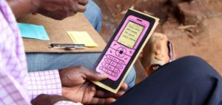
Prototype Ideas (similar to “Concept Testing”)
  To prototype is test drive: to introduce early/informal draft concepts in areas where clients are, and observe how they interact with them, then continue to refine and prototype until concepts start generating the desired response
Photo: GRID Impact. Designers from Grameen Foundation test paper prototypes in Uganda
Select Channels
Develop Messages
Draft Creative Brief
Prototype Ideas
Develop Materials
Pretest Materials
Produce Final Materials

Slide 56
Prototype Ideas
Prototypes can come in many forms – story boards, drawings, role playing, etc. Make something simple that conveys the idea you want to test drive (or even a “sacrificial concept” that you don’t think will work, just to get more dimensions of feedback)
If adapting materials from another country or program, the originals might serve as your first-round prototypes.
Introduce a prototype out in its intended environment – areas where you find your target audience. Observe how they interact with it; after observing, get their feedback on why they interacted with it the way they did.
Based on the feedback, re-do your prototype and see how people respond. Repeat until you get the desired response.
RESOURCE: Details on prototyping can be found at https://www.designkit.org/methods/34
Select Channels
Develop Messages
Draft Creative Brief
Prototype Ideas
Develop Materials
Pretest Materials
Produce Final Materials

Slide 57
Develop Materials
Guided by what you learn in prototyping, you are ready to develop your real materials
Select designer and supplier
Development may require engagement of an external partner or occur within your creative team
Before going “to scale”, produce formal mock ups for pretesting
Select Channels
Develop Messages
Draft Creative Brief
Prototype Ideas
Develop Materials
Pretest Materials
Produce Final Materials

Slide 58
Pretest Materials
Pretesting is showing the materials to members of the target audience before final production and eliciting their reactions
It will help ensure demand creation materials are appropriate for and understood by the target audience
Message pretesting is extremely important for showing how well target audiences receive, understand, and feel about key messages
Engage relevant stakeholders before pretesting the material to ensure their endorsement of the final materials.
Steps:
  Identify pretest objective
  Organize logistics
  Conduct pretest
  Analyze results
  Revise materials accordingly
RESOURCE: Details on pretesting can be found at https://www.thecompassforsbc.org/how-to-guides/how-conduct-pretest
Select Channels
Develop Messages
Draft Creative Brief
Prototype Ideas
Develop Materials
Pretest Materials
Produce Final Materials

Slide 59
Prototyping versus Pretesting
 | Prototyping | Pretesting
Intent | Test to learn | Test to validate
Timing | Pre-production | Post-production
Product | Rough draft | Near final
Investment | Minimal | Moderate
Environment | Real-world | Research/focus group
Feedback | Observe/Query (“Why did you…?”) | Hypothetical (“How would you…?”)
Select Channels
Develop Messages
Draft Creative Brief
Prototype Ideas
Develop Materials
Pretest Materials
Produce Final Materials

Slide 60
Material Production and Dissemination Plan
Once all the findings from the pretest have been taken into consideration, programs make decisions on how the materials will be produced at scale
  Based on the demand creation budget, determine the production amount
Develop a dissemination plan to ensure materials reach the intended audience using the appropriate channels and approaches
Select Channels
Develop Messages
Draft Creative Brief
Prototype Ideas
Develop Materials
Pretest Materials
Produce Final Materials

Slide 61
Knowledge Check

Slide 62
If a man is not interested in the HIV protective benefits of MC, which two of these messages could you share with him to convince him to go for MC?
A. MC offers health benefits to your female sex partner(s) such as reducing her risk for cervical cancer.
B. After you are circumcised, you can have sex with more women.
C. MC offers protection from STIs.

Slide 63
Step 4: Implementing and Monitoring Demand
Creation Approaches

Slide 64
VMMC Demand Creation Approaches
Demand creation for VMMC includes various approaches aimed at strategically motivating the target groups to seek VMMC
It goes beyond developing messages and IEC materials, as previously discussed
A combination of approaches are need for an effective VMMC program
Notes:
To ensure that supply is aligned with demand, collaboration between service delivery and demand generation is critical
When demand for services is not properly matched with supply, it can lead to long waiting times for clients or clients being turned away. This can impact negatively on client experience and deter clients from referring their peers for circumcision

Slide 65
Demand Creation Approaches
For the greatest reach and impact, a combination of approaches is usually necessary.
Advocacy
Community Mobilization
Entertainment Education
Information and Communication Technologies (ICT)
Interpersonal Communication (IPC)
Information Education and Communication (IEC)
Mass and Traditional Media
Referrals
Partnerships
Beware of message fatigue: Your target can be overexposed to a message and begin to tire out. Using different executions of the same message and different versions of materials can help reduce this.
However the target audience needs to see/hear the message multiple times before they make the decision to go for circumcision.

Slide 66
Example of how these approaches can be applied in socio ecological model
Approaches
Barriers
Structural and Systems
Cultural and Societal norms
Interpersonal relationships
Individual
Advocacy
Partnerships
Distance to the clinic
Associated cost e.g., transport, lost wages
Unavailability of services
Lack /poor coordination between service and delivery and DC teams
Advocacy
Community mobilization
Mass media and Traditional media
IEC
Entertainment Education
Cultural practices
Religious beliefs
Perceived threat to masculinity
Myths and misconceptions
Community mobilization
IPC
Mass media and Traditional media
IEC
Entertainment Education
Lack of partner support
Peers not approving VMMC
Lack of family support
IPC
Mass media and Traditional media
IEC
Entertainment Education
ICT e.g Facebook, WhatsApp, SMS
Referrals
Fear of pain
Fear of HIV test
Fear of complications
Sexual abstinence during healing
Low perception of HIV risk
Length of healing time
Low health seeking behavior

Slide 67
Advocacy
Advocacy operates at the political, social, and individual levels and works to mobilize resources and political and social commitment for social change and/or policy change
Advocacy aims to create an enabling environment at any level, including the community level (i.e. traditional government or local religious endorsement)
VMMC programs cannot function successfully without strong support from key stakeholders in the communities and countries they serve
One of the first priorities in the VMMC program should be to enlist local leaders to help engage the community
Advocacy is a multipronged effort, identify allies and engage them to advocate for MC
Primary audiences for advocacy include:
  MOH
  Government officials
  Health care workers
  Implementing partners
  Traditional/religious leaders

Slide 68
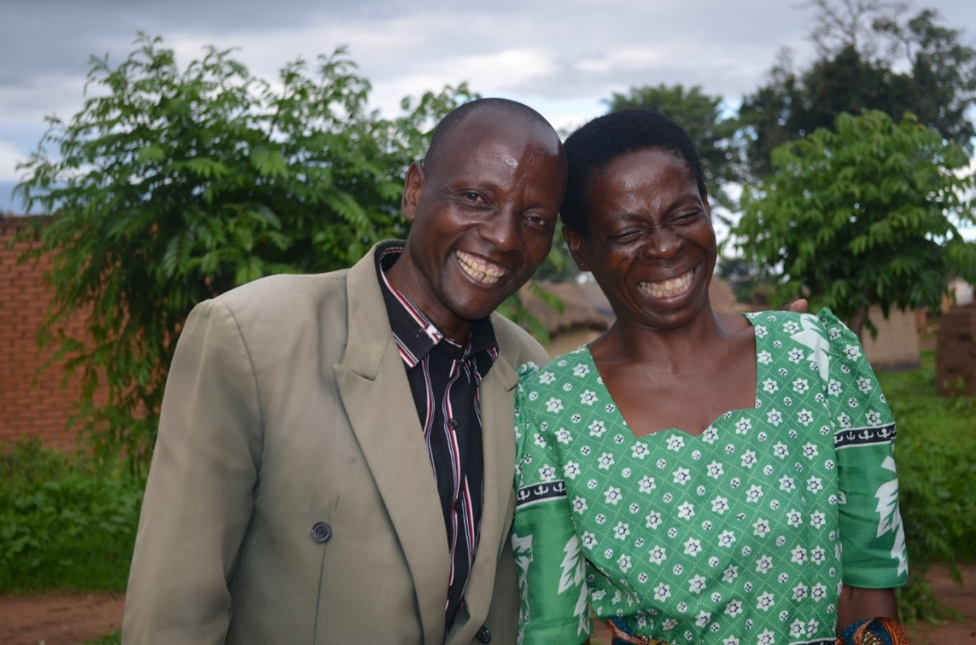
Case Study: A Village Chief Inspires His Community to Fight HIV
Recognizing the role that influential leaders could play in creating demand for HIV prevention services, Jhpiego/Project IQ-Malawi designed a strategy to utilize traditional and religious leaders in breaking down barriers to men accessing VMMC services by providing these leaders with information about VMMC.
If leaders wanted to have a VMMC procedure Project IQ scheduled the procedure privately and at the leader’s convenience.
The Senior Group Village Headman in Kawalika and an influential leader in the Chewa tribe got circumcised at age 52. Traditionally, the Chewa are a non-circumcising population,
Nduwaluwa’s visit marked a turning point in HIV prevention efforts in Lilongwe and his community’s acceptance of VMMC.
His action inspired three village headmen and over 300 young men in Lilongwe to get circumcised
Bobby Nduwaluwa, the Senior Group Village Headman in Kawalika and an influential leader in the Chewa tribe – one of the largest in the country.

Slide 69
Community Mobilization
A successful community mobilization effort not only works to solve problems but also aims to increase the capacity of a community to successfully identify and address its own needs and begin to seek VMMC services
Community mobilization aims at increasing acceptability of MC as a healthy social norm and HIV prevention intervention
Just as with individuals, communities have a journey to MC – they need initial engagement/sensitization/buy-in, more practical mobilization to services, etc.
Primary audience may include community members: men, women, local leaders, schools, teachers, work places, youth groups etc.
Notes:
Eg Zimbabwe soccer matches, road shows

Slide 70
Community Mobilization
When planning for community mobilization or activations think about:
  Number of activations
  Type of activation and main attraction/entertainment
  Best time(s) of year to host
  Venue or Location
  Marketing, branding, IEC and promotional materials
  HR required
  Whether MCs will be offered on site or transported
It’s important to plan ahead and make sure everyone understands their roles and responsibilities.

Slide 71
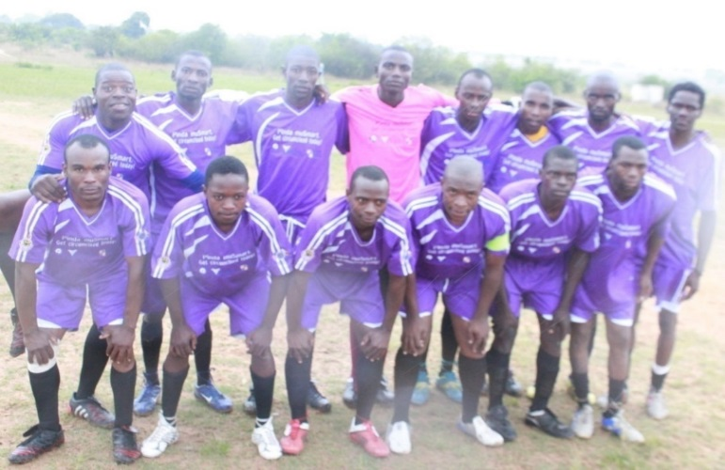
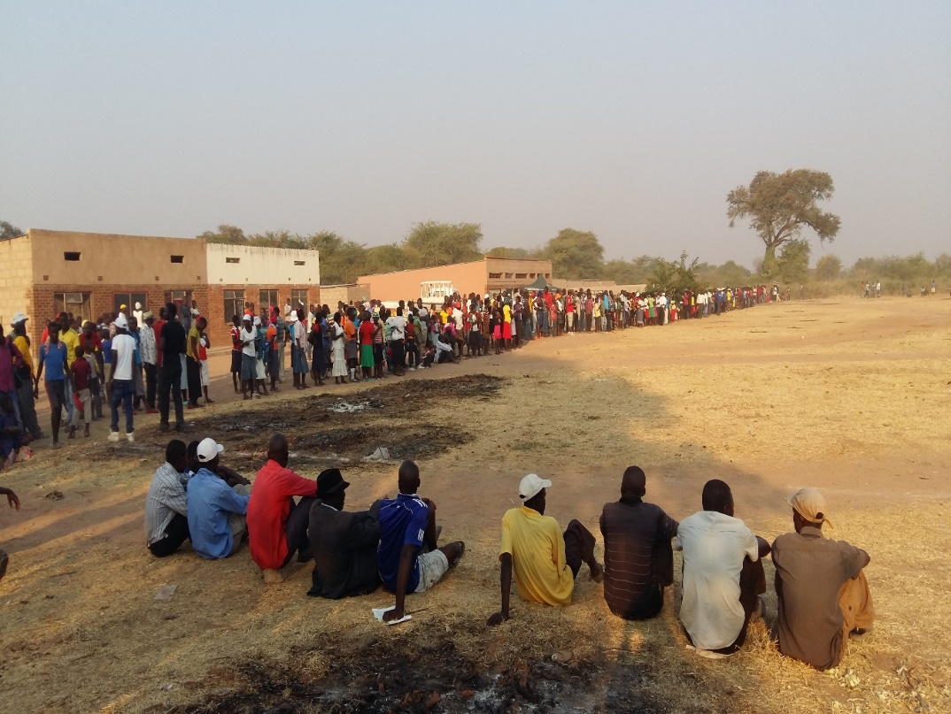
Case Study: Community Mobilization through Rural Soccer Galas
Soccer galas are always a crowd pleaser and an opportunity to reach and captivate older men with information on VMMC. They are also an opportunity to take advantage of men’s influence on each other to recruit for VMMC.
ITECH-Zimbabwe holds rural soccer tournaments in a league format, playing at ward level with end of the season finals for the top 8 teams. Teams compete by mobilizing their supporters and cash prizes are offered for first, second, and third place based on the number of men mobilized (not soccer performance).
Community teams, stakeholders, leaders, and local schools are all involved in the planning process. Loud haler and PA system announcements and marches with drum majorettes around the township and residential areas help promote the gala.
HTC tents are placed by the sports fields for all attendees and caravans are available for service delivery at the sports fields. There is also transportation for some clients to local health facility if they prefer a more private location.
Tournaments can bring in 500-2000 spectators and have on average 40-100 clients circumcised that day. Community mobilizers engage spectators, and those not ready on the day are booked, contact details are taken for follow-up. Appointments are tracked over the next 2-3 weeks and weekly performance averages are compared with the average for the 3 weeks prior to the soccer matches.
As the community participates, VMMC awareness and understanding increases for both men and women. Everyone looks forward to the event and it’s a reminder that the community has played a key role in the fight against HIV!
For more information: https://project-iq-resources.jhpiego.org/resource/men-along-the-last-mile-targeting-vmmc-services-by-location-and-population-to-reach-saturation/

Slide 72
Entertainment Education
Sometimes referred to as “Edutainment”
Uses both entertainment and education to engender individual and social change
Examples include: local theatre, storytelling, music, games, radio, television
Key messages are integrated into the entertainment in a way that makes them relatable and sparks thought and consideration among the audience
VMMC programs have used interactive dramas to inspire dialogue, raise awareness, shape attitudes, and generate a call to action (i.e., Get circumcised).

Slide 73
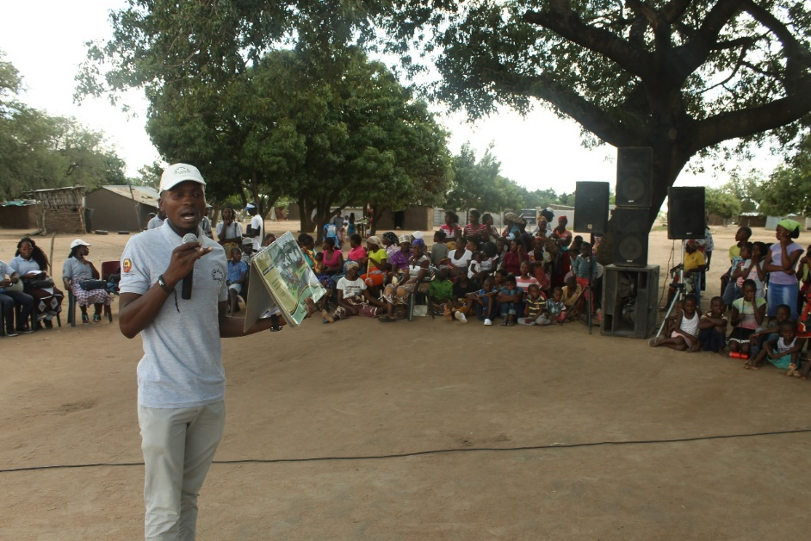
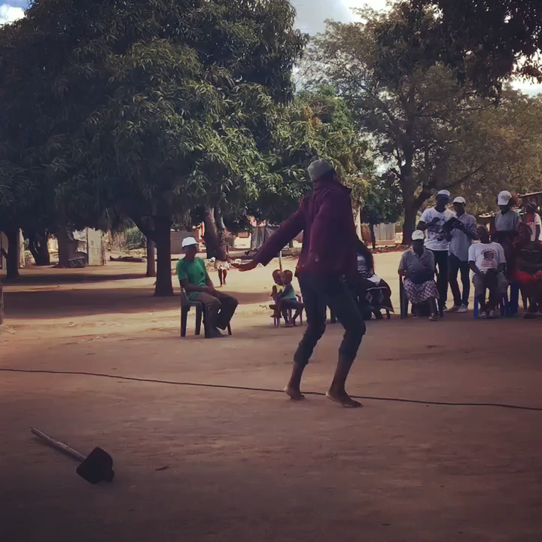
Example of Entertainment Education
Jhpiego-Mozambique partners with ADACUL, a cultural and arts-focused community based organization, to conduct VMMC theatre shows four times a month
The shows are held in rallies, schools, and markets with as many as 300 community members engaging
The key message disseminated is that “VMMC is free and supports good health.”
A monthly calendar outlines the session and complements other community lectures of the activistas to arrange support, such as transportation to the nearest MC site.
Click image to watch!

Slide 74
Interpersonal Communication (IPC)
Interpersonal and peer communication are based on one-to-one or peer to peer communication.
IPC aims at encouraging communities and individuals to take an active role in demanding and seeking VMMC services. It motivates uncircumcised men to go for VMMC
IPC is very critical as it gives greater depth of dialogue
IPC is effective when a standardized, comprehensive discussion guide and package of information is used
Notes:
Use of community mobilisers for IPC allows men who may be contemplating the procedure to ask questions specific to their own concerns in privacy. It works best when mobilizers use a standardized, comprehensive discussion guide and package of information

Slide 75
Interpersonal Communication (IPC)
The deployment of community mobilizers to undertake one-on-one messaging with prospective clients has been one of the most consistently employed and effective strategies in VMMC programs
Use of community mobilisers for IPC allows men who may be contemplating the procedure to ask questions specific to their own concerns in privacy
Ensure that your mobilisers speak the same language and live in the same community. Mobilisers should have a natural ability to “sell” a service, i.e, MC. Programs should seek to hire mobilisers with personality, and individuals who are articulate, relatable, and passionate about MC.
Using satisfied clients as community mobilisers has been effective in most programs
Programs have also used a mix of male and female mobilisers; in some sites, the female mobilisers have higher conversion rates (i.e., proportion of men receiving MC/ proportion of men mobilized). Other times, males prefer to speak to man around their own age.
Primary audiences include: uncircumcised men 10-14, 15-19, 29-24, 25-30+
Secondary audience: Partners (wives, girlfriends), mothers/fathers/guardians, adult circumcised men, etc.

Slide 76
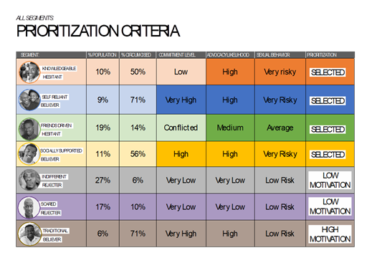
Example of Segmented IPC Charts from Zambia
SFH-Zambia conducted an implementation pilot of an IPC flip chart with tailored VMMC messaging for men 15-29 years old. The flip chart quickly helps mobilisers segment men so they receive the appropriate messages (color-coded).
Overall conversion rate (circumcisions/appointments) was 43% during pilot compared to 35% for standard methods. The conversion rate was higher amongst priority segments at 45% compared to
39% in non-priority segments. 68% of those circumcised were
aged 15-29 years in both methods. On average, men took 42
days from first contact to circumcision.
Segmented IPC flip chart with tailored messages
http://programme.ias2017.org/Abstract/Abstract/2603
Notes:
Background: Although Zambia has seen an increase in VMMC since 2009, targets have not been achieved hence need for innovative demand creation methodologies including use of market research and human centred design (HCD). These methods should target the most impactful ages (15-29 years) and shorten the journey to circumcision. Utilizing findings from a 2014 journey mapping study conducted in Zambia, Society for Family Health (SFH) employed HCD strategies to analyse and translate findings into demand creation solutions. The process prioritized four of seven identified segments of men, created robust archetypes, and uncovered insights used to inform tailored messages and prototypes for new VMMC demand creation tools to be piloted for effectiveness, efficiency and usability.
Methods: A non-randomized implementation pilot was conducted in eight SFH supported public facilities in four districts. Twenty-three Community Health Workers (CHWs) (13 male, 10 female) and eight supervising CHWs were selected and trained on new messaging and tools. A similar number of CHWs continued to utilize standard demand creation methods in the same facilities.
CHWs conducted door-to-door mobilization activities using new tools and potential clients were classified into a specific segment, exposed to tailored messaging and tools, and recorded in the daily activity report (DAR). Clients interested in getting circumcised were scheduled for an appointment and provided with a referral card. Clients who missed appointments were followed-up a maximum of three times by the CHW.
Results: Overall conversion rate (circumcisions/appointments) was 43% (1,461/3,421) during pilot compared to 35% (884/2,532) for standard methods. Conversion rate was higher amongst priority segments at 45% compared to 39% in non-priority segments. 68% of those circumcised were aged 15-29 years in both methods. On average, men took 42 days from first contact to circumcision. Younger CHWs were more effective whilst female CHWs'' conversion rate was 47% compared to 38% for male CHWs.
Conclusions: The use of segmentation to provide tailored messages and tools is as effective as established demand creation methods and has potential to improve and revolutionize approaches to demand creation for VMMC. Emphasis should be placed on mapping the cascade to VMMC and shortening a man''s journey to circumcision.

Slide 77
Information and Communication Technologies
ICTs are fast growing and evolving platforms for electronic, digital technologies, including computing and telecommunications technologies, which enable communication and promote the interactive exchange of information
ICTs also include mobile and smart phones and the use of SMS, and social media such as Facebook, Twitter, and WhatsApp

Slide 78
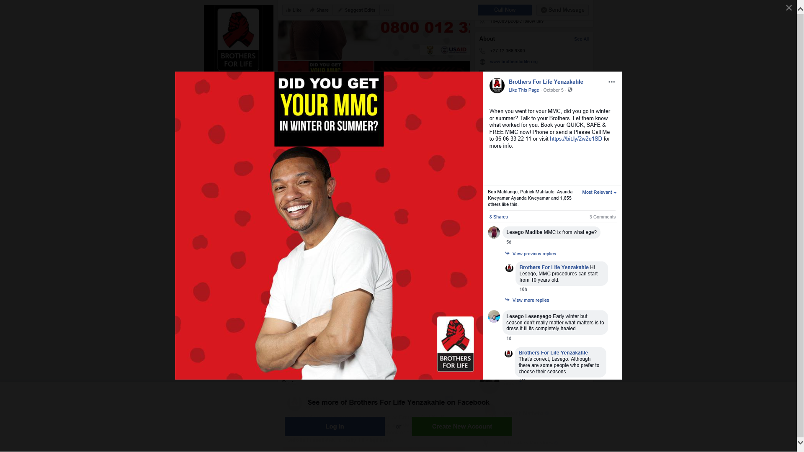
Example from South Africa on Use of SMS and Social Media for Appointment Booking
The Brothers For Life Campaign in South Africa makes it easy for men to reach out to book appointments via, text, email, or Facebook.

Slide 79
Mass and Community-Based Media
Community-based media reach communities through locally-established outlets such as local radio stations and community newsletters/newspapers as well as activities such as rallies, public meetings, folk dramas, and sporting events
Mass media can reach large audiences through radio, television, and newspapers or magazines
Community radio tends to be less expensive and programs have had more success
Radio call-in programs are very effective as they promote dialogues
When considering mass media formats, consider what media formats the audience already accesses and who they think is a credible, trustworthy, and informed source of information
Notes:
Mass media is often expensive

Slide 80

Brothers4Life “Zing” MMC Campaign
“Salon,” a medical male circumcision (MMC) campaign developed as part of the Brothers for Life programme in South Africa, featured women in a hair salon discussing the benefits of the procedure.
Running from February 2015 to July 2016, the campaign used television, radio, billboards, and posters to promote discussions between men and women about MMC, as well as the use of condoms by men after circumcision.
The results of an evaluation of the impact of the campaign and its recommendations are described in this report.
Click screen to watch!

Slide 81
Information Education and Counselling (IEC)
If funds permit, IEC materials should be developed for different target audiences (e.g., for youth 15-19, young men 20-24, 25-30, married men, couples)
IEC materials should convey the key messages for the target audience

Slide 82
Examples of VMMC IEC Materials
For more examples of IEC materials, visit the VMMC Clearinghouse Resource Library

Slide 83
Partnerships
Partnerships are essential to VMMC programs in order to achieve MC targets so that HIV epidemic control can be attained
Engaging the private sector in VMMC has helped to tackle issues of privacy, long queues, and crowded waiting areas at public facilities
Public-private partnerships (PPP) have also resulted in national level VMMC advocacy campaigns
Workplace partnerships have enabled VMMC programs to use workplace clinics for MC procedures during certain time points, and have led to policy changes such as time off work for employees to recover from MC

Slide 84
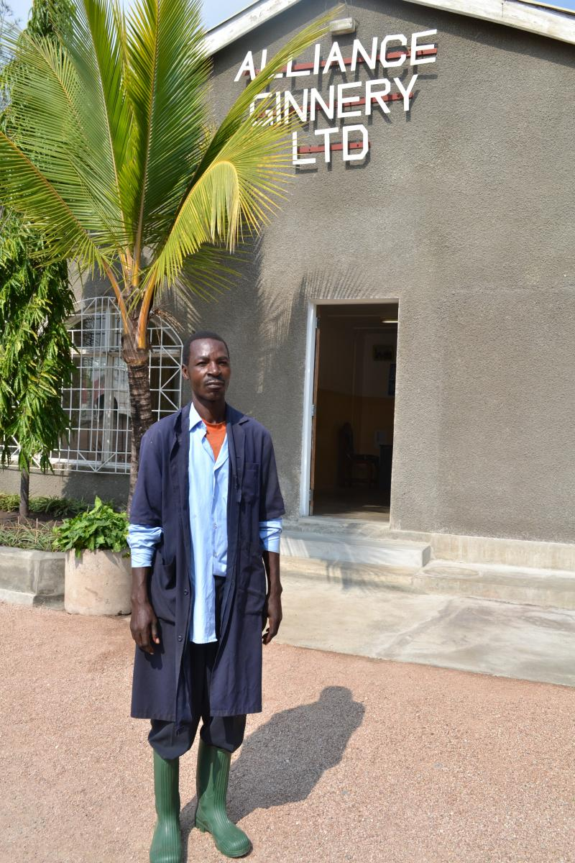
Case Study: Partnering with Private Employers on Provision of MC Services
In rural villages like Kasoli in Tanzania, people depend on agriculture for their livelihoods, and working at the cotton ginnery is a respected and rare employment opportunity
In 2016, IntraHealth International-Tanzania engaged owners of the Alliance Cotton Ginnery to provide MC services among their employees and men in the surrounding community, in collaboration with the Council Health Management team (CHMT) and the ward and village/hamlet leaders; the MC team worked closely with the ginnery owners, management, and employees to plan for service delivery and sharing of resources
The cotton ginnery authorities led mobilizing of employees and surrounding communities; the ginnery provided space for delivering MC services within their complex
Employees were granted a 5-day paid leave to undergo the MC procedure and recover without docking their payments
Over the course of 3 weeks, 1,926 men were circumcised and tested for HIV, of which 30 were adult male ginnery staff, representing 80% of the factory’s employees
Through this partnership, the cotton ginnery strengthened its relationship and positive reputation with the surrounding communities and goodwill among its employees; the employees benefited by getting a free MC while receiving their daily payments
The success of this partnership can be attributed to careful identification of an opportunity for
mutual benefit, careful service planning, sharing and planning for resource contribution,
and involving district and community leaders.
This model is now being expanded to other disciplines such as laborers on sugar and tea
plantations, miners, and fisherman, and motorcycle “bodaboda” riders
Notes:
In rural villages like Kasoli in Bariadi district Tanzania, people depend on agriculture for their livelihoods, and working at the cotton ginnery is a respected and rare employment opportunity. In 2016, IntraHealth International-Tanzania engaged owners of the Alliance Cotton Ginnery to provide MC services among their employees and men in the surrounding community. In collaboration with the Council Health Management team (CHMT) and the ward and village/hamlet leaders; the MC team liaised and closely worked with the ginnery owners; ginnery management and employees to plan for service delivery and sharing of resources. The cotton ginnery authorities took a lead on mobilizing its employees and other locals in the surrounding communities to come out for MC services. The ginnery provided space for setting up and delivering MC services within their complex.
Employees who were circumcised were granted a 5-day paid leave to undergo MC procedure and recover without docking their payments. 1,926 men were circumcised and tested for HIV of which 30 were adult male ginnery staff representing 80% of the factory’s employees.
Through this partnership, the cotton ginnery strengthened its relationship with the surrounding communities and goodwill among its employers and further enhanced its positive reputation in the community. The employees on the other hand benefited from this collaboration by getting a free MC service while receiving their daily payments. The success of this partnership can be attributed to careful identification of an opportunity where everyone involved benefited, careful service planning, sharing and planning for resource contribution, and involving district and community leaders. This model is now being expanded to other disciplines such as laborers on sugar and tea plantations, miners, and fisherman, and motorcycle “bodaboda” riders.

Slide 85
Referrals
VMMC programs can leverage other health service programs to facilitate referral of HIV negative males to VMMC
Examples of two-way referral systems between VMMC and other health services could be:
  From HTS, STI clinics, or OPD-TB to VMMC for high-risk HIV negative males
  From ANC to VMMC for men with expecting partners or recently post-partum
  From VMMC to ART clinic for HIV positive males identified in VMMC clinic
  From VMMC to PrEP for high risk HIV negative men who have been circumcised
Creating an active referral system is recommended to track and follow-up with men who have not reported to VMMC site

Slide 86
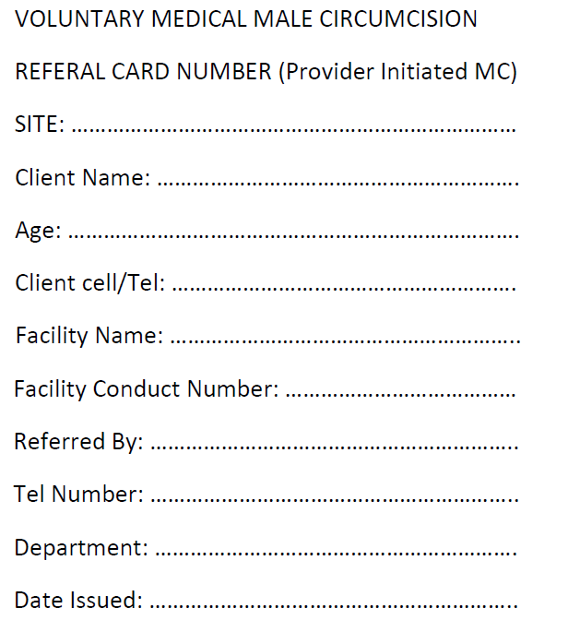
Example of VMMC Referral from Other
Health Services
Jhpiego-Malawi orients providers from other service points in the health facility on VMMC so they can initiate referrals among eligible patients to VMMC services.
These are nurses, clinicians working in other services points in the health facility like ANC, OPD, STI clinic etc.
VMMC
OPD
VCT
ANC
All HTS points
STI clinic
Referral forms are given to clients and a duplicate remains at the referring site. This is an effective way of having patients attending others services at the facility have access to VMMC information and services.
Notes:
Jhpiego-Malawi, orients providers from other service points in the health facility on VMMC so they can initiate referrals among eligible patients to VMMC services. Service providers at all other service delivery points in the supported facilities undergo a half day sensitization meeting on basic VMMC information. These are nurses, clinicians working in other services points in the health facility like ANC, OPD, STI clinic etc. The providers provide brief information about VMMC- importance/benefits and provide clear direction on the location of the VMMC site at the health facility. Referral forms are given to clients and a duplicate remains at the referring site. This is an effective way of having patients attending others services at the facility have access to VMMC information and services.

Slide 87
Knowledge Check

Slide 88
TRUE or FALSE?
Implementing only one demand creation approach will result in an effective VMMC program.
False. A combination of demand creation approaches is needed for an effective VMMC program.
TRUE
FALSE

Slide 89
Considerations for Implementation
Ensure that supply matches demand.
  Coordination between demand creation and service delivery is critical. This can be done through regular meetings and sharing reports.
  Mapping VMMC sites to ensure that demand creation activities are focused around the site catchment areas.
  Geographic information systems (GIS) have also been used to map where high numbers of uncircumcised men are. Programs should consider intensifying demand creation interventions in these areas.
  DC activities are intensified during campaign periods to match with enhanced service delivery.

Slide 90
Considerations for Implementation
Demand creation services should start at least 2 weeks prior to service delivery and maintained throughout the service delivery period.
Ensure adequate funding and resources:
  Is the capacity there?
  Are the mobilisers well-trained? Consider refresher trainings also.
  Is the effort going to be worth the projected impact?
  Is the intervention sustainable? Ensure that the effort is worth the projected impact.

Slide 91
Considerations for Implementation
Continue engagement with MOH and other key stakeholders, and provide regular updates and support
Continuously monitor to check if the different approaches and channels are yielding positive results
Set up dynamic communication with service delivery team to quickly identify gaps (e.g., WhatsApp group)
Access service delivery data, regularly
Notes:
For an example implementation matrix see page 31 of Kenya’s communication strategy: https://www.malecircumcision.org/sites/default/files/document_library/T11.Communication_Strategy%20for%20VMMC%20in%20Kenya.pdf

Slide 92
Monitoring

Slide 93
Monitoring
Monitoring is the routine collection and measurement of program data
Ongoing collection and assessment of program data helps to make timely corrections and modifications to the implementation of demand creation activities to reach program objectives
Monitoring helps to:
  Determine the extent to which the messages reach the target audience
  Track progress of demand creation activities, ensuring that activities are implemented as planned
  Monitor number of MCs performed
Monitoring provides the information you need to guide real-time adjustments

Slide 94
Monitoring
Routine monitoring of the demand creation activities will help to determine which approaches are working best and intensify on those approaches.
It also helps to determine if the numbers are fluctuating – depending on different factors – and helps to adjust accordingly.
Use key performance indicators to assess what approaches are working a specific district:
  # of clients reached
  # of client referred
  # of client circumcised
  % of clients in the priority age band: 15-29
Set appropriate targets and assess weekly/monthly achievement against the set target.
If at all possible, collecting these indicators for a short period before the intervention to establish a baseline makes it much clearer whether it is working after introduction
Monitoring the performance of demand creation activities against the cost is also important.
  Where is your money working hardest?
  What activities are resulting in greatest uptake of MC and how much do those activities cost?
Monitoring should occur on a regular basis: weekly/monthly/quarterly intervals

Slide 95
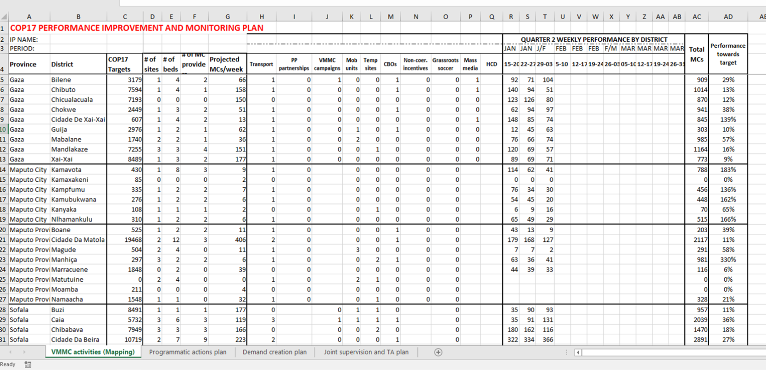
Example of Monitoring Tool (Dashboard)
Notes:
Example of M&E tool used by Mozambique

Slide 96
Knowledge Check

Slide 97
Monitoring is an essential part of VMMC demand creation because it helps to:
A. Determine the extent to which the messages reach the target audience
B. Track progress of demand creation activities, ensuring that activities are implemented as planned
C. Allows for dynamic change of demand creation strategies, as needed.
D. All of the above

Slide 98
Step 5: Evaluation and
Replanning

Slide 99
Evaluation
Evaluation measures how well the VMMC program is achieving its objectives
Evaluation can help determine if the VMMC demand creation activity was effective at reaching the target audiences and motivating them to seek VMMC or encourage others to do so
Evaluation can also show which communication activities, channels, and messages worked best
An evaluation requires a study design and measurement over time

Slide 100
Evaluation Types
Formative evaluation: includes pre-testing and is designed to assess the strengths and weaknesses of materials or campaign strategies before implementation. It permits necessary revisions before the full effort goes forward.
  Its basic purpose is to maximize the chance for program success before the communication activity starts.
Process evaluation: assesses with the demand creation activities are being implemented properly and whether the approaches are bringing clients to the facility.
  This is the most common evaluation method used to assess demand creation since changes need to be dynamic in order to meet targets

Slide 101
Evaluation Types
Outcome evaluation: used to obtain descriptive data on a project and to document short-term results. Task­-focused results are those that describe the output of the activity (e.g., the number of MC inquiries received as a result of a radio ad).
  Short-term results describe the immediate effects of the project on the target audience (e.g., percentage of the target audience scheduling MCs).
Impact Evaluation: A more rigorous study to determine if the desired change has occurred. Focuses on the long-range results of the program, including changes or improvement in health status.
  Rarely possible because they are costly, involve extended commitment, and may depend upon strategies besides communication. Also, the results often cannot be directly related to the effects of an activity or program because of other (external) influences on the target audience that occur over time.

Slide 102
Evaluation Tips
Evaluating whether a demand creation activity worked can be challenging, especially since men make take months to make the decision to go for MC
When introducing a new intervention/activity, it is best to capture baseline data for at least a month prior and then introduce the new demand creation activity for a period of time, then assess if there has been a change in uptake relative to baseline
  Other options are to look at data from the previous year during the same time frame or compare data to a “control” site/area with similar characteristics.
If you introduce too many new interventions/activities at once, it will be difficult to determine which one is making the difference
The results from an evaluation should be used to inform planning and replanning for future VMMC demand creation programs
Evaluations should always be seen as part of the step that goes back to planning for new VMMC demand creation programs and activities

Slide 103
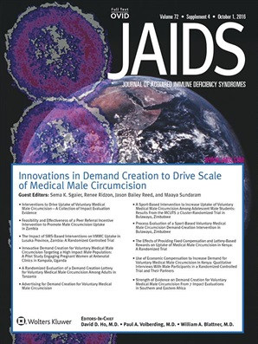
Innovations in Demand Creation to Drive Scale of Medical Male Circumcision
For additional reading on impact evaluations of VMMC demand generation interventions, refer to the October 1 2016, Volume 72, Supplement 4 in the Journal of Acquired Immune Deficiency Syndrome
Notes:
https://journals.lww.com/jaids/toc/2016/10012#-1281820829

Slide 104
Summary
Demand creation is the practice of increasing awareness of and desire to obtain a certain commodity or service among an intended audience
VMMC demand creation goes beyond simply raising awareness or providing information. It must address barriers and enlist key motivators to convince eligible males to undergo MC and connect them with the service point!
Applying a conceptual framework for MC demand creation can demonstrate how programming can tackle issues around male circumcision (i.e. barriers and motivators)
Successful demand creation programs carefully design communication strategies and coordinate consistent messages that are delivered through multiple channels, and approaches
Programs should always ensure that that supply matches the demand for services
Regular engagement and collaboration with MOH, community partners, and other key stakeholders can strengthen demand generation programs, and assist with implementation
Monitoring and evaluation of demand creation activities against MC uptake is critical to understanding what approaches are having the most impact

Slide 105
References and Resources
Sema K Sgaier, James Baer, Daniel C Rutz, Emmanuel Njeuhmeli, Kim Seifert-Ahanda, Paulin Basinga, Rosie Parkyn and Catharine Laube (2015) Toward a Systematic Approach to Generating Demand for Voluntary Medical Male Circumcision: Insights and Results From Field Studies. Global Health: Science and Practice June 2015, 3(2):209-229; https://doi.org/10.9745/GHSP-D-15-00020
Health Communication Partnership (December 2003). The new P-Process, steps in strategic communication. Baltimore: Johns Hopkins Bloomberg School of Public Health / Center for Communication Programs / Health Communication Partnership http://www.who.int/immunization/hpv/communicate/the_new_p_process_jhuccp_2003.pdf
Hatzold K, Mavhu W, Jasi P, Chatora K, Cowan FM, Taruberekera N, et al. (2014) Barriers and Motivators to Voluntary Medical Male Circumcision Uptake among Different Age Groups of Men in Zimbabwe: Results from a Mixed Methods Study. PLoS ONE 9(5): e85051. https://doi.org/10.1371/journal.pone.0085051
Auvert B, Taljaard D, Lagarde E, et al. Randomized, controlled intervention trial of male circumcision for reduction of HIV infection risk: the ANRS 1265 Trial. PLoS Med. 2005;2:e298. https://www.ncbi.nlm.nih.gov/pmc/articles/PMC1262556/

Slide 106
References and Resources
Voluntary Medical Male Circumcision (VMMC) Demand Creation Toolkit (2010). file:///C:/Users/evh6/Downloads/VMMC_Demand%20Creation%20Toolkit.pdf
UNAIDS Guidance Note on Developing a Communication Strategy for Male Circumcision. JC1875E (English original, May 2010) https://www.malecircumcision.org/resource/unaids-guidance-note-developing-communication-strategy-male-circumcision
RTI International, Population Services International (PSI) & Centers for Disease Control and Prevention(2013) Voluntary Medical Male Circumcision (VMMC) Demand Creation Toolkit . https://www.malecircumcision.org/resource/voluntary-medical-male-circumcision-demand-creation-toolkit
USAID ASSIST Project https://www.usaidassist.org/toolkits/vmmc-cqi-and-eqa-toolkit/demand-creation
https://blog.pkids.org/2012/09/06/social-marketing-101/

Slide 107
References and Resources
The Health Communication Capacity Collaborative HC3. (2014) A theory-based framework for media selection in demand generation programs. Baltimore: Johns Hopkins Bloomberg School of Public Health Center for Communication Programs
https://sbccimplementationkits.org/demandrmnch/power-of-demand-generation/
https://sbccimplementationkits.org/demandrmnch/mnh-step5/
https://health.gov/environment/Casestudies/typeseval.htm
https://www.thecompassforsbc.org/how-to-guides
https://www.designkit.org/methods
https://www.designforhealth.org/
IPSOS, Upstream, Final Mile, Population Services International, Jhpiego. (2017) Action Catalyst Tools: https://www.malecircumcision.org/resource-bundle/action-catalyst-tools-voluntary-medical-male-circumcision

Slide 108
Contributors & Acknowledgments
Omega Chituwo (CDC-Zambia)
Stephanie Davis (CDC-HQ)
Manya Dotson (Jhpiego-USA)
Ruben Frescas (Jhpiego-Mozambique)
Wezi Msungama (CDC-Malawi)
Melissa Habel (CDC-HQ)
Francis Kaira (Jhpiego-Zambia)
Catey Laube (Jhpiego-USA)
Isa Miles (CDC-HQ)
Lucy Mphuru (IntraHealth-Tanzania)
Clara Wakutaipa (SFH-Zambia)

Slide 109
Thank you!

