Slide 1
Global Prevention Coalition
SESSION 07:
Adolescent girls, young women and their male partners in high-incidence communities
Sub-title
NAME

Slide 2
Overview
Brief epi
Priority issues
Guidance on AGYW programming
Status of implementation and good practices
Questions and discussions

Slide 3
HIV prevention is about empowerment, choices, and protection

Slide 4
Young women at high risk of HIV
Number of new HIV infections among young people (aged 15–24 years), by sex, eastern and southern Africa and western and central Africa, 2000–2017
Eastern and southern Africa
Western and Central Africa
500 000
500 000
450 000
450 000
400 000
400 000
Number of new HIV infections
350 000
Number of new HIV infections
350 000
300 000
300 000
250 000
250 000
200 000
200 000
150 000
150 000
100 000
100 000
50 000
50 000
0
0
2000
2001
2002
2003
2004
2005
2006
2007
2008
2009
2010
2011
2012
2013
2014
2015
2016
2017
2000
2001
2002
2003
2004
2005
2006
2007
2008
2009
2010
2011
2012
2013
2014
2015
2016
2017
Females
Males
Source: UNAIDS 2018 estimates.
Notes:
In sub-Saharan Africa, adolescent girls and young women (aged 15–24 years) bear the brunt of HIV prevention shortcomings, accounting for one in four HIV infections in 2017 despite being just 10% of the population.
In many regions, physiological vulnerabilities to HIV are compounded by gender inequalities and gender-based violence, limiting the ability of young women and girls to benefit from HIV and sexual and reproductive health services.
This figure shows that For every three new infections among young men (aged 15–24 years) in eastern
and southern Africa, there were seven new infections among young women of the same age.
In western and central Africa, for every three new infections among young men (aged 15–24 years), there were five new infections among young women of the same age.
The fact that adolescent girls and young women are substantially affected by the HIV epidemic is partially due to gender roles prevalent in society, to social norms that affect them, and to their limited access to education and resources, all of which prevent adolescent girls and young women from making essential decisions about their health and lives.
Harmful laws and practices in relation to early marriage, early pregnancy and lack of access to confidential sexual and reproductive health services prevent adolescent girls and young women from obtaining essential HIV prevention information and services.
Respect for adolescent autonomy and decision-making, providing empowerment, and changing gender norms and laws can enhance access to—and ability to use— HIV prevention services among adolescent girls and young women

Slide 5
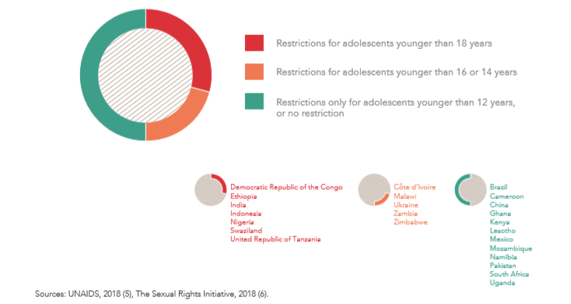
Countries with age of consent laws to access sexual and reproductive health services

Slide 6
Percentage of young people (aged 15–24 years) who had correct and comprehensive knowledge about HIV,
eastern and southern Africa, 2012–2017
100
90
80
70
Per cent
60
50
40
30
20
10
0
Rwanda
Kenya
Namibia
Eswatini
United Republic
of Tanzania
Zambia
Zimbabwe
Uganda
Malawi
Ethiopia
Angola
Lesotho
Mozambique
Madagascar
Comoros
South Africa*
Young men
Young women
* The survey in South Africa used different wording and included an additional question.
Source: Population-based surveys, 2012–2017.

Slide 7
The issues
Coordination is challenging and sub optimal
Geographic prioritisation is improving, but need further engagement at local level.
Missing the most at risk and vulnerable girls
Lack of standard packages
Delivery platforms have not been articulated in most countries and engagement of civil society
Lack programme coverage indicators and monitoring

Slide 8
Where are the young women we need to reach? Sub-national top priority areas for HIV prevention among young women
Country | High incidence (0.3-1.0) | Very high incidence (1.0-2.0) | Extremely high incidence (2+)
South Africa*) | Western Cape, Northern Cape | Limpopo | KZN, EC, MP, FS, NW, GP,
Nigeria | Bayelsa, Benue, Ebonyi, Edo, Imo, Lagos, Ondo, Oyo, Sokoto, Tarabe | Akwa-Ibom, Nasarawa
Mozambique | Inhambane, Manica, Maputo Cidade, Niassa, Sofala, Zambezia | Cabo Delgado, Gaza, Maputo Provincia
Kenya*) | Rift Valley | Nyanza
Zambia | Eastern, Luapula, Muchinga, North Western, Northern | Copperbelt, Lusaka, Southern, Western
Uganda | Mid Eastern, South Western | East Central
Zimbabwe | Bulawayo, Harare, Manicaland, Mashonaland Central / East /West, Masvingo, Midlands | Matebeleland North / South
Malawi*) | Southern region
Cameroon | Centre, Douala, Est, Nord Ouest, Sud, Sud Ouest, Yaoundé
Ethiopia | Gambela
Cote d’Ivoire | Centre-North, Sud-Ouest
Namibia | Hardap, Karas, Kavango, Kunene, Ohangwena, Omaheke, Omusati, Oshikoto, Otjozondjupa | Erongo, Khomas, Oshana, Zambezi
Swaziland |  | Hhohho | Manzini, Shiselweni, Lubombo
Countries with no sub-national HIV incidence estimates available (determined based on sub-national HIV prevalence as a proxy)
Angola | Cuando Cubango, Cubene
Lesotho
Tanzania | Tabora, Shinyanga, Mbeya, Iringa, Rukwa, Dar es Salaam, Pwani, Ruvuma, Katavi | Njombe
No high-incidence districts: DR Congo, Ghana *) Country already has more detailed district estimates in place

Slide 9
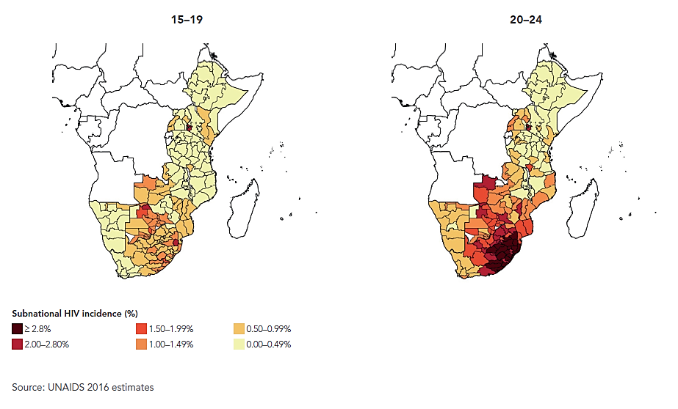
Subnational focus
HIV incidence among young women in southern and eastern Africa

Slide 10
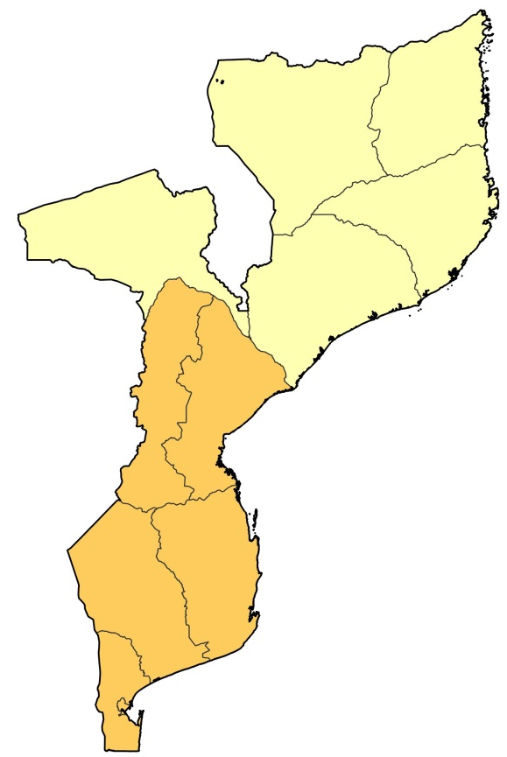
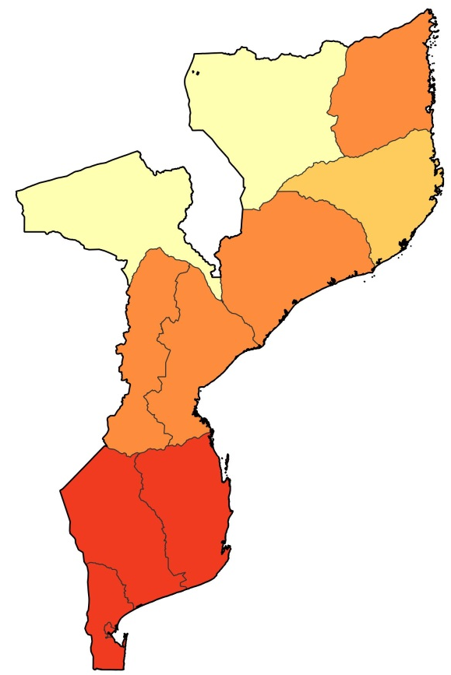
Sub-national HIV incidence (%) among young women in Mozambique, 2015
(15–19 years old)
(20–24 years old)
HIV incidence (%)
1.50 – 1.99%
1.00 – 1.49%
0.50 – 0.99%
< 0.50%

Slide 11
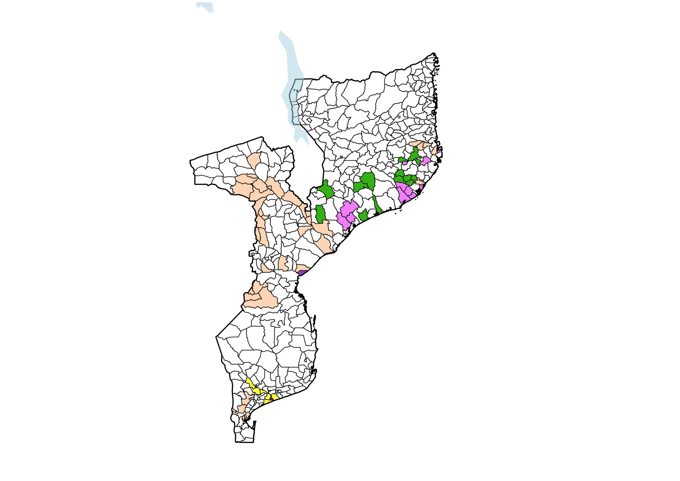
Current coverage of programs
for adolescent girls and young women, Mozambique
Funding:
DREAMS
The Global Fund
DREAMS* and the Global Fund
National government
National government and the Global Fund
Proposed priority area for comprehensive women and girls prevention coverage
Source:
Notes:
Overall there seems to be good geographic alignment of donor funded partners programmes with HIV incidence locations, with key partners complementing each other in the selection of districts, but there is still a wide range in coverage of national programmes (between 10 and 100 % of high incidence districts covered).
(In some countries like Uganda and Zimbabwe, geographic coverage of programmes is not fully aligned with areas with highest estimated incidence.)
BUT: It is only partially clear whether and to what extent current programme intensity is aligned to incidence levels.
Investing in the highest burden districts will be key to ensure maximum efficiency

Slide 12
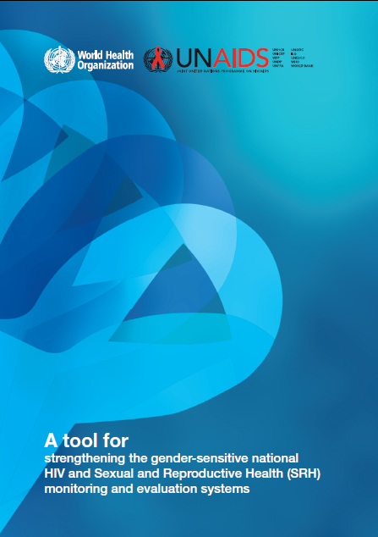
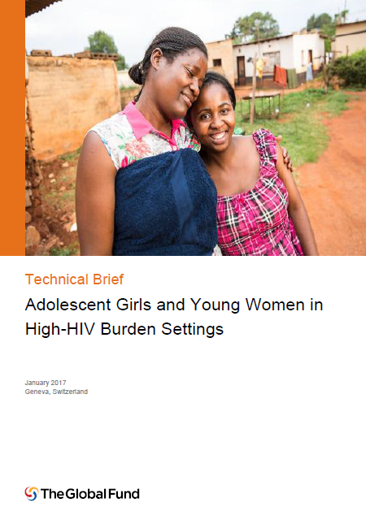
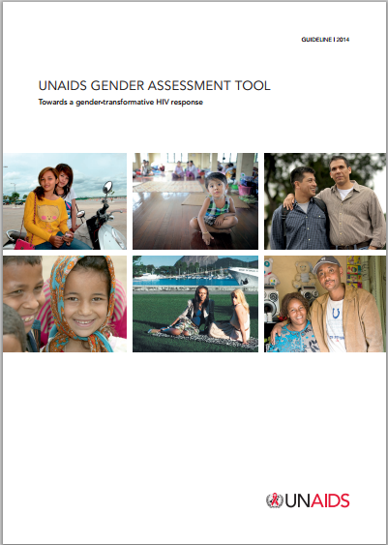
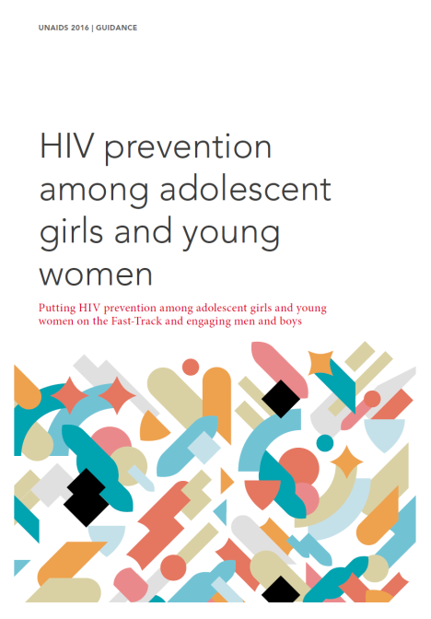
Gender responsive tools available:
Strengthening the gender sensitive HIV and SRHR M&E Systems
All referred to in:
Assessing your HIV response
Develop Programmes
Notes:
WHO/UNAIDS (2016) Tool for strengthening gender-sensitive national HIV and Sexual and Reproductive Health Monitoring and Evaluation systems:
The tool provides guidance to conduct a three-stage process to gender analysis:
a descriptive analysis of disaggregated data;
analysing these data over time and in relation to norms; and
c) interpreting data with reference to the broader sociocultural, economic and political context.
http://apps.who.int/iris/bitstream/10665/251903/1/9789241510370-eng.pdf?ua=1
HIV Gender Assessment tool (2013):
English:
http://www.unaids.org/sites/default/files/media_asset/JC2543_gender-assessment_en.pdf
French:
http://www.unaids.org/fr/resources/documents/2014/20140505_JC2543_gender-assessment
Spanish:
http://www.unaids.org/es/resources/documents/2014/20140505_JC2543_gender-assessment
Stop TB/UNAIDS: HIV/TB Gender assessment tool (2016) : http://www.stoptb.org/assets/documents/resources/publications/acsm/Gender_Assessment_Tool_TB_HIV_UNAIDS_FINAL_2016%20ENG.pdf
Other tools/briefs:
16 ideas for addressing VAW in the context of the HIV epidemic (2013) (WHO/UNAIDS) http://apps.who.int/iris/bitstream/10665/95156/1/9789241506533_eng.pdf
ALIVHE Framework
Global Fund Technical Brief : Adolescent Girls and Young Women in High HIV Burden Settings (2017) http://www.theglobalfund.org/documents/core/infonotes/Core_AdolescentGirlsAndYoungWomen_TechnicalBrief_en/
Checklist for Integrating Gender into the Processes and Mechanisms of the Global Fund to Fight AIDS, TB and Malaria http://files.unaids.org/en/media/unaids/contentassets/documents/unaidspublication/2014/JC2543_gender-assessment_en.pdf
HIV prevention: Biomedical, Behavioural, Structural
Condom promotion and distribution.
School based HIV prevention --including comprehensive sexuality education that engages boys on addressing harmful masculinities.
Keeping girls in school, including secondary school.
Cash transfer and social grants. These have shown promising effects in lower HIV and STIs prevalence.
Removing legal or policy barriers to adolescents’ use of services for HIV and sexual and reproductive health.
Adopt and support for policies on non-discriminatory and youth-friendly service provision in health facilities.
Integration of HIV with sexual and reproductive health services and gender based violence programmes; that address the multiple needs young women and girls have.

Slide 13
UNAIDS guidance for programming
Why this guidance?
Complex field, but sufficient evidence
No other UN guidance specifically on HIV prevention
Options menu rather than blueprint

Slide 14
HIV PREVENTION IS A RIGHT
Fulfilling this right begins with providing
people who are at increased risk of HIV
infection with unhindered access to education and information and effective prevention and treatment services.

Slide 15
Key factors associated with HIV risk among young women and their partners
Behavioral
Age-disparate sex
Multiple partnerships
Sex work and sexual exploitation
Transactional sex
Early sexual debut
Gaps in knowledge and limited personalized risk perception
Biological
Biological susceptibility of women
Biological susceptibility of adolescent girls
High HIV viral load among male partners
Low prevalence of male circumcision
Harmful practices
(eg. intra-vaginal)
Other infections
Structural factors
Harmful social and gender norms
Low secondary school attendance
Lack of economic empowerment
Labour migration and spousal separation
Barriers to SRH services
Orphanhood
Child sexual abuse
Gender-based violence incl early marriage
Marriage patterns
Analyze at country-level and sub national level

Slide 16
Options MENU
Dimension of
change
HIV prevention
outcomes
Impact
Menu options
Condoms
Fewer partners/ more partner choice
(less risky partners)
School-based prevention
(in context of comprehensive sexuality education)
Norms, know how, skills
Core prevention programs
Interpersonal communication
Reduced
HIV incidence
Support choices of young
women who have agency
Pre-exposure prophylaxis
Safer sex negotiation (condom use)
HTS, ART, VMMC for men
Biological factors
Policy, legal change
Community mobilization
Reduce susceptibility
and transmissibility
Consistent use of ARVs for prevention (ART, PrEP, PEP)
Synergistic
effects on education, GBV, gender norms, SRHR
Multi- and new media
Policy & structural action
Cash transfers / incentives
Gender norms & GBV prevention
Structural factors
More men go for HIV/health services (HTS/ART & VMMC)
Sexual and reproductive health and rights
Enhance agency among
young women
Enhanced leadership
Notes:
Always combine behavioural, biomedical and structural interventions
Targeted at specific subgroup, based on risk analysis
Ideally with unique identifier, e.g. same girl or young women is exposed to multiple interventions, e.g.

Slide 17


The Core Package
Empower Girls & Young Women and reduce risk
Mobilize Communities for change
Reduce Risk of Sex Partners
Strengthen Families
Community Mobilization & Norms Change
School-Based
Interventions
Additive Funding VMMC
Parenting/ caregiver Programs
Additive Funding
TX for Men
Characterization of male partners to target highly effective interventions (ART, VMMC)
Social Protection
(Cash Transfers, Education Subsidies, Combination
Socio-Economic Approaches)
Youth-friendly sexual and reproductive health care (Condoms, HTC, PrEP, Contraceptive Mix, Post-violence care)
Social Asset Building

Slide 18
Platforms and basic packages for HIV prevention in high incidence locations
Locations | Components | Priority populations
All locations including low and medium incidence settings (0.0 – 0.3) | Delivered on a facility-based and school-based platform Access to SRH services (contraception, maternal health, GBV, STIs …) Access to basic HIV services (HIV testing, ART, condoms, VMMC & related counselling) National-level HIV communications (SBCC/ demand generation through information materials, social marketing, electronic & new media …) Access to primary and secondary education including comprehensive sexuality education Youth-friendly health systems Only partially funded from HIV response budget | Population of reproductive age PLHIV and people who seek prevention services Defined priority populations for specific themes/ services Adolescents in and out-of-school Young people
High incidence (0.3-1.0) (in addition to the above) | Delivered through community and other non-health platforms: Interpersonal HIV prevention (structured interventions: eg Stepping Stones, SASA!, demand generation for services) Outreach services (condom distribution, HTS including prevention counselling, very focused PrEP,) Selected social support (eg. keeping girls in schools, economic empowerment) Mostly funded from HIV response budget (except social support) | Analyze risk profiles and focus on adolescent girls, young women and male partners at high risk
Very high incidence (1.0-2.0) | Same as above | Same as above but with expanded coverage
Extremely high incidence (2.0+) | Same as above | All or virtually all adolescent girls, young women and male partners within the high-incidence location/ district
Notes:
Standard health facility and school-based service platforms providing basic Sexual and Reproductive Health (SRH) and HIV prevention services and comprehensive sexuality education (CSE) should be available country-wide but may not necessarily be HIV donor funded.
In high-HIV incidence settings, an expanded and intensified HIV prevention package for AGYWs should be delivered through community-based approaches, and include peer outreach, community action like SASA or Stepping Stones, condom distribution, and HIV testing and referrals. In extremely high incidence settings, and supported by additional risk assessment and profiling, this should be complemented with PrEP delivery at community level and additional economic empowerment.

Slide 19
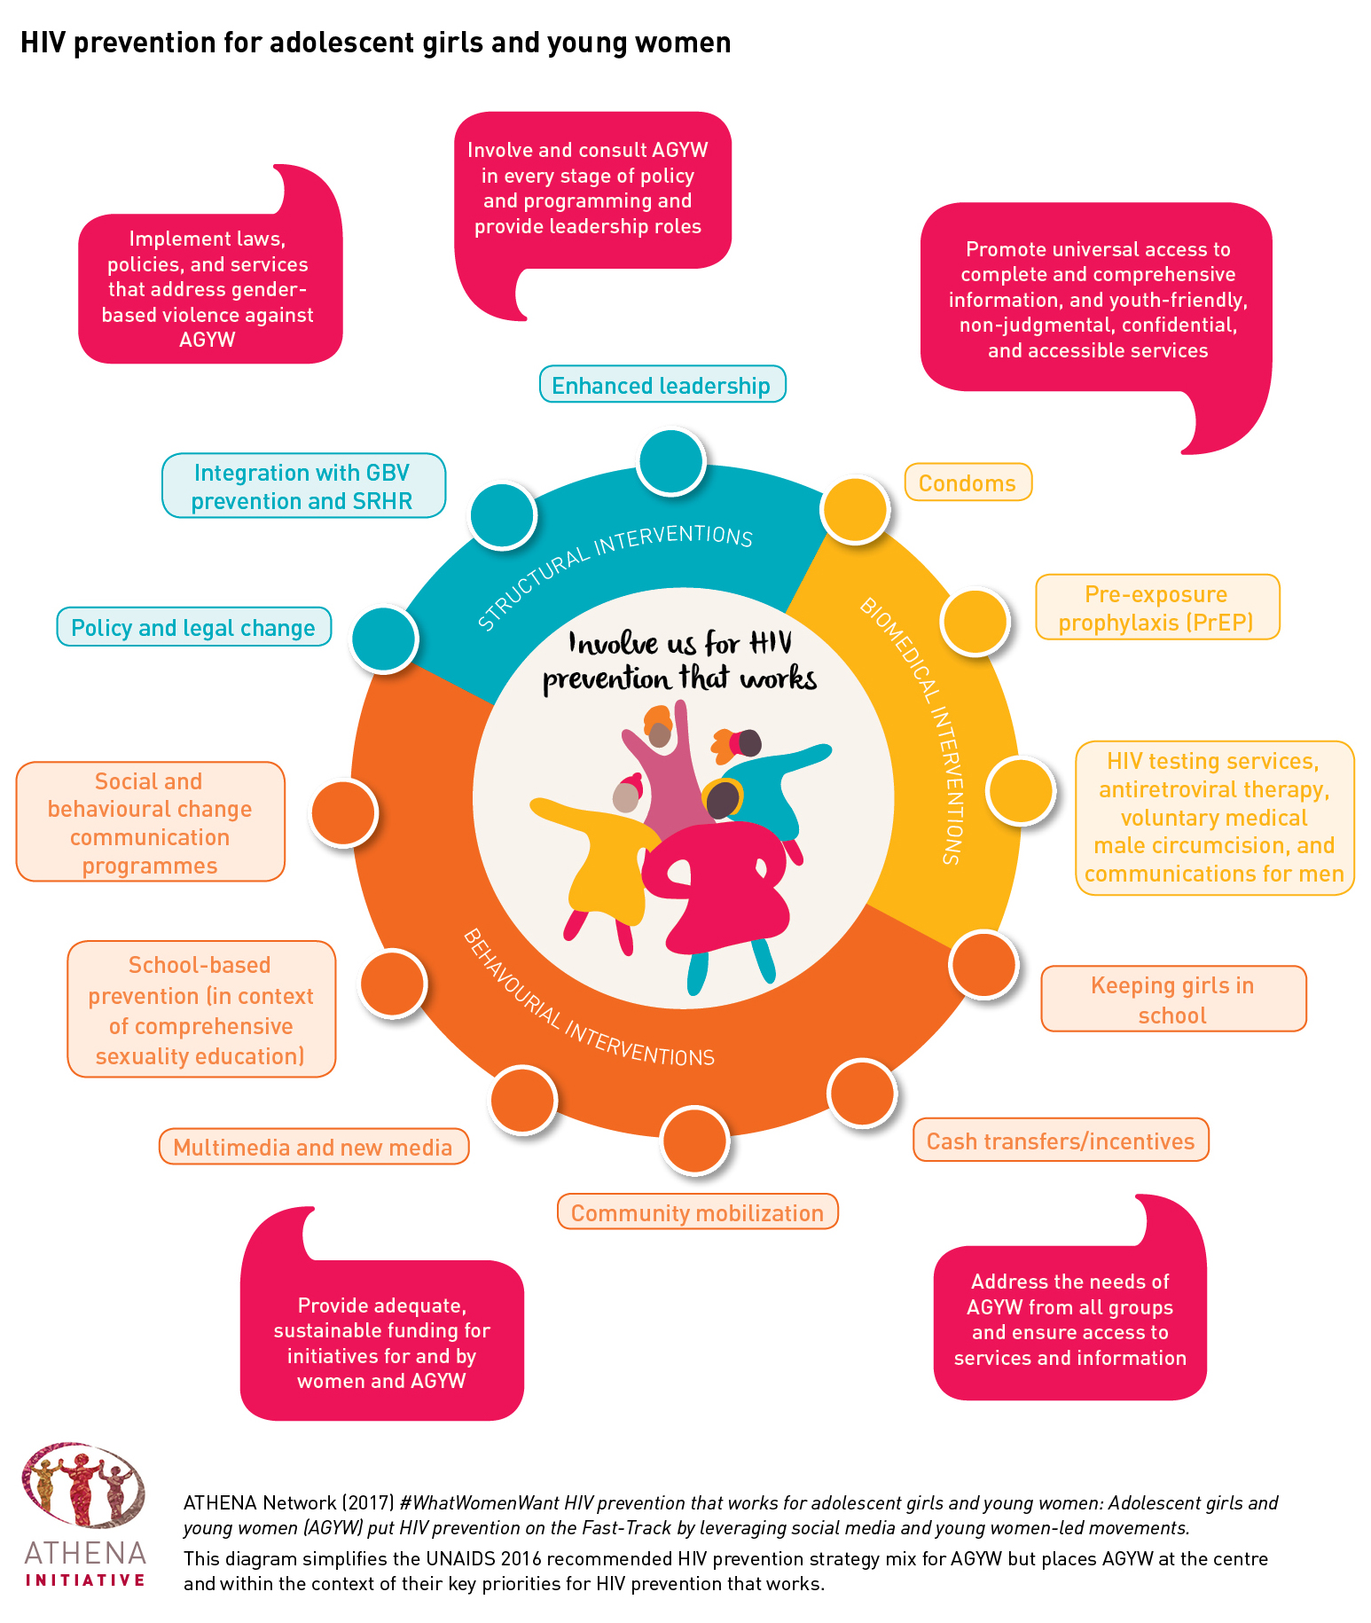
Community based programmes
-intensify prevention packages in high HIV incidence settings
Involve a combination of different face-to-face activities—including advocacy, communication and training activities—that address multiple outcomes, including knowledge, risk perception, gender norms, violence, skills, sexual behaviours and HIV service demand.
Key to transform communication programmes, rebuilding them around evidence informed models and linking young women and their partners—through demand generation— to HIV services.
Notes:
In high-HIV incidence settings, an expanded and intensified HIV prevention package for AGYWs should be delivered through community-based approaches.
This should include peer outreach, community action like SASA or Stepping Stones, condom distribution, and HIV testing and referrals.
In extremely high incidence settings, and supported by additional risk assessment and profiling, this should be complemented with PrEP delivery at community level and additional economic empowerment.
Social and behaviour change programmes though not sufficient on their own to halt epidemics, not providing SBC programmes, entails a risk of reducing communication about HIV in severely affected communities.

Slide 20
Community response deliver
Delivery of comprehensive packages for prevention, ensuring coverage, intensity and quality.
Map and document AGYW programmes implemented by different stakeholders/implementing partners in selected sites to better understand which delivery systems are successful with reaching AGYW with recommended packages.
Notes:
Impactful, achieve scale, deliver quality services, have unique reach, flexible and cost effective.
Stronger together: From health and community systems to systems for health
The World Bank found that investments in communities have improved knowledge, increased service uptake and decreased HIV incidence
Achieve scale
The AIDS Service Organisation (TASO) has provided services for more than 200 000 people living with HIV.
Deliver quality services
The application of models by Médecins Sans Frontières of community-based ARTdelivery demonstrate improved adherence o treatment regimens, resulting in fewer treatment failures and increased access (8).
Have unique reach
In many settings, community-based responses may be the only way to reach key population.
Flexible
Community-based responses can directly support public health systems or provide stand-alone services.
Cost-effective
World Bank and other studies show the cost effectiveness of community-based response

Slide 21
How can geographical prioritization and programme packages be established, coordinated and scaled up between partners at country level?
Country stakeholder dialogue on the currently available estimates, any additional data and the implications for programming
Developing more granular mapping of high, very high and extremely high HIV incidence locations (incl hotspots)
Update and refine tables of programme coverage of sub-national areas with HIV prevention programmes for adolescent girls, young women and male partners
  which components of the package are currently covered
  which sub-populations are covered (AGYW 10-29 by age, men 20-34)
  who covers & funds which components and which sub-populations (government, PEPFAR, GF, bi-lateral, civil society)
Identify overlaps in coverage and gaps to be covered
At country-level, develop a consensus estimate of the number of adolescent girls, young women and male partners at high risk (to be reached)
Map investments/coverage from other sectors like education, broader SRH investments, major initiatives on GBV, child marriage and social protection starting with the high, very high and extremely high incidence locations
Notes:
Map investments/coverage from other sectors like education, broader SRH investments, major initiatives on GBV, child marriage and social protection starting with the high, very high and extremely high incidence locations

Slide 22
Tracking progress and ensuring accountability

Slide 23
Thematic sheet

Slide 24
Status of implementation and good practices

Slide 25
Geographic locations and programme packages for AGYW– young women & partners (GPC Action 5)
Country | Geographical locations / population size estimates AGYW (5c) | Defined service packages for specific groups of AGYW (5d)
Angola | Mapping based on DHS done globally | No defined packages for AGYW
Brazil | Not applicable | Not applicable
Cameroon | Mapping based on global epi estimates | Yes, but not shared
China | Not applicable | Not applicable
Cote d-Ivoire | Mapping based on global epi estimates | Yes, but not shared
DRC | Mapping based on global epi estimates showed no high incidence areas | Yes, but not shared
Eswatini | Mapping based on global epi estimates | Yes, document available
Ethiopia | Mapping based on global epi estimates | Plans to define packages
Ghana | Mapping based on global epi estimates showed no high incidence areas | Not applicable
India | Not applicable | Yes, but not shared
Indonesia | Not applicable | Not applicable
Kenya | Full mapping and geographically diversified strategy | Yes
Lesotho | Full mapping and geographically diversified strategy | Yes, but not shared
Malawi | Mapping based on global epi estimates | In draft, incl in National Prevention Strategy
Mexico | Not applicable | Not applicable
Mozambique | Mapping based on global epi estimates | No
Namibia | Mapping based on global epi estimates | Yes, but still to be made available
Nigeria | Mapping based on global epi estimates | Yes, but not made available
Pakistan | Not applicable | Not applicable
South Africa | Full mapping and geographically diversified strategy | Yes
Tanzania | Mapping based on global epi estimates | Yes, but not shared
Uganda | Mapping based on global epi estimates | Yes, but not shared
Ukraine | Not applicable | Not applicable
Zambia | Mapping based on global epi estimates | Yes
Zimbabwe | Mapping based on global epi estimates | Yes but not shared

Slide 26
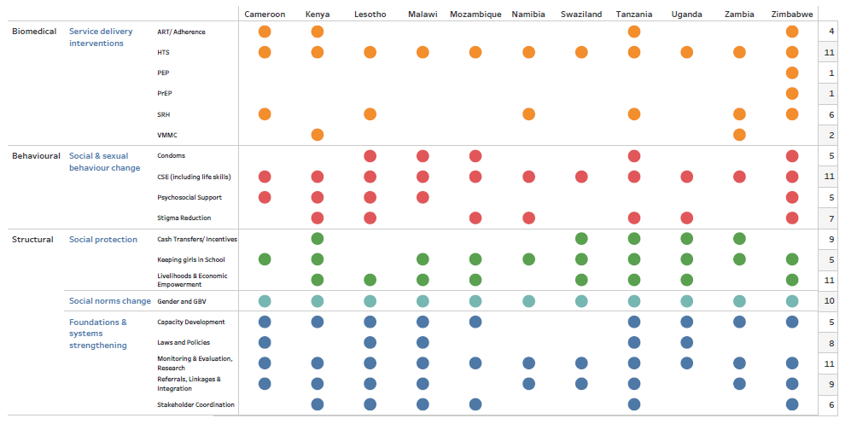
Global Fund AGYW interventions- Summary Investments (2018-2020)
11 Countries
Notes:
This is a mapping done by Global Fund showing the biomedical, behavioural and structural interventions included in the catalytic fund for AGYW.
This is to indicate that additional funding is going into programming for AGYW, but there is still a challenge in terms of ensuring that a comprehensive package in defined areas and for specific populations at the right intensity, as it does not seem to add up to the recommended package in several countries.

Slide 27
Kenya Adolescent Girls and Young Women Combination Prevention Standard of Care Package
Age Group | Biomedical |  | Behavioural | Structural
 | Community Level | Facility Level | Community
10-14 | SRH education clubs in schools, HTC | HTC VMMC PEP Post Rape Care, PrEP for high risk | Life skills training e.g., Stepping stones, Creating Futures | Programmes to keep girls in school; GBV reduction; SRH education at school; Social protection.
15-19 | SRH education clubs in schools, HTC | HTC VMMC PEP Post Rape Care PrEP for high risk | Life skills training e.g., Stepping stones, Creating Futures | Programmes to keep girls in school; GBV reduction; SRH education at school; Social protection.
Young Women at Risk (15-24 Years) | Condoms - female and male Family Planning Emergency contraception, HTC STI screening and treatment | PEP eMTCT PrEP Post Rape Care VMMC | Evidence Informed Behavioural interventions-e.g., Health Choices, Positive health dignity and prevention, Promoting Condom use, Partner HTC Build social assets | Programmes to keep girls in school; GBV reduction; SRH education at school; Social protection. Economic empowerment e.g. IMAGE; Social asset building. Parental programs.

Slide 28
Take away messages
Enhance leadership and coordination of AGYW programmes and delivery platforms
Youth and CSO engagement
Sharpen geo-spatial analysis of HIV incidence settings for AGYW & male partners
Improve targeting to ensure we reach the most vulnerable AGYW and their male partners
Definition of national (rather than project) packages
Basic national SRH/HIV program packages, CSE (nation-wide)
  Intensified actions in high-HIV incidence settings
Measurement of programme coverage
  Tracking proportion of young women reached with specific packages

Slide 29
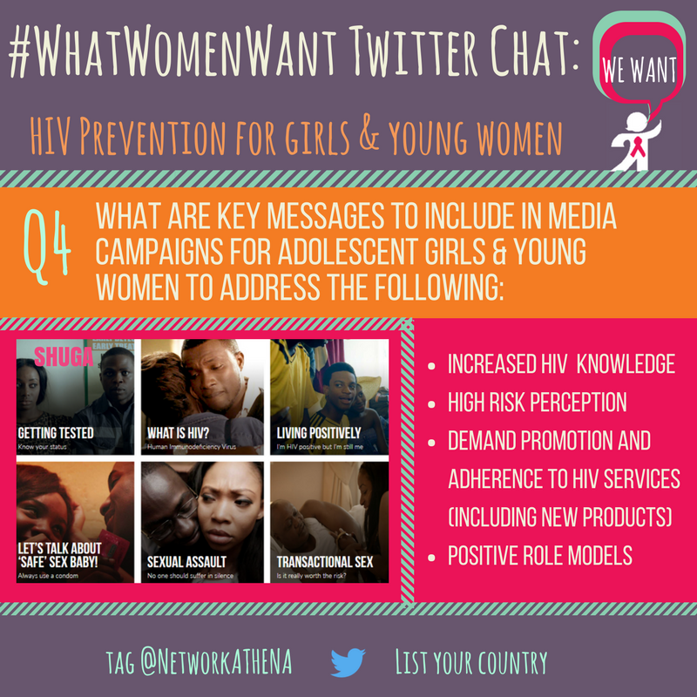
Thank you!

