Slide 1
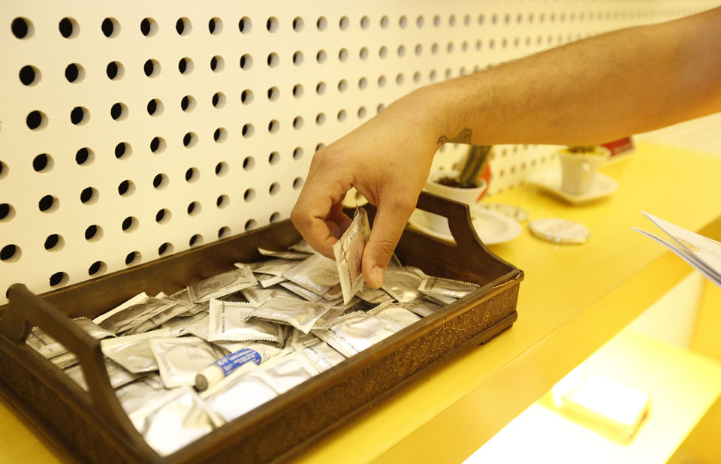
Condom programming
An overview of status and tools

Slide 2

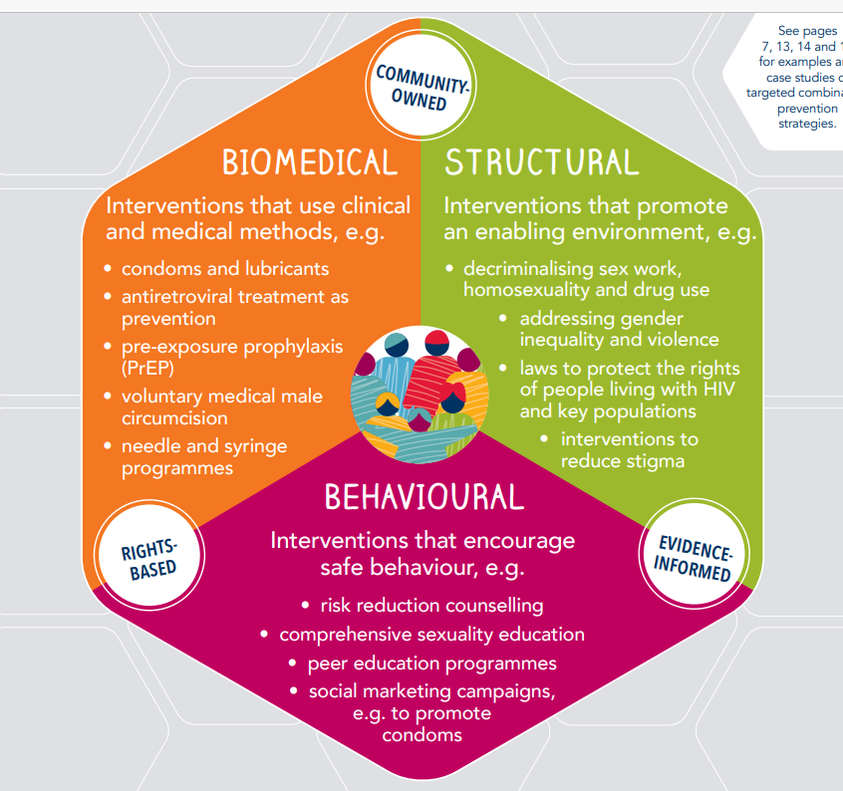
Triple protection: a multi-purpose prevention tool that
simultaneously protects sexual partners from:
STIs
HIV
Unintended pregnancy
Male and female condoms are the only prevention method for triple protection
Condoms as part of a growing combination of prevention choices, both for HIV/STI and pregnancy prevention
BUT condoms have – after 2010 – at least in part dropped off both from contraception and HIV prevention agendas
Need to reinvigorate and reposition condom promotion and distribution – including in the health sector

Slide 3
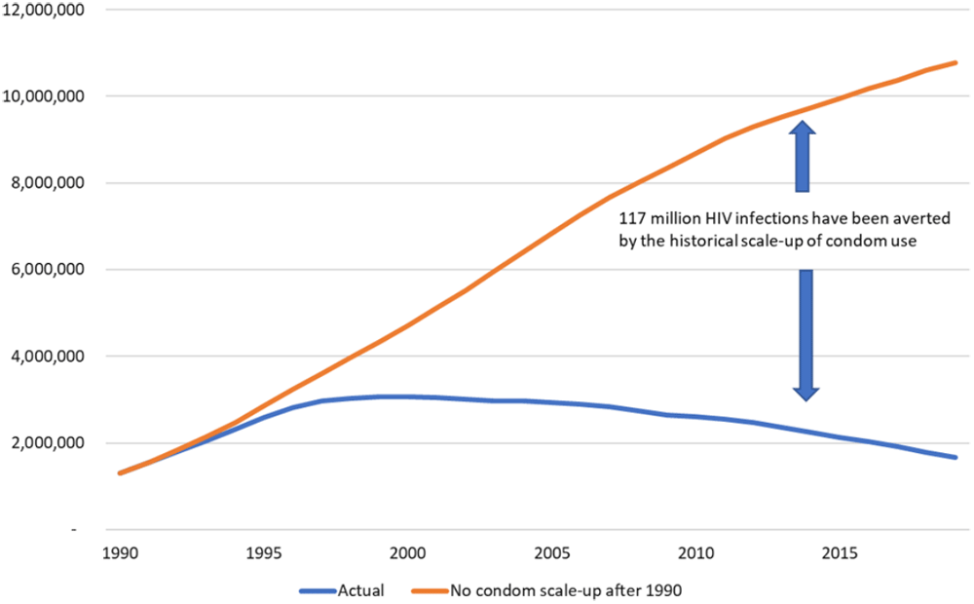
Number of new HIV infections with and without historical scale-up of condom use.
Globally and in
the long-run
condoms have
had a major
impact on the
HIV epidemic
Stover J and Teng Y. The impact of condom use on the HIV epidemic [version 2]. Gates Open Res 2022, 5:91 (doi: 10.12688/gatesopenres.13278.2)
Notes:
Figure 1. Number of new HIV infections with and without historical scale-up of condom use.
Stover J and Teng Y. The impact of condom use on the HIV epidemic [version 2]. Gates Open Res 2022, 5:91 (doi: 10.12688/gatesopenres.13278.2)

Slide 4
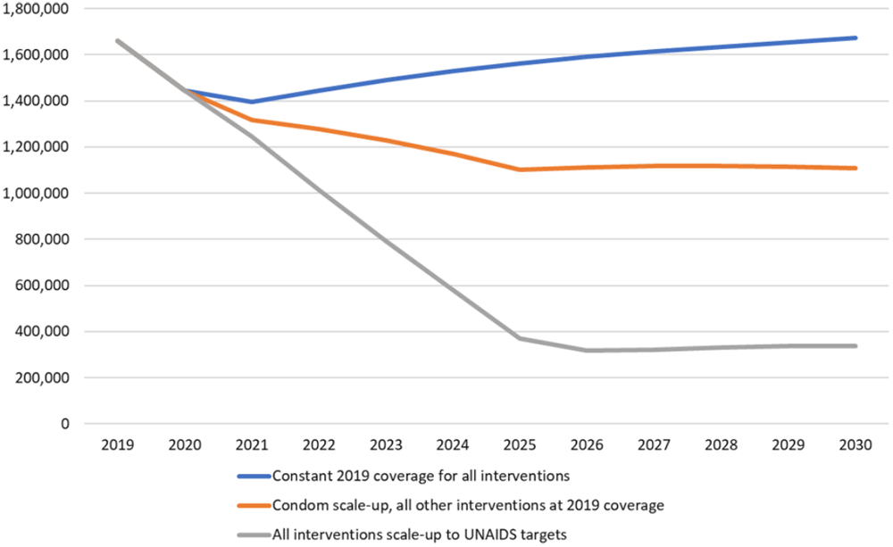
Number of new HIV infections in the future under three scenarios.
Condoms could
contribute
to reducing
HIV incidence
in the coming
decade
Stover J and Teng Y. The impact of condom use on the HIV epidemic [version 2]. Gates Open Res 2022, 5:91 (doi: 10.12688/gatesopenres.13278.2)
Notes:
Figure 2. Number of new HIV infections in the future under three scenarios.
Stover J and Teng Y. The impact of condom use on the HIV epidemic [version 2]. Gates Open Res 2022, 5:91 (doi: 10.12688/gatesopenres.13278.2)

Slide 5
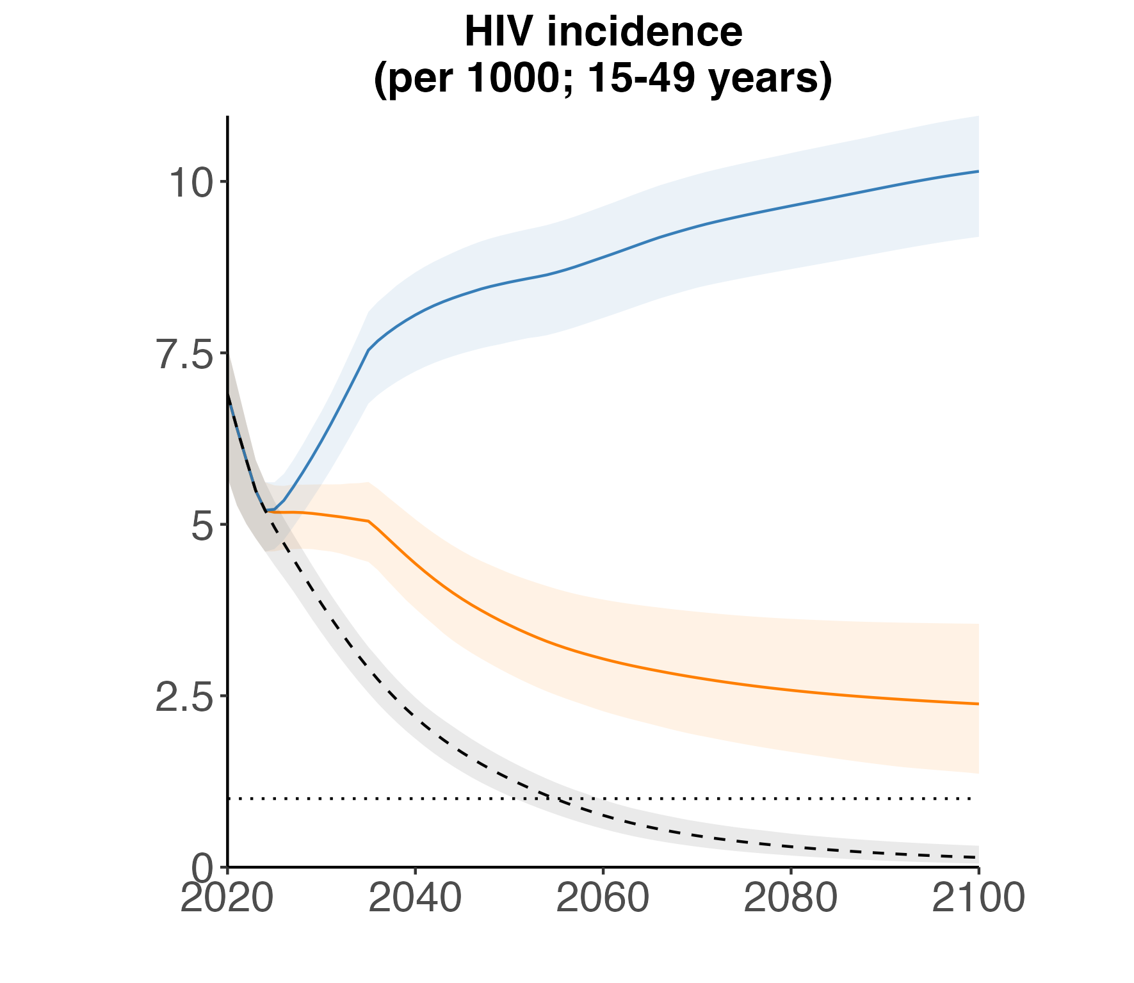
Reduced condom usage: incidence rises
Future increases in risk behaviour could substantially slow incidence declines
  E.g. reduced condom usage
Increased risk + scaled-back testing could reverse progress
→ Ability to monitor & adjust programmes to right levels
10.2/1000 in 2100
Condom usage reduced to 14%
+ 100% general HTS reduction
Condom usage reduced to 14%
2.4/1000 in 2100
Stefan Rautenbach, in preparation
Notes:
What would it take for explosive / rebounding incidence?

Slide 6
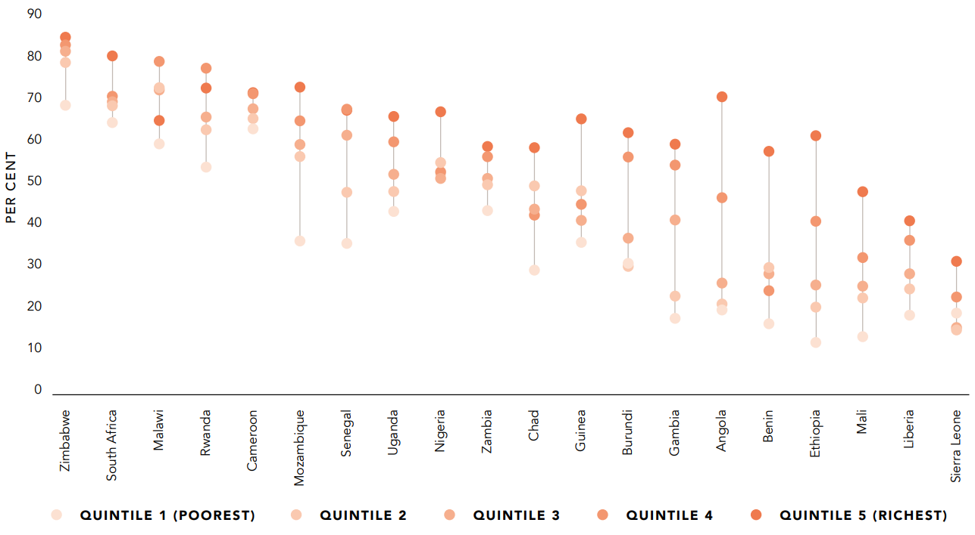
Conduct inequity analysis for better targeting of programmes
Condom use with non-regular partners (men 15-49) by wealth quintile
Countries with strong decentralized condom programmes reduced inequities in condom use

Slide 7
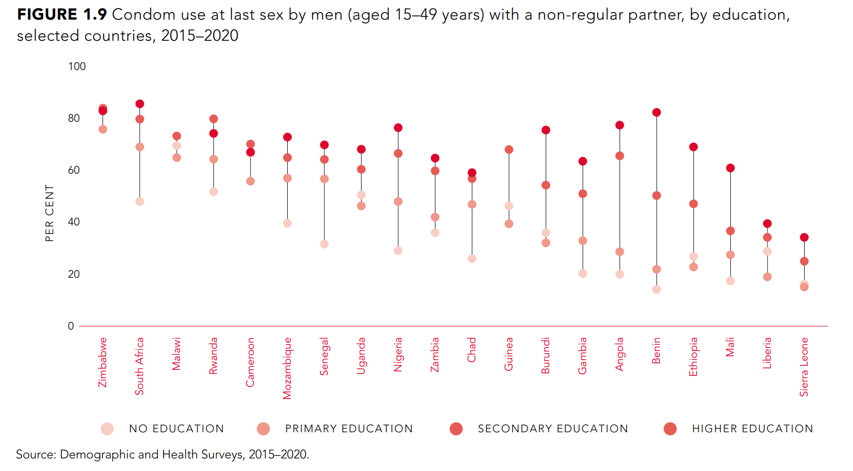

Slide 8
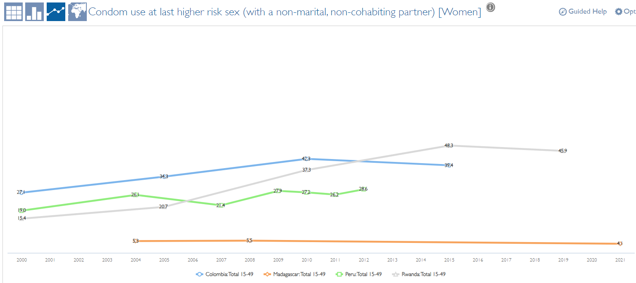
Stagnating trends in condom use with non-regular partners

Slide 9
Key populations – condom use targets achievable – great variation in progress

Slide 10
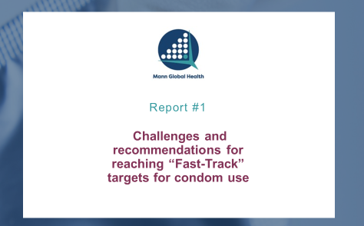
Summary of insights into condom programming
The “condom gap” is primarily and “demand gap”.
Condom programming has not fully adapted to the emergence of other HIV prevention options.
There is concern about decreasing social marketing programs but little consensus on how they should evolve to best contribute in evolving markets.
Free condoms distributed in the public sector will continue to be an important source but challenges remain in forecasting, distribution targeting, and monitoring.
The commercial sector is positioned to make a larger, if modest, contribution to condom markets, but barriers to expansion remain.
Consistently weak market stewardship functions in priority countries continue to impede progress.

Slide 11
Common weaknesses in national condom strategies
Results frameworks are sometimes missing or include unrealistic targets.
Include too many “priorities” without identifying and focusing resources on a few key constraints to condom use in the highest priority groups.
Too often plans are not operationalized.
Too little attention on ensuring program stewardship activities deliver value for a wide range of stakeholders.
M&E activities do not focus enough on stimulating performance improvement.
Notes:
e.g., seeking to achieve 90% condom use in all priority groups in a short timeframe generally not realistic in short-term for most risk behaviors
IF too many, then none. It can be challenging to make difficult choices that narrow the priorities to the most important and then direct resources there.
Sit on shelves.
Think of stakeholders as customers
M&E

Slide 12
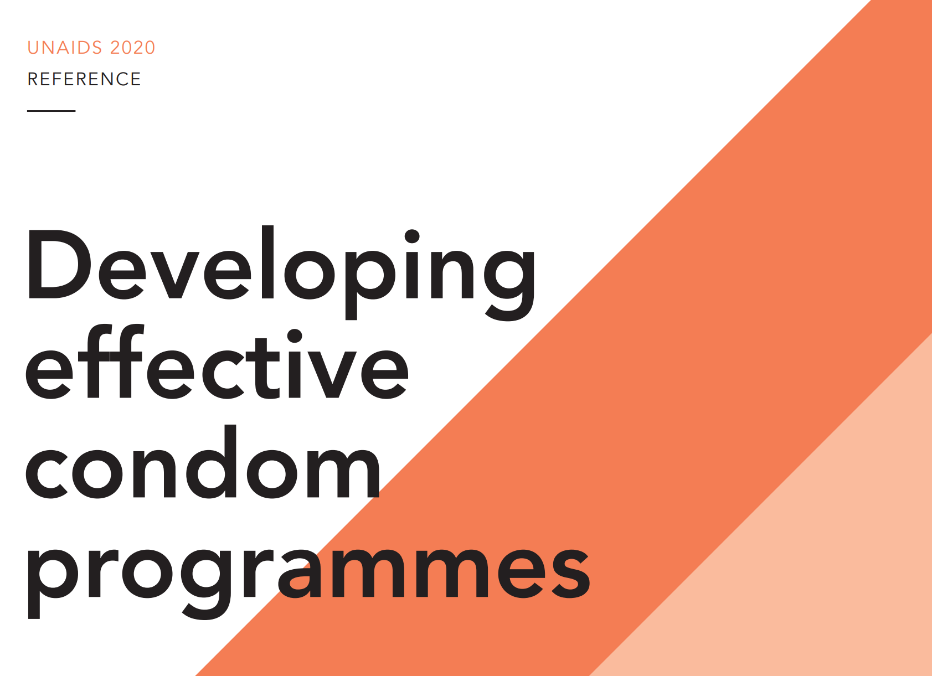
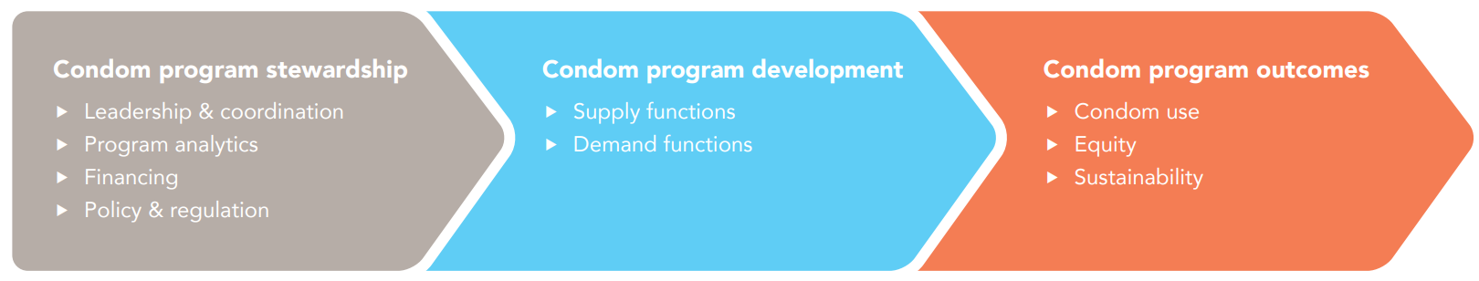
Condom program development and stewardship
Condom program pathway
Notes:
What we mean by program stewardship – it’s actually at the start of a pathway that leads to better program outcomes. Explain how that works.

Slide 13
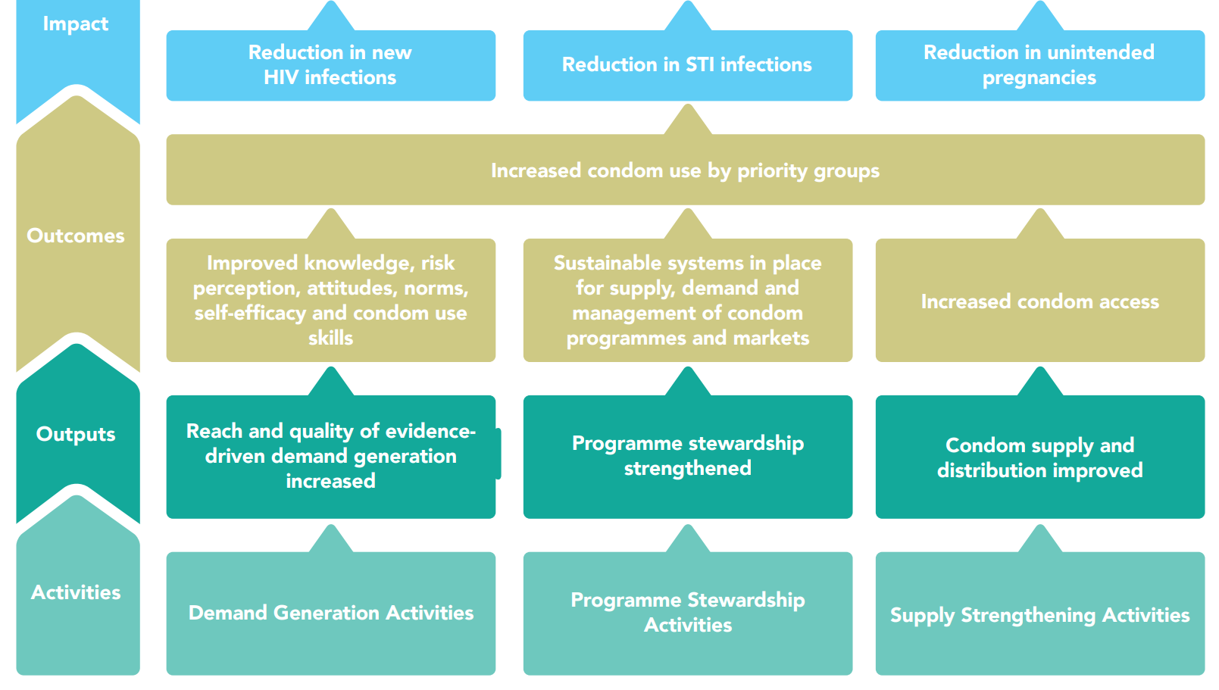
Condoms – a model results framework

Slide 14
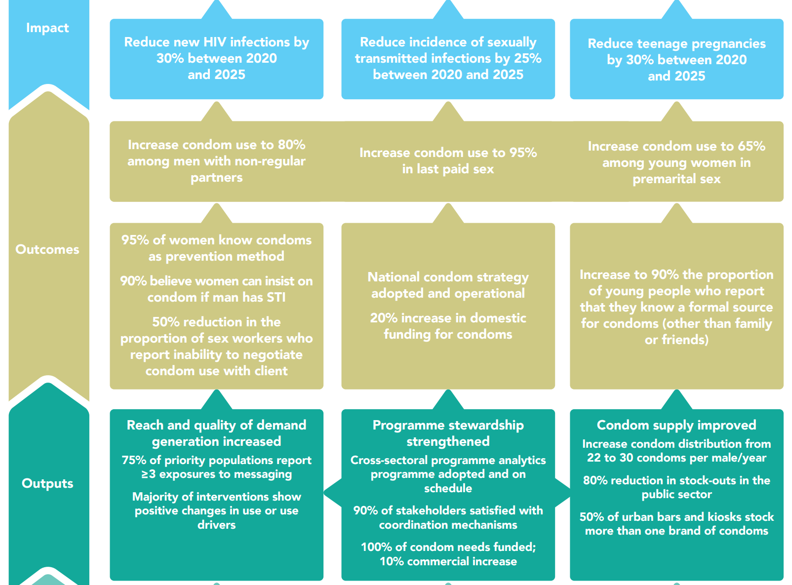
Indicators & targets: examples along the results chain

Slide 15
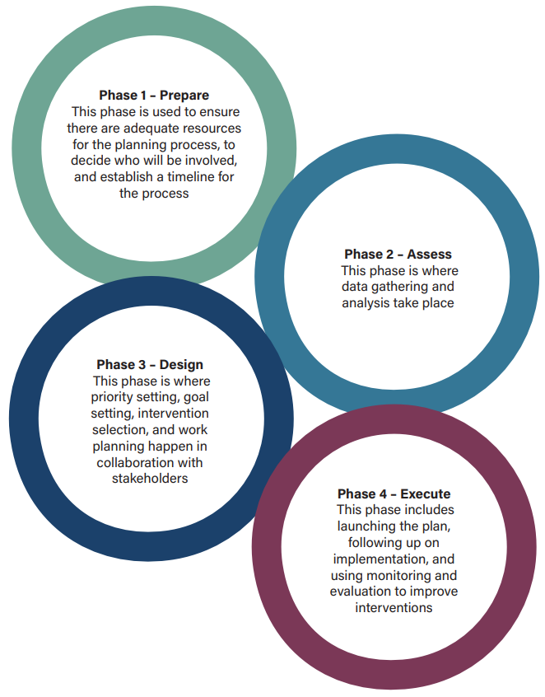
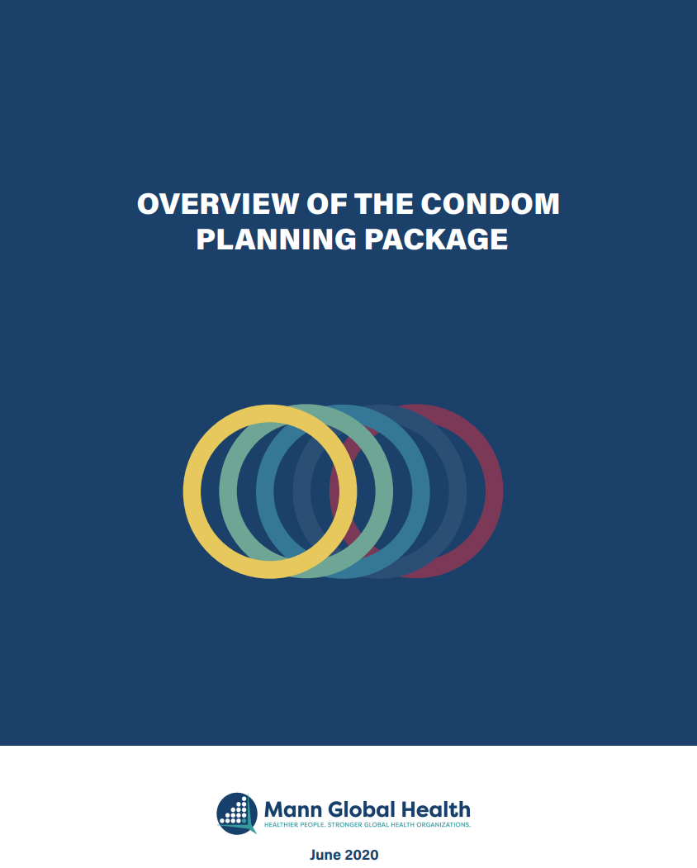
Detailed condom planning package

Slide 16
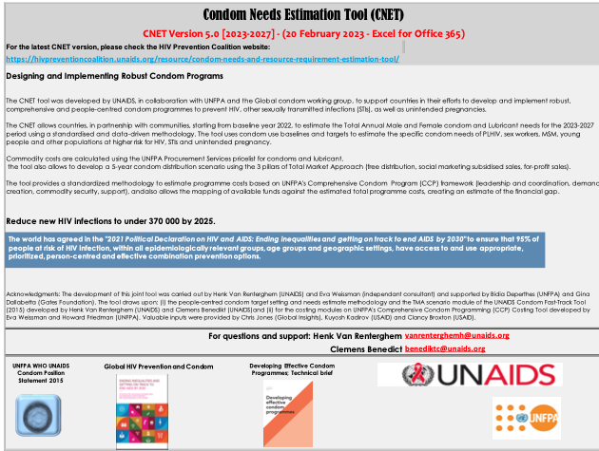
Overview of the CNET User Guide Slide Deck
The Condom Needs Estimation Tool (CNET) Slide Deck is a companion to the excel tool found on the UNAID website and the User Guide.
It is intended to support country teams and facilitators navigate through a participatory process which engages stakeholders in the development of condom estimates for program use.

Slide 17
Section Two: Use the CNET to Develop Estimates Step by Step
Set up Country Dashboard
Confirm populations using checklist
Determine baseline for current condom availability
Validate population size estimates and condom use data
Develop condom needs estimate*
Determine female condom, lubricant and specialty condom needs.
Establish TMA targets including free condom distribution by population.
Identify resource needs based on commodity costs.
Resource people and consultations can be included throughout this process.
Sheet: Condom Unit Cost (5) and Results-Commodities (6)
Sheet: Free Condoms (3c) and Condom Distribution- TMA (4)
Sheet: Condom Requirements (3) and Alternative Scenarios (3a)
Sheet: Female Condoms and Lubricant (3b)
Sheet: Demographic Data (2)
Sheet: Intro (4)
Sheet: Condom Availability (1)
Sheet: Intro (3)
* Gap analysis: the condom availability graph, condom requirement, and alternative scenario should inform estimates and program/policy decisions.
Notes:
Section Two of the User Guide outlines each step for estimate development. It explains the architecture of the tool, provides guidance principles and each step in detail from set up, priority population confirmation for estimate development, baseline data, validation of population data provided on the demographic health sheet, the estimate and break down of condom types, sectors and resources.

Slide 18
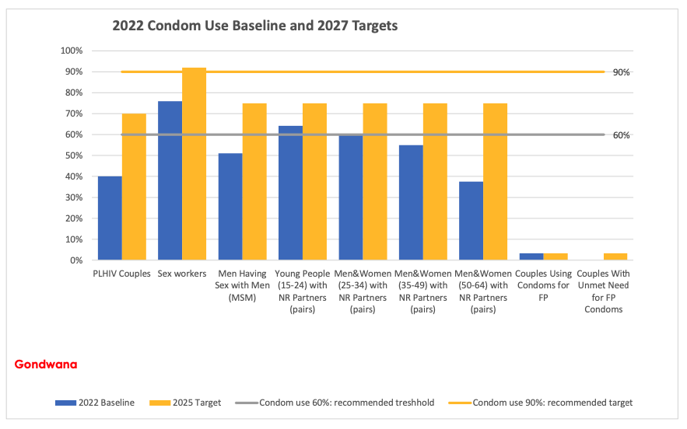
The Graph: Condom Needs Scenario provides teams with a quick comparison of population specific baseline with draft condom use targets to facilitate analysis.
It is recommended to stay between 60-90%, based on the Global Fund’s ambitious targets, however, every target requires investment on programs.
Will countries invest highly in programs to create demand among 50-64 for condom use ?
Notes:
It is recommended to stay between 60-90%, based on the Global Fund’s ambitious targets, however, every target requires investment on programs.

Slide 19
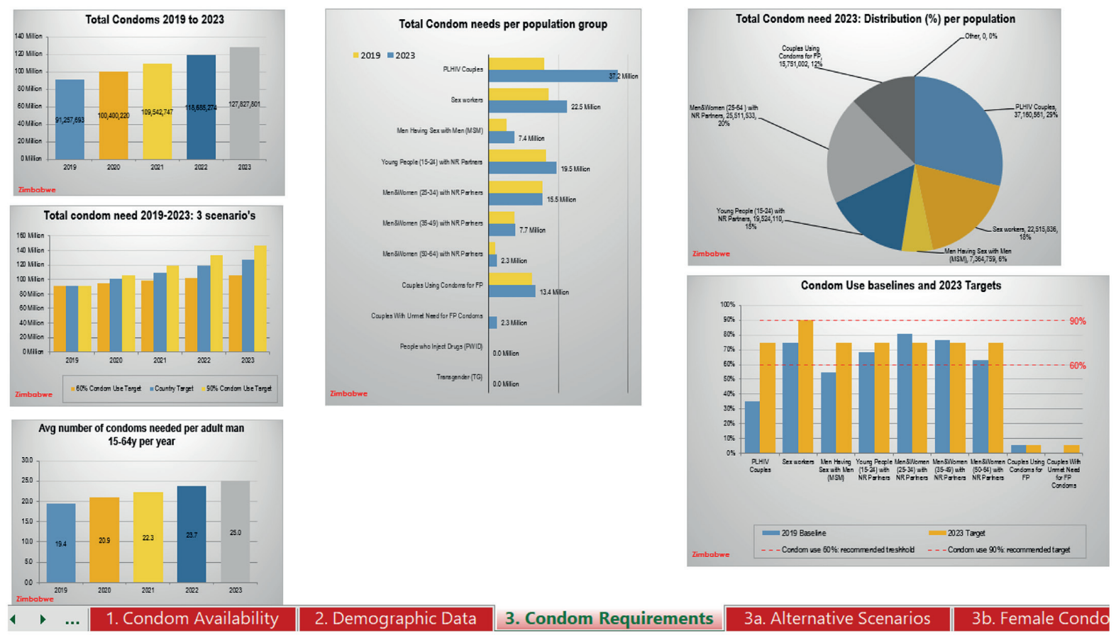
CNET: Various outputs

Slide 20
Proportion of gay men and other men who have sex with men with casual partners reporting consistent condom use, biomedical prevention and any condomless anal intercourse in the previous six months, Sydney, Australia, 2015–2020
Where other options are available, condoms remain a critical prevention choice, but their role will in part change where PrEP and U=U are used
Source: Chan C, Broady T, Mao L, Bavinton BR, Bear B, Mackie B et al. Gay community periodic survey: Sydney 2020. Sydney: Centre for Social Research in Health, UNSW Sydney; 2020.

Slide 21
Recommendations: Condom stewardship
Substantially increase investment in demand creation. Condom use is more likely to lag because of a lack of motivation or ability to use condoms rather than due to a supply gap. Use is unlikely to increase without sustained, large-scale demand generation activities. The largest generation of African youth in history is growing up without exposure to demand generation.
Support for an adequate condom supply in the public sector for the foreseeable future. Free condoms must be available for the segments of the population that depend on them especially rural populations, youth and key populations. Support for procurement should be based on realistic forecasts for the growth in demand and should consider the contribution of the commercial and social marketing sectors.
Invest in leadership and coordination functions at the country level to strengthen government leadership and market stewardship in support of a people-centered programme and a total market approach ensuring equity in access and a healthy market to guide resource allocation.
Invest in market, population and location data and the capacity to use it. To inform programming across all sectors, it is critical that all market actors understand who is using condoms; who is not using condoms and why; the number of condoms distributed and where; and target audience responses to interventions. This information should be packaged and widely shared in order for it to be actionable for decision-makers.
Integrate smart and comprehensive condom programming, including skills-building into the broader HIV, SRH and health promotion system. The emergence of other prevention options (PrEP and VMMC), expanded testing and treatment, scale up of family planning and other SRH programs are opportunities for condom programs to reach more people more frequently within an ecosystem that provides choice to target audiences.
Support better, more targeted, more efficient public sector distribution that reaches those in need of free condoms through active, provider-initiated promotion and distribution by health care providers in facilities and outreach workers. Improved distribution starts with understanding condom needs in relation to demand; quantification and procurement within a TMA; and market segmentation to map those in greatest need of free condoms and how best to reach them and provide them with adequate (e.g. 3-month) supplies.
Support social marketing organizations (SMOs) to achieve higher value impact. SMOs are well positioned to contribute to demand creation, market stewardship, and market intelligence efforts using public funds, while evolving brands toward full cost-recovery in most contexts.
Address market barriers to create more space and increase economic incentives for the commercial sector. Reducing barriers will be critical to accelerate the engagement of the commercial sector and increase the likelihood that condoms can reach more people and gradually reduce the market’s dependence on subsidy.

Slide 22
Conclusions: Condom programming still in crisis, but new generation of condom programs needed as part of combination prevention
Countries with strong decentralized condom programmes (Zimbabwe, South Africa, Malawi) achieved high condom use and reduced inequities in condom use
Strategic initiative in 4 countries (Malawi, Mozambique, Uganda, Zambia) enhanced condom program stewardship, innovative demand generation and last mile distribution approaches
Increased GF support to condom financing partially mitigated effects of declining other investment, but condom programming and financing remains in crisis overall
  Limited non-health sector access
  Lack of investment in demand creation and last mile distribution
  A new generation of young people not exposed to condoms as a health & life-style choice
Focus on young generation of users, innovative demand generation, last mile distribution, development of different sectors (public, social marketing, private), synergies with other self-care products (such as self-tests)

Slide 23
Thank you!

