Slide 1

DEMAND GENERATION AND ADAPTATIONS
FOR MEN AND PREP IN THE PHILIPPINES
It’s PrEPing time!
Presentation by: Danvic Rosadiño, DIH
Program and Innovations Director, LoveYourself PH

Slide 2

Presentation outline
AIDA model and content planning
Differentiated PrEP campaigns
Key takeaways

Slide 3
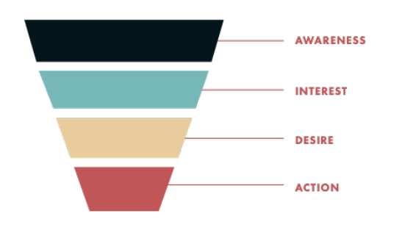
The Marketing Funnel
Demand generation is more than just generating demand
In marketing, the AIDA model* is used to describe a client’s PrEP journey
With careful analysis, this provides insight how to influence potential clients at certain stages
Causes of bad breath

Slide 4
The Marketing Funnel
*AIDA model:
Awareness: The client is aware of their problems and possible solutions for them.
Interest: The client shows interest in the service.
Desire: The client begins to evaluate a certain service.
Action: The client decides whether to avail the service.
Causes of bad breath

Slide 5
What should be in a content?
In generating content (whatever the channel is), we ensure that they all educate, entertain, and inspire.
In educating, we can always provide correct and factual information regarding PrEP.
To keep them entertained, use themes, tone and feel that will catch their attention and keep them engaged, while answering the question: What’s in it for me?
Lastly, providing an element in every channel where they will be inspired to do an action plan: Go to a website to know more, or call this number, or go to this clinic/center.
Causes of bad breath

Slide 6

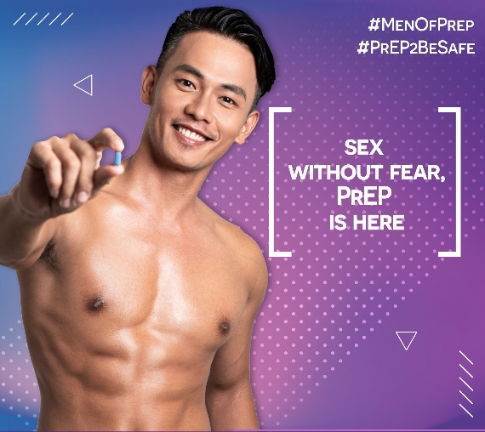
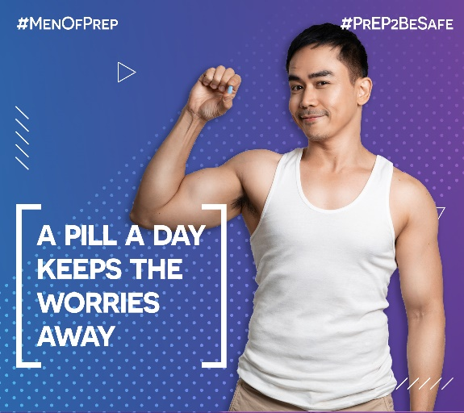
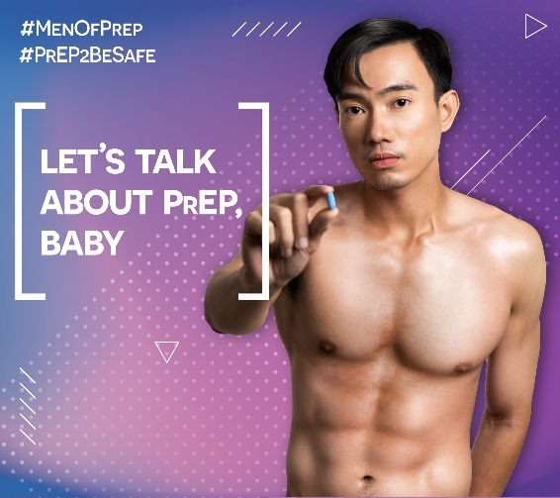
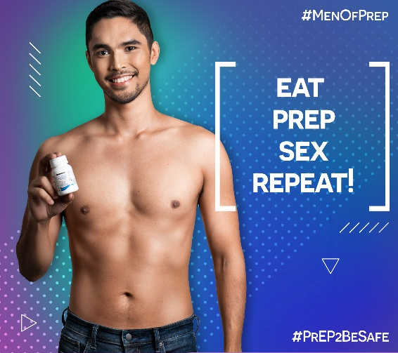
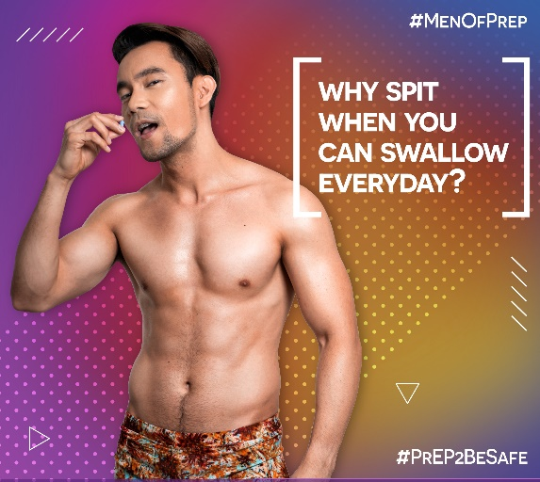
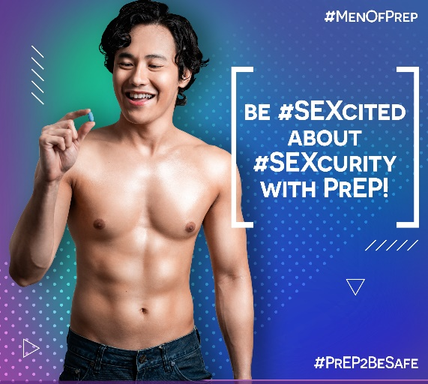
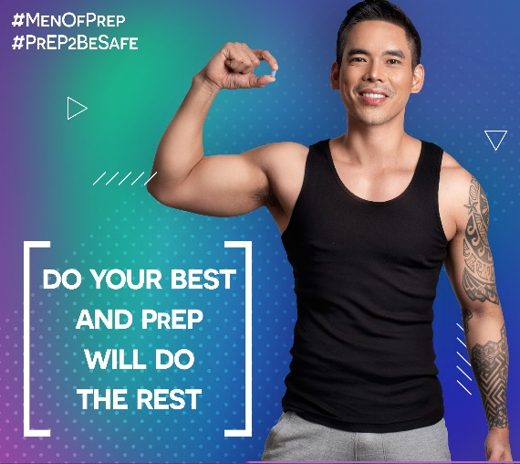
#MenofPrEP
A PrEP campaign for men who love men

Slide 7
#MenofPrEP
A PrEP campaign for men who love men
LoveYourself’s first major PrEP campaign after its demonstration project
Aimed to spread awareness about PrEP, and draw interest
Composed of social media-famous ambassadors willing to promote/be a peer support for PrEP, without monetary compensation
Posts reaches 30,000 unique engagement per post, PrEP inquiries increased by 2000%, increased PrEP enrollment from 50 to 750 in just 4 months

Slide 8








#QueensofPrEP
A PrEP campaign to unleash the queen in you

Slide 9
#QueensofPrEP
A PrEP campaign to unleash the queen in you
LoveYourself’s second major PrEP campaign, highlighting the use of queens as ambassadors: cisgender woman beauty queens, transwoman queens, and drag queens (which may be gay, bisexual, or other men who have sex with men)
Aimed to continue the sparked PrEP interest in a different target market
PrEP enrollment among transgender women increased by 200%, sparked great interest to PrEP among the transwomen and the drag community

Slide 10



#SummerFunCollab
A PrEP campaign for the sexually adventurous

Slide 11
#SummerFunCollab
A PrEP campaign for the sexually adventurous
LoveYourself’s first sexually-charged PrEP campaign for a specific target market: Alter (online anonymous) gay, bisexual, and other men who have sex with men who are active on Twitter to find sex, promote sex, and/or do sex work
Done in a period where awareness of PrEP in Twitter is extremely high: Goal is to continue the conversation, spark interest, and do activities that will lead to PrEP enrollment (even during COVID)
Generated 4,000,000 unique engagement, made PrEP enrollment steady even during COVID lockdowns

Slide 12


#FREEdomWithPrEP
A PrEP campaign that gives you freedom

Slide 13
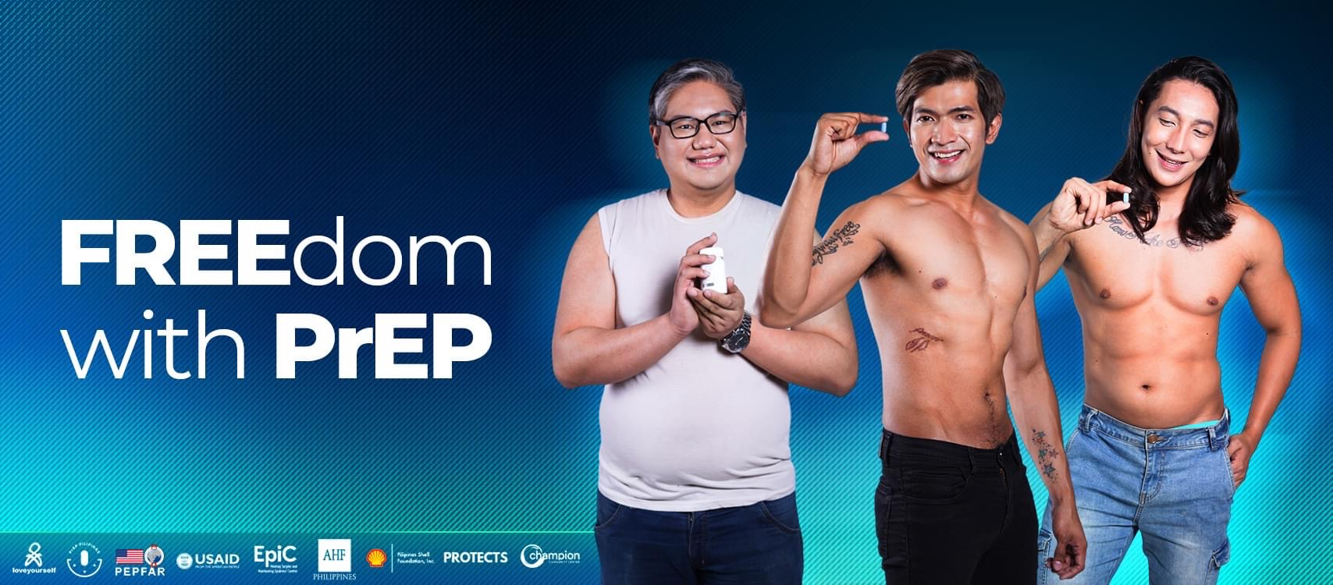

#FREEdomWithPrEP
A PrEP campaign that gives you freedom

Slide 14
#FREEdomWithPrEP
A PrEP campaign that gives you freedom
LoveYourself’s current major PrEP campaign, targeting the greater majority of gay, bisexual, and other men who have sex with men who are aware of PrEP, but has not accessed PrEP services
Highlighted with completely free access to PrEP (as enabled by various partners such as PEPFAR, USAID, EpiC, and Global Fund)
Campaign enabling other differentiated and demedicalized PrEP services: enrollment to PrEP via HIV self-testing, offering PrEP in non-medical facilities, etc.

Slide 15
6,234
PEOPLE INITIATED WITH PREP VIA LOVEYOURSELF HUBS
From June 2017 to October 2022
Composed of demonstration project participants, and clients accessing PrEP either for free or out-of-pocket
Approximately 70% of overall PrEP enrollment in the Philippines

Slide 16
Key takeaways
In generating content (whatever the channel is), we ensure that they all educate, entertain, and inspire
Always think of the target market – what do they want, where to reach them, how to reach them. Different strokes for different folks!
Demand generation is not just generating demand – it involves lead generation, demand capture, and service delivery acceleration

Slide 17











Acknowledgements

Slide 18
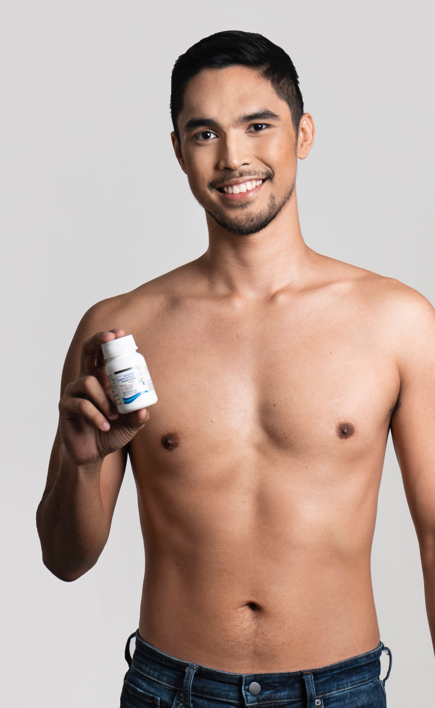







DEMAND GENERATION AND ADAPTATIONS
FOR MEN AND PREP IN THE PHILIPPINES
Thank you!
www.loveyourself.ph
@loveyourself.ph
LoveYourself Inc
@LoveYourselfPH
@loveyourselfph
LoveYourselfTV

