Slide 1
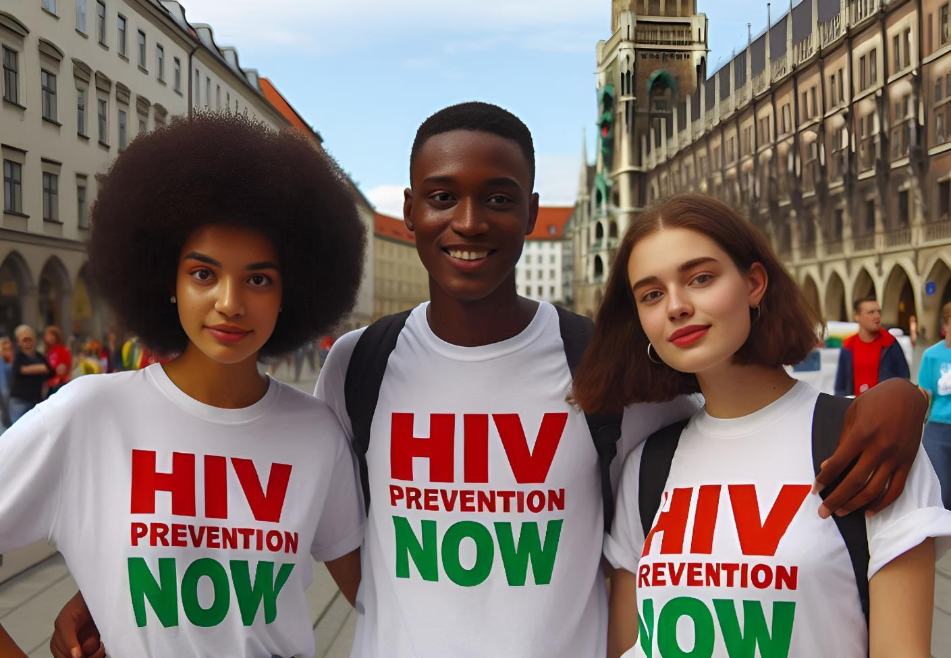


Global HIV Prevention Coalition
22 - 26 July
Munich, Germany

Slide 2
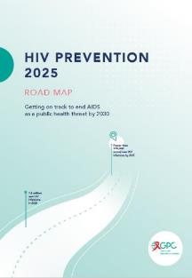
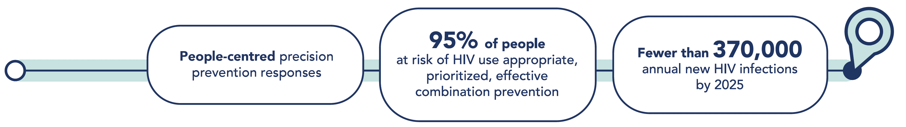
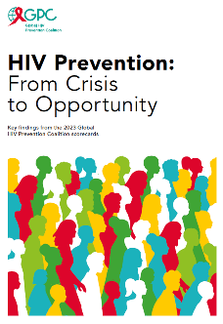
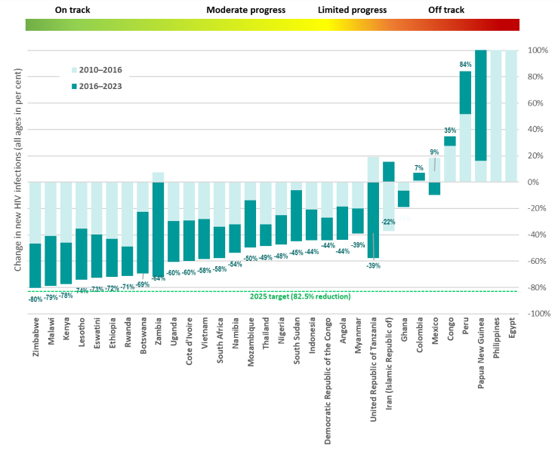
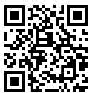

The Global HIV Prevention Coalition: What Will Success Look Like?
The 2025 high-level HIV prevention targets and commitments:
An 82.5 % reduction compared to 2010
Progress is possible, targets are achievable,
IF countries accelerate prevention
HIV prevention pillars are off track
Notes:
Fewer than 370,000 new infections translates into more than 80% reduction compared to 2010.
Nine GPC countries i.e Zimbabwe, Rwanda, Lesotho, Kenya among others are on track to meet the 2025 global targets: with reduced new HIV infections by 66% since 2010.
HIV Prevention programme coverage is low especially for Key and priority populations – progress has been made but we are still off track to meet programmatic targets.
HIV prevention options need to be made available and accessible to users by choice.
Strong political leadership, sufficient and reliable funding, an enabling environment to implement programmes at scale is required.
Tools are available at the GPC to help countries reach targets; accessible via the GC resource Hub: https://hivpreventioncoalition.unaids.org/
The need to convene around HIV prevention has never been greater than today, we need sustain and strengthen political and technical commitment of HIV prevention on the global agenda.

Slide 3
Declines in new infections in the sub-Saharan African regions, but not fast enough. Global targets will be missed, primarily due to stagnation in new infections in other regions
Change in the numbers of people (all ages) acquiring HIV, by region, 2010–2023
Compared with 2010, the number of people acquiring HIV has risen in eastern Europe and central Asia, the Middle East and North Africa and Latin America—but the number has decreased in Asia and the Pacific, western and central Europe and North America, the Caribbean, western and central Africa and eastern and southern Africa
Source: UNAIDS epidemiological estimates, 2024 (https://aidsinfo.unaids.org/).

Slide 4
The Urgency of Now (1):
A moment of opportunity to turn around the prevention crisis
1.3 million new HIV infections in 2023: more than 3 times the 2025 target
A widening array of prevention options
Countries demonstrate progress is possible, but limited investment into prevention leading to stagnating and rising HIV incidence in too many countries, in particular where key populations are most affected
The time to act is now: If 1.3 million people continue to acquire HIV every year, the response will not become any less challenging but much more complex and costly in 2030 and 2050
Investing both in treatment & prevention is essential to achieve 2030 HIV incidence reduction targets
Red projection at current effort
Blue projections if countries meet 2025 prevention, treatment and enabler targets
Notes:
Background:
Lenacapavir: PURPOSE 1 study has announced results for cisgender women; full data analysis not available yet (Wednesday Gilead has a late breaker on Len).
PURPOSE 2, which included cisgender men and transgender women, started 3 months after PURPOSE 1. Results not yet available.
Access schemes that include low and middle income countries, including in sub-Saharan Africa, but also middle income countries in Asia-Pacific and Latin America given the KP epidemic who may otherwise miss out on lowest prices.

Slide 5
The Urgency of Now (2):
Accelerating long-acting PrEP choice & innovation
Access to PrEP is increasing but only in a few countries
  3.5M people are currently accessing PrEP (16% of the 2025 PrEP target)
Landmark results announced for the PURPOSE 1 study of lenacapavir as PrEP with 100% efficacy reported in cisgender women in Uganda and South Africa
  Results from PURPOSE 2, which includes cisgender men and transgender women, are expected in late 2024 or early 2025
  If recommended for use as PrEP, this would add an additional effective prevention choice for key and vulnerable populations
To accelerate the scale-up of prevention efforts and meet the 2025 PrEP targets, there is an urgent need for:
  Ensuring the affordability, availability, and access to a range of long-acting PrEP options (including DVR, CAB-LA, and lenacapavir, if recommended for use as PrEP) for all low- and middle-income countries worldwide, in addition to oral PrEP.
  Swiftly adopting decentralized and differentiated delivery models that prioritize a person-centered approach.
  Enabling legal and policy environments conducive to large-scale implementation.
Notes:
Background:
Lenacapavir: PURPOSE 1 study has announced results for cisgender women; full data analysis not available yet (Wednesday Gilead has a late breaker on Len).
PURPOSE 2, which included cisgender men and transgender women, started 3 months after PURPOSE 1. Results not yet available.
Access schemes that include low and middle income countries, including in sub-Saharan Africa, but also middle income countries in Asia-Pacific and Latin America given the KP epidemic who may otherwise miss out on lowest prices.

Slide 6

Large variation of progress in reducing new HIV infections between countries
104% | 543%| 609%
.../... ..../... .../...
Eight GPC focus countries have reduced their annual number of new HIV infections by at least 66% since 2010.
The majority of countries need to accelerate to achieve 2025 targets.
*No 2024 estimates reported for Brazil, Cameroon and Central African Republic

Slide 7
What it takes to close the persistent prevention gap
To bridge the prevention gaps between countries and populations people-centered, effective, sustainable and resilient HIV prevention programmes at scale need:
(1) financial resources for making prevention options available and accessible;
(2) reliable, disaggregated data (including community-generated data) so planners can focus interventions with greater precision;
(3) people-centered design and communication focused on people with the greatest need for prevention services;
(4) differentiated service delivery and innovation and investment in trusted access platforms;
(5) addressing underlying behavioral and structural including rights related barriers to prevention access;
(6) strong and consistent political leadership.

Slide 8
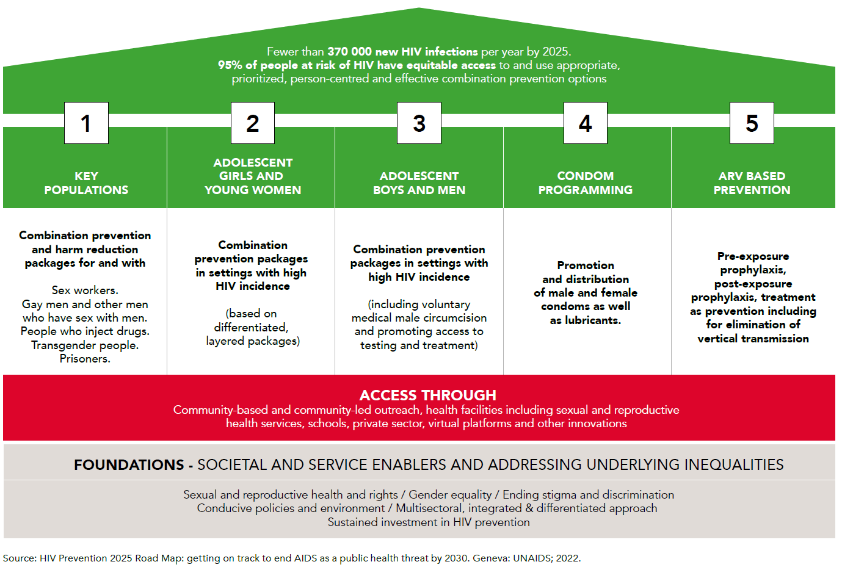
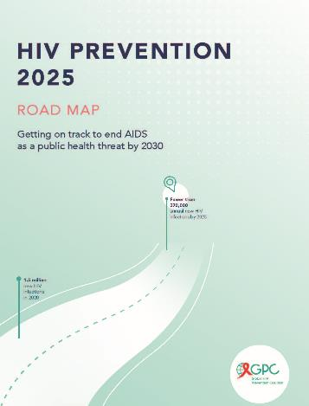
Five priority pillars: access platforms and foundations in the Global HIV Prevention 2025 Road Map

Slide 9
Prevention is off track to meet 2025 targets
^{[1]} Global 2025 targets for condom use vary by level of HIV incidence in a geographical area and by individual risk. They are set at 95% for people at highest risk and 70% and 50% for people a moderate and low risk. Since data presented here are for a population at high risk (people with non-regular partners) in an entire country, a benchmark of 80% has been included as a proxy for the targets.
^{[2]} The benchmark of 21.2 million users is based on the global PrEP targets, which translate into 10.6 million person-years of PrEP. An assumed average duration of PrEP use of 6 months per year thus yields the benchmark of 21.2 million users.
Source: UNAIDS epidemiological estimates, 2024 www.aidsinfo.unaids.org.

Slide 10
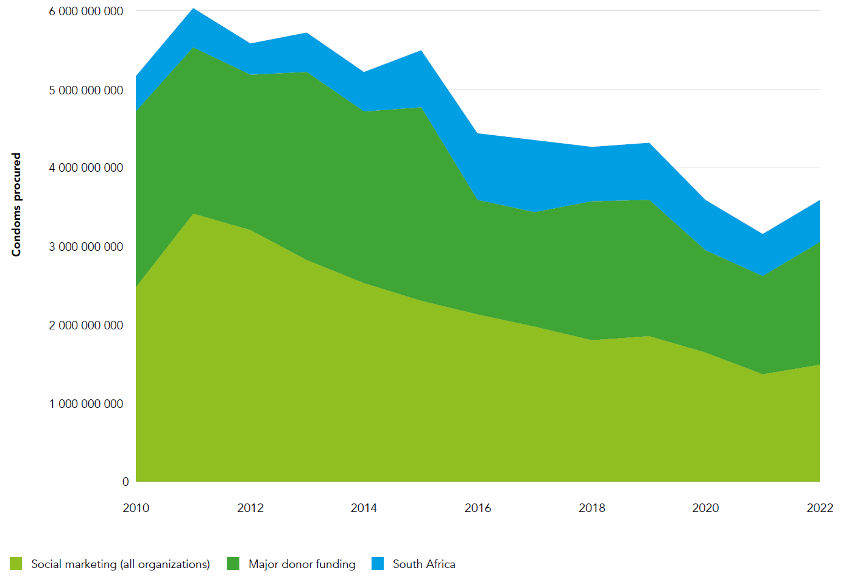
Trends in condom distribution via major condom procurers and distributors, 2010-2022
Declining investment and volumes in condom procurement and social marketing
A 27% reduction comparing 2010-16 and 2016-2022
A 37% reduction from the peak year of 2011 despite a growing young population!
Social marketing volumes reduced by half from peak
Reducing public investment likely a driver of inequity and decline in condom use

Slide 11
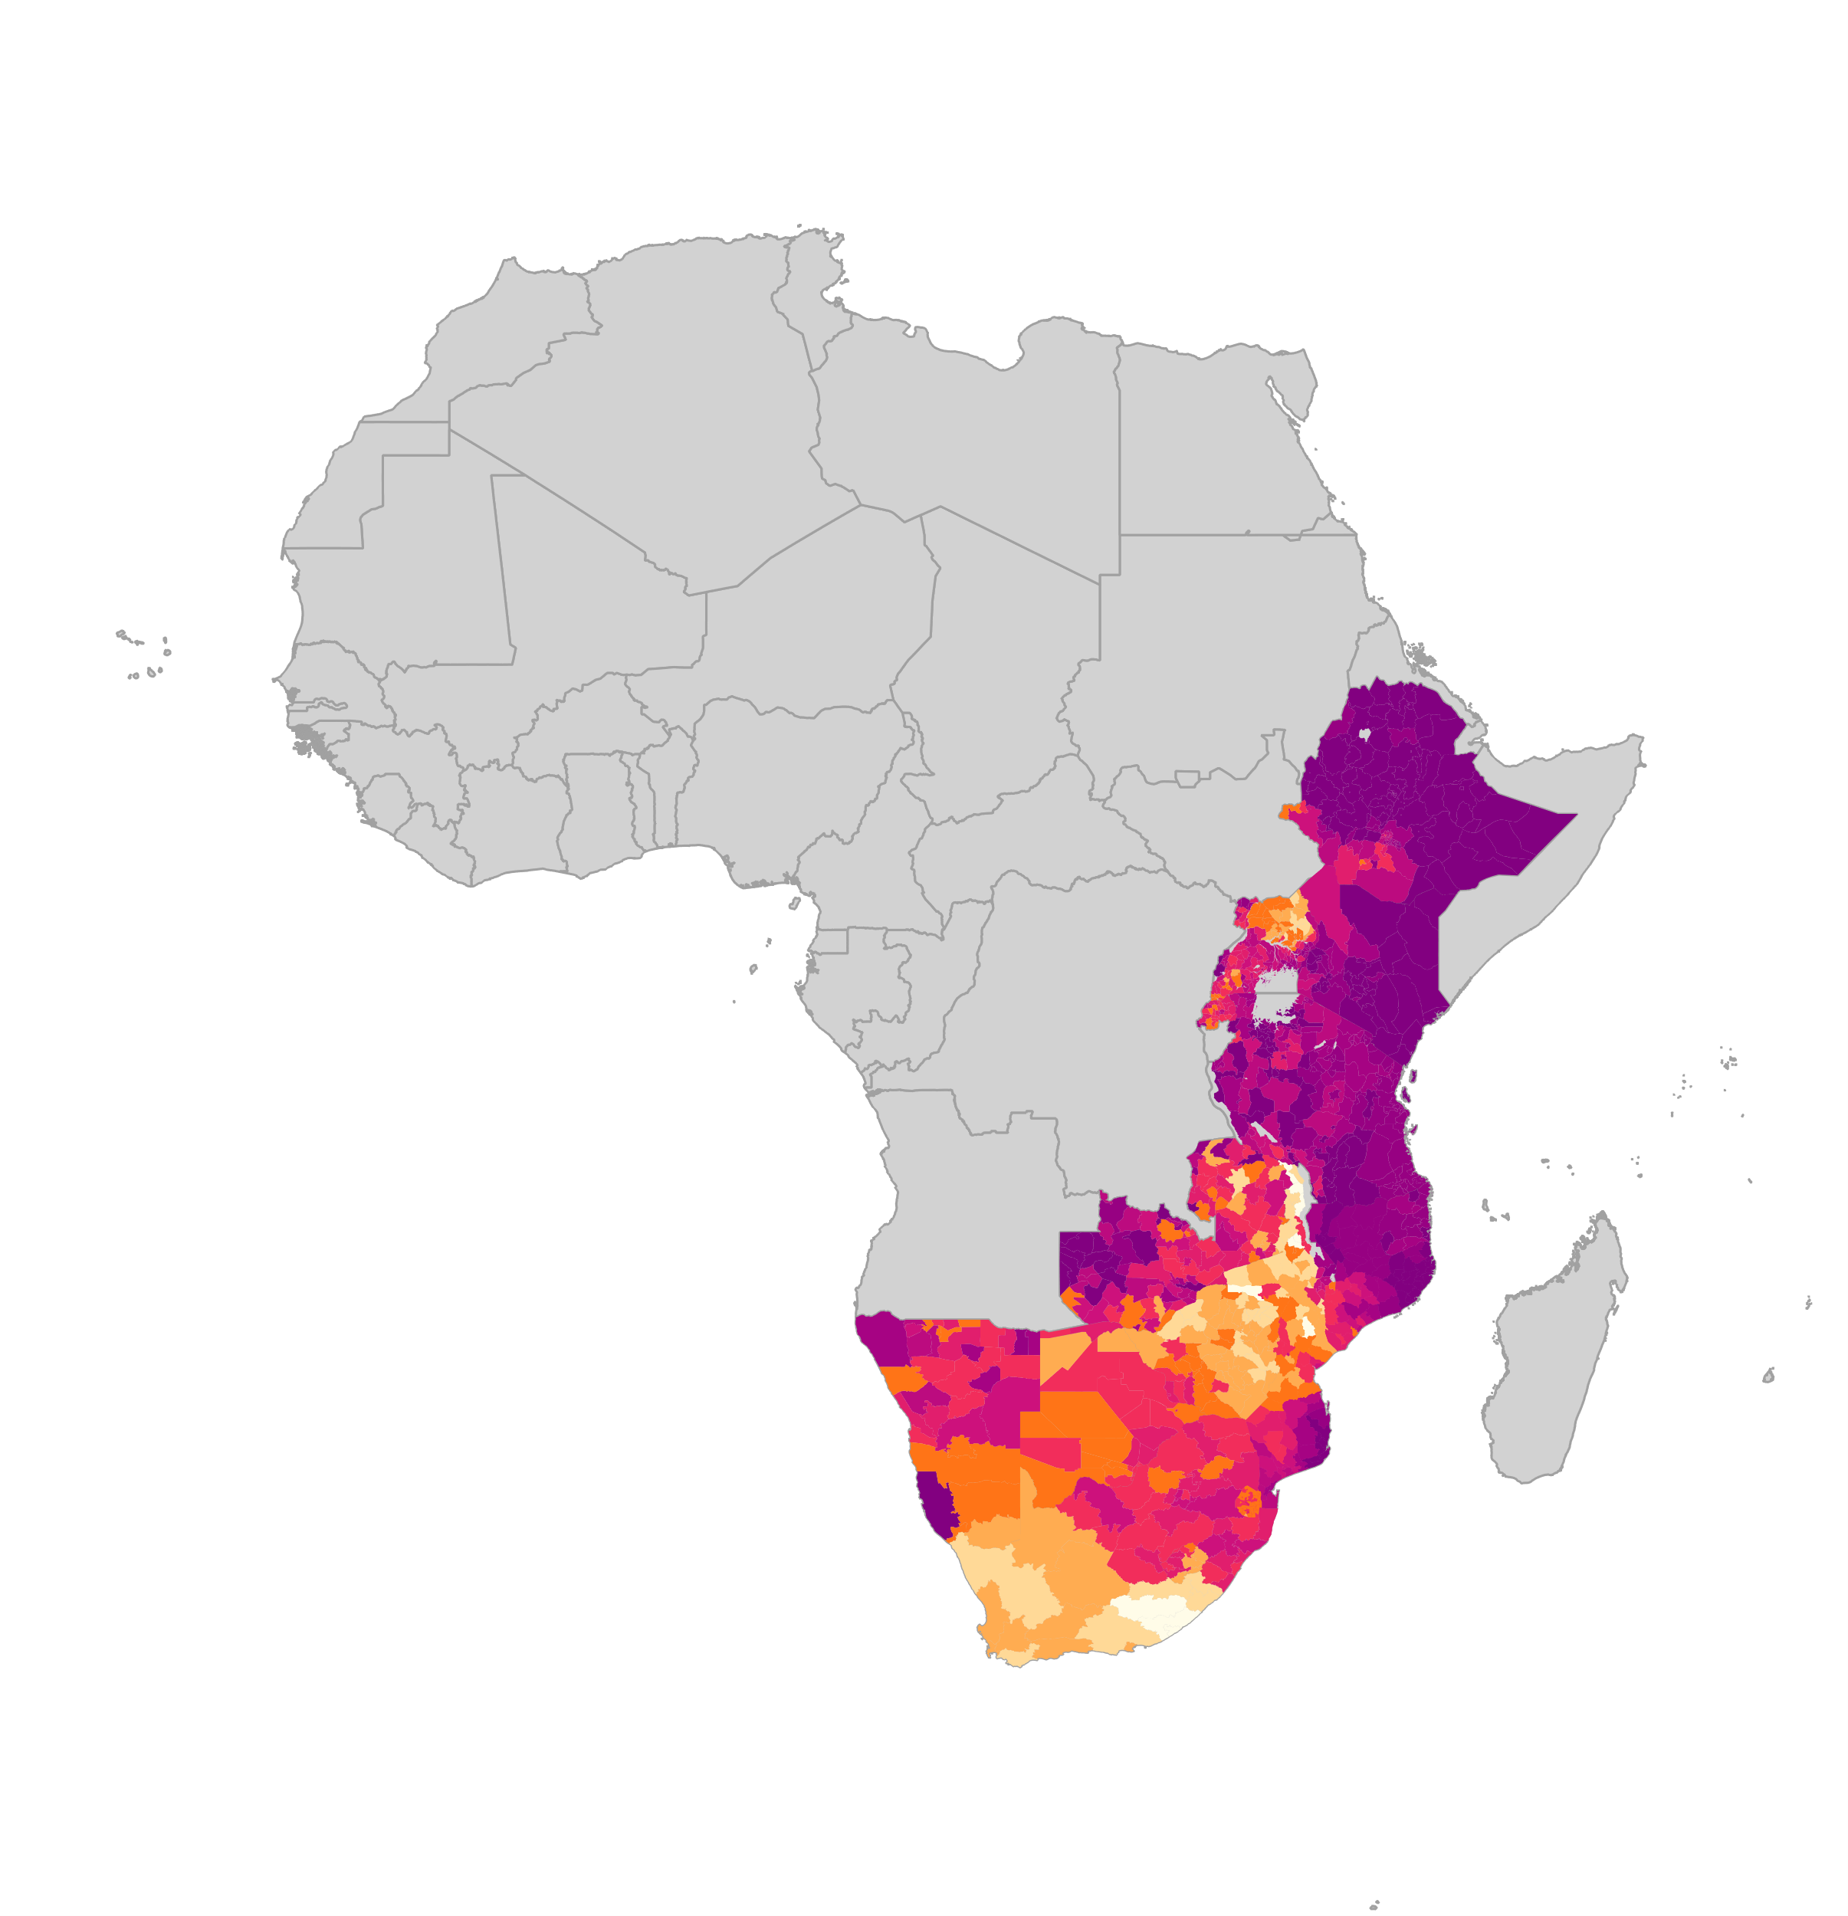
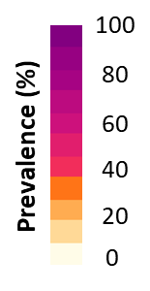

37.5 million men and boys accessed VMMC package of services by 2023 -
But VMMC, other prevention and treatment coverage for men & boys remains far from targets
Number of men and boys accessing VMMC package of services
Estimated coverage of VMMC among men 15-49
Global HIV Prevention Coalition promotes an integrated combination and male SRH pillar approach for boys and men including HTS/ART and gender-transformative approaches
VMMC coverage remains far from reaching the 90% 2025 targets –and no full recovery after COVID-19 in terms of uptake and persistent funding gaps
Sources: Coverage maps- special analysis by Avernir Health through the UNAIDS-led VMMC data workstream. Analysis done using DMPPT2 Tool and integrated 3MC model using data up and until 2023. VMMC progress over time: UNAIDS Global AIDS Monitoring, 2023; www.aidsinfo.unaids.org)

Slide 12
Growing numbers of people using PrEP: 3.5 million in 2023, but this is just 16% of estimated global need
Number of people using PrEP in 2022, relative to 2025 targets
Source: UNAIDS epidemiological estimates, 2024. www.aidsinfo.unaids.org.

Slide 13
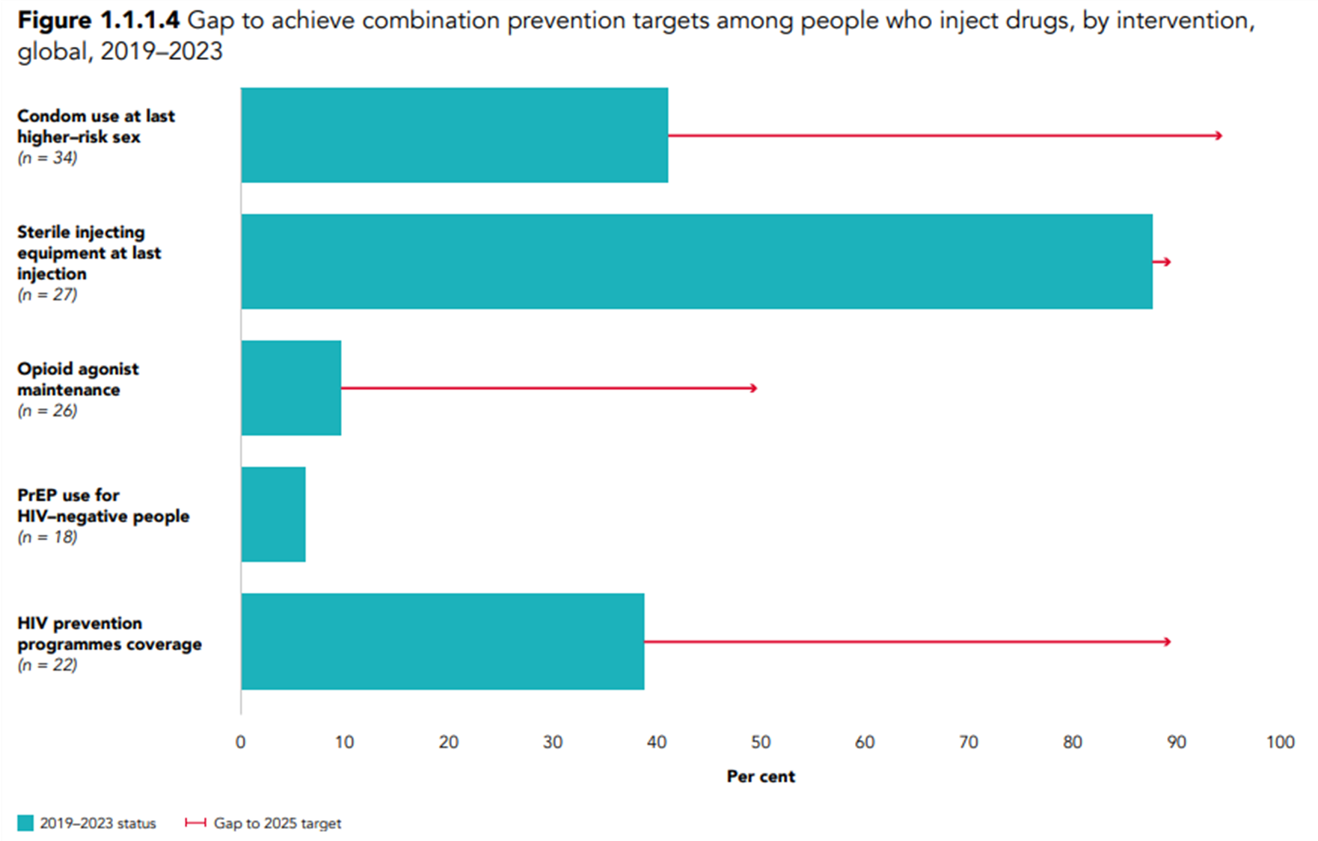
Low and middle income countries with major gaps against 2025 harm reduction targets
In 12/27 reporting countries, ≥90% of people who inject drugs use safe injecting practices at last injection, but gaps remain in consistent access and in other countries
Coverage gaps for OAT remain particularly large despite multiple health and social benefits
Major benefits of evidence-based policy shifts and investing in harm reduction
Notes:
Of 22 reporting countries, 39% of PWID received ≥2 relevant prevention services in previous 3 months
>60% in only 5 countries (Albania, Kazakhstan, Nigeria, Thailand and United Republic of Tanzania)
3 countries met 2025 targets for 200 needles and syringes per person per year
In 12/27 reporting countries, ≥90% reported to PWID using safe injecting practices
In only 2 countries (Malaysia and Seychelles), ≥90% PWID reported to receive OAMT

Slide 14
Key elements for sustainable prevention
Strong political commitment to share financing responsibility and support inclusive multisectoral governance and policies.
A mix of domestic and international financing that is adequate, sustainable and equitable and that includes financing of community- led activities and services – and integration of prevention into health financing schemes
Predictable funding allocations for science- driven, high- impact prevention programmes that are backed by well-functioning surveillance and data systems.
Resilient capacity to deliver and manage integrated, differentiated and equitable HIV prevention interventions, adopt evidence-based approaches in line with international guidelines, and introduce innovations.
The removal of harmful laws and the implementation of enabling policies that support accessible, equitable, accessible and high- quality HIV services.

Slide 15
Thank you
Please contact us for any questions using this email: hivpc@unaids.org

