Slide 1


Improving Aligned Support for HIV Prevention
Condom Programming Beyond Condom Strategic Initiative
Dr. Namwinga Chintu
Program Innovation Prevention Treatment and Pediatrics
UNAIDS, Geneva
Rosemary Kindyomunda
Programme Specialist, SRH/ HIV
UNFPA ESARO, Johannesburg

Slide 2
Steep decline in New HIV Infections among AGYW in
GPC Member States (2010-2020)
Persistent gaps in condom use is preventing countries from achieving goals to reduce HIV incidence.

Slide 3
Contribution to reductions in new infections by intervention category in UNAIDS global strategy
Condoms are a proven, scalable, cost effective tool to reduce new infections
Treatment (testing, ART, retention)
Biomedical: VMMC and PrEP
Behavior change
  condom use for general population
  comprehensive sexuality education
  economic empowerment
Key populations: prevention services for FSW, MSM and PWID)
Societal enablers (not shown) are critical to attaining target coverage levels
ART to 95-95-95
VMMC & PrEP
Key pop prevention
Behavior Change
John Stover, UNAIDS Technical Consultation, 20-21 July 2023

Slide 4
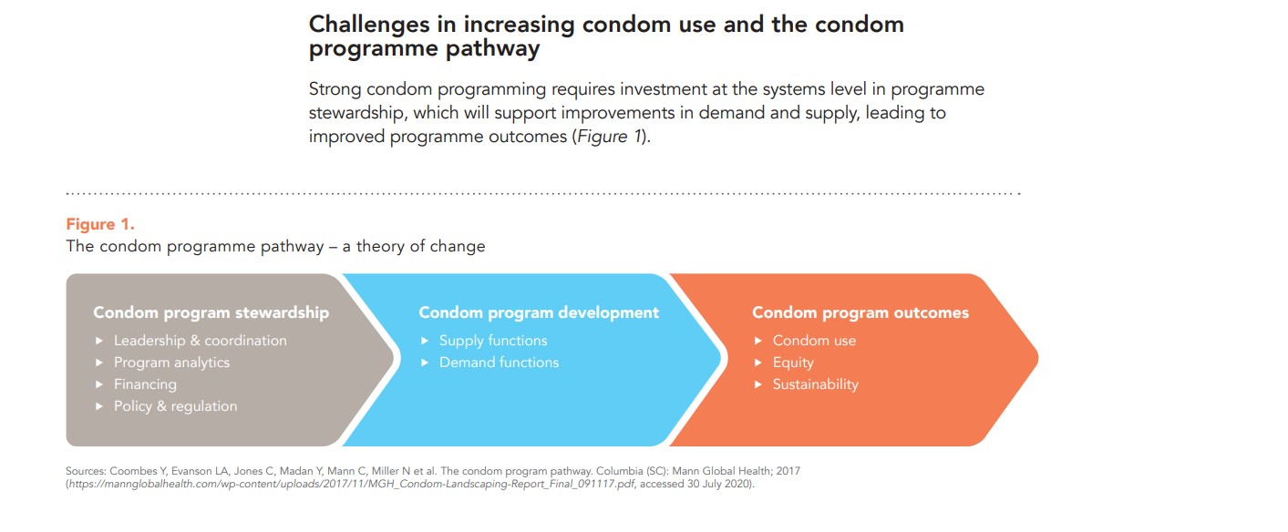

Slide 5
The Bet on Stewardship
The Strategic Initiative supports sustainable systems level fixes that underpin better designed and performing national prevention programs leading to healthier condom markets.
1
Improve the design of programs that bring a Total Market Approach to the core, and address
systemic constraints in the market.
2
Build out targeted tools & guidance improving program management
and stewardship.
3
Nurture a talent pool of regionally-based consultants and institutions
through mentoring, distance support, tools & approaches.
4
Provide on-demand technical support for condom programming.

Slide 6
“New Generation” Condom Programming
People-centered
Who needs a condom?
Understanding population
How feasible is consistent access
  Inequity lens
  Beneficiary engagement
Consistent and correct use
  Skills, comprehensive knowledge
  Position in options package
The Stewardship Key
Conducive policy & social environment
  Cement the role of condom in HIV prevention
Integrated strategic planning
  Evidence - Size estimates, target setting
  Forecasting & quantification
Integrated programme delivery
  Influence behaviour, create demand
  Public private partnerships
  Market segmentation and development
  Track - data for decision making
Build community competence
  Engage, Increase knowledge on options

Slide 7
Condom Strategic Initiative Focus- Build Capacity for improved Condom Programing
The overall objective of the Condom Strategic Initiative is to:
Catalyze improvements in the quality of condom programs -more differentiated, equitable, people-centered, which will lead to sustained increases in condom use amongst priority populations, and reduced # of HIV infections
Sub objectives:
Strengthen national and sub-national institutions (NAC, MOH) and systems for improved condom program stewardship
Increase innovation in demand creation and last-mile distribution, including through public-private partnerships
Objectives
Total Budget: $5 million
$4.3 million via UNAIDS
UNFPA Implementing Partners
Focus Countries
Malawi, Mozambique, Uganda, Zambia
(All are also receiving Matching Funds)

Slide 8
Implementation architecture
Global Fund Country Teams
Global Fund Secretariat
Complementary
support
Oversight on country grants
44Technical Assistance Areas
Reinvigoration of Condom Programming Structures
Evidence based condom quantification and fore casting
Strengthened last mile distribution mechanisms
Relevant and effective demand generation
Innovation and sustainability plans included in GC7 Applications
Private sector engagement
Grant to
UNAIDS
Global HIV Prevention Coalition (GPC) Secretariat
Technical & Managerial Hub
Integration into global prevention response
Global Coordinator of the Initiative
Hosted by UNAIDS
Builds & manages overall partnership
Regional Support Manager
Hosted by UNFPA
Provides direct country support
Condom Technical Support
(regional specialists integrated into TSM)
Public-private innovation fund
Continuous direct programmatic & management support
Support to priority actions and capacity-building on condom programme stewardship, last-mile distribution and innovative demand generation
Scopes of work
driven by identified country priority needs
Cross-country
learning & exchange
Country focal
point/ manager
Country focal
point/ manager
Country focal
point/ manager
Country focal
point/ manager
Other countries
Malawi Mozambique Uganda Zambia

Slide 9
“New Generation” Condom Programming: learning from implementation of the Condom SI
The condom is appreciated – but needs championing
Structured stewardship is a prerequisite & feasible
Tools key for institutionalized action
  PSAT, PSET, CNET, TMA, CP Planning Package
Up-to-date evidence critical
Domestic financing possible
External funding streams are critical catalytic anchors
Tracking the condom is feasible
  With improved LMD approaches
Public Private Partnerships work
  exploit various angles
Private-for-Profit Innovations for sustainable healthy markets
Diverse LMD options the way to go
  Condom at HFs not reaching high risk groups
No demand creation without LMD
Differentiated, integrated programme delivery is feasible – pop. specific
Communities know better
  Empower for people-centered programmes
Notes:
Appreciate the condom and position as critical option in in SRH, HIV packages
CP is multisectoral, multipartner and multilevel, it demands strong oversight for commodity security, integrated action and accountability. Functional Condom Working Groups provide this support
Global tools assist with standardization but country level guidance tools e.g. on M&E frameworks also key
Evidence in CP informs advocacy but is lacking. It is for example possible to lobby for domestic financing hinged on evidence on cost-effectiveness of the condom
The demand creation gap is largely a LMD gap. Commodity availability enhances uptake

Slide 10
Overcoming Condom Programming obstacles: learning from implementation of the Condom SI
Condom/lube still stigmatized
  Standardize output reporting on external funds?
Lack of data impacts advocacy and programme decision making
  Invest in CP data analytics, evidence generation
The free condom threatens transition to sustainable markets
  Free commodity increasing but handling capacity weak
  willingness to buy not well exploited
  Utilize external funding to grow the total market
High unmet need YET low condom uptake
  Invest in innovative demand creation
Competing interventions?
  Prioritize programming for CHOICE
Inadvertent/subtle deprioritization
  ‘Condoms/lubricant use at last sex by those not taking PrEP with a nonregular partner whose HIV viral load status is not known to be undetectable’
Defunding/declining social marketing
  Innovate around new business approaches
Notes:
The condom still faces stigma at policy, programming, service delivery and community levels. It may not be easily overcome without standardized programming
Country systems have limitations for handling increasing quantities of free condoms, yet there is willingness to buy that is not fully exploited
Defunding social marketing affected condom messaging and impacted ability to transition from free to condoms at a cost

Slide 11
Overcoming Condom Programming obstacles: learning from implementation of the Condom SI
Challenging to meaningfully integrate condoms into prevention and treatment portfolio (but essential)
TMA more of theory than practice
  Advocate transformation of national tax regulations
  Condition free commodity support to development of healthy markets
Major funding streams can do better
  Value for Money accountability linked to defined outputs
If it is not measured, it is not done!
  How do we amplify focus on outputs before outcomes
Weak local HR capacity/expertise for CP
  One-off TA limited to catalytic action
  Invest in HR for CP – positioning/cadres
Exploit mega trends
  Expand digital technological solutions
  Amplify CP under global Selfcare advocacy

Slide 12
Key Considerations Beyond the Condom SI
Sustain the momentum we need to move faster, be more focused and more specific
Support countries to meaningfully integrate condoms into all aspects of HIV programming (starting with integrating stewardship into the broader prevention response)
Scalable catalytic interventions for responsive condom programming are possible, effective and urgently needed
Oversight for institutionalization of condom programming coupled with accountability at multiple levels is essential
Funding needs to be specifically earmarked for Stewardship demand generation and last mile distribution- ‘Program smarter’
Funding streams for condoms need to pivot to a new generation of programing that is more differentiated, equitable, people-centered and goes beyond procurement to achieve 2025 and 2030 prevention targets and goals
Re-energize global advocacy and action for the effective and responsive condom programming
Global Condom TWG /think tank to revisit condom indicators that measure impact and coverage- Data on condom programming needs strengthening

Slide 13
Thank you

