Slide 1



Innovative Strategies and Challenges in Addressing HIV Among Men: Insights and Future Directions
Wole Ameyan
Adolescent HIV, Men and HIV Lead, WHO
Switzerland
Notes:
Introduction: Despite significant strides in the global HIV response, men are consistently falling behind in achieving the 95-95-95 targets compared to women.
Key Data: Only 77% of men living with HIV know their status, 71% are on treatment, and 62% are virally suppressed, compared to higher percentages among women.
Implications: This gap highlights the urgent need for targeted interventions to better engage men in HIV testing, treatment, and care services.

Slide 2
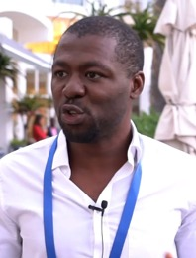
Introductions and session format
Wole Ameyan
Adolescent HIV, Men and HIV Lead, WHO, Switzerland - Moderator

Slide 3
Men are lagging on progress in the 95-95-95 targets
Testing and treatment cascade among women and men, Global, 2023
Men are consistently falling behind in achieving the 95-95-95 targets compared to women.
  Only 83% of men living with HIV know their status,
  72% are on treatment, and
  67% are virally suppressed
This gap highlights the urgent need for targeted interventions to better engage men in HIV testing, treatment, and care services.
Source: Further analysis of UNAIDS epidemiological estimates, 2024
Notes:
Introduction: Despite significant strides in the global HIV response, men are consistently falling behind in achieving the 95-95-95 targets compared to women.
Key Data: Only 83% of men living with HIV know their status, 72% are on treatment, and 67% are virally suppressed, compared to higher percentages among women.
Implications: This gap highlights the urgent need for targeted interventions to better engage men in HIV testing, treatment, and care services.

Slide 4
Regions show differential men lag in progress towards the 95-95-95 targets
Source: Further analysis of UNAIDS epidemiological estimates, 2024
Notes:
This slide calculates and illustrates the percentage gap between females and males for the 95-95-95 targets across different regions.
Key Observations:
In some regions, the gap is quite large, indicating a significant lag in men's progress compared to women.
For instance, in Eastern Europe and Central Asia, the gap is particularly pronounced.
Actionable Insights: Addressing these gender disparities requires targeted interventions that focus specifically on the needs of men in these regions.

Slide 5
Absolute numbers of undiagnosed men by region
Source: Further analysis of UNAIDS epidemiological estimates, 2024
Notes:
Undiagnosed Men: This slide shows the absolute number of men living with HIV who are undiagnosed in different regions.
Key Regions:
Asia and the Pacific – Highest number of undiagnosed men – mostly men from key population epidemics
Eastern and Southern Africa: Second highest number of undiagnosed men, highlighting a critical area for intervention.
Western and Central Africa: Also significant numbers of undiagnosed men.
Urgency: Addressing these undiagnosed cases is crucial for controlling the epidemic and reaching global HIV targets.

Slide 6
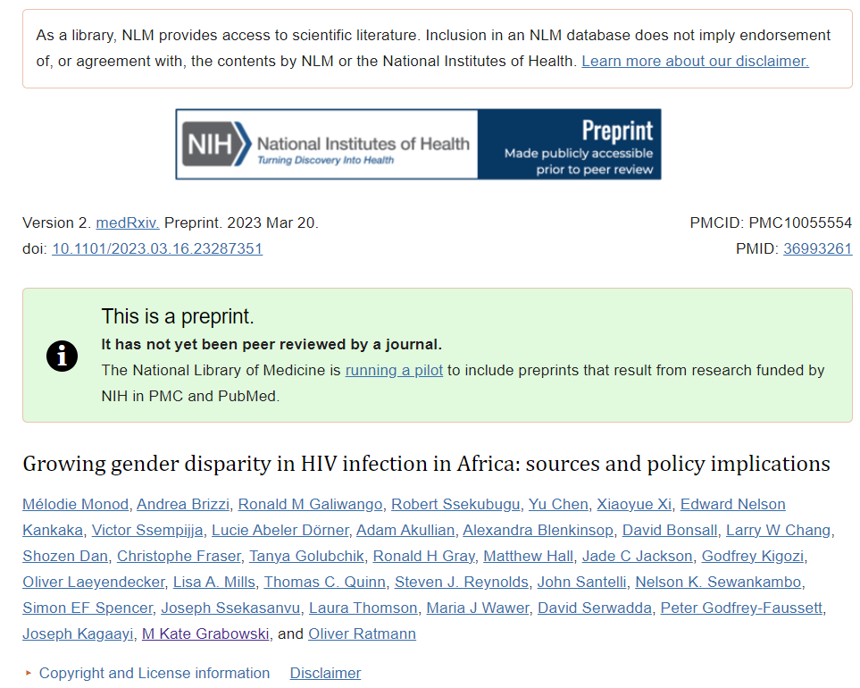
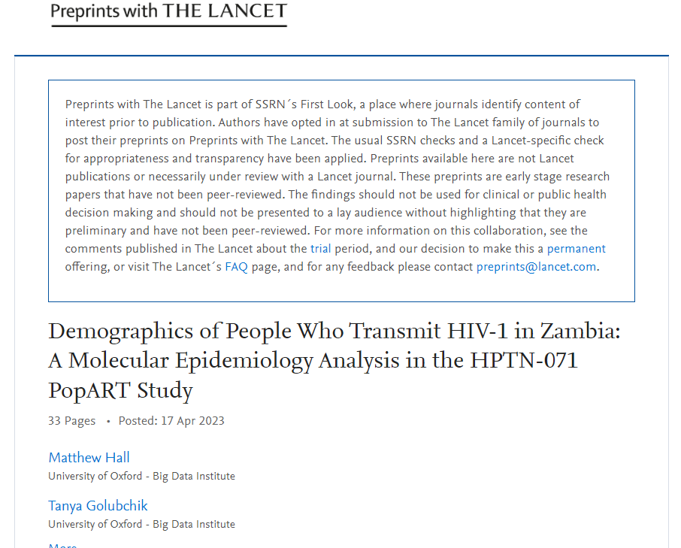
New studies show we need to ask ‘questions of the answers’
Viral suppression and transmission dynamics
Advanced HIV disease and transmission risk
New infections
Increasing majority of new infections arising from men, widening pre-existing gender disparity in HIV transmission
Intra-community transmission
Large majority of transmissions occurred between partners from the same community
Increasing transmission flows
Increasing contribution of transmission flows to AGYW by partners aged 25-40 years
Viral suppression rates were 1.5-2-fold higher among women than men
Pre-prints Mélodie Monod et al., 2023, Growing gender disparity in HIV infection in Africa: sources and policy implications; Matthew Hall et al., 2023 Demographics of People Who Transmit HIV-1 in Zambia: A Molecular Epidemiology Analysis in the HPTN-071 PopART Study
Closing the suppression gap in men could have reduced infections in women by one half and ended gender disparity in HIV incidence
Men aged 25-40 should be the focus of treatment for prevention, likely the quickest pathway to rapidly reducing incidence among women
More frequent testing to avert transmission from recent infections and efforts to retain people in care to avert transmission from chronic infection
More male-centred HIV services should be a central component to prevent infections and end HIV and AIDS as a public health threat by 2030

Slide 7
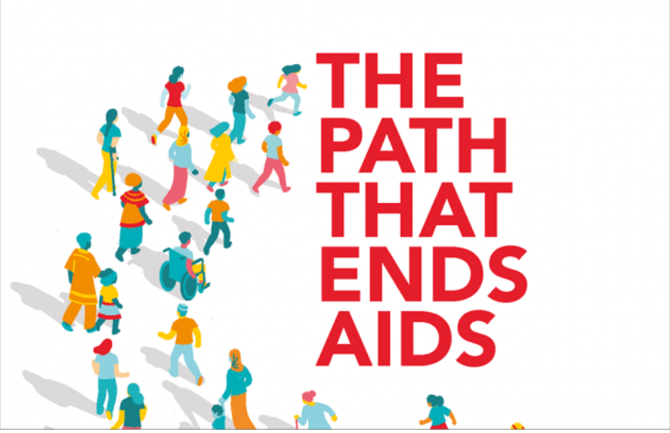
The quickest path to ending AIDS
So many paths but perhaps in line with current realities, we should be looking at the quickest and most sustainable path to ending AIDS
Doing things differently
It means a focus on novel populations (men) and innovations like never before
Switching off the tap!
The quickest path to ending AIDS
We need to attack frontally sources of new infections (men)
Focus on the bottom line
Access, quality and support. Be pragmatic on evidence-based interventions

Slide 8
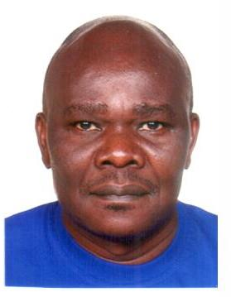
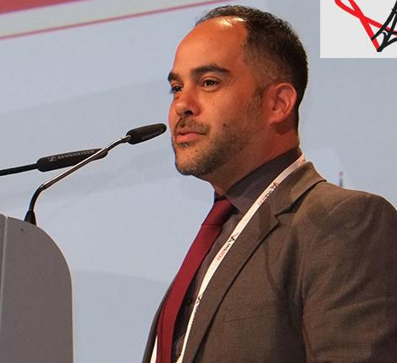
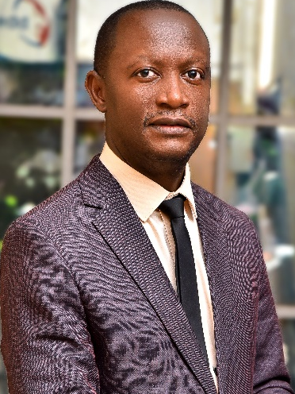
Exploration of Innovative strategies
Mr. Nelson Otwoma
Executive Director, National Empowerment of People Living with HIV/AIDS in Kenya (NAPHAK), Kenya - Engaging communities in intervention design and implementation.
Dr. Carlos Toledo
HIV Prevention Branch Chief in the Division of Global HIV and TB at the U.S. Centers for Disease Control and Prevention Headquarters, Atlanta, USA - VMMC programme evolution and what we can learn as an example of a successful intervention and its current challenges.
Mr. Robert Serwanga
Minister of Youth, Sports and Culture, Buganda, Uganda - Engaging traditional leaders.

Slide 9

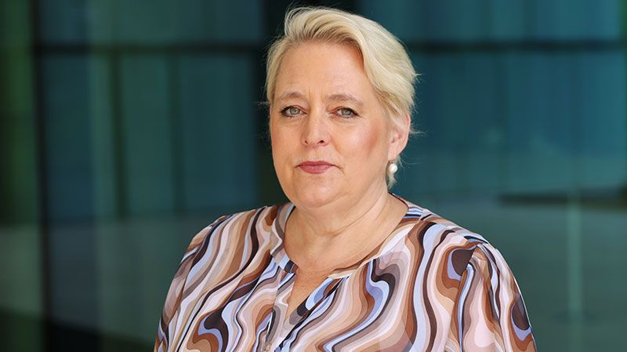
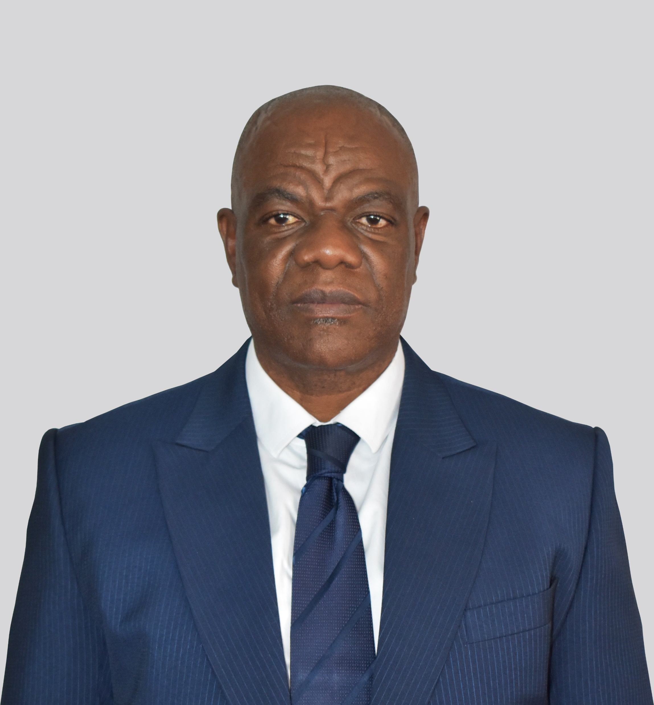
Addressing unique challenges
Professor Kathyn Dovel
University of California, Los Angelis (UCLA), USA, Partners in Hope, Malawi - Services and missed opportunities.
Christine Stegling
Deputy Executive Director for Policy, Advocacy and Knowledge Management, UNAIDS, Switzerland – Addressing gender related issues in HIV among men and boys.
Mr. Ontiretse Letlhare
National Coordinator, National AIDS and Health Promotion Agency (NAHPA), Botswana - Providing leadership and coordination on Men and HIV work.

Slide 10
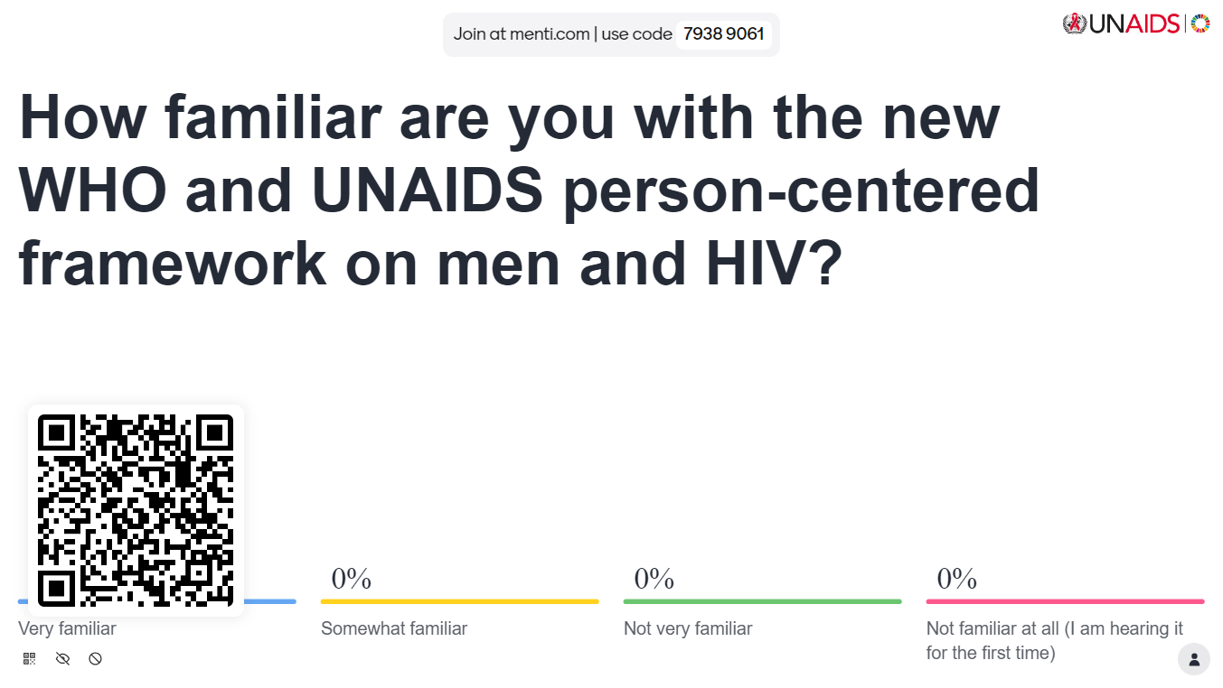
Mentimeter

Slide 11
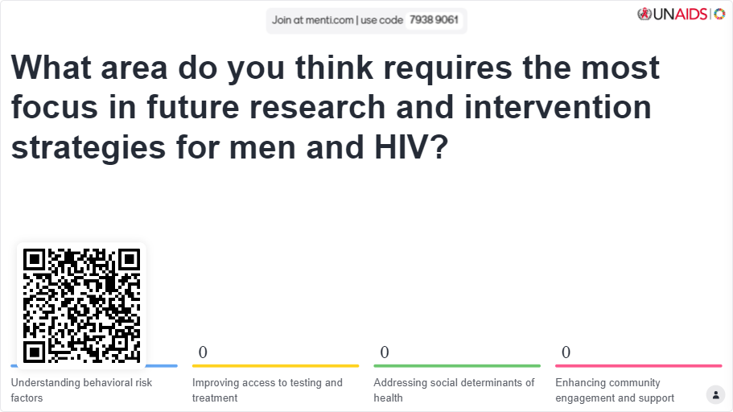
Mentimeter

Slide 12
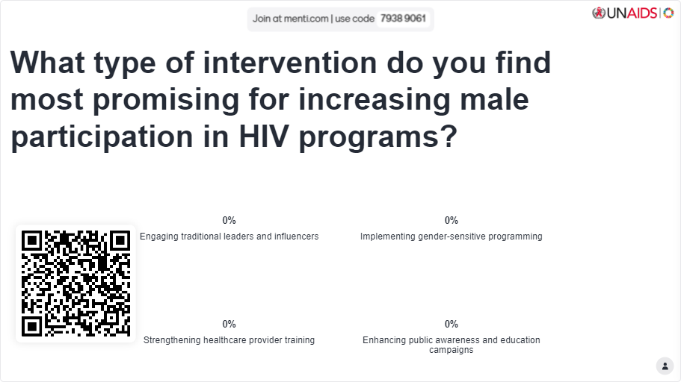
Mentimeter

Slide 13

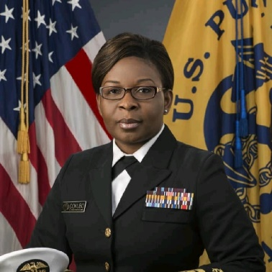
The role of advocacy and power of partnerships to advance the response among men and boys
Mitchell Warren
Executive Director, AVAC, USA – The role of advocacy.
Emily Kainne Dokubo, MD, MPH
Deputy Global AIDS Coordinator – Program Quality, U.S. President’s Emergency Plan for AIDS Relief (PEPFAR), Bureau of Global Health Security and Diplomacy (GHSD), U.S. Department of State, USA– The power of partnerships in addressing HIV among men and boys

Slide 14
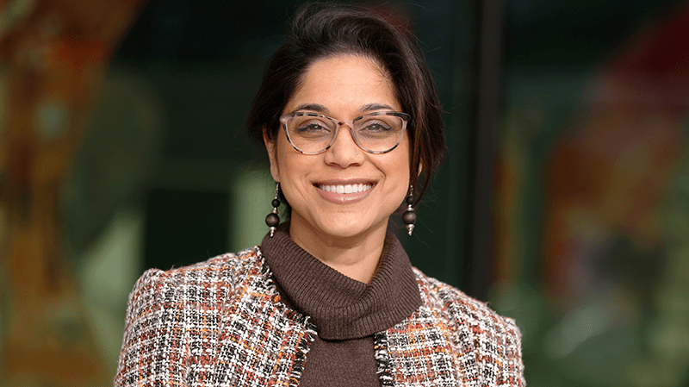
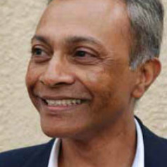
Future directions
Angeli Achrekar
Deputy Executive Director for Programmes, UNAIDS - Summary remarks and vision for the future.
Dr. Yogan Pillay
Director, HIV & Tuberculosis Delivery, Bill and Melinda Gates Foundation, South Africa - Funding perspectives.

Slide 15
Thank You
Session contacts
Lycias Zembe: zembel@unaids.org
Wole Ameyan:ameyanw@who.int

Slide 16
Case studies on interventions reaching men with HIV and related health services
We are soliciting case studies on men focused interventions for inclusion into a WHO and UNAIDS Men and HIV Implementation Brief
Scan the QR codes to be taken to an online platform to submit your case study

