Slide 1

What is required to achieve the 2025 and 2030 HIV targets for reducing new HIV infections?
What is required to sustain the response post 2030?
Mary Mahy and Jeffrey Imai-Eaton
15th Meeting of the National HIV Multi-Sector Leadership Forum
7 November 2023

Slide 2
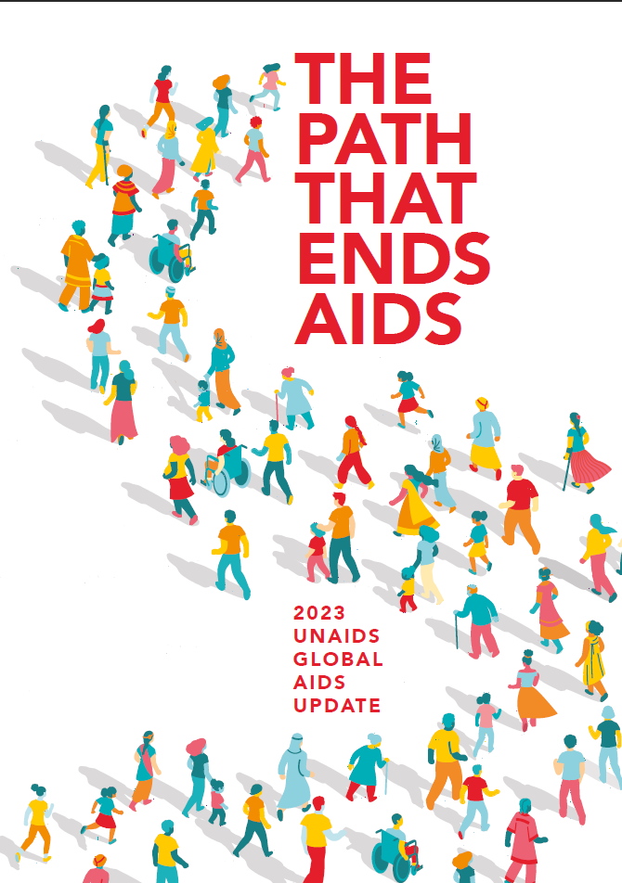
Outline
Status of the global HIV epidemic
Targets for 2025 and 2030
What comes next?
  Defining sustained HIV epidemic control
  Implications of changing HIV epidemiology in 2030 and beyond for HIV programmes

Slide 3
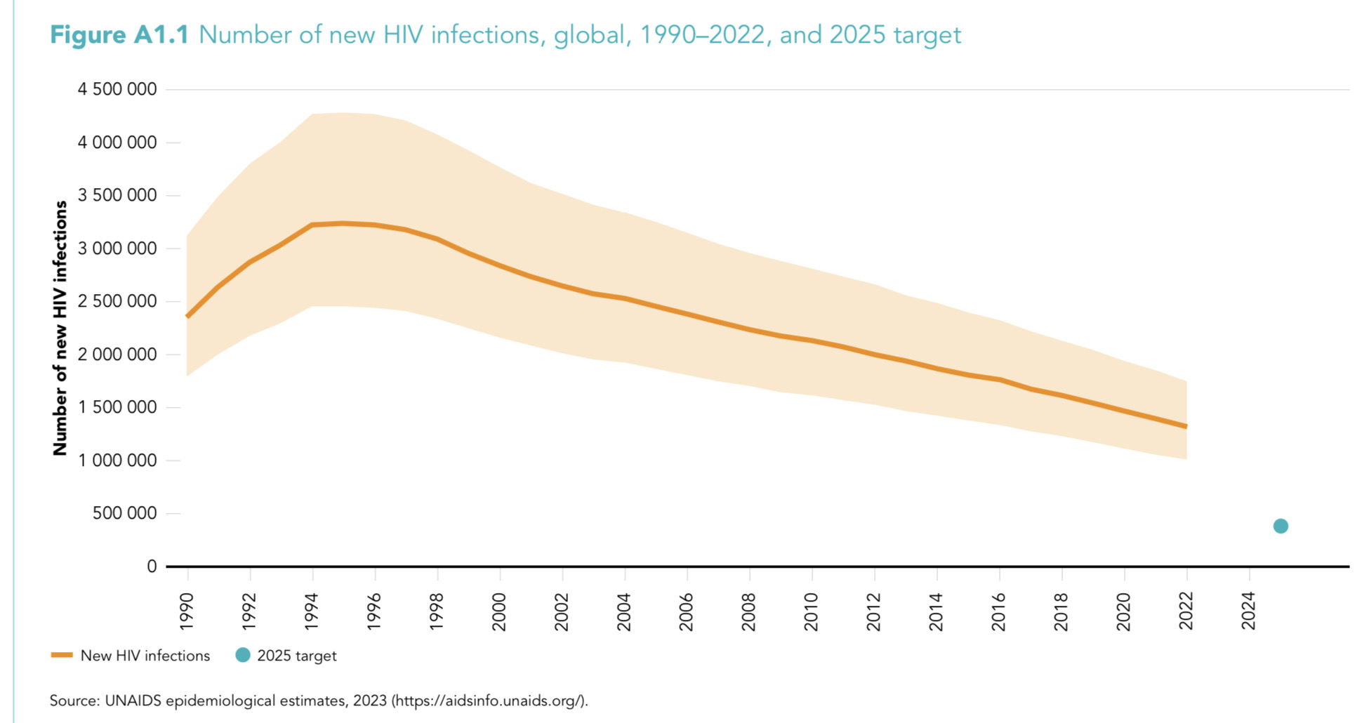
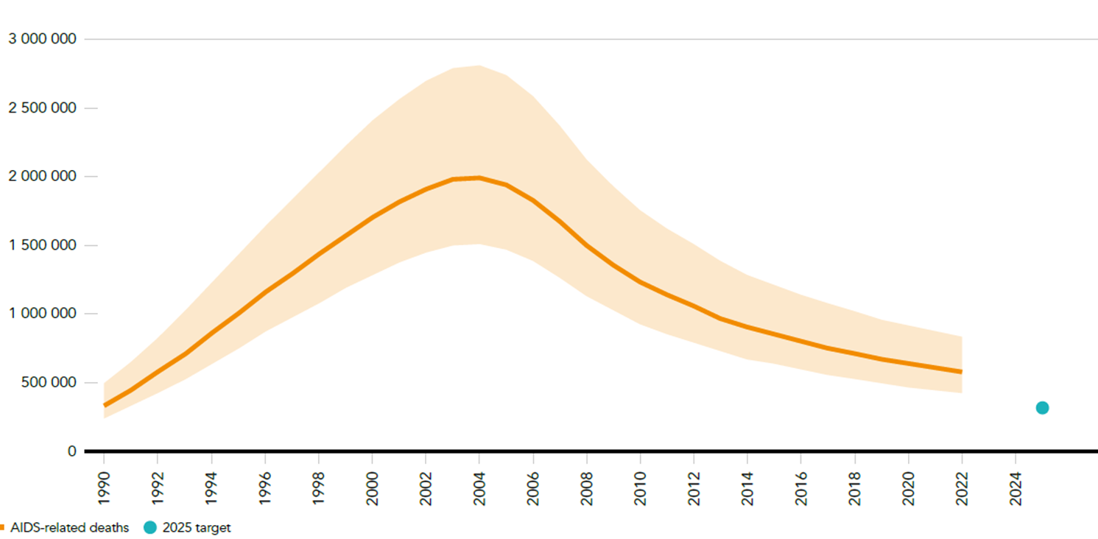
New HIV infections, global, 1990-2022 and 2025 target
New HIV infections are declining globally…
…but not fast enough to reach 2025 and 2030 targets
AIDS-related deaths declining—within reach of target
2022:
1,300,000
AIDS-related deaths, global, 1990-2022 and 2025 target
2022:
630,000
Source: UNAIDS 2023 epidemiological estimates.

Slide 4
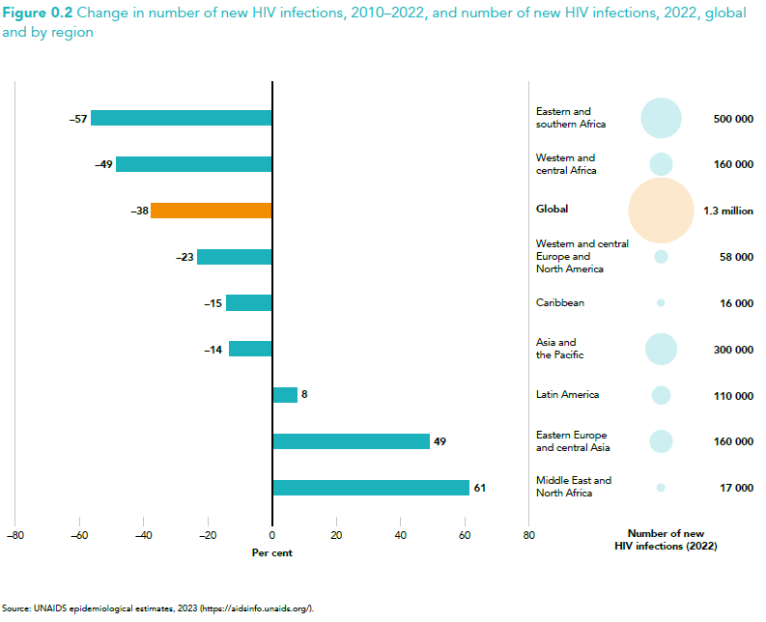
Declines in new HIV infections are strongest in regions with highest HIV burdens:
Eastern and southern Africa
Western and central Africa
Source: UNAIDS 2023 epidemiological estimates.

Slide 5
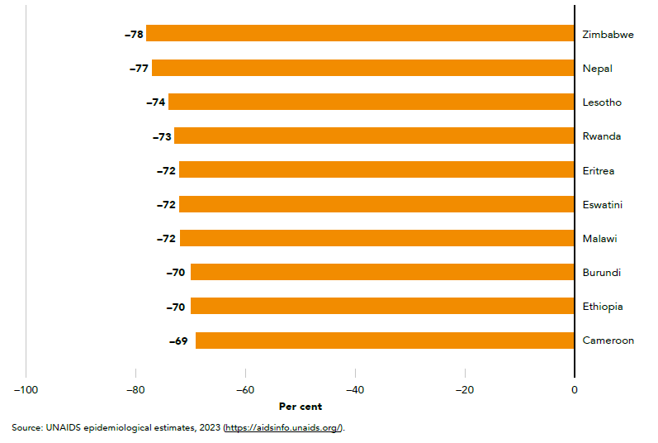
Change in new HIV infections 2010-2022, select countries with largest declines
Major declines in new infections in some high burden countries
Source: UNAIDS 2023 epidemiological estimates.

Slide 6
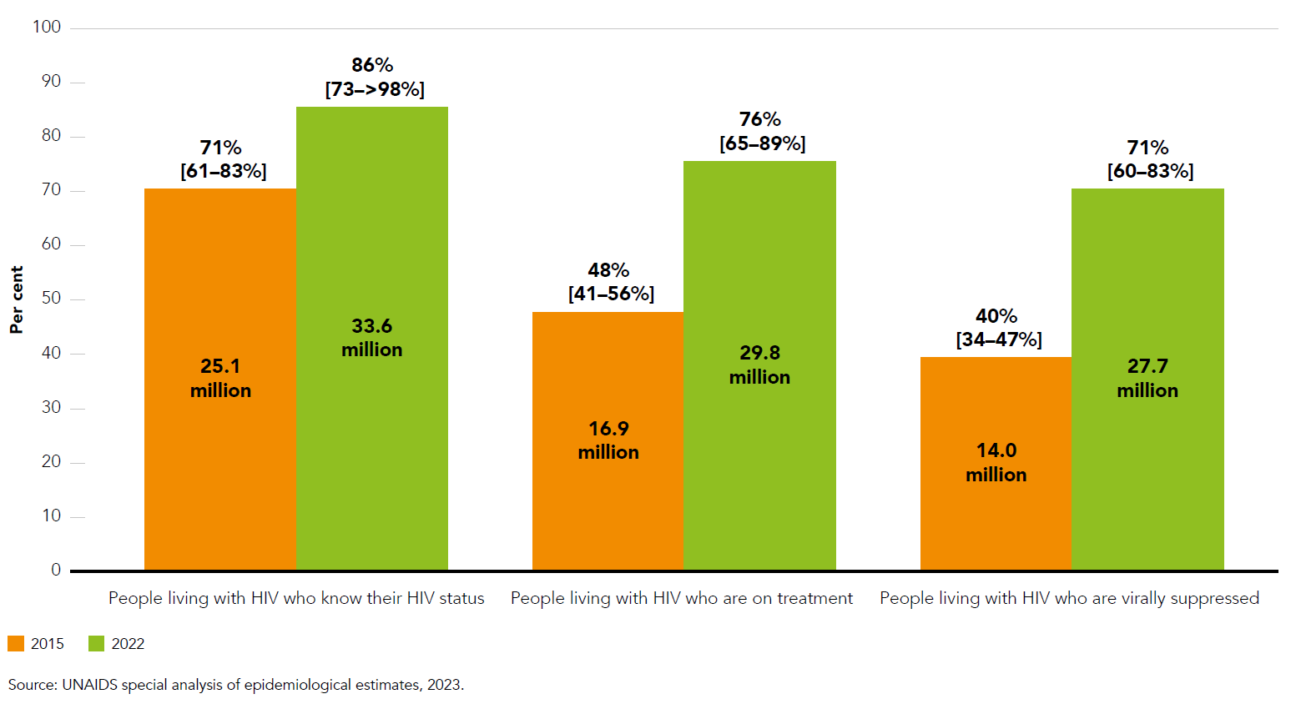
Percentage and number of people living with HIV who know their HIV status, are receiving antiretroviral therapy and are virally suppressed, global, 2015 and 2022
Impressive scale up in cascade since 2015
Source: UNAIDS 2023 epidemiological estimates.

Slide 7
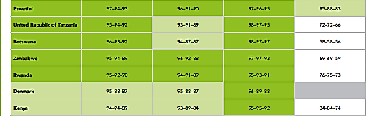
Progress toward the treatment cascade, 2022
Total population
living with HIV
Men aged 15+ years
living with HIV
Women aged 15+ years living with HIV
Children aged 0-14 years living with HIV
Success is not equal across all population groups:
Men, children, and key populations lag behind
Reached the 95-95-95 testing and treatment targest (equivalent to 95-90-86 in this table)
Reached the 90-90-90 testing and treatment targest (equivalent to 90-81-73 in this table)
Data not available
Source: UNAIDS 2023 epidemiological estimates.

Slide 8
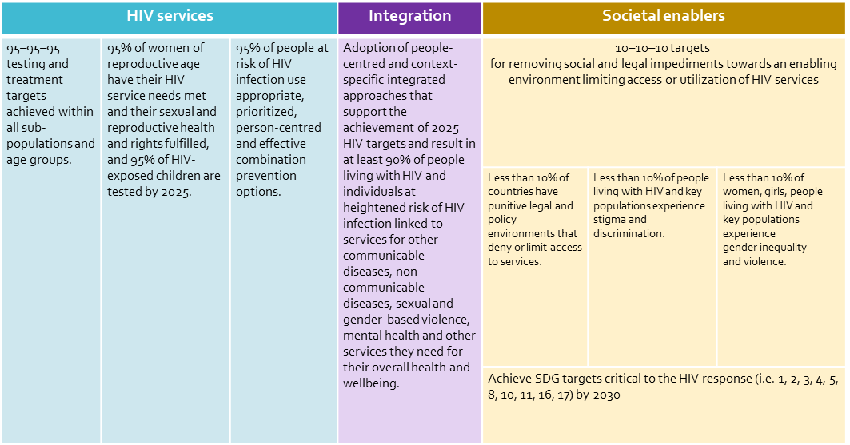
Global AIDS strategy 2025 targets
Sexual health, ANC & PMTCT
Criminalisation
Gender inequality & violence
Testing and
treatment
HIV prevention
Stigma & discrimination

Slide 9

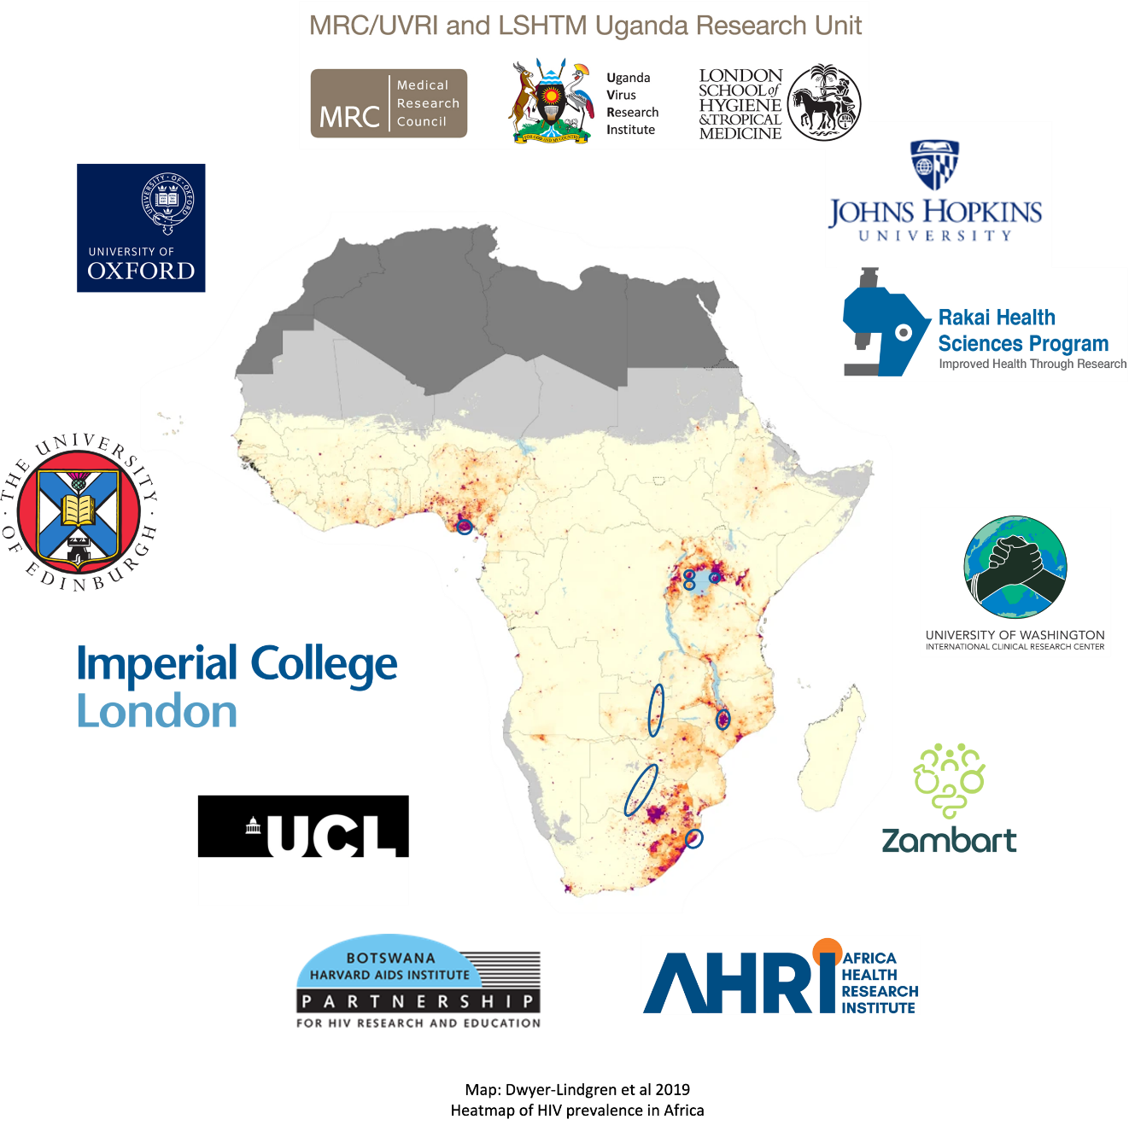

Epidemiologic consultation on charting the post 2030 AIDS pandemic and response
Compared future projections to 2040 from seven mathematical models
Used one model to look at scenarios:
  Scenario 1: Maintain current coverage
  Scenario 2: Reach Global Strategy prevention and treatment targets by 2030
Reviewed population cohort and phyologenetic studies on HIV transmmission dynamics
Analysis limited to Eastern and Southern Africa
We assumed: societal enablers and structural interventions maintained at levels required to implemented at sustain intervention coverage levels.
Questions:
What are expected HIV epidemic trajectories in settings at or near 95-95-95?
What are implications of changing HIV epidemiology for HIV programmes?
In what circumstances is there a risk of HIV returning as a major public health threat?

Slide 10
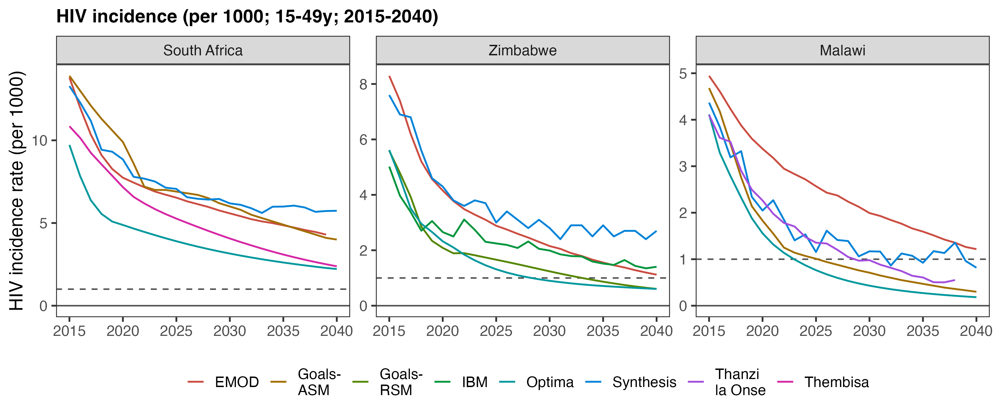
Assuming the current treatment and prevention coverage are maintained:
HIV incidence will continue to decline to 2040
HIV Modelling Consortium, MIHPSA Phase 1, UNAIDS Technical Consultation, 20-21 July 2023

Slide 11
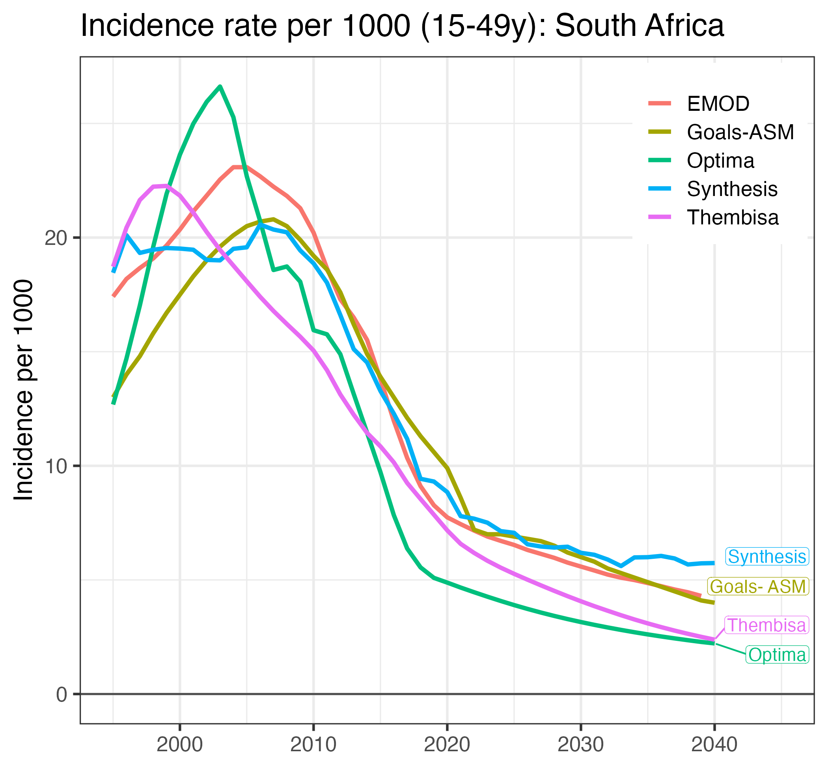
Incidence decline will likely slow between 2025-2040
Why does rate of incidence decline slow after ~2018–2022?
Mostly saturation of ART scale up → reductions in population viraemia slows
  2010-2020: ART scale-up → rapid reduction in population viraemia
  2025- : decreasing viraemia mostly from reducing HIV prevalence
HIV Modelling Consortium, MIHPSA Phase 1, UNAIDS Technical Consultation, 20-21 July 2023
Notes:
We sought to further explore why we see a consistent pattern across the models of an inflection and slowing in the rate of incidence decline between 2018 and 2022, exemplified here in the model projections for South Africa.
This is mainly due to a shift in what is driving HIV incidence decline

Slide 12
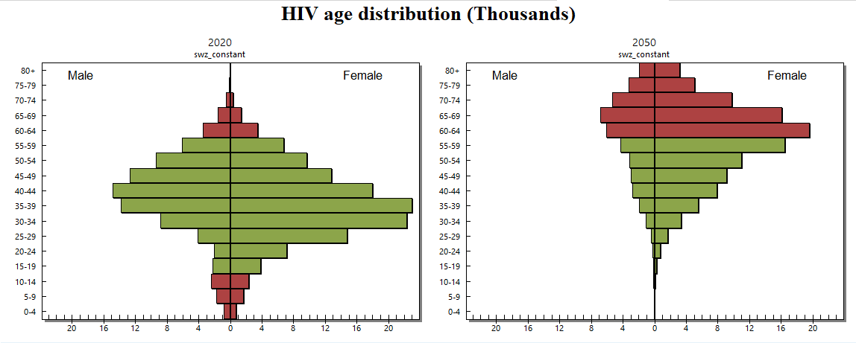
The population living with HIV will age dramatically
John Stover, UNAIDS Technical Consultation, 20-21 July 2023

Slide 13
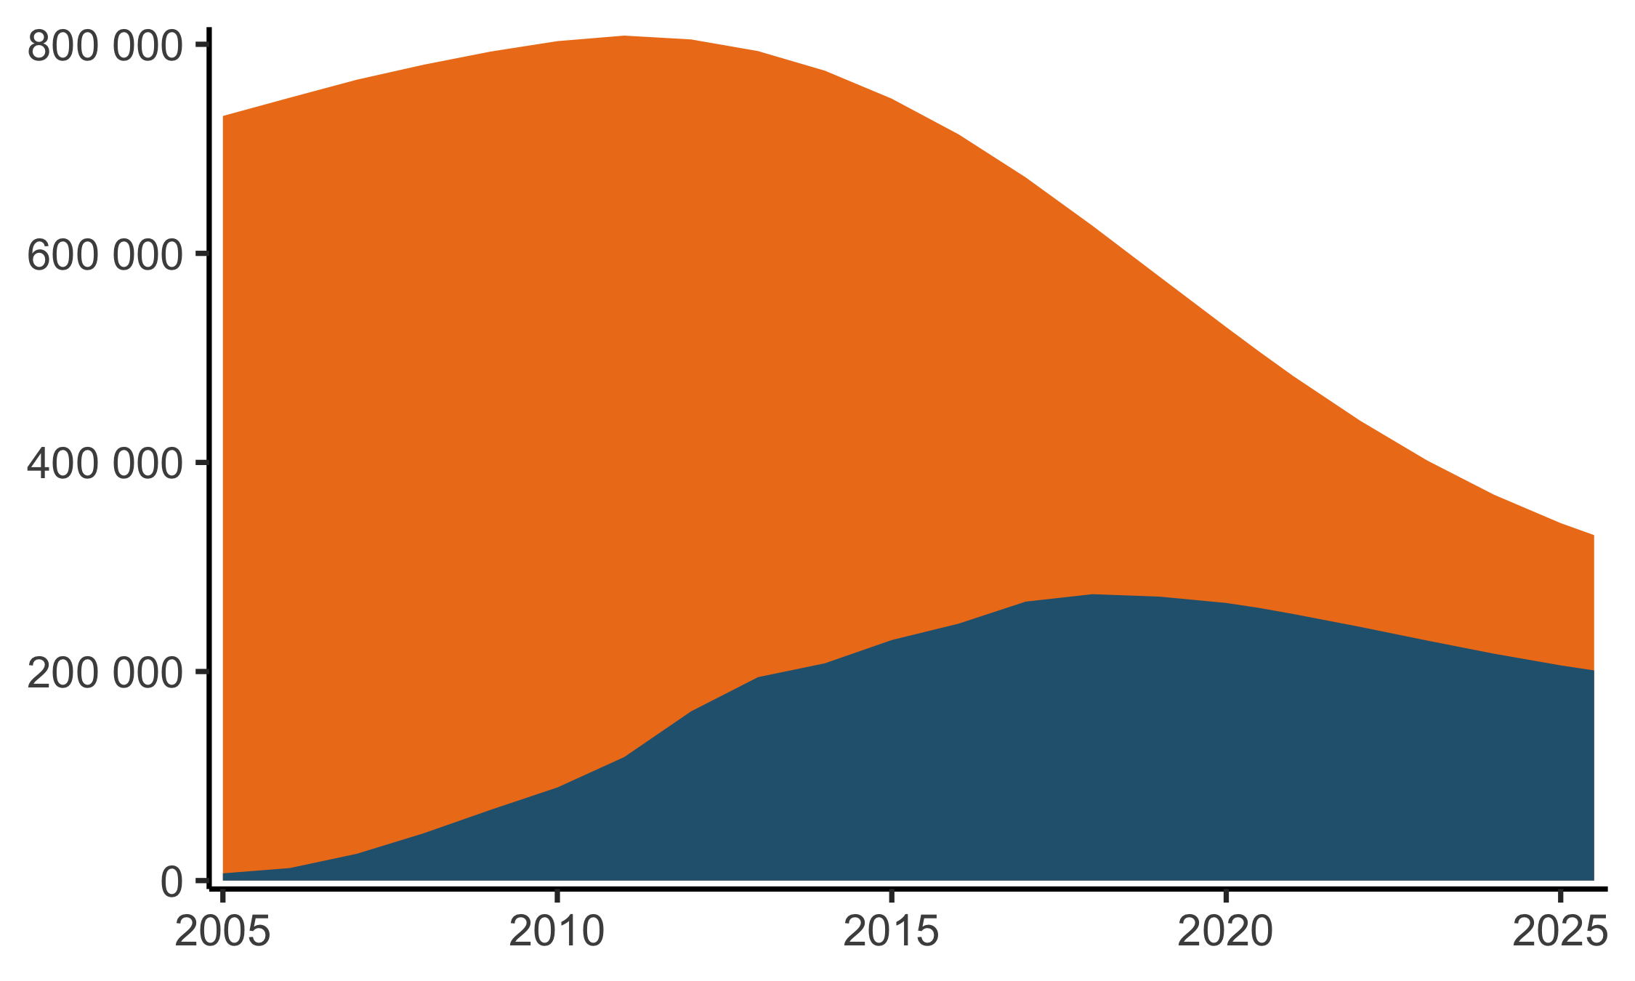
Prevented infections → fewer men with viraemia → lower exposure of HIV transmission to young women
South Africa: Men living with HIV, age 25-34 years
Untreated
Men aged 25-34 years with untreated HIV infection decreased ~4-fold between 2015–2025
2015: 518,000 untreated MLHIV 25-34y
2020: 260,000 untreated
2025: 136,000
On ART
Eaton AIDS 2022; source: Leigh Johnson, Thembisa 4.4 (www.thembisa.org)
Notes:
We see this dynamic of a reducing infectious population playing out clearly in epidemic estimates in South Africa.
Between 2015 and 2025, the number of men aged 15-24 in South Africa with untreated HIV infection—and therefore potentially at risk of transmitting—roughly halved every five years.
Some of this reduction in men with viraemia came from increasing the number on ART. However most of the reduction came simply from reducing total numbers of men living with HIV in this age group.

Slide 14
Maintain current coverage
(treatment AND prevention):
17% reduction between 2022-2030
Attain 95-95-95 by 2030
(+ current Px coverage):
59% reduction by 2030
Attain all Global AIDS Strategy targets by 2030:
2022-2030: 88% reduction
(ambitious condom and other prevention targets)
John Stover, UNAIDS Technical Consultation, 20-21 July 2023
Notes:
Maintain current coverage
(treatment AND prevention):
2022-2030: 17% reduction
2030-2050: 36% reduction
Attain 95-95-95 by 2030
(+ current Px coverage):
2022-2030: 59% reduction
2030-2050: 58% reduction
Attain all Global AIDS Strategy targets by 2030:
2022-2030: 88% reduction
2030-2050: 72% reduction

Slide 15
Large number of people living with HIV requiring services
20.0
16.8 million
Maintain current coverage
Attain 95-95-95 by 2030
12.7 million
Attain all Global AIDS Strategy targets by 2030
People living with HIV (million)
10.0
0.0
John Stover, UNAIDS Technical Consultation, 20-21 July 2023

Slide 16
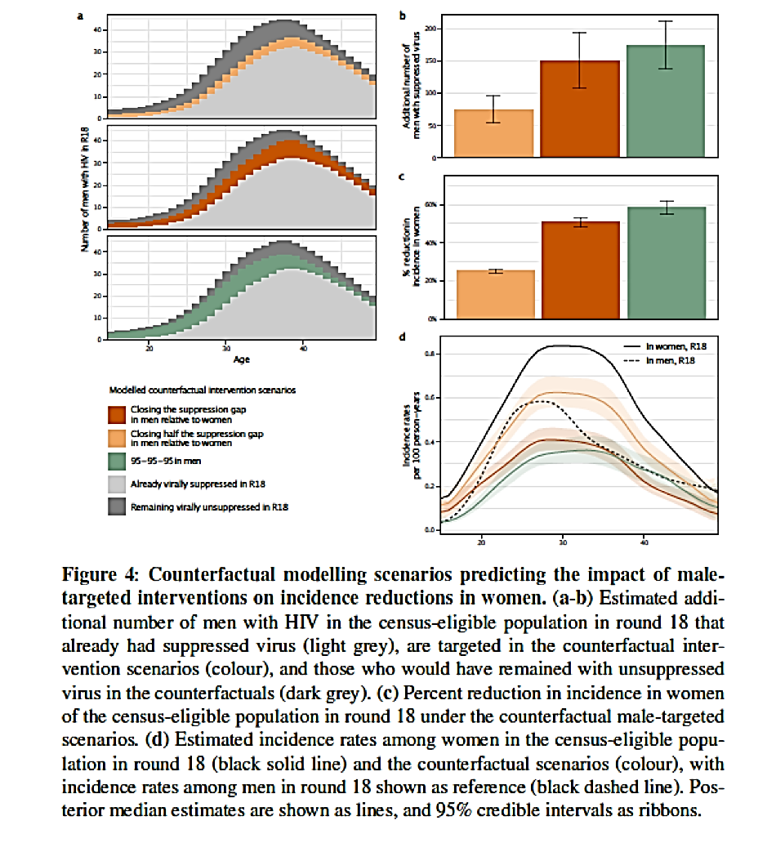
Reducing inequity in treatment access will reduce onward transmission
Phylogenetic data on patterns of HIV transmission demonstrate:
  Men transmit HIV about 4x more frequently than women, increasing disparity
  Men have lower ART coverage and viral suppression
  Men 25-39 years disproportionately transmit HIV
Closing gender gap in viral suppression: could reduce new HIV infections among women by half, slowing onward transmission and ensuring men live healthy lives
Data from Rakai Community Cohort Study, Uganda
Source: Monod et al. medRxiv 2023

Slide 17
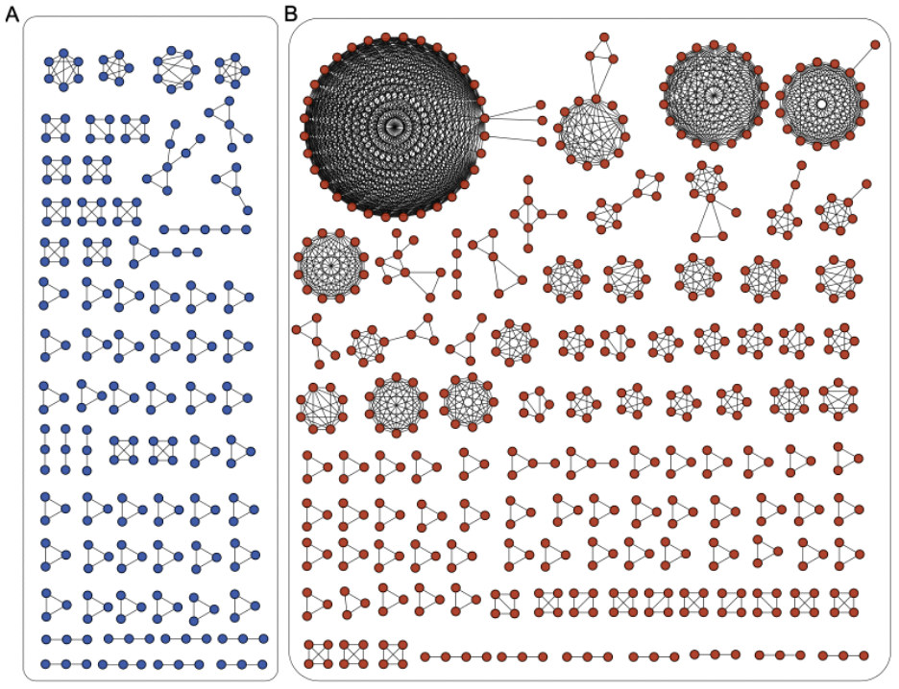
No ‘silver bullets’: small clusters and diffuse nature HIV transmission in SSA epidemics → challenging to precisely risk target HIV prevention
Europe
Zambia
Clustering of Transmissions: European compared to Zambian HIV epidemic
Abeler-Dörner et al. in preparation
Notes:
On the right you an see phylogenetic clustering patterns from European HIV sequences. You can see very large clusters in these European sequences which a hallmark of western epidemics including the US, in which we have been implementing cluster busting interventions . But if you look here on the left, which shows clustering among Zambian sequences, you see very few clusters. Most clusters in Zambia are size two or three sequences at most. So very different from nothern epidemics.

Slide 18

The ‘End of AIDS as a public health threat’
Defined as 90% reduction between 2010 and 2030 in:
New HIV infections
AIDS-related deaths
Also committed to:
90-90-90 by 2020
Zero discrimination by 2030
UNAIDS World AIDS Day Report 2014

Slide 19
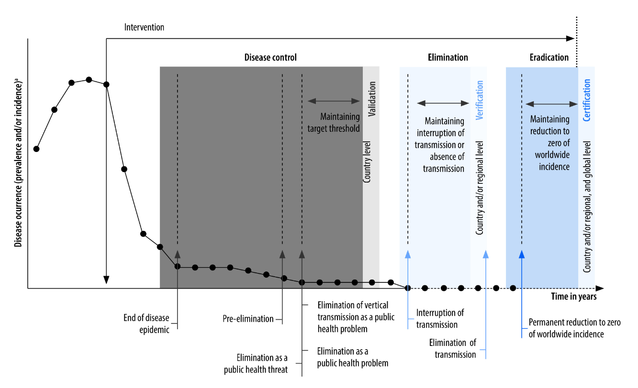
Defining epidemic control
‘No longer a public health threat’ is also referred to as disease control
Reduction in disease incidence, prevalence, and morbidity or mortality to low level
As a result of deliberate efforts (interventions)
Continued intervention measures are required to maintain the reduction
~1995
~2010s
~2030-
2050
~2020s
Khawar et al., Bull World Health Organ 2023

Slide 20
Defining epidemic control
Epidemic control in the context of HIV: reach and sustain low level of transmission through reducing infectious HIV population (low prevalence of HIV viraemia)
  Suppressing viraemia among PLHIV
  Preventing acquiring HIV (through both treatment and primary prevention)
Post-2030 priority for high burden settings: sustain steadily declining new HIV infection for several decades
  Control health system resources for HIV care and treatment
  Reduce risk of return of HIV transmission

Slide 21
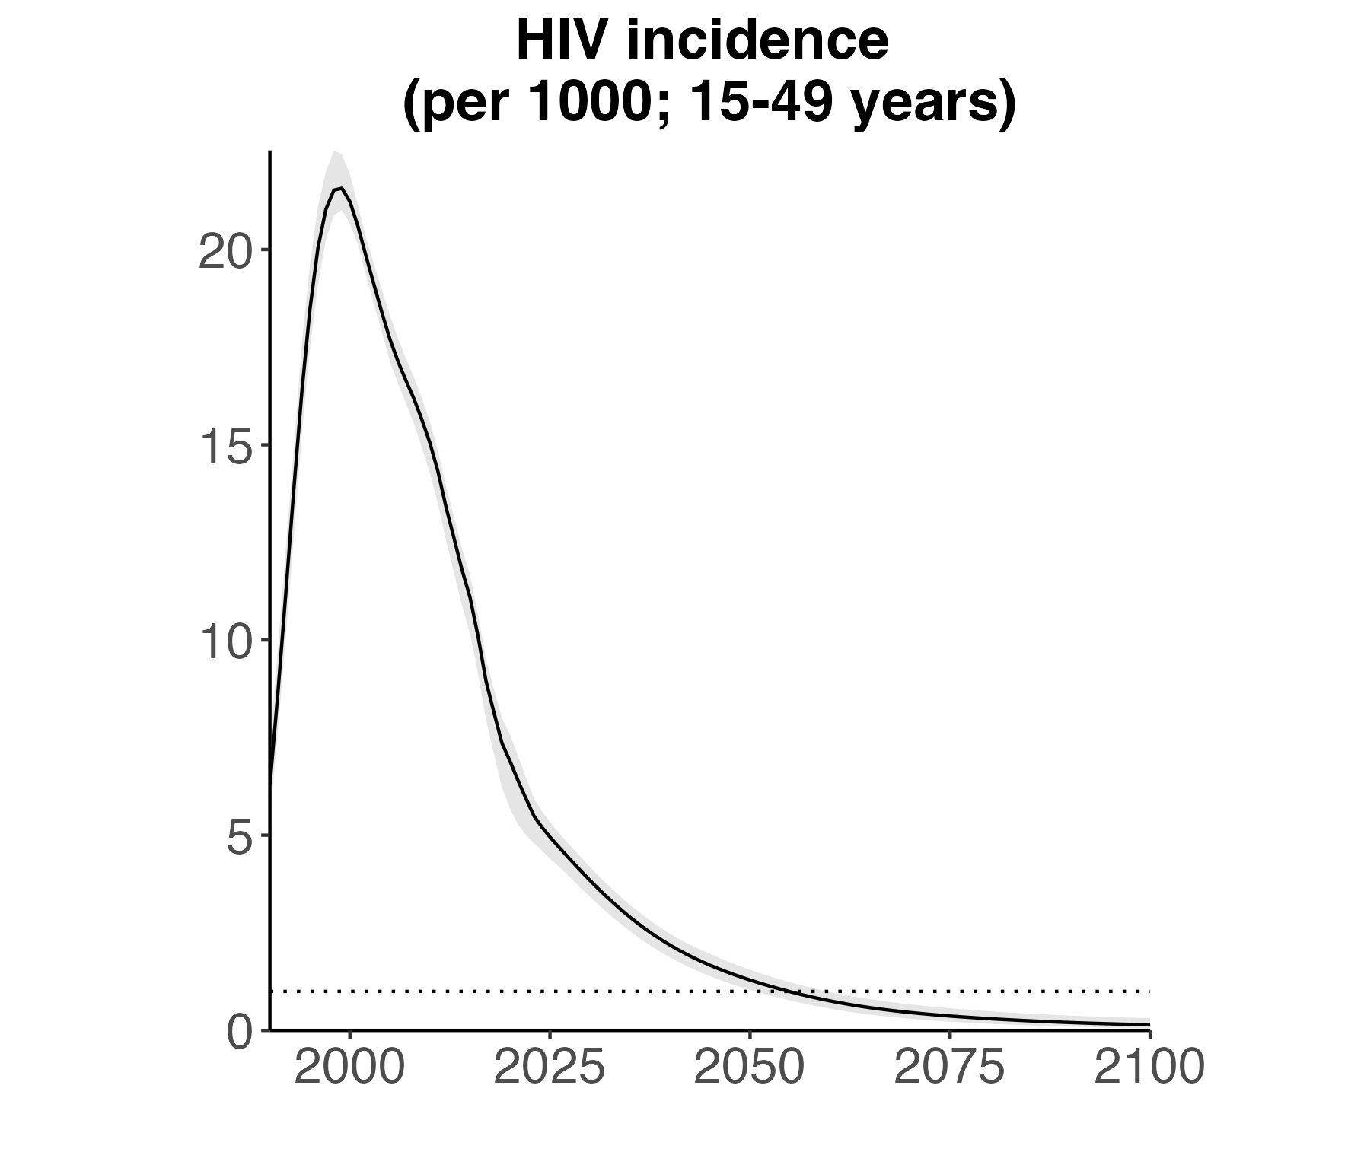
South Africa—epidemiologic impacts of potential future programme changes
‘Status quo’ projection
40 tests per 100 adults each year (~20 million by 2040)
ART coverage: 78% adult PLHIV
  Higher in women than men
  ~65% in MSM; 80% in FSW
Condoms: 33% of all sex acts
  Higher among higher risk
VMMC: increasing to ~80% coverage in 15-49 by 2040
PrEP:
  ~35% among FSW
  ~35% among MSM
  7% among AGYW (higher risk)
4.95/1000
in 2025
<1/1000
in 2055
0.14/1000
in 2100
Thembisa model v4.5; Stefan Rautenbach, in preparation

Slide 22
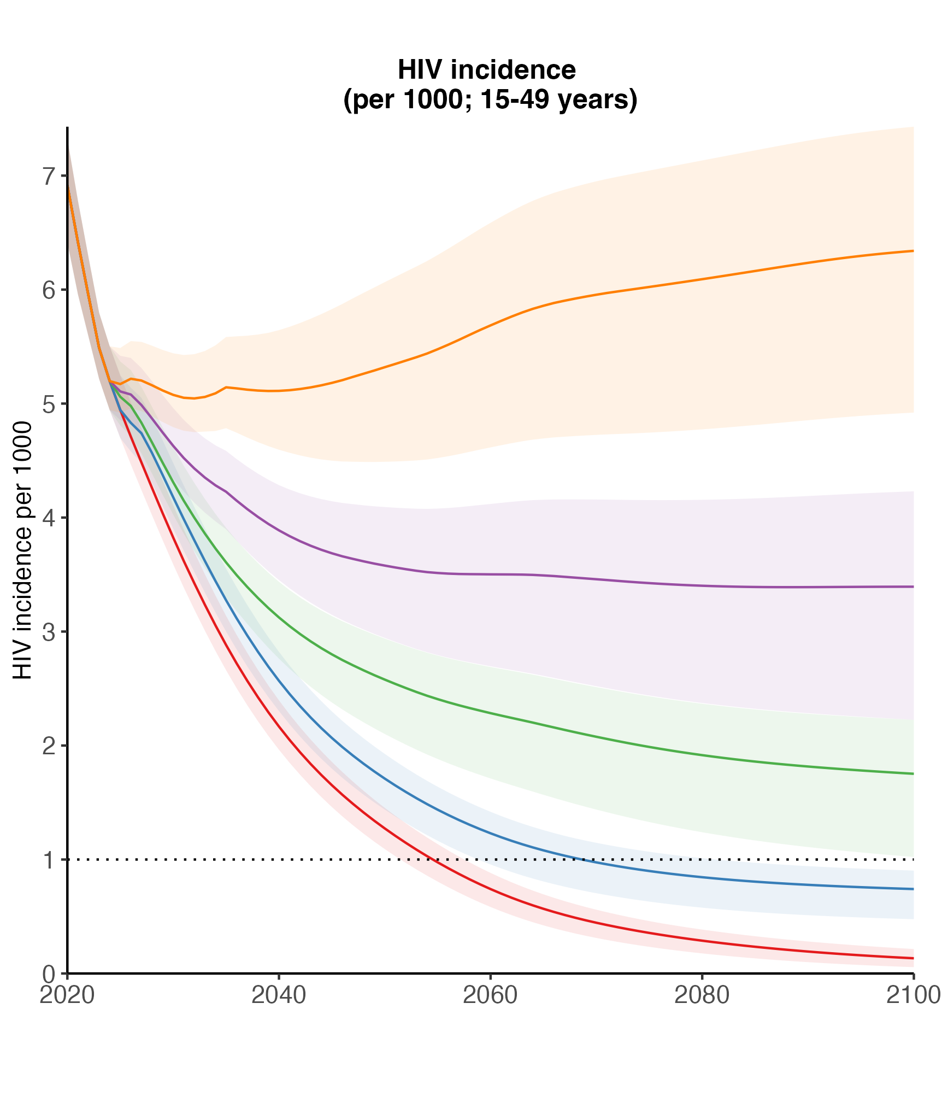
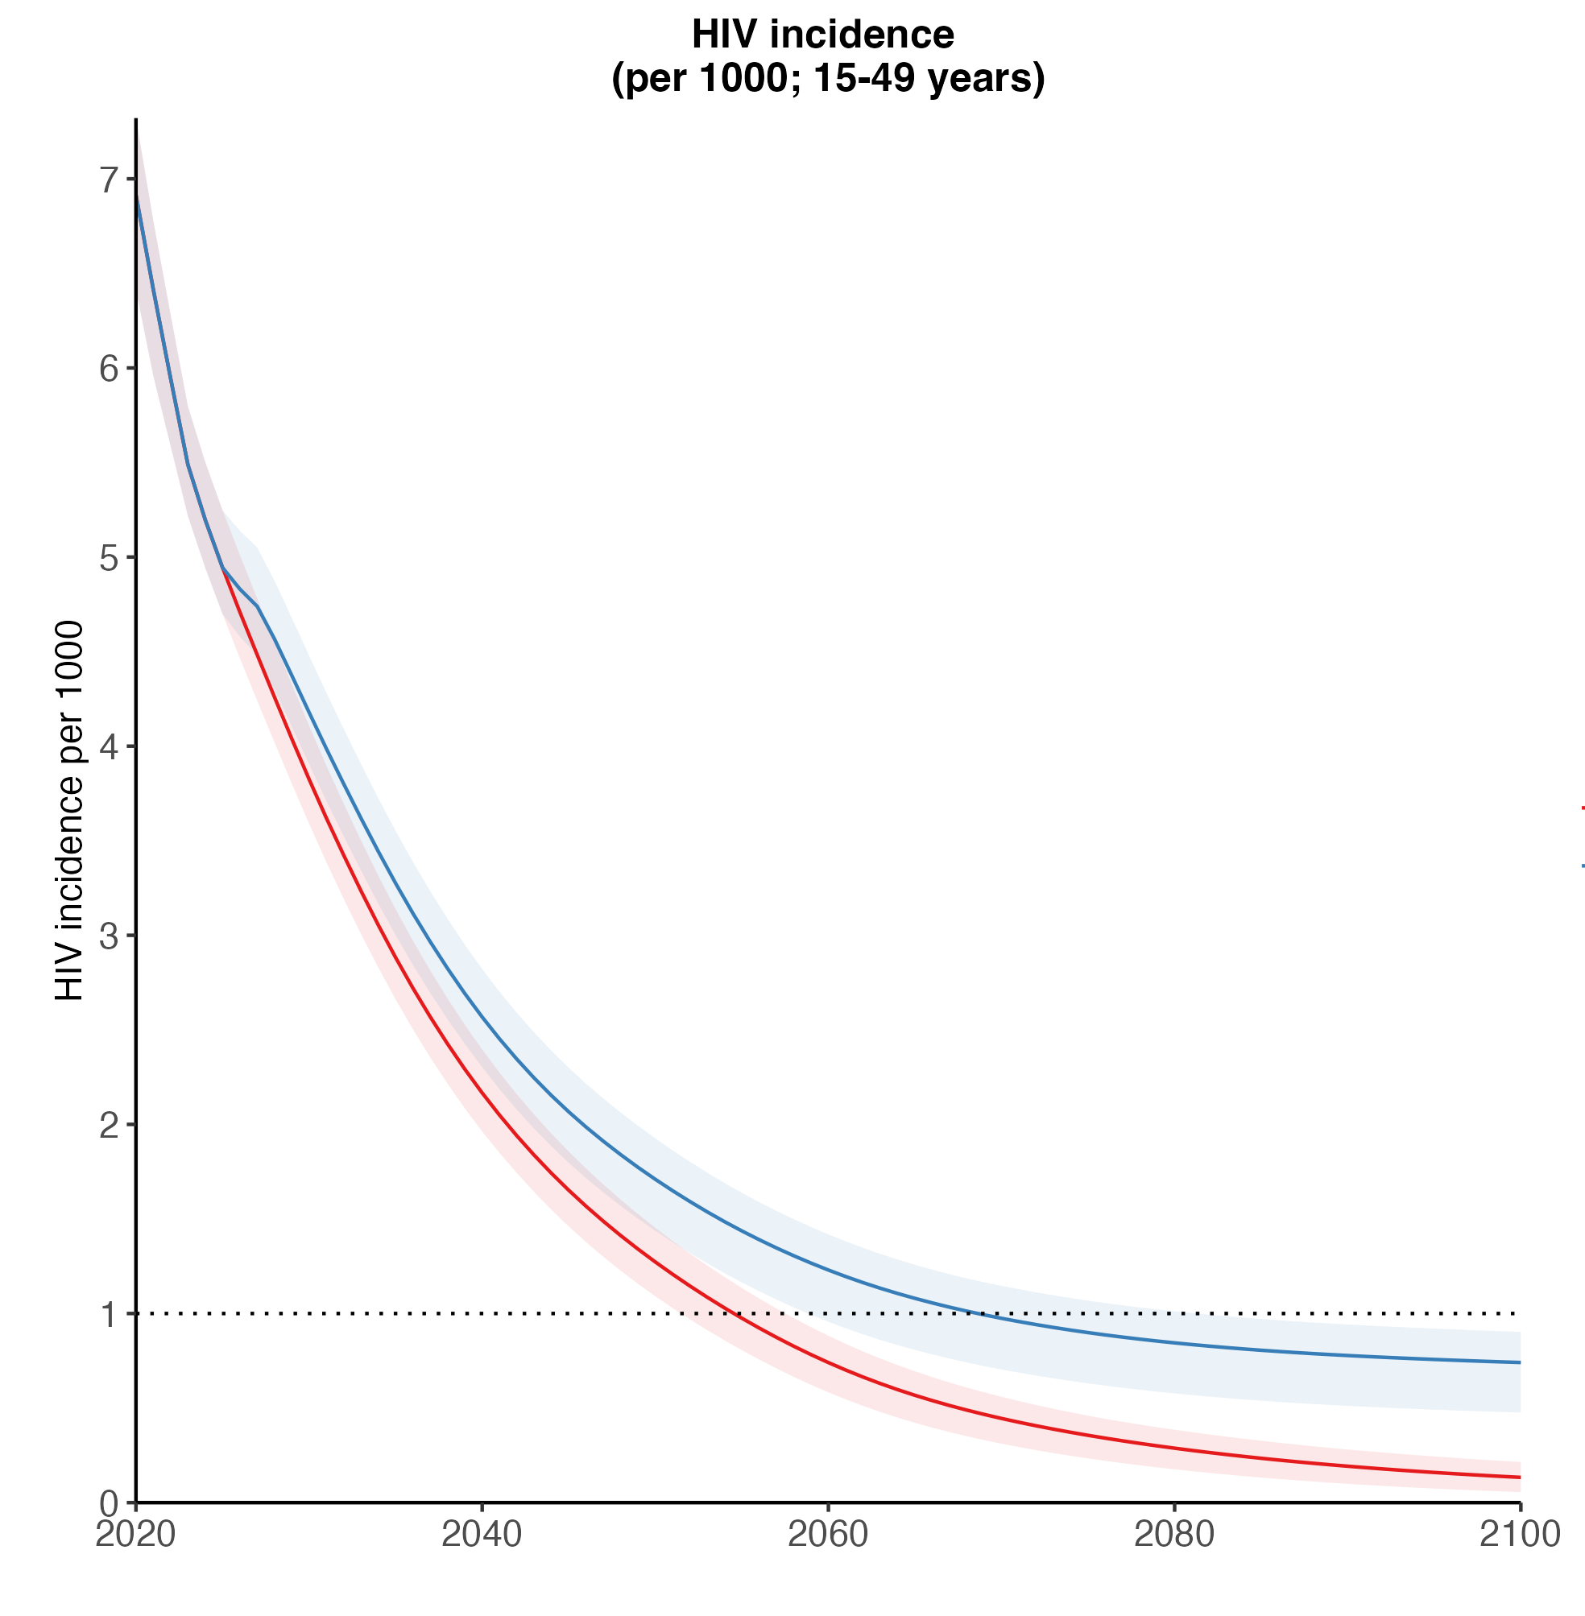
Sustain current HIV testing and treatment
Discontinue other prevention from 2025
Condom use reduce to 23% (+ discont.e PrEP, VMMC)
Equilibrium increase ~6.3 per 1000
Condom use reduce to 28% (+ discon. PrEP, VMMC)
Equilibrium incidence ~3.5 per 1000
Discontinue PrEP & VMMC
Equilibrium incidence ~2 per 1000
Discontinue PrEP (FSW, MSM, higher risk AGYW)
< 1/1000 delayed to 2065
Equilibrium incidence 0.8 per 1000
Continue current prevention
Stefan Rautenbach, in preparation

Slide 23
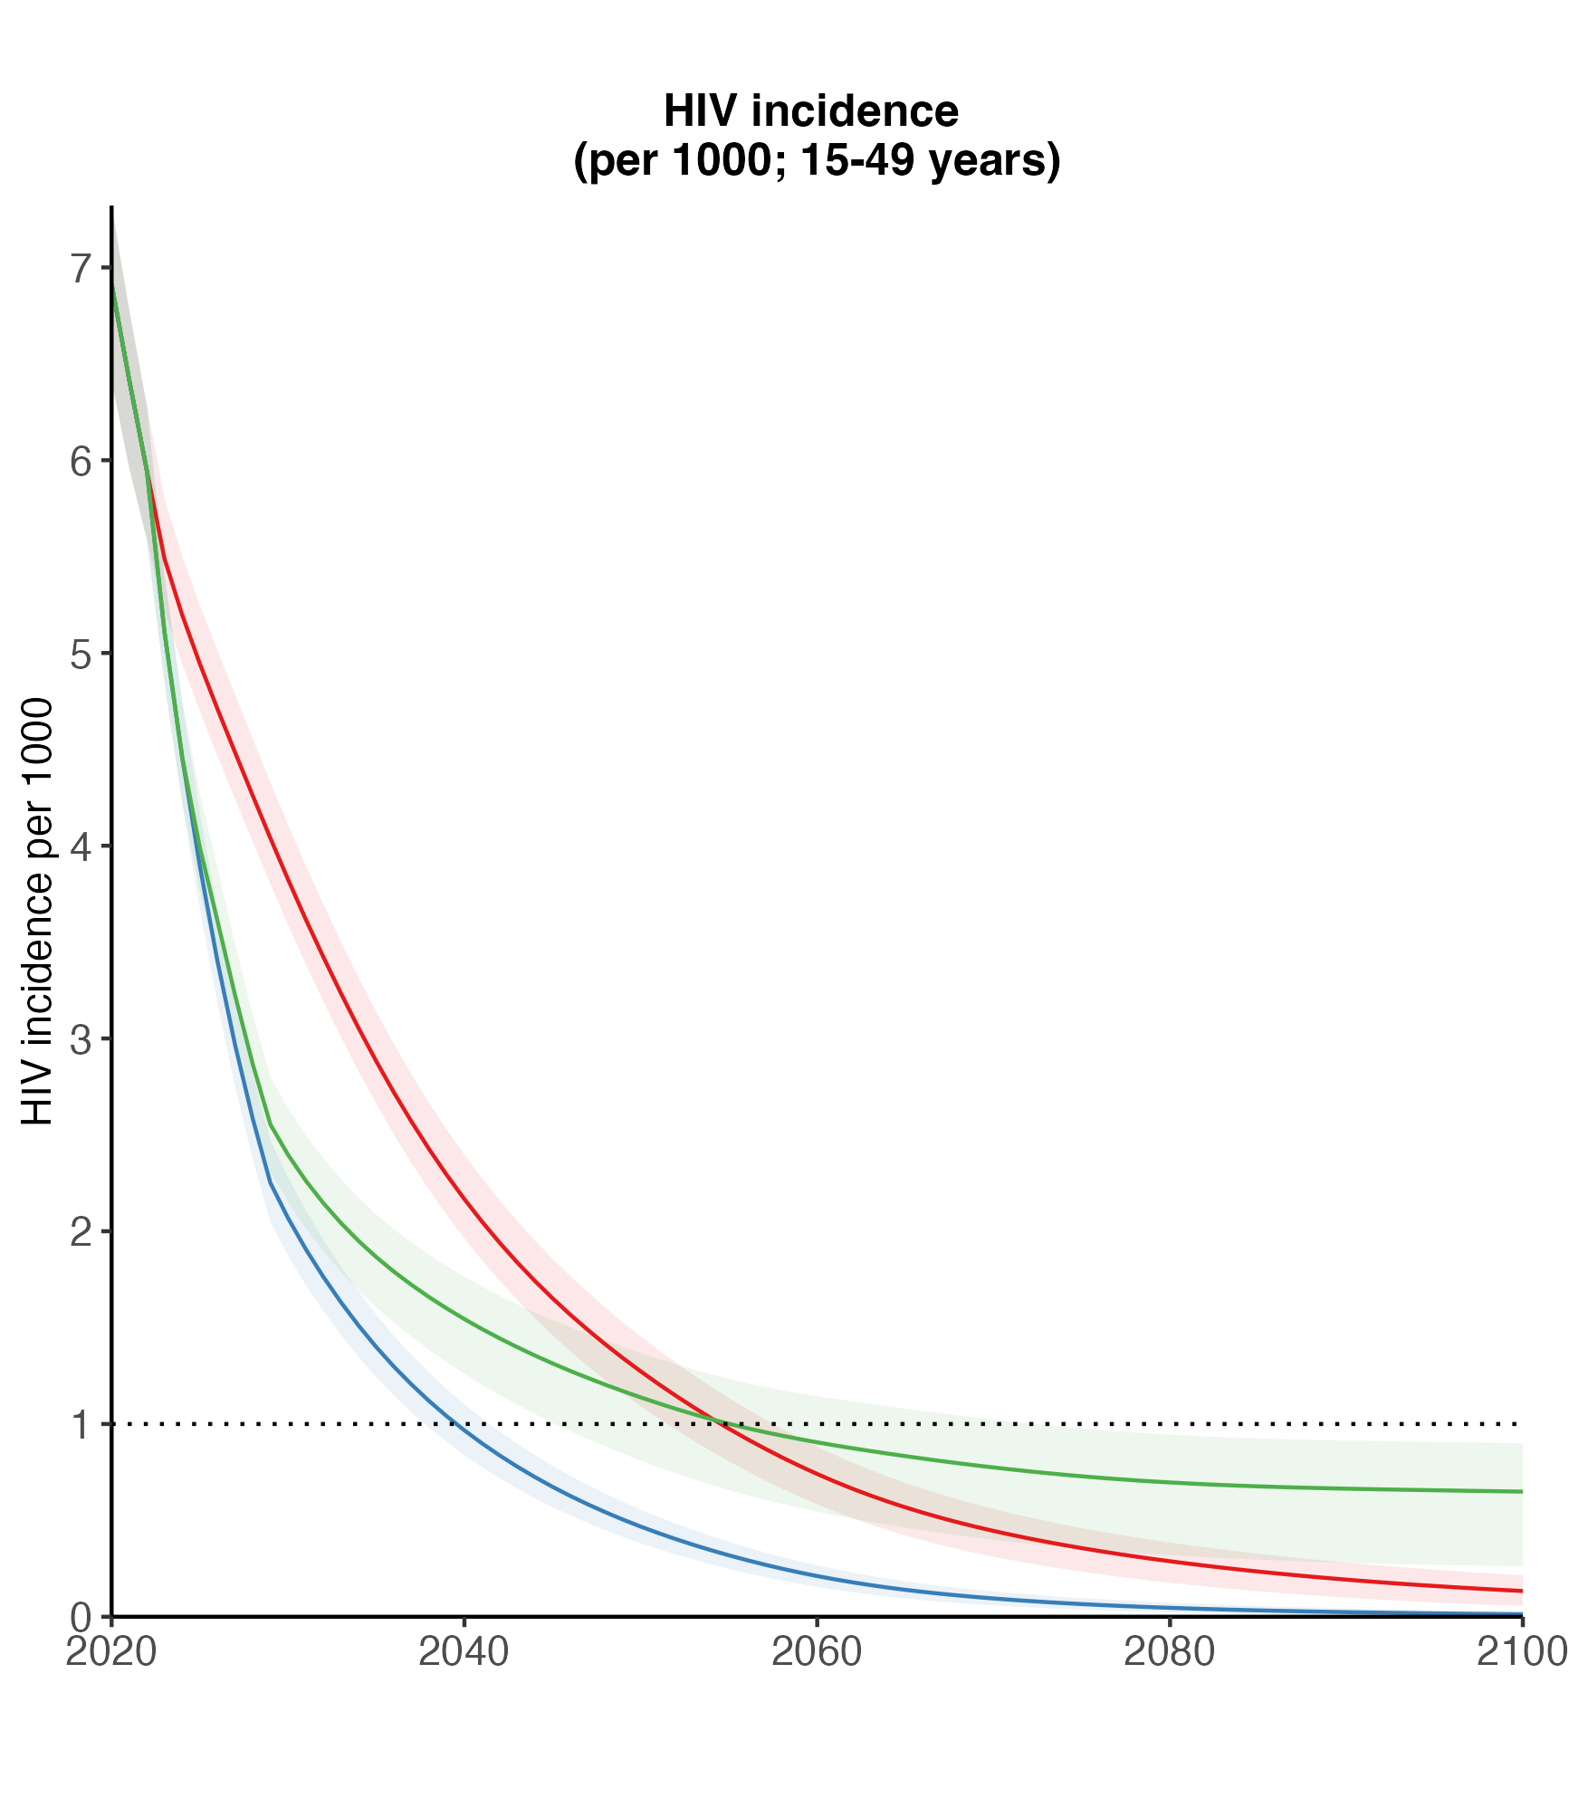
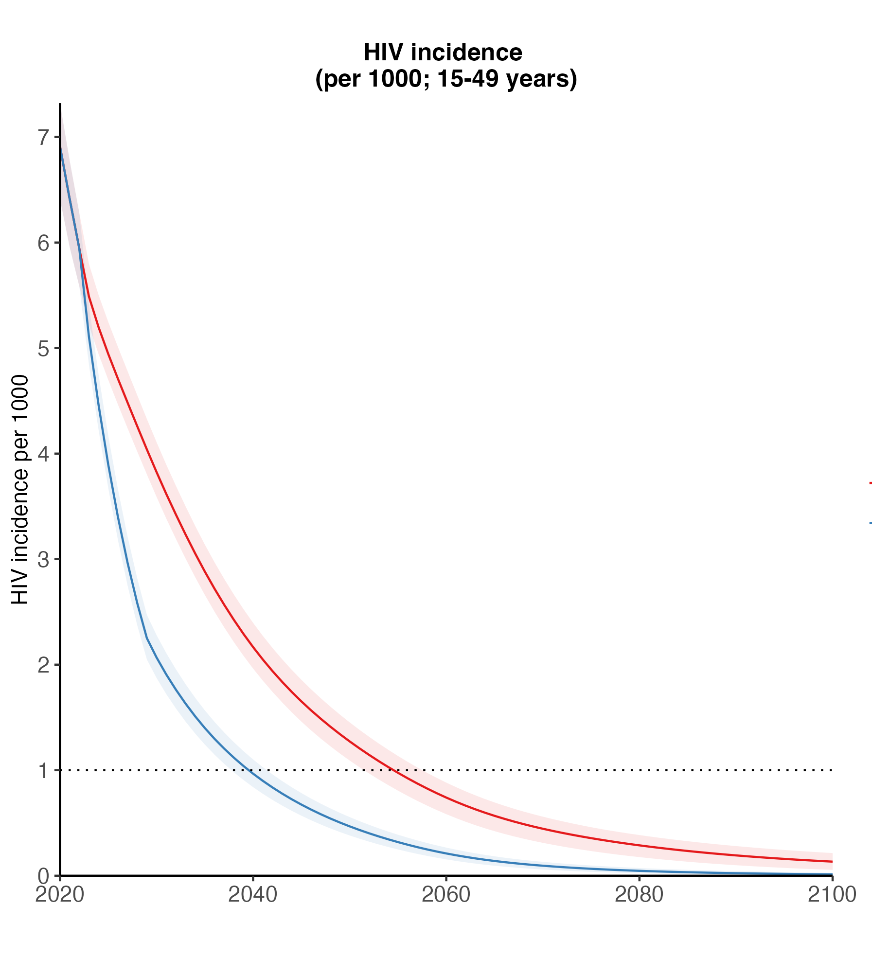
Attaining 95-95-95 accelerates incidence decline. Discontinuing primary prevention results in stable long-term HIV incidence
Improve ART retention to attain 95-95-95 by 2030 & continue current prevention
Attain 95-95-95 by 2030 & discontinue PrEP and VMMC from 2025
Equilibrium incidence ~0.9 per 1000
Continue current testing,
treatment, and prevention
Stefan Rautenbach, in preparation

Slide 24
Models can help guide choice of optimal prevention and treatment options
PrEP
MSM
EE
ART = antiretroviral therapy, PMTCT = prevention of mother-to-child transmission, Condoms = condom promotion and logistics, CSE = comprehensive sexuality education, FSW = services for sex workers, OST = opioid substitution therapy, PWID = services for people who inject drugs, NSP = needle and syringe programs, MSM = services for men who have sex with men, EE = cash transfers
ART
Condoms
VMMC
CSE
FSW
John Stover, UNAIDS Technical Consultation, 2-4 October 2023

Slide 25
Key messages: What will HIV look like beyond 2030?
Sustaining HIV epidemic control: continued intervention measures are required
  Focus on reducing population HIV viraemia through viral suppression and prevention infections
If programmes maintain current coverage levels, HIV incidence will continued declining for 15+ years
  But expect slower rate of decline compared to 2010–2020 period of rapid ART scale-up
Reducing inequities in treatment coverage and viral suppression is could rapidly accelerate incidence declines—men, key populations, and other sexually active populations with lower coverage
Large population with HIV will age: reducing HIV infection risk to young people (including AGYW)
  Shift in new infections, HIV prevention needs, to older age groups
Disproportionate HIV risk among key populations → distinct HIV prevention needs
  Gay men and other MSM, female sex workers, clients of sex workers, people who inject drugs,

Slide 26
Priorities for HIV programmes
Double down on U=U: maintain extremely high treatment coverage, retention and undetectable viral load
  Alignment of individual health outcomes and epidemiologic outcomes
  Integration with other health services; meet changing health needs of aging HIV population
Focus on timely diagnosis: rapidly attain viral suppression → limit transmission opportunity
  Easy access to HIV testing; increasingly through self-tests
  High rates of testing among at-risk population with very low yield
  Low levels of late diagnosis and advanced HIV disease
Nimble HIV prevention: anticipate evolving individual needs and preferences in a reducing risk environment
  Create a prevention programme that will not allow new infections to increase
  Requires access, information, motivation, and options
Intensive key population services: prevention services that meet the distinct needs of populations sustained in perpetuity

Slide 27
What is needed to establish a resilient HIV response?
Social enablers:
  End criminalization, stigma and discrimination, and gender inequality and violence
Empowering communities
  Deliver programmes;
  Monitor accountability of integration and transition
Maintain high HIV awareness and motivation for HIV testing and prevention
Enshrine country-ownership and effective central management systems
…. to sustain steadily declining HIV incidence for decades to come
to a resilient HIV response

Slide 28
Contributors to UNAIDS Consultation on HIV projections and transmission dynamics post-2030
Advisory Group: Lanre Edun, Geoff Garnett, Anne-Claire Guichard, Mary Mahy, Michelle Morrison, Robert Selato, John Stover, Irum Zaidi, Mohammed Abdulaziz
HIV Modelling Consortium MIHPSA Project
Phase I Country modelling leads:
Malawi: Debra ten Brink, Rob Glaubius
South Africa: Leigh Johnson, Edinah Mudimu, Haroon Moolla
Zimbabwe: Isaac Taramusi, Valentina Cambiano
Modelling teams
EMOD: Anna Bershteyn, Edinah Mudimu, David Kaftan, Daniel Citron
Goals: John Stover, Rob Glaubius, Isaac Taramusi, Carel Pretorius
IBM (Zimbabwe): Mike Pickles
Optima: Debra ten Brink, Rowan Martin-Hughes
Synthesis: Andrew Phillips, Valentina Cambiano, Jennifer Smith, Loveleen Bansi-Matharu
Thanzi la Onse: Tara Mangal
Thembisa: Leigh Johnson, Lise Jamieson, Haroon Moolla
Other modelling and epidemiologic analysis
South Africa HIV projections: Stefan Rautenbach, Lilith Whittles, Gesine-Meyer Rath, Lise Jamieson, Leigh Johnson
PANGEA-HIV collaboration: Lucie Abeler-Dörner, Christophe Fraser
Rakai Community Cohort Study: Kate Grabowski
Goals: John Stover; EMOD Eswatini: Adam Akullian; PopART-IBM: Will Probert

Slide 29
Extra slides

Slide 30
Reconceptualise “end of AIDS” from an endpoint to a situation that is maintained:
Epidemiologic conditions and metrics defining ‘AIDS no longer public health threat’
Programmes, policies, and services to ensure epidemiologic situation is maintained
Surveillance and monitoring to ensure epidemiologic condition sustained & programme/policies implemented with fidelity

Slide 31
Modelling to Inform HIV Programmes in Sub-Saharan Africa (MIHPSA) Collaboration [Phase 1]
South Africa
EMOD
Goals-ASM
Optima
Synthesis
Thembisa
Zimbabwe
EMOD
Goals-RSM
Optima
Synthesis
PopART-IBM
Malawi
EMOD
Goals-ASM
Optima
Synthesis
Thanzi la Onse
Projections to 2040 assuming sustaining current levels of interventions (testing, treatment, prevention)
  In most projections, assumed testing and treatment to sustain population VL suppression slightly below 95-95-95 targets + combination prevention
HIV Modelling Consortium, MIHPSA Phase 1, UNAIDS Technical Consultation, 20-21 July 2023

Slide 32
Burning questions
What is the mix of timely diagnosis & VL suppression and acquisition-blocking prevention to keep HIV controlled in a changing risk environment?
  How quickly will we diagnose and treat in low-ish incidence context? (testing freq.)
  How much exposure needs to be blocked between infection and VLS to keep R(t) <1?
How quickly do we want HIV incidence to decline in the future?
  R(t) <1; R(t) <<1; R(t) <<<1
HIV infection
Lifelong ART & VLS
(years)
Contacts (transmission
opportunities)
Primary prevention

