Slide 1
Robert Serwanga. Minister Youth, Sports and the Arts.
Buganda Kingdom - Uganda.
MEN and HIV Session IAS 2024.
Innovative Strategies and Challenges in Addressing HIV Among Men: Insights and Future Directions.

Slide 2
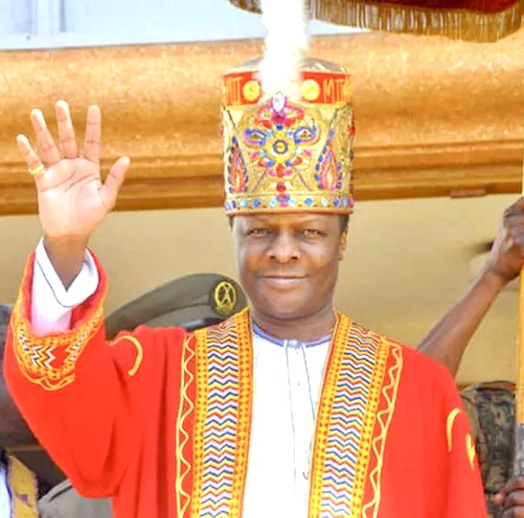
rserwanga@buganda.or.ug x.com/robert_serwanga
+256-414-274-738 Mob. +256-772-495-309.
Buganda-Baganda people within Uganda.
Uganda has 45 Million people.
The KABAKA is UNAIDS Goodwill Ambassador for ending AIDS among men (since March 2017)
A Trusted, and influential leader in the Country, the African Region & beyond.
https://youtu.be/gg_uLhF9WZw
HM The Kabaka (King)
Ronald Muwenda Mutebi II
www.buganda.or.ug

Slide 3
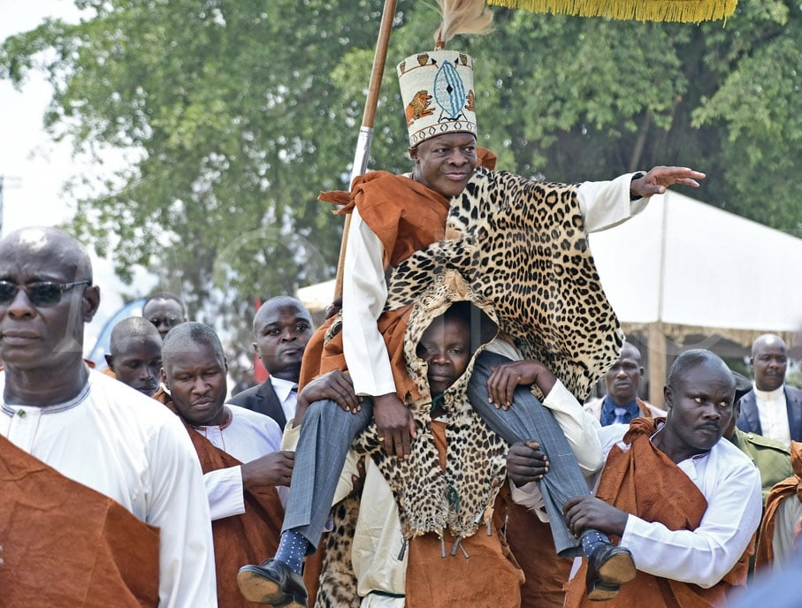
Traditional Leadership
Culture
Shared Values
Beliefs.
Norms.
Consideration
Acceptable
Appropriate
Desirable
Influence
The way we learn.
Live.
Behave
Results
Shapes personality.
Guides thoughts, feelings and actions
WWW.buganda.or.ug
rserwanga@buganda.or.ug x.com/robert_serwanga
+256-414-274-738 Mob. +256-772-495-309.

Slide 4
Contribution to success of HIV interventions among Men.
Accepting HIV is moister and Owning the Challenge.
Embedding all Interventions in our culture in some instances redirecting Culture.
Communication and language.
Leading Change through Opinion leaders in the Governance infrastructure.
WWW.buganda.or.ug
rserwanga@buganda.or.ug x.com/robert_serwanga
+256-414-274-738 Mob. +256-772-495-309.

Slide 5
Buganda Kingdoms contribution to success of HIV interventions among Men.
Accepting HIV is moister and Owning the Challenge
WWW.buganda.or.ug
rserwanga@buganda.or.ug x.com/robert_serwanga
+256-414-274-738 Mob. +256-772-495-309.

Slide 6
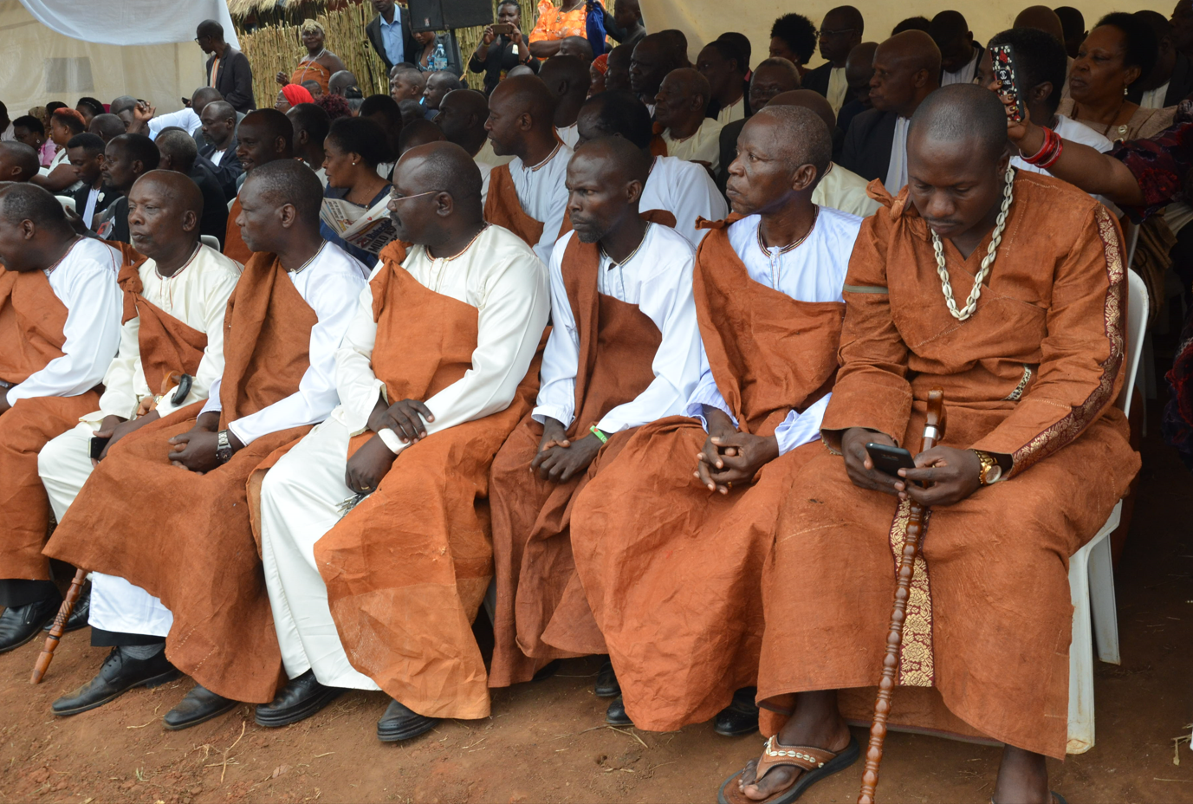
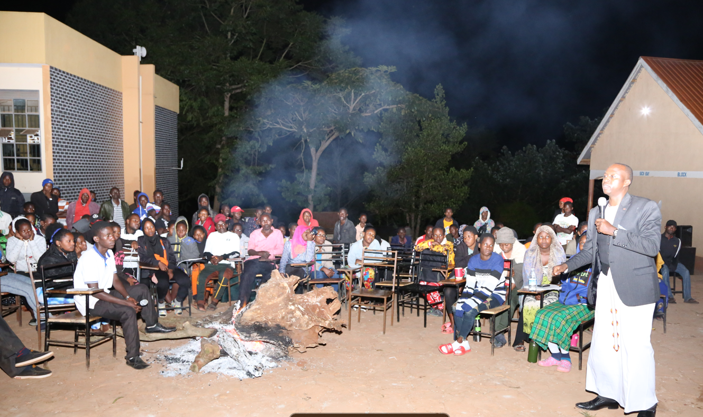
Buganda Kingdoms contribution to success of HIV interventions among Men.
2. Embedding all Interventions in our culture in some instances redirecting Culture.
WWW.buganda.or.ug
rserwanga@buganda.or.ug x.com/robert_serwanga
+256-414-274-738 Mob. +256-772-495-309.

Slide 7
Buganda Kingdoms contribution to success of HIV interventions among Men.
3. Communication and language.
WWW.buganda.or.ug
rserwanga@buganda.or.ug x.com/robert_serwanga
+256-414-274-738 Mob. +256-772-495-309.

Slide 8
Contribution to success of HIV interventions among Men.
3. Communication and language.
WWW.buganda.or.ug
rserwanga@buganda.or.ug x.com/robert_serwanga
+256-414-274-738 Mob. +256-772-495-309.

Slide 9
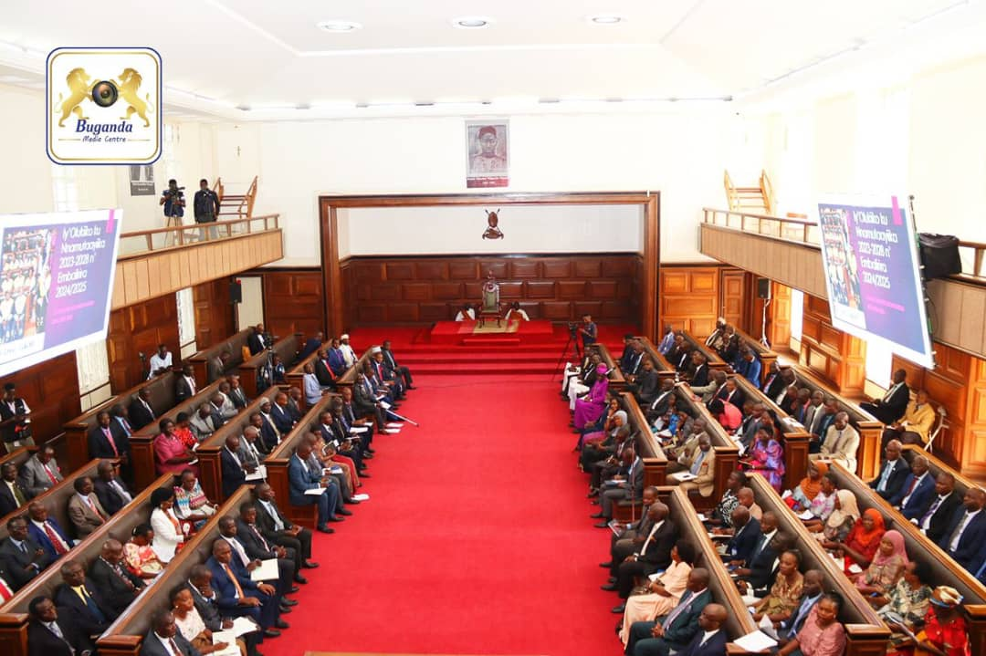
Buganda Kingdoms contribution to success of HIV interventions among Men.
4. Leading Change through Opinion leaders in the kingdom Governance infrastructure.
WWW.buganda.or.ug
rserwanga@buganda.or.ug x.com/robert_serwanga
+256-414-274-738 Mob. +256-772-495-309.

Slide 10
Most effective Strategies : -
Honest translation of messages/interventions to Aid understanding .
Theming all institutional Activities to include HIV interventions.
Brotherhood.
WWW.buganda.or.ug
rserwanga@buganda.or.ug x.com/robert_serwanga
+256-414-274-738 Mob. +256-772-495-309.

Slide 11
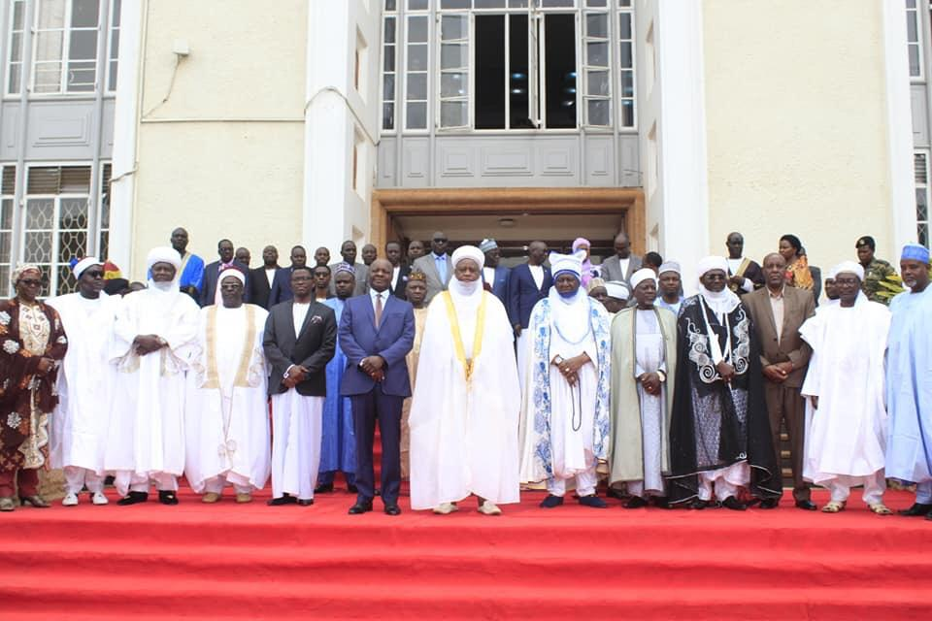
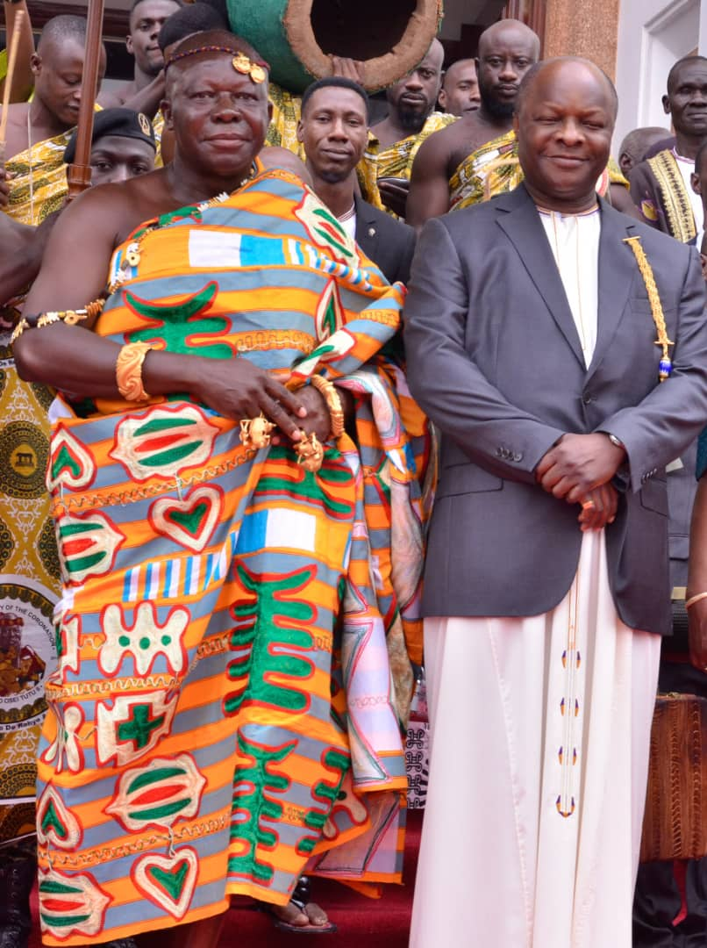
Other African Cultural leaders have often visited the Kabaka discussions have been on the HIV theme and other health issues

Slide 12
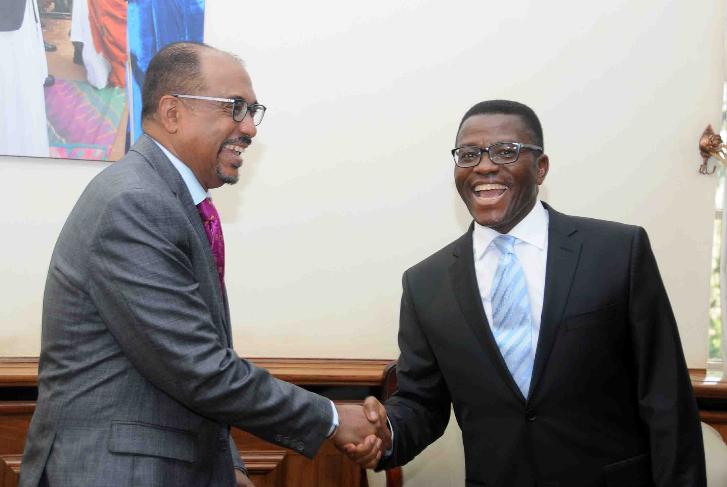
The Impact
This approach has significantly improved HIV- Cultural- related behaviors in Buganda Kingdom between 2016 and 2020 including;
Increased knowledge of HIV status from 89% to 94%,
Increased HIV treatment coverage from 64% to 92% .
A 52% decrease in new HIV Infections.

Slide 13
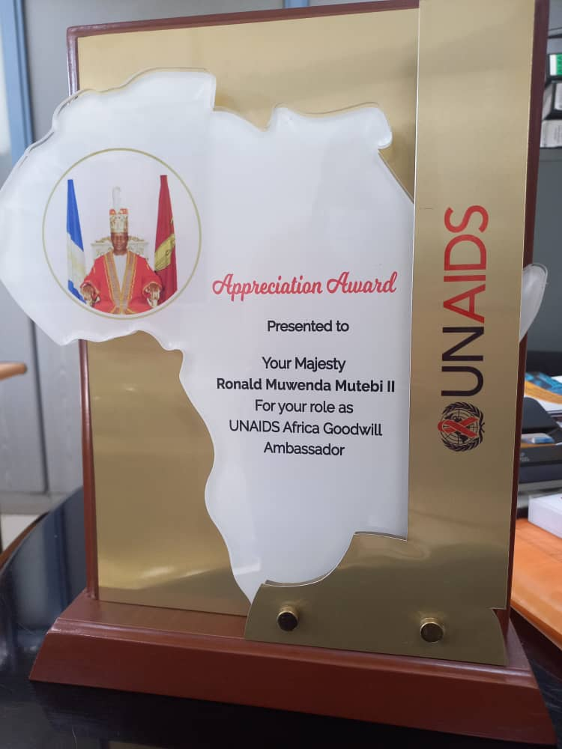

Slide 14
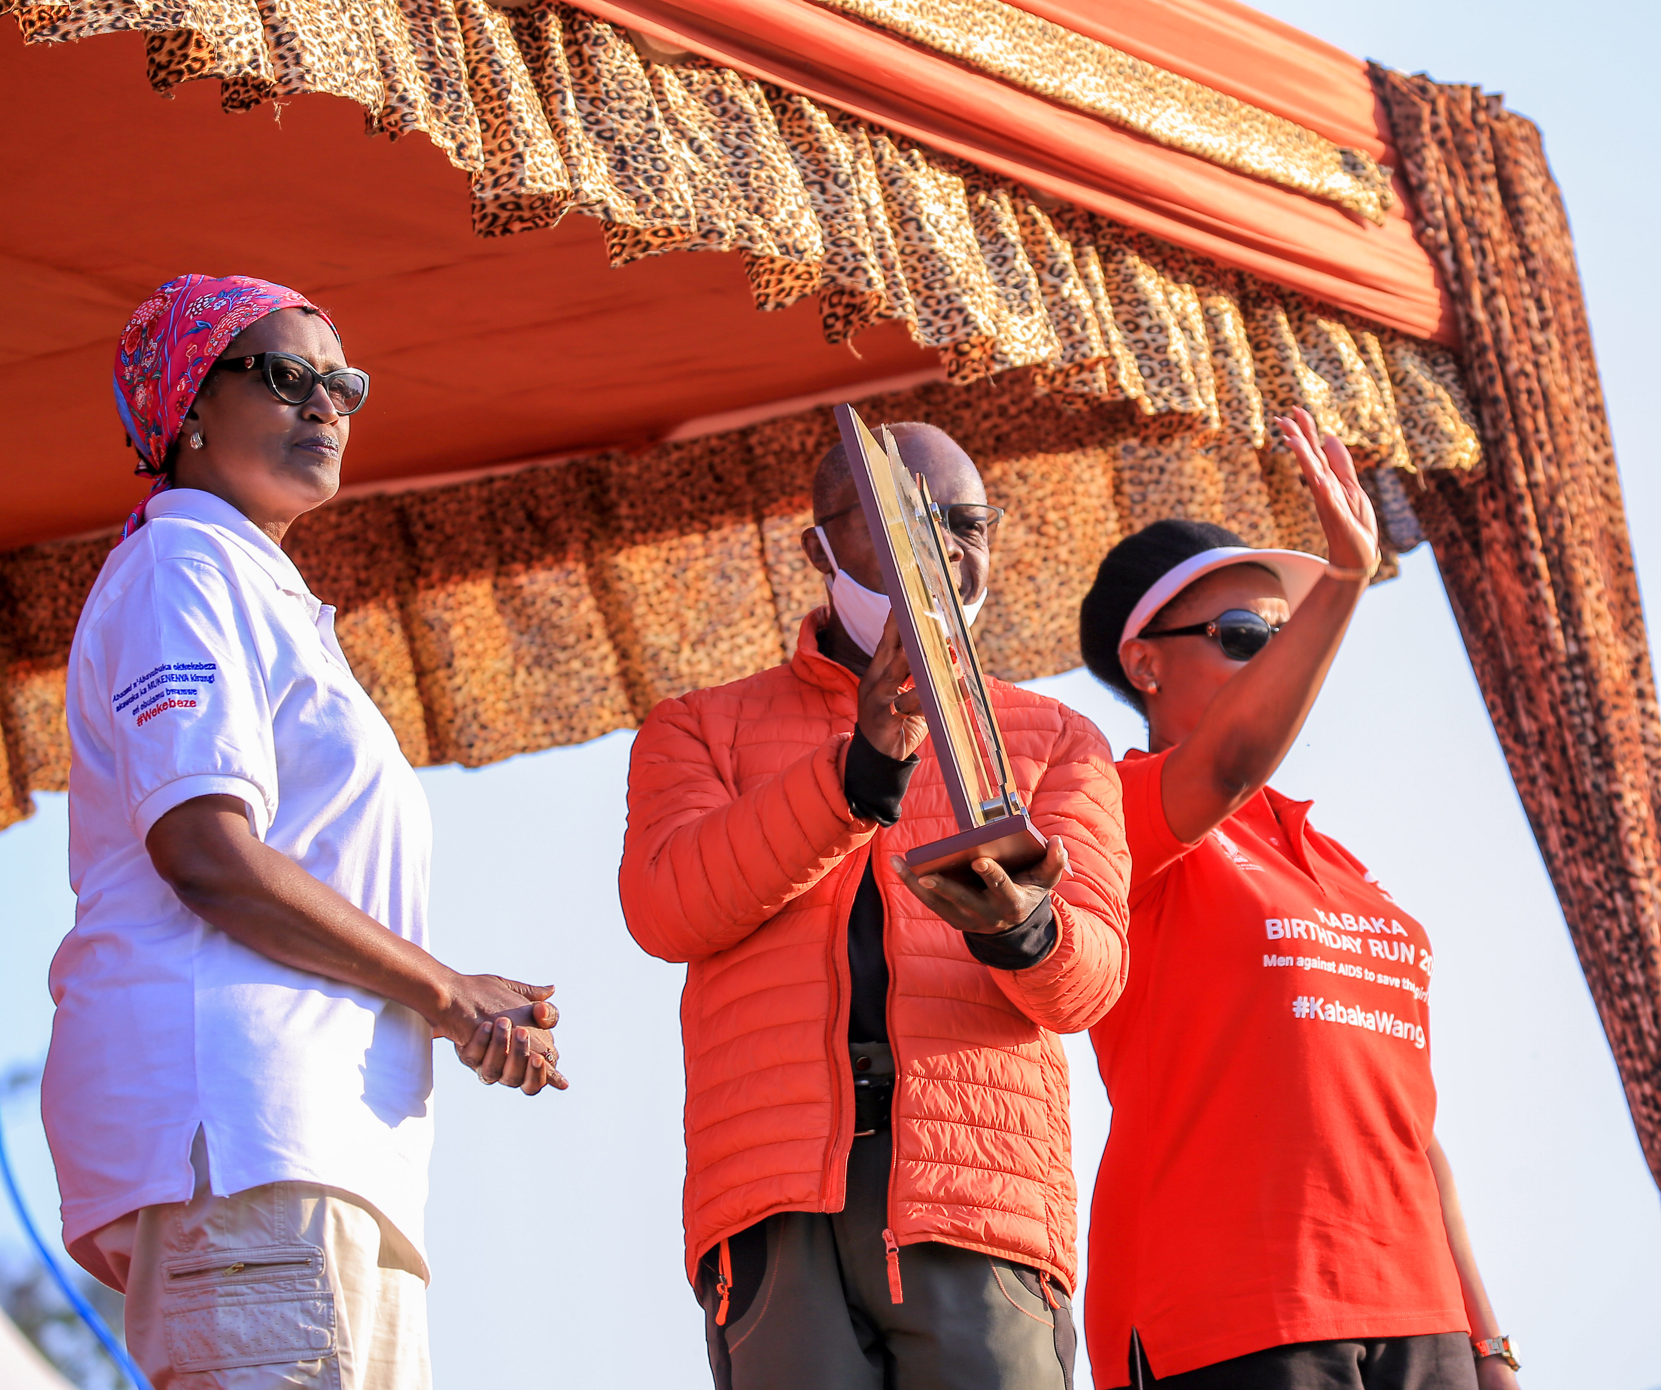

Slide 15
