Slide 1
Module 1: Key elements of programming with key populations
Session 1.2: Community empowerment and community-led responses
In-Reach Online Training | Increasing support and partnerships with key populations at risk of HIV

Slide 2
Introduction
The WHO Key Populations Consolidated Guidelines, 2022 note that “Key populations often have little or no control over HIV, STI and viral hepatitis risk factors driven by the legal, political and social and programmatic environment, and the context of their lives.”
This session explores how community empowerment can address this problem by increasing the ability of key population communities to take leadership in implementation of programs and services and address structural constraints to their health, human rights and well-being.
SESSION 1.2 | INTRODUCTION

Slide 3
Session 1.2: Community empowerment and community-led responses
Questions to frame this section
What is community empowerment?
How community empowerment supports HIV services
How UN organisations can support community empowerment for HIV services
The key population implementation tools
Take-home messages
Session review questions
Further information and resources

Slide 4
Framing questions
1. Community empowerment is a way of improving the access and quality of programs and services for key populations.
Agree
Disagree
Unsure
2. The 2021 Political Declaration on HIV and AIDS has set clear targets for countries to accelerate community-led responses.
Agree
Disagree
Unsure
SESSION 1.2 | QUESTIONS TO FRAME THIS SESSION

Slide 5
Framing questions
3. UN organisations should support key populations’ involvement in all aspects of designing, implementing and monitoring HIV programmes.
Agree
Disagree
Unsure
4. Community empowerment is not part of WHO guidance on HIV programming for key populations.
Agree
Disagree
Unsure
SESSION 1.2 | QUESTIONS TO FRAME THIS SESSION

Slide 6
Framing questions: responses
Correct. Community empowerment enables key populations to exercise leadership in designing and implementing the services that will help them best.
Correct. There are explicit targets for community-led responses in HIV testing and treatment, prevention programming and societal enablers.
Correct. Key populations are experts in their own needs and understand how to make programmes effective on the ground.
Incorrect. Latest guidance from WHO recommends community empowerment as part of a comprehensive package of HIV services for key populations. So do the UNAIDS, Global Fund and PEPFAR strategies.
SESSION 1.2 | QUESTIONS TO FRAME THIS SESSION

Slide 7
Session 1.2: Community empowerment and community-led responses
Questions to frame this section
What is community empowerment?
How community empowerment supports HIV services
How UN organisations can support community empowerment for HIV services
The key population implementation tools
Take-home messages
Session review questions
Further information and resources

Slide 8
What is community empowerment?
Community empowerment refers to all activities that put key populations at the centre of programmatic and development responses. This includes key populations leading high-quality interventions and services
Community refers to key population networks and organisations, rather than the broader geographic, social or cultural groupings of which they may be a part.
For example, in this training, terms like community-led services and community-led monitoring refer to services and monitoring led by organisations of key populations.
SESSION 1.2 | WHAT IS COMMUNITY EMPOWERMENT?

Slide 9
Three pillars of community
empowerment
Choice and control: Having the power as an individual or community to take decisions on issues affecting one’s life
Community formation and integration: This means social support, networking, forming an identity as a community, representing and advocating for a constituency, and enhancing community participation in community life
Access to essential resources: for example, access to: Work, education, housing, health care, nutrition, personal safety, security, quality of life. Often a source of funding is a prerequisite
SESSION 1.2 | WHAT IS COMMUNITY EMPOWERMENT?

Slide 10
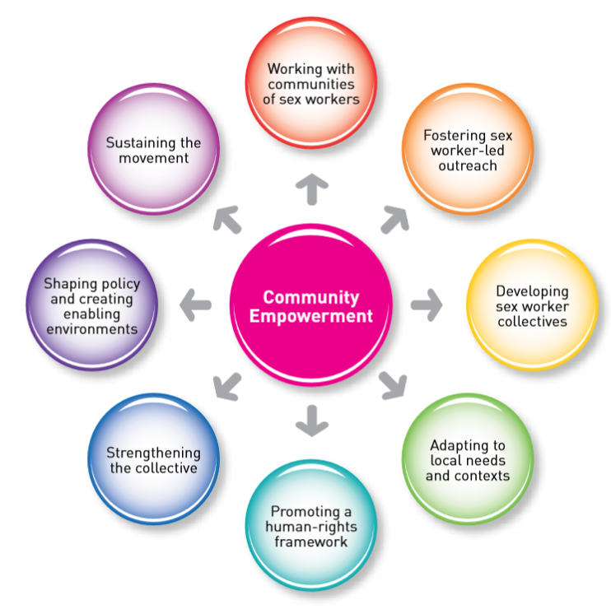
Why does community empowerment
matter?
When communities of key populations participate in empowerment activities, they become more able to understand, articulate and advocate for their rights and needs, for example, for:
HIV prevention and treatment services
Critical enablers to protect their rights, health and well-being
Empowerment activities include:
Training and learning
Advocacy
Planning, organising, delivering, managing and monitoring HIV services
Community-led responses to HIV are central to community empowerment. This means that programmes are run by communities, for communities.
Source: Implementing Comprehensive HIV/STI Programmes with Sex Workers, 2013
SESSION 1.2 | WHAT IS COMMUNITY EMPOWERMENT?

Slide 11
Communities at the heart of the HIV response:
The 30-80-60 targets
In the 2021 Political Declaration on HIV and AIDS, governments have committed to ensuring strong leadership of communities in the HIV response.
By 2025, community-led organisations – including organisations led by key populations – should deliver:
30% of testing and treatment services
80% of prevention services for communities at high risk
60% of programmes to support societal enablers
The 30-80-60 targets are also part of the Global AIDS Strategy 2021-2026.
SESSION 1.2 | WHAT IS COMMUNITY EMPOWERMENT?

Slide 12
Communities at the heart of the HIV response:
The 10-10-10 targets
In the 2021 Political Declaration on HIV and AIDS, governments have committed to removing social and legal impediments towards an enabling environment limiting access or utilization of HIV services.
By 2025:
Less than 10% of countries have punitive legal and policy environments that deny or limit access to services.
Less than 10% of people living with HIV and key populations experience stigma and discrimination.
Less than 10% of women, girls, people living with HIV and key populations experience gender inequality and violence.
The 10-10-10 targets are also part of the Global AIDS Strategy 2021-2026.
SESSION 1.2 | WHAT IS COMMUNITY EMPOWERMENT?

Slide 13
Session 1.2: Community empowerment and community-led responses
Questions to frame this section
What is community empowerment?
How community empowerment supports HIV services
How UN organisations can support community empowerment for HIV services
The key population implementation tools
Take-home messages
Session review questions
Further information and resources

Slide 14
How community empowerment supports
HIV services
The GIPA principle (greater involvement of people living with HIV) applies equally importantly to key populations. GIPA commits countries to support meaningful engagement of key populations in the response to HIV, viral hepatitis and STIs.
Effective empowerment of key populations includes sustained engagement and leadership-building. Examples of community empowerment, engagement and leadership efforts that the UN supports include:
Supporting key populations to own and lead programmes and implement services
Strengthening key population networks, communities and collectives, and ensuring community ownership of programmes
Supporting meaningful participation of key populations in broader civil society and human rights efforts.
Let’s look at several ways in which community-led responses can facilitate better services for key populations.
SESSION 1.2 | HOW COMMUNITY EMPOWERMENT SUPPORTS HIV SERVICES

Slide 15
1. Community-led programs
and services
Key population-led organisations and networks have successfully organised and delivered programs and services since the earliest days of the HIV epidemic.
Community-led programs and services increase access, uptake and coverage of often hidden key populations.
Image: UNAIDS / Mplus Foundation
SESSION 1.2 | HOW COMMUNITY EMPOWERMENT SUPPORTS HIV SERVICES

Slide 16
Examples of community-led
programs and services
Community outreach workers (in-person and virtual, using ICT*) provide prevention services, referrals and community mobilisation
Peer navigators guide people through clinical services, eg for HIV/STI testing, and helping people newly diagnosed with HIV to start and stay on antiretroviral therapy (ART)
Safe spaces (drop-in centres) give key population members places to access services and training, and to socialise
Community-led monitoring holds service providers accountable and helps improve services *ICT = Information and communication technology
SESSION 1.2 | HOW COMMUNITY EMPOWERMENT SUPPORTS HIV SERVICES

Slide 17
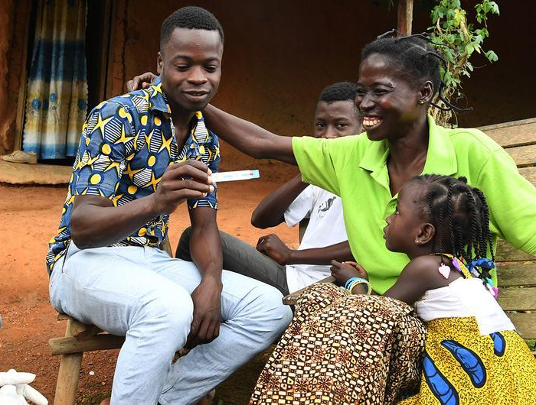
2. Community-led monitoring (CLM)
What is CLM?
CLM is an accountability mechanism for HIV responses at different levels, led and implemented by community-led organisations.
CLM uses a structured platform of trained peer monitors to systematically and routinely collect and analyse data on HIV service delivery.
CLM builds evidence on what works well, what is not working and what needs to be improved.
CLM enables cross-checking and validation of data collected and reported by governments.
Image: UNICEF / Frank Dejong
Source: Establishing Community-Led Monitoring of HIV Services: Principles and Process (UNAIDS, 2021)
SESSION 1.2 | HOW COMMUNITY EMPOWERMENT SUPPORTS HIV SERVICES

Slide 18
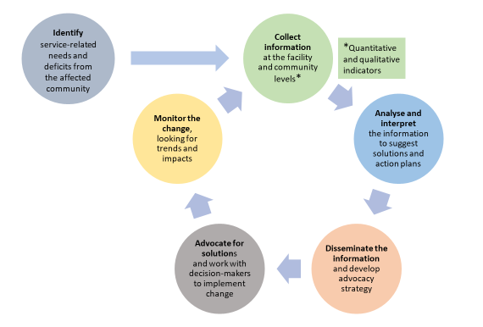
The CLM approach
Source: Establishing Community-Led Monitoring of HIV Services: Principles and Process (UNAIDS, 2021)
SESSION 1.2 | HOW COMMUNITY EMPOWERMENT SUPPORTS HIV SERVICES

Slide 19
Why invest in CLM?
CLM helps to obtain accurate, current and local data for local use and problem-solving.
Mobilising communities to collect information about the quality of services increases their ownership of programmes designed to benefit them.
It gives voice to communities and can creates positive dynamics between what the state must deliver, what providers must give and what communities must contribute.
Sources: Establishing Community-Led Monitoring of HIV Services: Principles and Process (UNAIDS, 2021); presentation by Alain Manouan at PEPFAR Country Operation Plan for Côte d’Ivoire (Johannesburg, 2020).
SESSION 1.2 | HOW COMMUNITY EMPOWERMENT SUPPORTS HIV SERVICES

Slide 20
3. Community-led activities for
critical enablers
What are critical enablers?
Critical enablers are strategies, activities and approaches to:
Remove punitive laws, policies and practices
Reduce stigma and discrimination
Empower key population communities
Address violence
SESSION 1.2 | HOW COMMUNITY EMPOWERMENT SUPPORTS HIV SERVICES

Slide 21
Why invest in community-led activities
for critical enablers?
Critical enablers improve the accessibility, acceptability, uptake, equitable coverage, effectiveness and efficiency of HIV, viral hepatitis and STI programs and services.
They create an enabling environment that leads to better outcomes for these diseases.
They are an essential part of the Global AIDS Strategy 2021-2026 (the “10-10-10 targets”).
See Session 1.4 for more details.
SESSION 1.2 | HOW COMMUNITY EMPOWERMENT SUPPORTS HIV SERVICES

Slide 22
Case study: Community-led responses
in a humanitarian setting
In Ukraine, Alliance Global, the country’s largest LGBT organisation, supports a Global Fund-funded network of paralegals.
Peer paralegals act as first responders when human rights violations occur within the LGBT community. They provide immediate support for people being questioned or detained by authorities, and lead public campaigns to challenge stigma and discrimination.
Following the Russian invasion of Ukraine in 2022, the paralegal network adapted to respond to the immediate needs of the community during the crisis, by:
Establishing permanent links with community members to monitor emerging needs
Finding temporary shelters for those who lost their homes
Supporting those who relocated to other regions to maintain their supplies of medication.
Source: Ukrainian LGBTI Activist on Breaking Down Barriers to Health Despite Deadly Conflict (The Global Fund, 2022)
SESSION 1.2 | HOW COMMUNITY EMPOWERMENT SUPPORTS HIV SERVICES

Slide 23
Session 1.2: Community empowerment and community-led responses
Questions to frame this section
What is community empowerment?
How community empowerment supports HIV services
How UN organisations can support community empowerment for HIV services
The key population implementation tools
Take-home messages
Session review questions
Further information and resources

Slide 24
Capacity strengthening of communities
Capacity strengthening of key population-led organisations improves many aspects of programming, including better:
Leadership, self-governance and organisational development
Epidemiology and data collection
Programme design, management, and monitoring and evaluation
Staff development
Advocacy for societal enablers
SESSION 1.2 | HOW UN ORGS CAN SUPPORT COMMUNITY EMPOWERMENT FOR HIV SERVICES

Slide 25
Resourcing and advocacy
Resources and expertise are needed to strengthen key population-led organisations in:
Leadership
Self-governance
Organisational development
The UN can work to counter policies and laws that impede the ability of community-led organisations to provide a full range of HIV programs and services. UN efforts can help to end:
Criminalisation of key populations
Criminalisation of outreach (e.g. carrying prevention commodities such as condoms or needles and syringes)
Bans or restrictions on the formation of community-led organisations, or of their involvement in providing HIV services
See Session 1.4 for more details.
SESSION 1.2 | HOW UN ORGS CAN SUPPORT COMMUNITY EMPOWERMENT FOR HIV SERVICES

Slide 26
Session 1.2: Community empowerment and community-led responses
Questions to frame this section
What is community empowerment?
How community empowerment supports HIV services
How UN organisations can support community empowerment for HIV services
The key population HIV implementation tools (SWIT, MSMIT, TRANSIT, IDUIT)
Take-home messages
Session review questions
Further information and resources

Slide 27
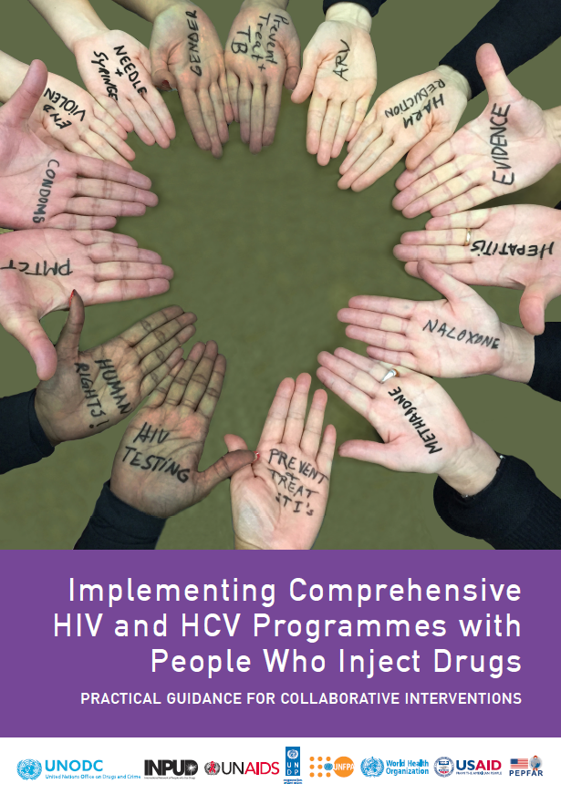
The implementation tools for comprehensive HIV, STI and
HCV programming with and for key populations
The SWIT
(Sex workers)
The MSMIT
(Gay, bisexual and other men who have sex with men)
The IDUIT
(People who inject drugs)
The TRANSIT
(Transgender people)
SESSION 1.2 | THE KEY POPULATION IMPLEMENTATION TOOLS

Slide 28
Why the key population HIV
implementation tools matter
Developed jointly during 2013-2017 by networks of key population organisations, UN agencies and other stakeholders
Global in scope
Widely supported by many reputable stakeholders (UNFPA, UNDP, UNAIDS, WHO, UNODC, USAID, PEPFAR, Global Fund etc.)
Their legitimacy means the implementation tools can be used by UN as advocacy tools to strengthen programs and services for key populations
Community empowerment is a core value and underlying principlefoundation of the implementation tools
SESSION 1.2 | THE KEY POPULATION IMPLEMENTATION TOOLS

Slide 29
Session 1.2: Community empowerment and community-led responses
Questions to frame this section
What is community empowerment?
How community empowerment supports HIV services
How UN organisations can support community empowerment for HIV services
The key population implementation tools
Take-home messages
Session review questions
Further information and resources

Slide 30
Take-home messages
The 2021 Political Declaration on HIV and AIDS, and the Global AIDS strategy (2021-2025) call for more key population programs and services to be community-led (the “30-80-60 targets”).
Community-led responses are game-changers in reducing inequalities and supporting effective and resilient HIV responses. They include:
Community-led programs and services
Community-led monitoring to gauge service quality and hold providers accountable
Community-led activities to strengthen critical enablers.
Resourcing these efforts and removing laws and policies that impede the ability of community-led organisations to lead programs and services are key to accelerating the response to HIV and for reducing inequalities experienced by key populations.
SESSION 1.2 | TAKE-HOME MESSAGES

Slide 31
Session 1.2: Community empowerment and community-led responses
Questions to frame this section
What is community empowerment?
How community empowerment supports HIV services
How UN organisations can support community empowerment for HIV services
The key population implementation tools
Take-home messages
Session review questions
Further information and resources

Slide 32
Session review questions
SESSION 1.2 | SESSION REVIEW QUESTIONS

Slide 33
Session 1.2: Community empowerment and community-led responses
Questions to frame this section
What is community empowerment?
How community empowerment supports HIV services
How UN organisations can support community empowerment for HIV services
The key population implementation tools
Take-home messages
Session review questions
Further information and resources

Slide 34
Further information and resources
The following publications give guidance on community empowerment and supplement the information in the four key populations implementation tools (SWIT, MSMIT, IDUIT and TRANSIT).
Consolidated Guidelines on HIV, Viral Hepatitis and STI Diagnosis, Prevention, Treatment and Care for Key Populations (WHO, 2022)
Establishing Community-led monitoring of HIV Services: Principles and Process (UNAIDS, 2021)
Holding the Line: Communities as First Responders to COVID-19 and Emerging Health Threats (UNAIDS, 2021)
Communities deliver (UNAIDS & Stop AIDS Alliance, 2015)
Communities Make the Difference (UNAIDS, 2019)
SESSION 1.2 | FURTHER INFORMATION AND RESOURCES

