Slide 1

Global Prevention Coalition
SESSION 09: Overview of Pre-Exposure Prophylaxis, PrEP
Dr Rachel Baggaley, Michelle Rodolph, Dr Shona Dalal, Dr Ioannis Hodges-Mameletzis
WHO HIV Department
Geneva, Switzerland

Slide 2
Latest WHO recommendations and guidance

Slide 3
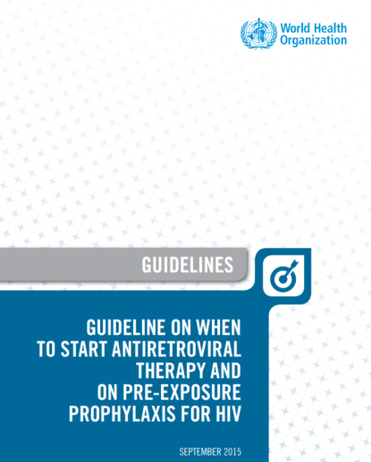

WHO PrEP recommendations
2015
2017
PrEP for HIV negative people at substantial HIV risk (≈3 per 100 person years)
strong recommendation based on high quality data
PrEP drugs on EML
(TDF/FTC, TDF/3TC, TDF)
Notes:
The recommendation, including medicines available.
The evidence of additional effect when added to a primary prevention programme
Dosing schedules – daily, event driven. Periods of risk
WHO recommendation is daily
Are considering a recommendation on event driven for MSM based on current evidence

Slide 4
WHO PrEP recommendations
Oral PrEP (containing TDF) should be offered as an additional prevention choice for people at substantial risk of HIV infection as part of combination prevention approaches.
An enabling recommendation, not population specific
Provide PrEP as a choice of prevention strategy within combination prevention
  Condoms and lube
  Harm reduction
  HIV testing and linkage to ART
Provide PrEP with comprehensive support
  Adherence counselling
  Support: Legal, social, emotional support
  Contraception and reproductive health services
Notes:
Replace with 2016 cover (consolidated ARV)

Slide 5
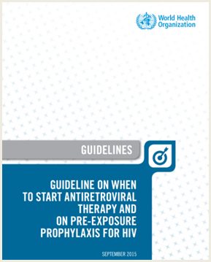

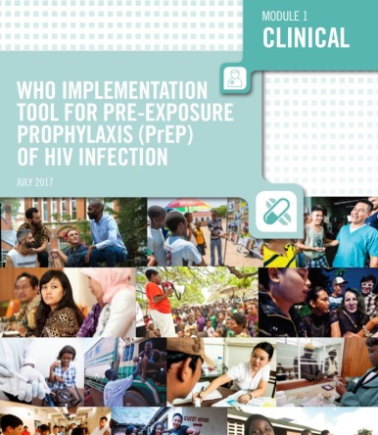
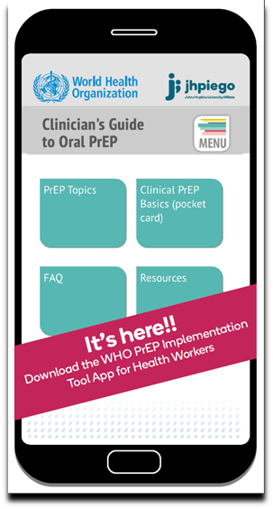
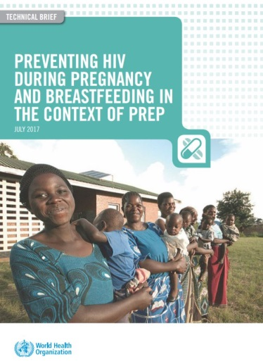
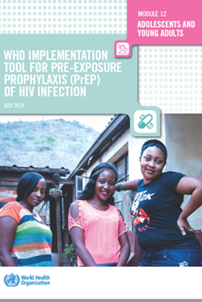

WHO guidance on PrEP
PrEP for people at substantial HIV risk (≈3 per 100 person years)
PrEP drugs on EML
(TDF/FTC; TDF/3TC; TDF)
WHO PrEP implementation tool (module-based)
2015
March 2017
July 2017
WHO update on PrEP use during pregnancy & BF)
Adolescents and YP
July 2017
July 2018
August 2018

Slide 6

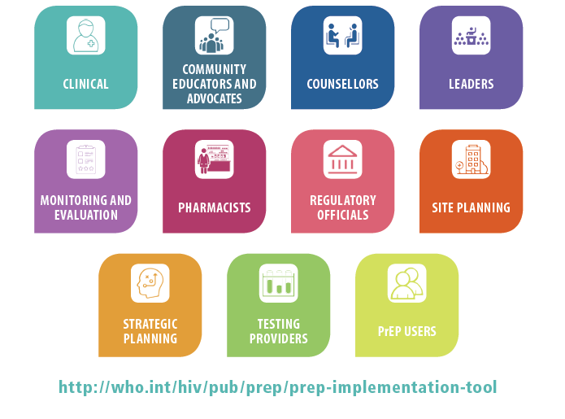
WHO PrEP Implementation Tool
Modular
Different audiences, settings, and populations
Suggestions not GRADE recommendations
Much uncertainty
Learn as implement
Frequent updates anticipated as clinical and implementation evidence accumulates
2018
PrEP for young peope
2019 event driven PrEP
Notes:
suggestions, yes, but we tried to be ‘as evidence-based’ as we could.

Slide 7
Priority populations

Slide 8

Where are/should PrEP services be focused?
Epidemiology
geography
Pop density
SDC- everywhere
MSM, transgender women - everywhere
Individual risk
Self-perception
Who wants PrEP
SW – ESA
Risk score
Population group
AGYW –some ESA
?others
PrEP for people at substantial HIV risk (≈3 per 100 person years)

Slide 9
SSo what does this mean?
MSM and Transgender women
Everywhere
Adolescent girls and young women
Focusd on specific geographic areas in ESA
SW – ESA
Sex workers
?others geographical areas
Everywhere (as bridge)
Serodiscordant couples
Sub-populations
What about PWID, PWUD and heterosexual men

Slide 10
Current status
Current uptake of PrEP
250,000 current PrEP users
350,000 have ever started PrEP (most in US and Europe)
40 countries have PrEP policies “adopted”
PrEP is approved in >50 countries
15 national PrEP programmes (nost in HIC)
LMIC high HIV burden countries with national PrEP targets and programmes
  Kenya, Lesotho, South Africa, Zimbabwe – focus on AGYW, sex workers, SDC.
LMIC KP epidemic countries
  Thailand, Vietnam, Brazil, Philippines – pilots focusing on MSM
(note SW pilots in India – high retention in the context of a long-standing, community based organisation)

Slide 11
Which countries are currently offering PrEP outside the context of demonstration projects? ( available for free within national health system)
  USA (government-funded schemes, e.g. Medicaid, and state budgets)
  Australia: available nationally now through the Pharmaceutical Benefits Scheme (PBS) from 1 April 2018)
  New Zealand
  Portugal (phased-in approach, recently launch national roll-out)
  South Africa (NDoH): launched in 2016
  Kenya: launched in 2017
  Brazil: launched in December 2017
  Canada
  France: 1st European country to offer PrEP within its national health system (now leveraging community pharmacies in PrEP delivery)
  Norway
  Belgium
  Denmark
  Sweden
  Scotland
  Lesotho (SDC, KP including people in prisons, AGYW)
  Note: Other countries planning scale-up access in 2018
  Thailand will include it by October 2018 into its national health insurance (NHSO), currently PrEP is available in limited government hospitals
  Australia, Portugal, Netherlands, Vietnam

Slide 12
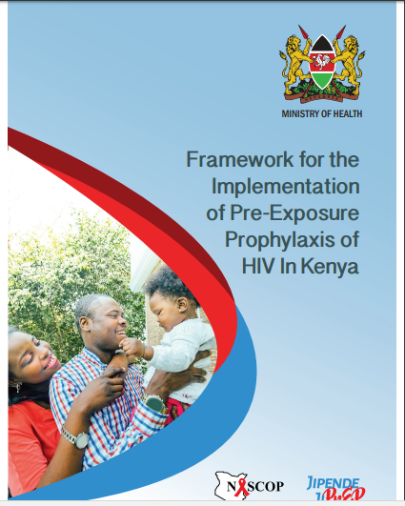
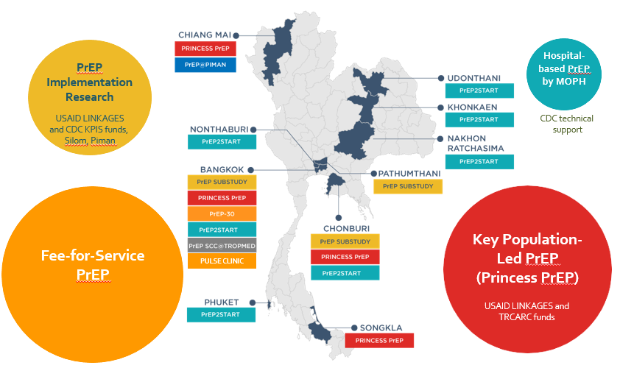

Examples of national programmes
Kenya
National programme
Multiple target populations
Multiple implementers
>24,000 have ever started PrEP in 900 health facilities
South Africa
National programme
Multiple target populations
Multiple implementers
>4000 PrEP initiations in SW
Pilots MSM
AGYW – just starting
Thailand
Est # Current PrEP Users
4,000-4,500
Aggregate target #PrEP users (all projects
Types of delivery
Demo projects
Large-scale implementation initiative
National level
Implementation project

Slide 13




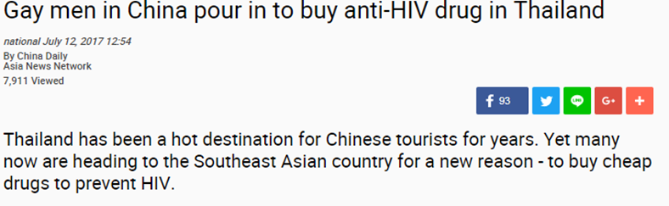
Note- PrEP is here
Private sector & “informal” PrEP use
7% of respondents currently taking PrEP, prior to the Brazilian rollout, inc through clinical trials and ordering online.
36% were likely to use PrEP in the next six months
Blued on line survey
24 million users in China
From survey increasing demand and informal use

Slide 14
Practical programme considerations

Slide 15
Key implemention issue for PrEP programming
Its not all about PrEP
  Most people offered PrEP don’t want it, wont take it
  Need to capitalise on interest (and funding for PrEP for other services)
  PrEP for AGYW – condoms, testing and treatments, FP, STIs, GBV, cervical cancer …
  PrEP for MSM – condoms, STIs, HBV, HCV, HAV, HPV, mental health,
  PrEP for Transgender women – condoms, STIs, hormone and other transitioning needs, mental health
  Cross cutting issues and vulnerabilities – eg drug use
Community engagement is key (for awareness, demand generation, support for retention and adherence)
Careful consideration of where to deliver
  KP services
  Where for AGYW? FP, tertiary education?
  Training for staff to make sure services friendly and convenient, stigma-free
How to offer
  To all?
  To those who request?
  Are risk assessments important/useful?
Staff training and support

Slide 16
Thinking about scale up
a priori
  National policy/guidelines
  Drug registration
  National buy-in
Where to start
  Epidemiology, demand, building on learning from pilots
Setting targets
  Estimation of population(s) size at substantial risk and likely to be reached by services,
  Service capacity assessment,
  Predicted uptake and continuation rates
Planning the services
  Staff training, SoPs, site selections, roll out plan, budget, (see WHO implementation guidelines)
Monitor to adjust programme

Slide 17
It’s all about integration – to maximize impact
Other prevention esp condoms
STIs, viral hepatitis, cervical cancer
Contraception
Testing – to link earlier to ART

Slide 18
You will need to address these concerns …
Cost
Where, Who
Safety
Drug resistance
Behavioral disinhibition
Safety
Adherence
>18 years
Why should we prioritize PrEP when treatment is our immediate priority?
Where do we start? Which populations ? Where to offer services?
'Toxic drugs' for people without HIV
People taking PrEP, esp. with poor adherence: Will this result in lots of drug resistance use?
Offering PrEP will mean people stop using condoms, have more sexual partners, more STIs
PrEP isn't safe during pregnancy and should be stopped when women become pregnant
What about drug interactions?
Lots of the trials had poor results with poor adherence
Many concerns esp. for adolescent girls

Slide 19
What we have learnt so far
PrEP programmes for MSM – awareness & demand increasing, showing impact in HIC – limited investment and traction in many LIC esp in SSA
PrEP programmes for SW – mixed picture, early days – need to build on and learn from successes
PrEP for AGYW – limited real success outside demo projects, but increasing interest
PrEP during pregnancy and BF in high incidence settings– could be key to eMTCT
Need to capture other benefits of a PrEP programme
  STIs – an opportunity or a challenges?
  Increased HIV testing – a huge benefits e
  Unmet FP need huge and PrEP services could reduce to this gap

Slide 20

Retention on PrEP by the AGYW need to learn and adjust programmes & approaches
www.lvcthealth.org
Notes:
Key Message: Living arrangement was associated with uptake; the observed frequency of AGYW living with their parents/ relatives was greater than would be expected under independence. Also the observed frequency of those who were cohabiting was smaller that would be expected under independence.
Simply put, the association observed is due to many AGYWs who live with their parents not taking up prep as would be expected if there was no association (independence) and fewer cohabiting AGYWs not taking prep as would be expected if there was no association (there was independence)

Slide 21
Issues for forecasting and costing
Forecasting and costing for oral PrEP
  Support for countries to focus strategically and ‘target well’
  Setting targets vs creating demand
  Event-driven, time bound
  Stopping and re-starting (evolving area in PrEP clinical settings)
What about future products and their role in shaping the PrEP market?
  Careful not to assume one product may take over the market (e.g. LA cabotegravir)

Slide 22
Final points

Slide 23
Key messages
Integration within combination prevention
  Focusing on PrEP alone will not have sufficient impact
  Coordinate budgeting and demand creation for all prevention
Integration with other services will maximise acceptability &impact
PrEP services need to for those who will benefit the most
  For PrEP to be effective/cost effective provide services to those who would benefit the most without stigmatising
  Be permissive with starting PrEP – flexibility in learning phase
Partnerships are key, policy makers, providers, PrEP users
Be realistic, but also be bold. Learn from current experiences
PrEP is here – we need to engage to make it safe and effective and to learn for future products

Slide 24
For discussion
PrEP can be cost effective if it is taken by those at substantial risk. How to achieve this in marginalised or disempowered populations without stigmatising?
Why fund PrEP instead of improving other parts of primary prevention? (false dichotomy)
How can the interest in, and funding for, PrEP be used to strengthen other primary prevention and SRH target setting, programme planning and service provision?

Slide 25
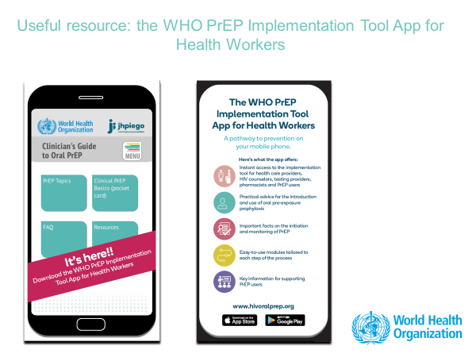
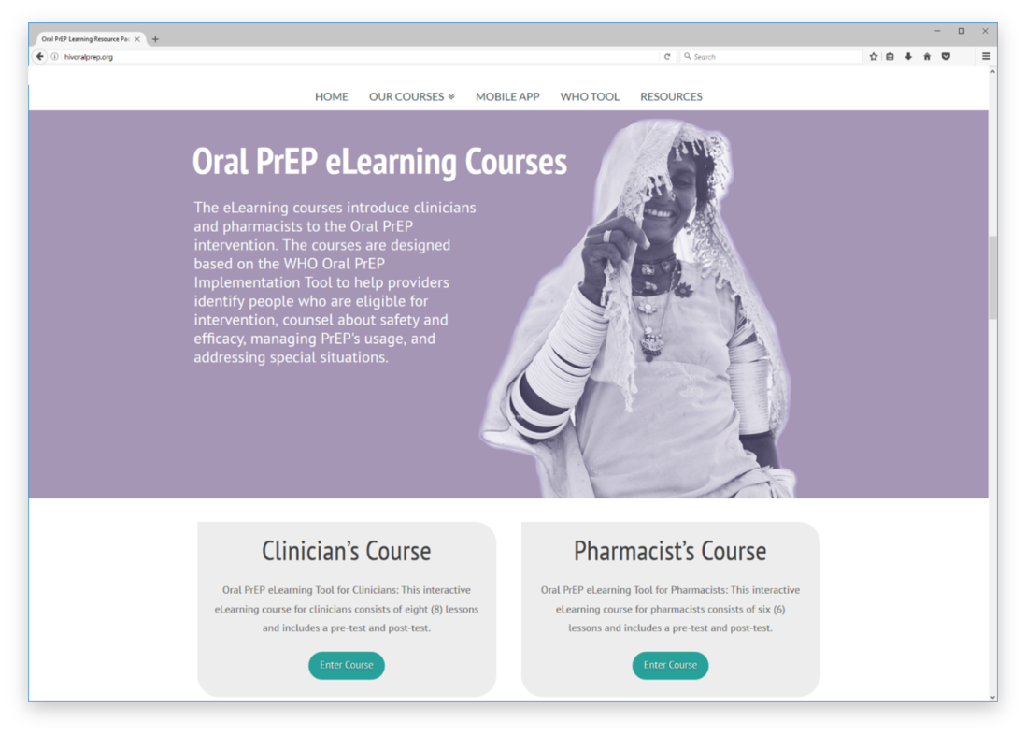
What next from WHO?
2018
Online interactive training tool
Mobile app
Future PrEP Products
CAB-LA
BNAbs

Slide 26
Thank you

