Slide 1
Social contracting
Concept and examples

Slide 7
India example
Acknowledgement for slides:
Dr Shobini Rajan, Chief Medical Officer (SAG),
National AIDS Control Organisation (NACO),
Ministry of Health and Family Welfare, Government of India

Slide 8
Social Contracting for Targeted Interventions under NACP
Implemented by Non-Government Organizations (NGOs) /Community–based Organizations (CBOs)
Peer-led interventions
Functioning based on standard guidelines – programmatic, operational & costing
Mentored and monitored by the State AIDS Control Society (SACS) , Technical Support Unit (TSU) and NACO
  Costing
  Guidelines
  Monitoring Indicators
Trained by SACS – all training modules developed and on website
Equipped in field level data collection part of a national Monitoring & Evaluation framework

Slide 9
Evolution of Social Contracting under NACP
(NACP V)
  TI fully funded under Domestic Budget
  Revised Standard Operating Procedure (SoP) on Selection of NGO/CBO
  Committed to concrete progress towards ‘ End of AIDS by 2030’
(NACP IV)
(NACP III)
  Scaled up
  Revision of Evaluation tool and manual
  HIV/AIDS Act 2017
  Revamping of TI
  Scale up of intervention and launch of Prison interventions
  Third Party Evaluation of NACP and Extension
(NACP II)
  Rapid Scale up of TI interventions Operational Guidelines for “ Implementing Targeted Intervention
  M& E framework
  Evaluation tool and Manual
  Link Worker Scheme( LWS)
(NACP I)
  TI model introduced under NACP
  Decentralization to States
  Establishment of Project Support Unit/Project Management Unit
  Establishment of NACO, SACS
  Pilot on Social Contracting ( Collaboration with NGO/CBO for prevention intervention )
  Initial interventions

Slide 10
Establishing a TI project
Selection of sites
  Estimation of HRGs at sites based on mapping data
Selection of Implementing partners (NGOs/CBOs)
Guidelines Revised in 2022
Expression of Interest (EOI) by SACS
Standard Operating Procedures (SOP) : NGOs/CBOs Selection to Implement Interventions/Projects in States/ UTs under NACP
(In Effect since July 2022)
Short listing of NGOs based on standardized criteria by Technical Appraisal Committee (TAC) headed by Project Director, SACS
Joint Appraisal visit by a team of external experts
Final review by Technical Advisory Committee for NGO empanelment
Approval by Executive Committee of SACS headed by PD, SACS

Slide 11
TI Structure
Awarding of TI project to the empanelled NGO
  Proposal development
  Exclusive / Core Composite
  Contracting
  Release of funds - installments
Contract period – Two years
  Extension based on bi-annual External Evaluation
  Continuation based on regular performance monitoring by PD of the SACS
  Planned interventions based on field level micro plans, scheduled outreach & vulnerability assessment
Implementation steps
Project Director
Project Manager
Counsellor
Outreach Worker
M&E Cum Accountant
Doctor
Infrastructure set up
Peer Educator
Recruitment of Staff
Community
Community Need Assessment and Selection of PEs

Slide 12


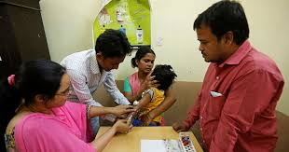
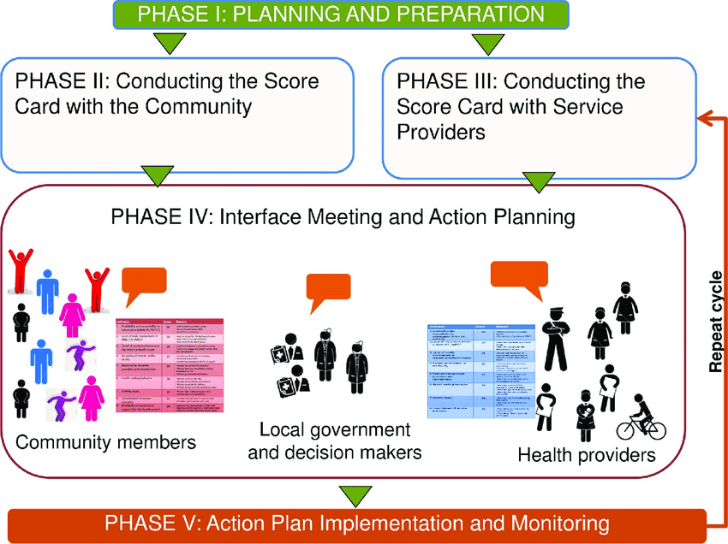
Service Provisions for Key Populations under NACP
Additional Services Under Revamping Strategy ( 2019 onwards..)
Clinical Services
Commodities
Provisions
Enabling
Environment
Community Outreach
Strengthened Outreach Activities
Population Mapping & Size Estimates
Virtual Outreach
DERA /Event based outreach
HRGs
Community
Mobilisation
Behaviour Change Communication
Commodities Availability
Secondary distribution N/S
Satellite OST Center
Community based ART dispensing
Referrals & Linkages
Service Delivery
Peer Navigation
Index Testing
Community Based Screening
Regular Medical Check ups
Management of STI/RTIs
Counselling for Behavior change
HIV testing and treatment services( Self, spouse & Partner)
TB screening and referral services
Provision of commodities - Condoms and Lubes
Linkages to ART Centre ( Adherence- Viral Load Testing)
Provision of Drop-in-centre (DIC) as safe space
Access to social protection schemes
Stigma free services
IDU(OST: Opioid Substitution Therapy, Needle Syringe Exchange Program, Tracking and STI treatment for Spouses, Abscess Management)
Creating an Enabling Environment
Community Score Card
Mentorship

Slide 13
Funding for Social Contracting Mechanism under NACP
Each TI is contracted according to the assigned target and costing based on the operational and financial guideline of NACO.
The funds are released on quarterly basis to NGO/CBOs by SACS.
All the payments to TI are done through PFMS (Public Financial and Management System) portal.
NGO/CBO have to submit the Statement of Expenditure (SOE) as per the prescribed format to SACS at the end of every month.
Internal audit system established to review the financial management system at TI level twice in a year.
NGO/CBO have to submit final audited statement to SACS at the end of the financial year.
Unit Cost Per HRG Per Year ( Approx.):
      FSW: INR-2183 (USD 27.99)
      MSM: INR 2312 (USD 9.64)
      TG : INR 2997 (USD 38.42)
      IDU: INR 4264 (USD 54.67)

Slide 14
Monitoring and Evaluation System
Internal Evaluation ( by SACS/ TSU)
External Evaluation by ( Third Party)
  NACO has setup Technical Support Units (TSUs) to support the implementation through NGOs/CBOs for prevention program,
  TSU Project officers (POs) are assigned 10 to 15 NGO TI project and the POs conduct intensive field visit to mentoring of the NGO TI projects.
  TSU also conduct six monthly assessment of TIs on a comprehensive tool that assesses services delivery to the Target Community
  a comprehensive performance indicator system has been developed
  As per the grading the initial reminders and warnings are issued to the poor performing NGOs to improve their performance.
TIs are evaluated with Standardized Evaluation Tool and Manual, developed by NACO
TIs are contracted for 2 years and evaluation is conducted at the end of the 2 year of contract by third party.
TIs are evaluated based on 48 indicators which includes
    Program delivery: 25 indicators
    Finance: 13 indicators
    Organizational capacity: 10 indicators
Under NACP Phase V, Evaluation of TI/LWS are made by TISS
(Institutional Mechanism Under Global Fund Grant)

Slide 15
Thailand example
Acknowledgement for slides:
Supabhorn Pengnonyang
Institute of HIV Research and Innovation IHRI

Slide 16



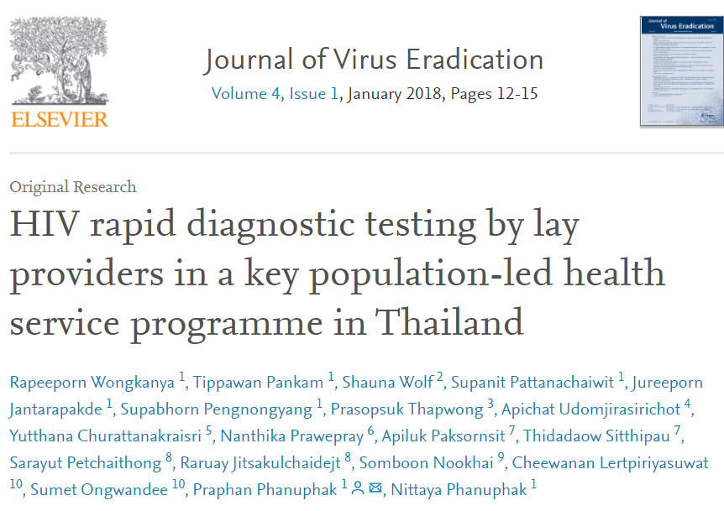
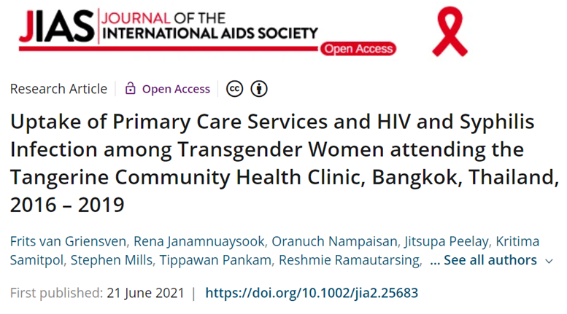
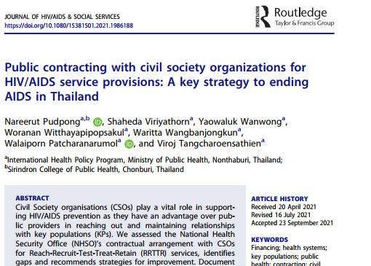

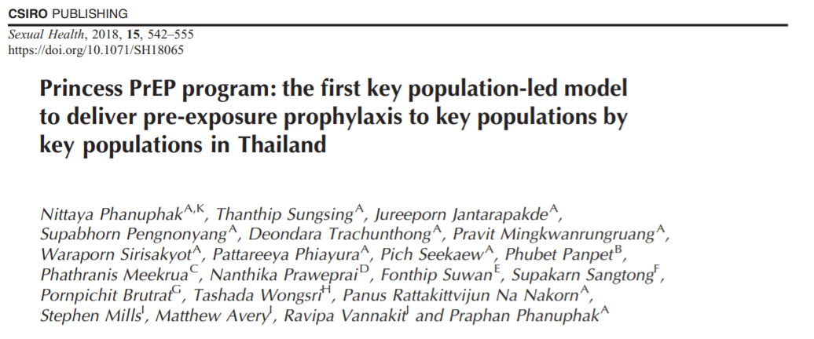

Domestic financing of KP-led health services (KPLHS) a success in Thailand
Thai government budgeted $6 million in prevention in 2015 but mechanisms and path for supporting community organizations were unclear
USAID LINKAGES and EpiC projects and others provided evidence and advocacy in multiple areas to build community-government relationships and ultimately funding
Evidence generation on the key role of community
Improvements in accreditation and reimbursement processes

Slide 17
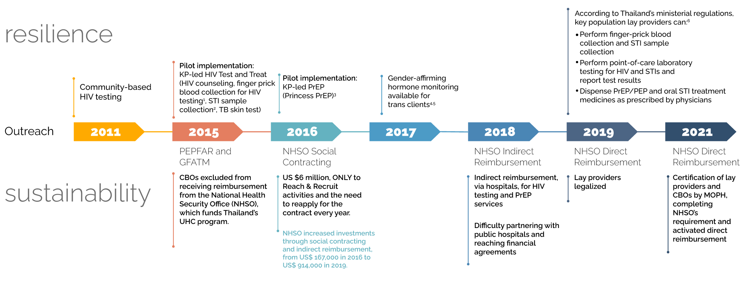
The Journey of KPLHS in Thailand
NHSO announced CSO-node registration
2022
Rena Janamnuaysook, Resilient and Sustainable Systems for Health, AIDS 2022

Slide 18

The road towards KPLHS sustainability in Thailand
PEPFAR and
GFATM
NHSO Social Contracting
NHSO Indirect Reimbursement
NHSO Direct Reimbursement
2015
CBOs excluded from receiving reimbursement from the National Health Security Office (NHSO), which funds Thailand’s UHC program.
2016
US $6 million, ONLY to Reach & Recruit activities and the need to reapply for the contract every year.
2018
Indirect reimbursement, via hospitals, for HIV testing and PrEP services
Difficulty partnering with public hospitals and reaching financial agreements
2019
Lay providers legalized
September 2021
Certification of lay providers and CBOs by MOPH, completing NHSO’s requirement and activated direct reimbursement
NHSO increased investments through social contracting and indirect reimbursement, from US$ 167,000 in 2016 to US$ 914,000 in 2019.

Slide 19
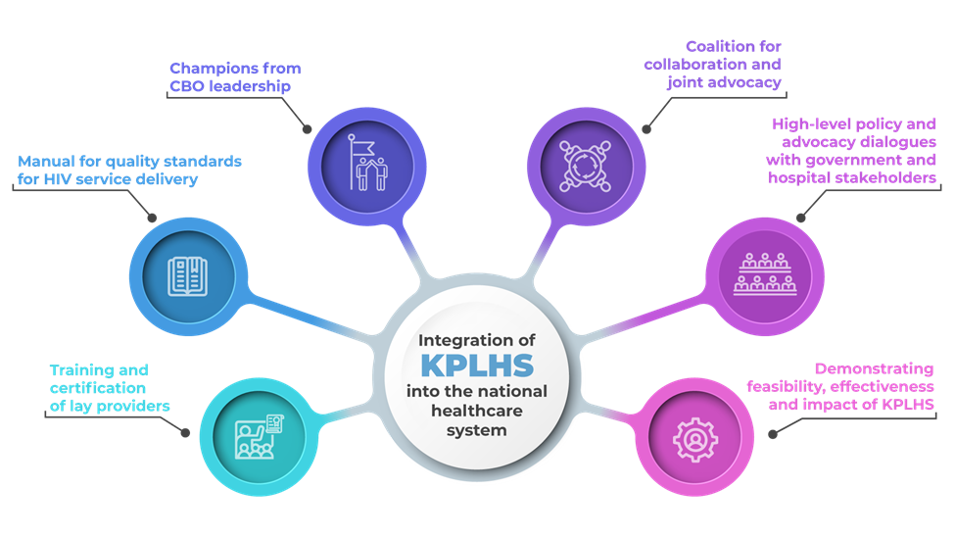
Components of a long-term, multi-stakeholder strategy to integrate KPLHS in the national healthcare system in Thailand

Slide 21


THANK YOU
THANK YOU!

