Slide 1
Towards a people-centered precision prevention approach
Considerations for prioritization

Slide 2
Many interventions, many populations, many platforms: What mix? What focus?
Behaviour change communication, blood safefy, cash transfers, community mobilization, comprehensive sexuality education, community-led prevention services, condom social marketing/market development, couples’ HIV prevention, address criminalization and legal change, education (keeping girls in school), early infant circumcision, economic empowerment of young women, HIV prevention in humanitarian settings, income generation for HIV prevention, integrated gender-based violence & HIV prevention, injectable PrEP, intergenerational sex campaigns, life-skills education, male & female condom distribution, mass media programmes, micro-finance for HIV prevention, multiple concurrent partnership campaigns, multi-purpose youth centres, needle & syringe distribution, new media prevention programmes, opioid substitution, overdose prevention, oral pre-exposure prophylaxis, parenting programmes, post-exposure prophylaxis, post-violence care, prevention with positives, prevention among men having sex with men, prevention among mobile populations, prevention among sex workers, prevention with people living with disabilities, prevention for people who inject drugs, prevention among transgender people, prevention with people in prisons, prevention for truck drivers, primary prevention among pregnant women, safe spaces, social asset building, treatment as prevention, STI diagnosis & management, U=U campaigns, vaccine development, vaginal ring, voluntary counselling and testing, voluntary medical male circumcision, work-place based prevention, youth friendly health services, … … …

Slide 3
People-centred precision prevention
For the right people
In the right locations
With the right interventions
At the right time
In the right way
At the right cost
The right combination and balance
Optimal decisions
for reducing HIV incidence
and thereby for health impact

Slide 4
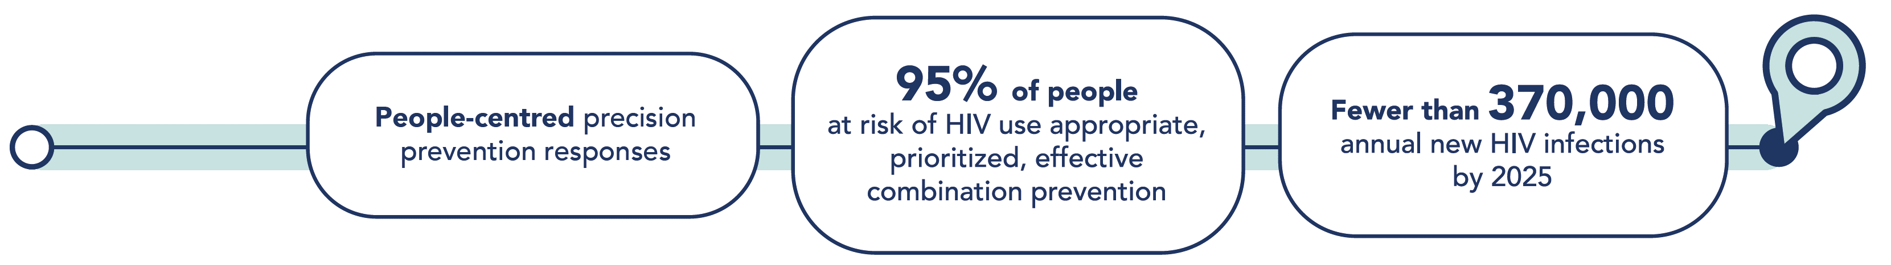
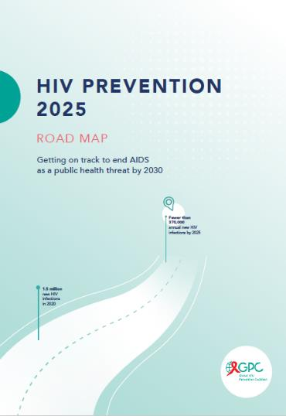

What Will Success Look Like
The 2025 high-level HIV prevention targets and commitments
An 82.5 % reduction compared to 2010
Notes:
Fewer than 370,000 new infections translates into more than 80% reduction compared to 2010.

Slide 5
Detailed HIV prevention targets in the new Global AIDS Strategy
for young people and adults
Young people and adults 15-49 |  | Risk by prioritization stratum
 |  | Very high |  | Moderate | Low
All ages and genders | Condoms/lubricant use at last sex by those not taking PrEP with a non-regular partner whose HIV viral load status is not known to be undetectable (includes those who are known to be HIV-negative) | 95% |  | 70% | 50%
 | PrEP use (by risk category) | 50% |  | 5% | 0%
 | STI screening and treatment | 80% |  | 10% | 10%
Adolescents and young people | Comprehensive sexuality education in schools, in line with UN international technical guidance | 90% |  | 90% | 90%
 |  | Strata based on geography alone
 |  | Very high (>3%) | High (1–3%) | Moderate (0.3–1%) | Low (<0.3%)
All ages and genders | Access to post-exposure prophylaxis (PEP) (non-occupational exposure) as part of package of risk assessment and support | 90% | 50% | 5% | 0%
 | Access to PEP (nosocomial) as part of package of risk assessment and support | 90% | 80% | 70% | 50%
Adolescent girls and young women | Economic empowerment | 20% | 20% | 0% | 0%
Adolescent boys and men | VMMC | 90% in 15 priority countries
People within serodiscordant partnerships | Condoms/lubricant use at last sex by those not taking PrEP with a non- regular partner whose HIV viral load status is not known | 95%
 | PrEP until positive partner has suppressed viral load | 30%
 | PEP | 100% after high-risk exposure

Slide 6
2025 Prevention Road Map: Thresholds for the prioritization of HIV prevention methods
 | Criterion | High and very high |  | Moderate | Low
Adolescent girls and young women | Combination of [national or subnational incidence in women 15–24 years] AND [reported behaviour from DHS or other (>2 partners; or reported STI in previous 12 months)] | 1–3% incidence AND high-risk reported behaviour | >3% incidence | 0.3–<1% incidence and high-risk reported behaviour OR 1–3% incidence and low-risk reported behaviour | <0.3% incidence OR 0.3–<1% incidence and low-risk reported behaviour
Adolescent boys and young men | Combination of [national or subnational incidence in men 15–24 years] AND [reported behaviour from DHS or other (>2 partners; or reported STI in previous 12 months)] | 1–3% incidence AND high-risk reported behaviour | >3% incidence | 0.3–<1% incidence and high-risk reported behaviour OR 1–3% incidence and low-risk reported behaviour | <0.3% incidence OR 0.3–<1% incidence and low-risk reported behaviour
Adults (aged 25 and older) | Combination of [national or subnational incidence in adults 25–49 years] AND [reported behaviour from DHS or other (>2 partners; or reported STI in previous 12 months)] | 1–3% incidence AND high-risk reported behaviour | >3% incidence | 0.3–<1% incidence and high-risk reported behaviour OR 1–3% incidence and low-risk reported behaviour | <0.3% incidence OR 0.3–<1% incidence and low-risk reported behaviour
Serodiscordant partnerships | Estimated number of HIV-negative regular partners of someone newly starting on treatment | Risk stratification depends on choices within the partnership: choice of timing and regimen of antiretroviral therapy for the HIV-positive partner; choice of behavioural patterns (condoms, frequency of sex); choice of PrEP

Slide 7
Detailed granular HIV prevention targets for key populations
KEY POPULATIONS | Sex workers | Gay men and other men who have sex with men | People who inject drugs | Trans-gender people | Prisoners and others in closed settings
Condoms/lubricant use at last sex by those not taking PrEP with a non-regular partner whose HIV viral load status is not known to be undetectable (includes those who are known to be HIV-negative) | -- | 95% | 95% | 95% | --
Condom/lubricant use at last sex with a client or non-regular partner | 90% | -- | -- | -- | 90%
PrEP use (by risk category) Very high High Moderate and low | 80% 15% 0% | 50% 15% 0% | 15% 5% 0% | 50% 15% 0% | 15% 5% 0%
Sterile needles and syringes | -- | -- | 90% | -- | 90%
Opioid substitution therapy among people who are opioid dependent | -- | -- | 50% | -- | --
STI screening and treatment | 80% | 80% | -- | 80% | --
Regular access to appropriate health system or community-led services | 90% | 90% | 90% | 90% | 100%
Access to post-exposure prophylaxis as part of package of risk assessment and support | 90% | 90% | 90% | 90% | 90%
30/60/80 targets … 80% of prevention for key populations through key population-led organizations

Slide 8
Thresholds for the prioritization of HIV prevention methods: key populations
 | Criterion | Very high | High | Moderate and low
Sex workers | National adult (15–49 years) HIV prevalence | >3% | >0.3% | <0.3%
Prisoners | National adult (15–49 years) HIV prevalence | >10% | >1% | <1%
Gay men and other men who have sex with men | UNAIDS analysis by country/ region | Proportion of populations estimated to have incidence >3% | Proportion of populations estimated to have incidence 0.3–3% | Proportion of populations estimated to have incidence <0.3%
Transgender people | Mirrors gay men and other men who have sex with men in absence of data | Proportion of populations estimated to have incidence >3% | Proportion of populations estimated to have incidence 0.3–3% | Proportion of populations estimated to have incidence <0.3%
People who inject drugs | UNAIDS analysis by country/ region | Low needle–syringe programme and opioid substitution therapy coverage | Some needle–syringe programme; some opioid substitution therapy | High needle–syringe programme coverage with adequate needles and syringes per person who injects drugs; opioid substitution therapy available

Slide 9
Considerations in adapting granular targets at country level
Follow the principles of granular target tables, not necessarily each single number or threshold
Important to set targets along the key steps in the results chain
  Coverage
  Outcome
  Impact
Thresholds are just a broad guide for setting targets
  No need to differentiate targets if most locations are clustered just above or just below the threshold
Translate into sub-national targets
Build a national M&E system and periodic performance review /accountability mechanism

Slide 10
People-centred precision prevention
For the right people
In the right locations
With the right interventions
At the right time
In the right way
At the right cost
The right combination and balance

Slide 11


Defining Who Needs Prevention
Adopt a simple and practical approach that enables countries apply the new risk thresholds and arrive at clearly defined denominators for prevention programs within 12 months, in line with the Global AIDS Strategy.
DETERMINE TOTAL POPULATION SIZE ESTIMATE
Countries should have up-to-date, nationally validated key population size estimates generated from empirical methods and sound statistical concepts.
Where PSEs are outdated or do not exist, global or regional averages may be used to benchmark. For MSM, this should be at least 1% of the total adult male population (WHO & UNAIDS, 2020).
In resource constrained settings, low-cost methodologies that generate reliable PSEs need to be developed and used.
Where possible, multiple sources should be triangulated for greater certainty.
Plausible PSEs should be mandatory in the development of all national strategic plans, prevention roadmaps as well as funding requests/country operational plans for major donors.
CALCULATE A PREVENTION DENOMINATOR
For key populations:
  Men who have sex with men with a non-regular partner
  All transgender women
  All sex workers
  All people who inject drugs
  All prisoners
  For other young people and adults:
Use sub-national HIV incidence estimates disaggregated by age, sex, location and risk. The denominator for regular community outreach should be populations with high HIV incidence (globally defined as more than 1 per 100 person years).
In parts of sub-Saharan Africa this level is also reached among people with non-regular partner(s), people who have transactional sex or another sexually transmitted infection.

Slide 12
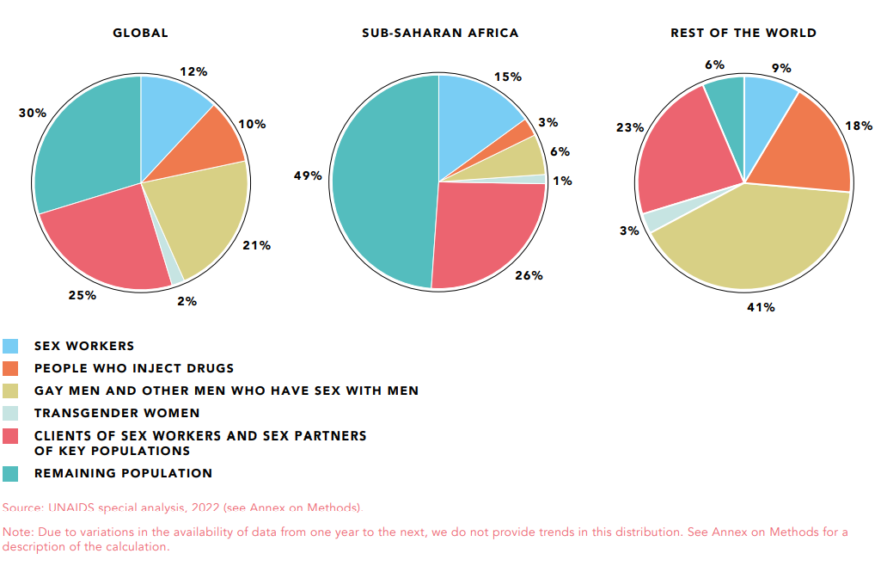
Consider country-specific patterns of HIV acquisition and transmission
Distribution of acquisition of new HIV infections by population, global, sub-Saharan Africa and rest of the world, 2021

Slide 13
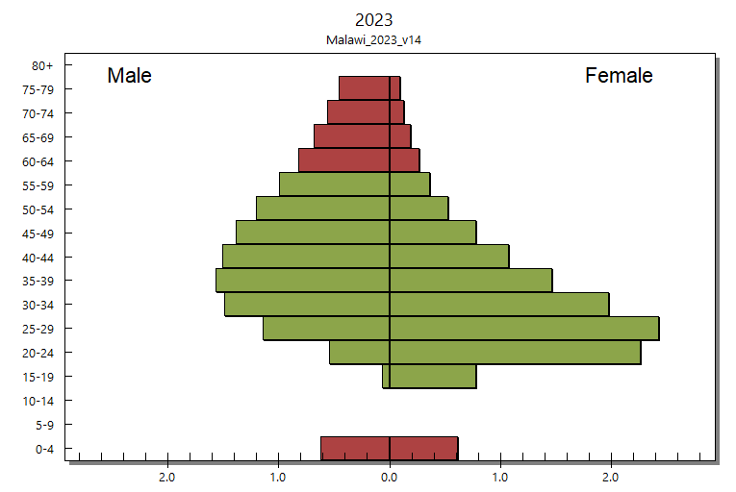
HIV incidence distribution (new infections per 1000 population per year)
Consider age & sex patterns of HIV transmission

Slide 14
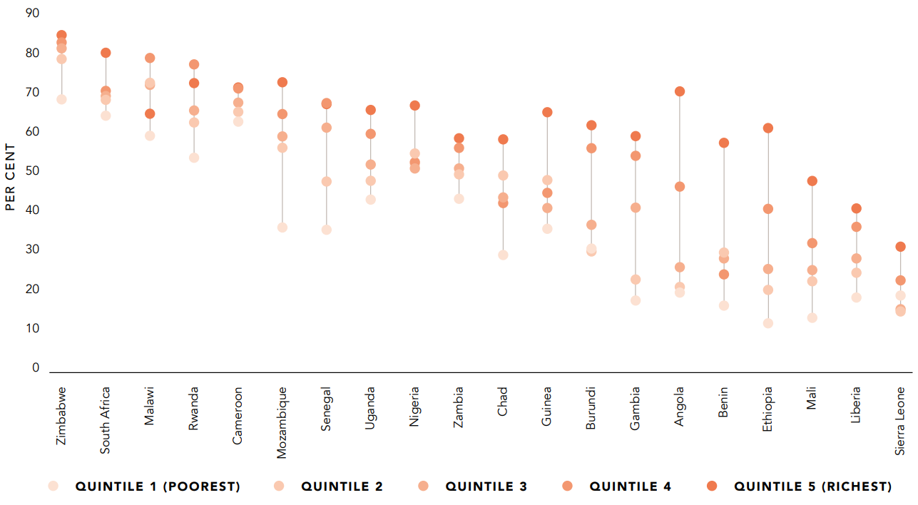
Conduct inequity analysis for better targeting of programmes
Condom use with non-regular partners (men 15-49) by wealth quintile
Countries with strong decentralized condom programmes reduced inequities in condom use

Slide 15
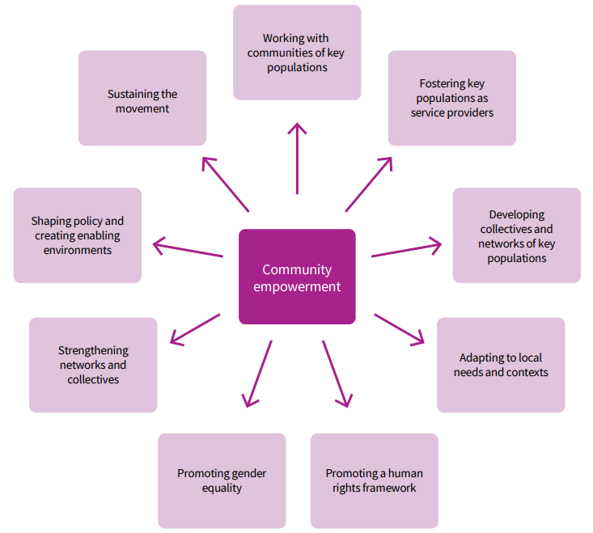
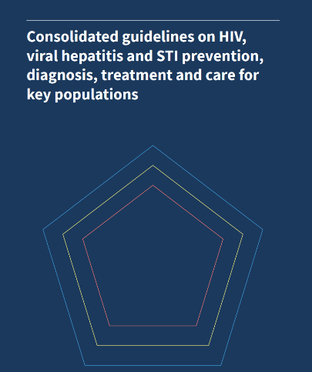
Understand communities
and put communities in the driving seat
  Co-create with communities
  Life-style choices
  Local design

Slide 16
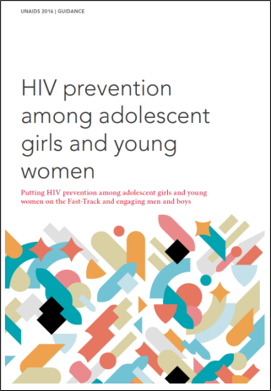
Understand key factors associated with HIV incidence at country and local levels
Example: List of factors potentially relevant factors to consider at country level
Which ones are relevant in the country? Which ones can be changed? Who is responsible for change? What is the comparative advantage of the HIV response? -> Prioritize
Behavioral
Age-disparate sex
Multiple partnerships
Sex work and sexual exploitation
Transactional sex
Early sexual debut
Gaps in knowledge and limited personalized risk perception
Biological
Gaps in viral suppression among male partners
Biological susceptibility of women and adolescent girls
Low prevalence of male circumcision
STIs and other co-infections
Harmful practices potentially increasing HIV acquisition (eg. intra-vaginal)
Structural factors
Harmful social and gender norms
Low secondary school attendance
Lack of economic empowerment
Labour migration and spousal separation
Barriers to SRH services
Orphanhood
Child sexual abuse
Gender-based violence incl early marriage
Marriage patterns

Slide 17
People-centred precision prevention
For the right people
In the right locations
With the right interventions
At the right time
In the right way
At the right cost
The right combination and balance

Slide 18
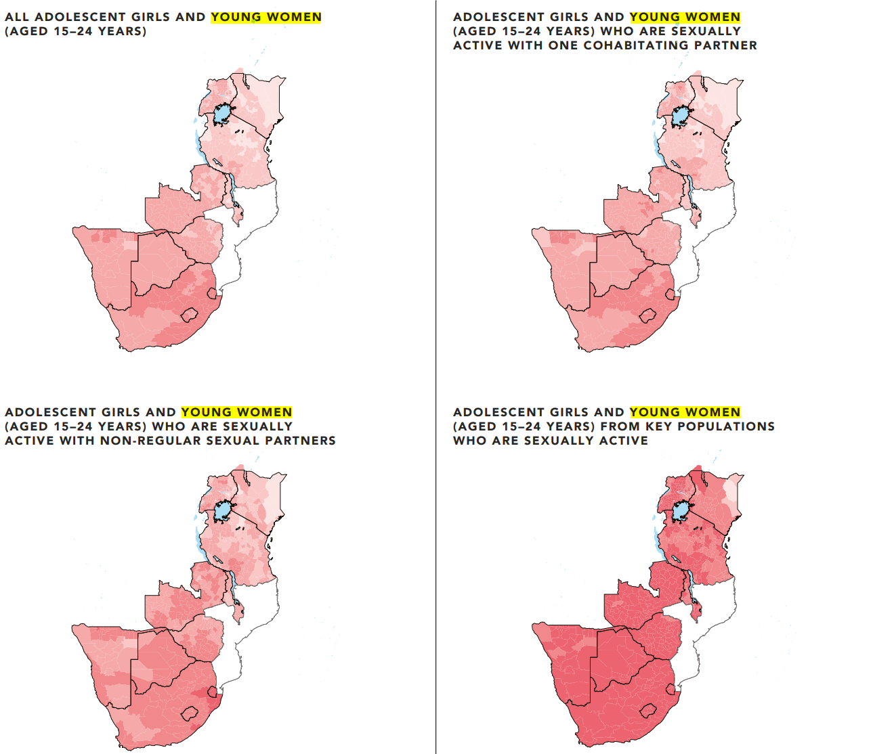
Use estimated HIV incidence rates: Large variation in HIV incidence on the continent
HIV incidence rates are under-used in HIV prevention programming
More than 1000-fold differences in HIV incidence between low-risk/low-incidence location and YWKP/high incidence location
HIV incidence rates among all AGYW 15-24 low to moderate in large parts of ESA
HIV incidence rates still very high among young women selling sex across most of ESA
HIV incidence rates
per 1000 person years
(MODERATE)
(HIGH)
(VERY HIGH)

Slide 19
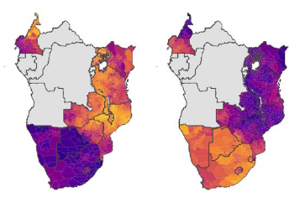
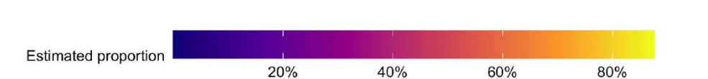
Regional differences in cohabitation patterns
One partner (20-24)
Non-regular partners (20-24)
Southern Africa:
Lower cohabitation,
Higher nonregular
partnerships

Slide 20
Analyze HIV incidence patterns:
Major differences in HIV incidence by:
Location
Individual level of risk
Sex
Age
Figure: Excerpt from a national summary of district estimates for an eastern African country
DO NOT CITE
Source: Tool for estimating the population size of people at risk of acquiring HIV in settings with high HIV incidence. Geneva, 2023.

Slide 21
Analyze HIV incidence patterns:
Major differences in HIV incidence by:
Location
Individual level of risk
Sex
Age
Figure: Excerpt from a national summary of district estimates for an eastern African country
DO NOT CITE
Source: Tool for estimating the population size of people at risk of acquiring HIV in settings with high HIV incidence. Geneva, 2023.

Slide 23
STEP 4: Analyze VOLUME OF NEW HIV INFECTIONS
Figure: Excerpt from a national summary of district estimates for an eastern African country
DO NOT CITE
Source: Tool for estimating the population size of people at risk of acquiring HIV in settings with high HIV incidence. Geneva, 2023.

Slide 24

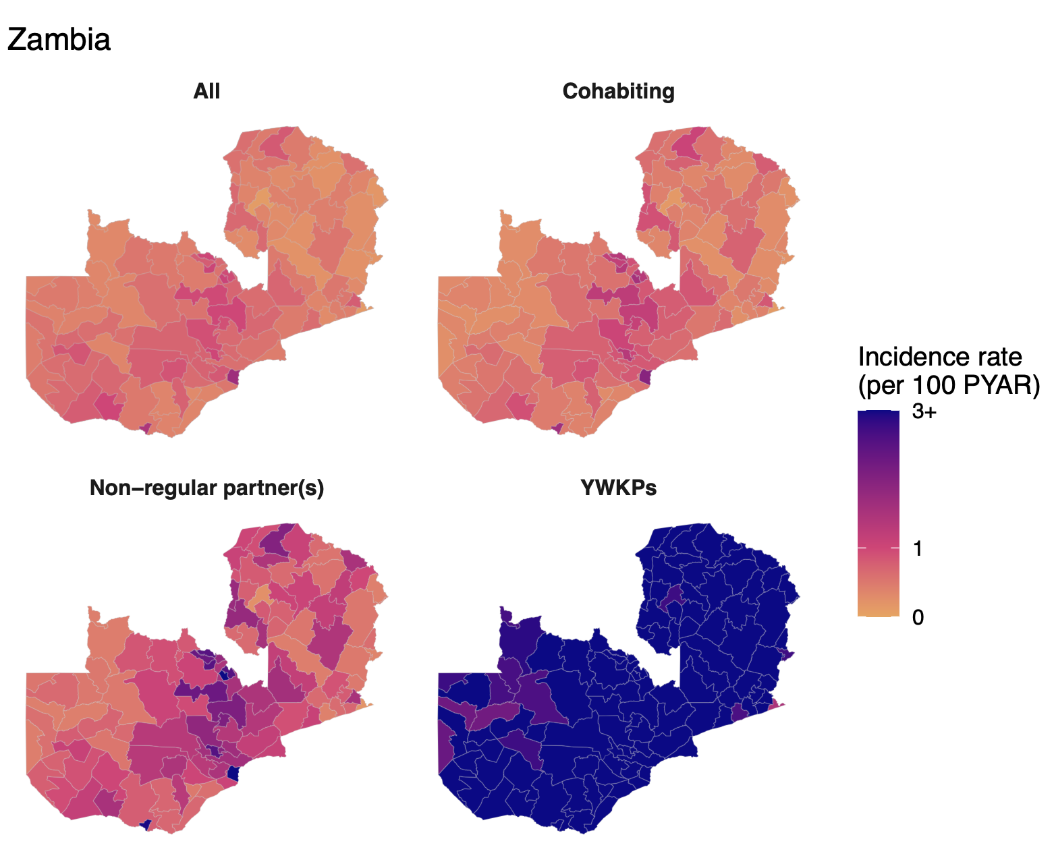
Prioritise geographic areas
The Tool can help you
to see diversity across
districts and make
geographic priorities
in programme planning

Slide 25
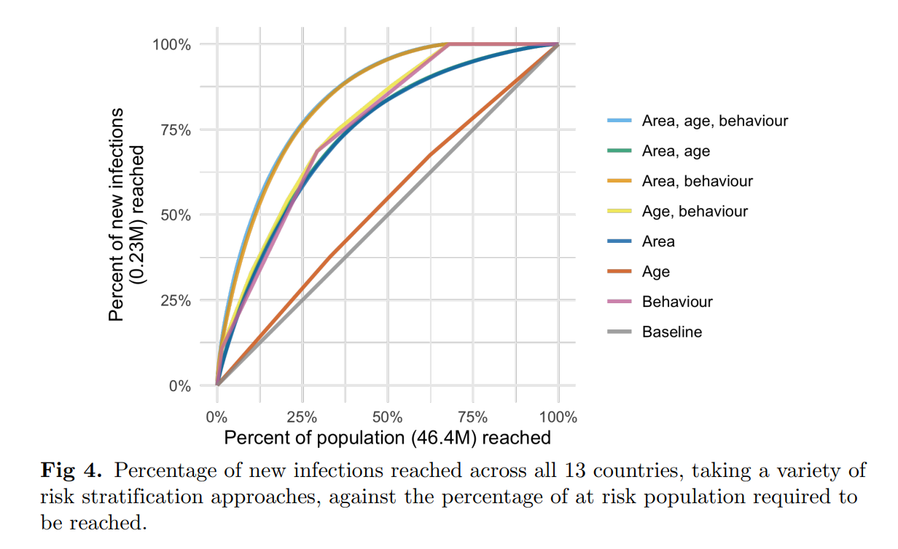
A differentiated location-population approach can be highly effective prioritizing prevention programmes: Reaching 25% of the population can avert 75% of new infections
Spatio-temporal estimates of HIV risk group proportions for adolescent girls and young women across 13 priority countries in sub-Saharan Africa Adam Howes1,2*, Kathryn A. Risher3,2, Van K´ınh Nguyen2 , Oliver Stevens2 , Katherine M. Jia4 , Timothy M. Wolock1,2, Rachel Esra2 , Lycias Zembe5 , Ian Wanyeki5 , Mary Mahy5 , Clemens Benedikt5 , Seth R. Flaxman6 , Jeffrey W. Eaton2

Slide 26
People-centred precision prevention
For the right people
In the right locations
With the right interventions
At the right time
In the right way
At the right cost
The right combination and balance

Slide 27
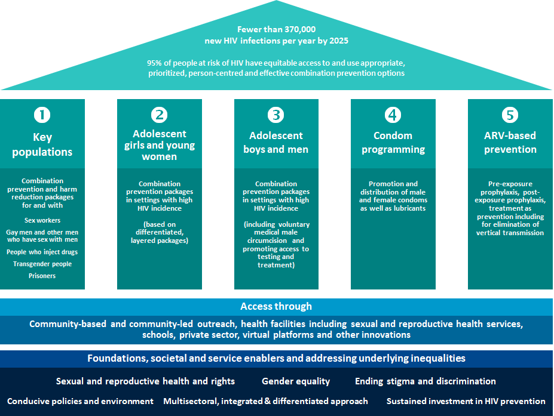
Prevention Pillars
Road Map
Focuses on scaling up primary prevention of HIV infections and on introducing policy, legal and societal enablers
Highlights complementarity and interaction between primary HIV prevention, testing, treatment and the prevention of vertical transmission of HIV

Slide 28
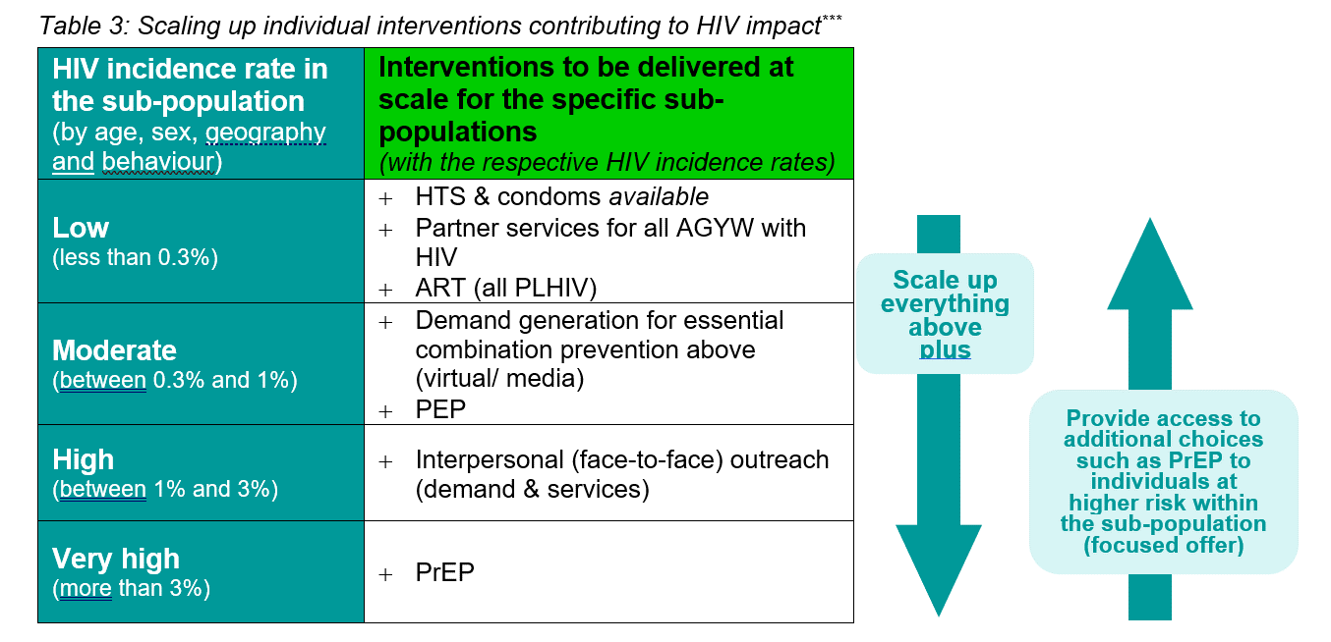
Design differentiated packages in line with levels of HIV incidence
Key population programmes

Slide 30

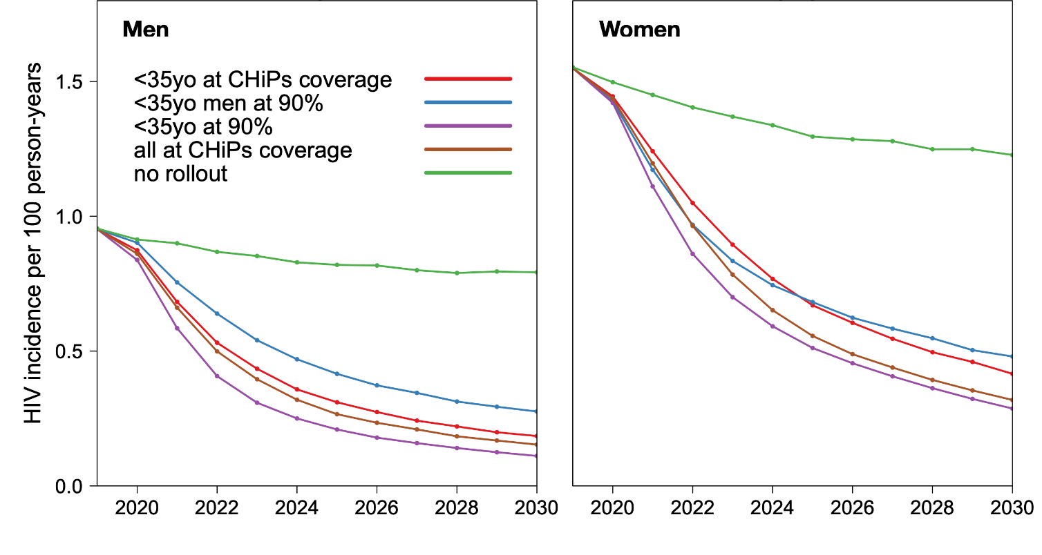

Ensure linkages to closing gaps in HIV treatment responses
Modelling in PopART suggests that reaching under 35-year-old men
Is almost as effective as reaching everybody

Slide 31
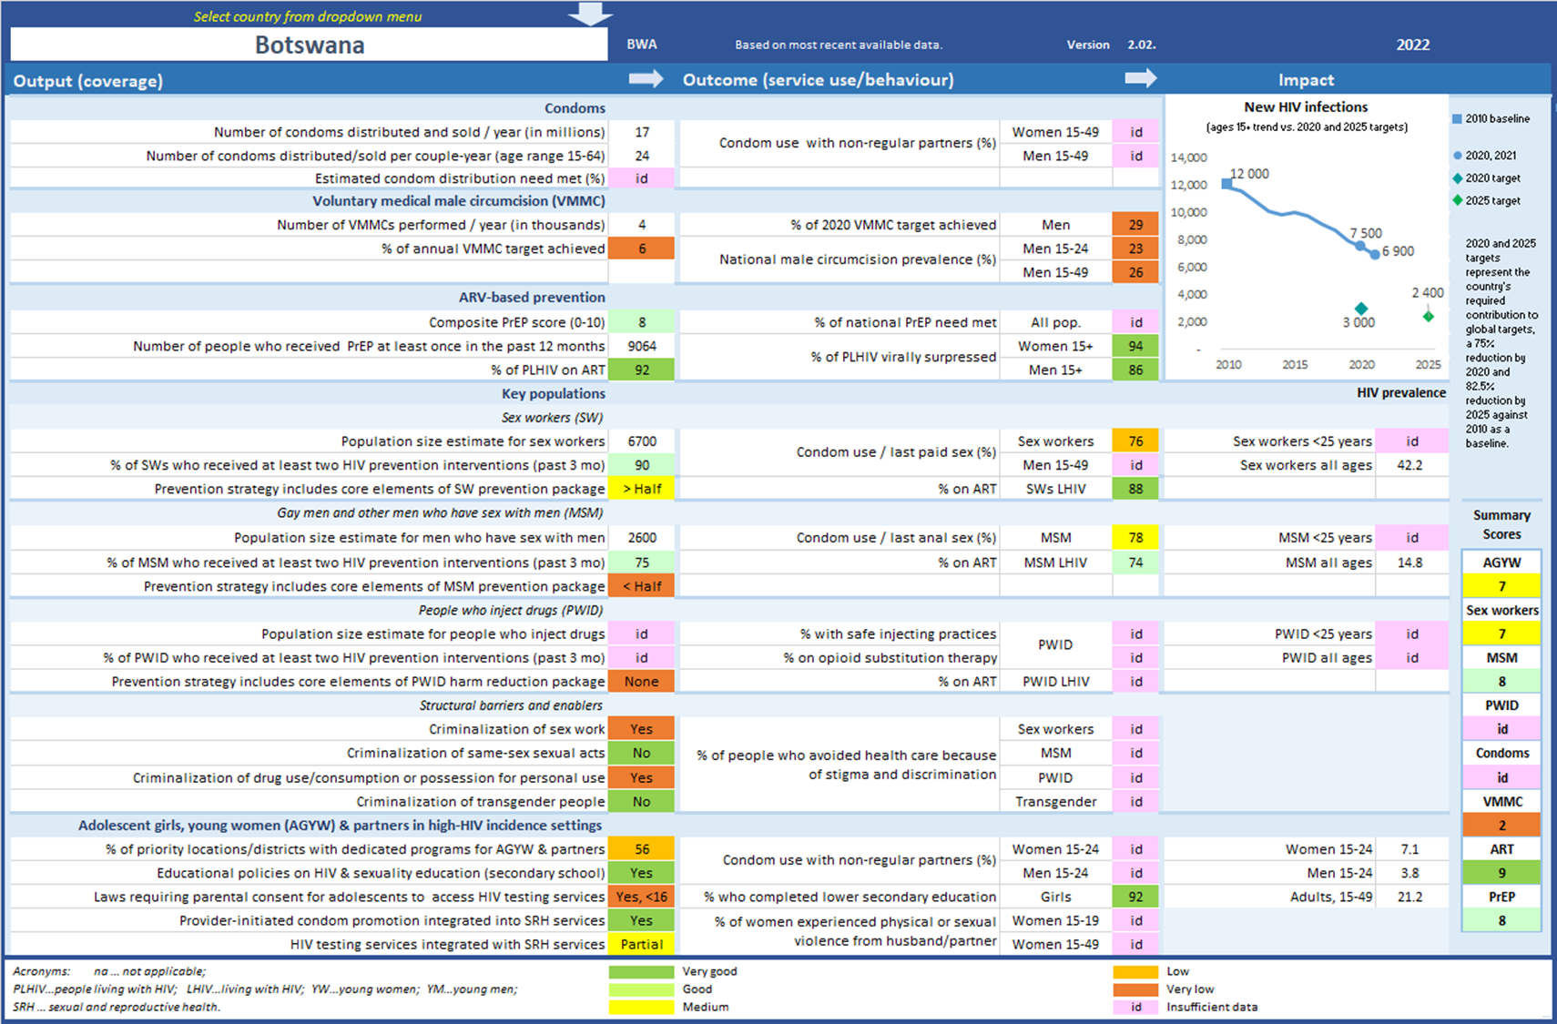

Track coverage, outcomes and Impact level results

Slide 32
People-centred precision prevention
For the right people
In the right locations
With the right interventions
At the right time
In the right way
At the right cost
The right combination and balance

Slide 33
Timing considerations: opportunities for precision
Critical importance of reaching key populations as early as possible:
  New sex workers and people who inject
  Young gay men and transgender people
  Precision metric: Time from newly joining a (KP) community or being sexually active in high incidence settings to being reached with programmes
Reaching young women and men during or just before peak incidence/transmission age (varies but often F18-29, M25-34)
In context of declining incidence: VMMC and PrEP most needed now, not in 10 years – frontload investment
Real-time monitoring

Slide 34
Consider long-term transmission dynamics
Estimated contribution of Condomless sex work across HIV epidemics: Short term vs. long term
In three different settings in Africa, in the short-run (1 year) prevention in sex work settings could avert up to 20% of new infections
In the long-run (20 years), 60-80% of all new infections could be preventable through better programs with sex workers
Cotonou
(Benin)
~ 3-4%
Bobo-Dioulasso
(Burkina-Faso)
~ 1%
Kisumu
(Kenya)
~ 15%
HIV prevalence :
80
60
40
20
Percent (%)
0
Fem Male Total Fem Male
Total Fem Male
Total
Fraction of all incident HIV infections due to condomless sex work in given population (over fixed time period)
Classical Proportional Attributable Fraction (PAF) in 2013 Transmission PAF (1 year; 2013)
Transmission PAF (20 years; 2013-2033)
Sources: Mishra, Boily, Low, Baral, JAIDS, 2014, Williams (PLoS One, 2014), Mishra (STI 2014)

Slide 35
People-centred precision prevention
For the right people
In the right locations
With the right interventions
At the right time
In the right way
At the right cost
The right combination and balance

Slide 36
The ‘right’ way is local: Finding and engaging people using local data
Example:
Using local data to
reach young women
in a district with high HIV incidence

Slide 37




Define the right mix of access platforms in line with where communities are and available resources – key populations
Expand mix of access platforms depending on resources available
Strengthen community outreach system (rather than single-issue outreach) for a continuum of prevention, testing, treatment & support
Importance of trusted access platforms (peer-led, accessible)
Consider scalability in designing the model: (add more elements as feasible with available resources)
Combine interpersonal with new virtual modalities
New WHO Key Population Guidelines upcoming
1. minimum
2. basic
3. full
4. full+ ART
Host ART clinician part-time at DIC
ART
Refer to clinical services
Train/host clinician part-time at DIC
Basic
clinic
Basic
clinic
Considerations in Planning and Budgeting for a Key Population Trusted Access Platform, June 2020 – Unaids
Refer to clinical services
Attempt to add safe space at least
Drop-in
centre
Drop-in
centre
Drop-in
centre
Peer-led
outreach
Peer-led
outreach
Peer-led
outreach
Peer-led
outreach

Slide 38
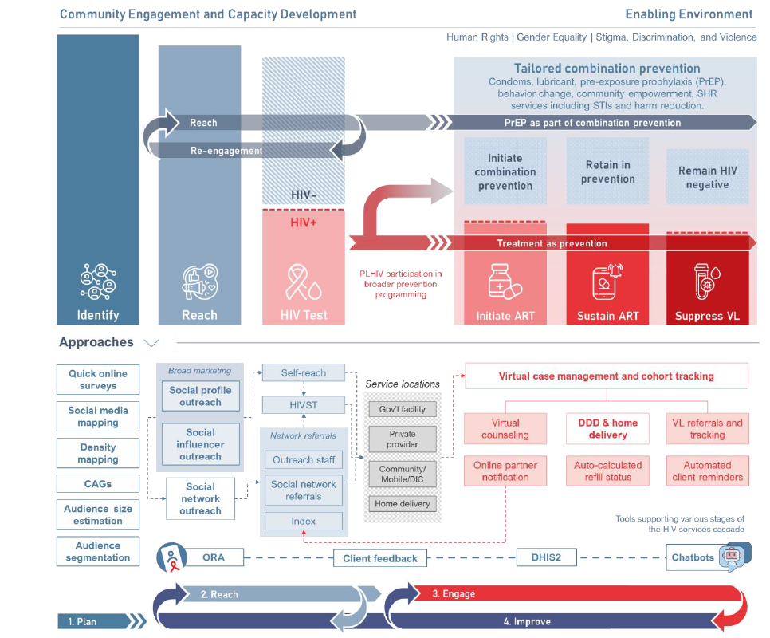
Virtual HIV interventions:
Consider the range of options and prioritize in line with country realities

Slide 39
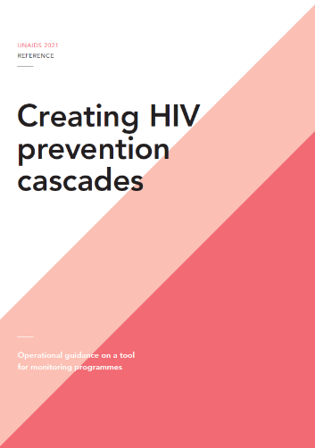
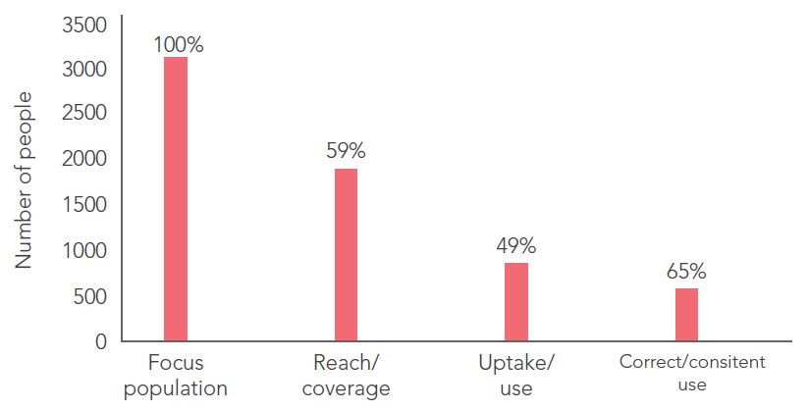
HIV prevention cascades can provide additional insights to enhance precision
Prevention cascades already in use in some countries
New guidance outlining a simplified programmatically oriented framework
Cascades can be focused on a sub- population or prevention method(s) – typically a combination of both
Important to recognize limitations: the denominator for prevention cascades (people at risk) is much more complex and unstable than for HIV treatment cascades
Cascades: an additional useful tool (but not a magic bullet)
Creating HIV prevention cascades; operational guidance on a tool for monitoring programmes – Unaids
Prevention cascades: the basic model

Slide 40
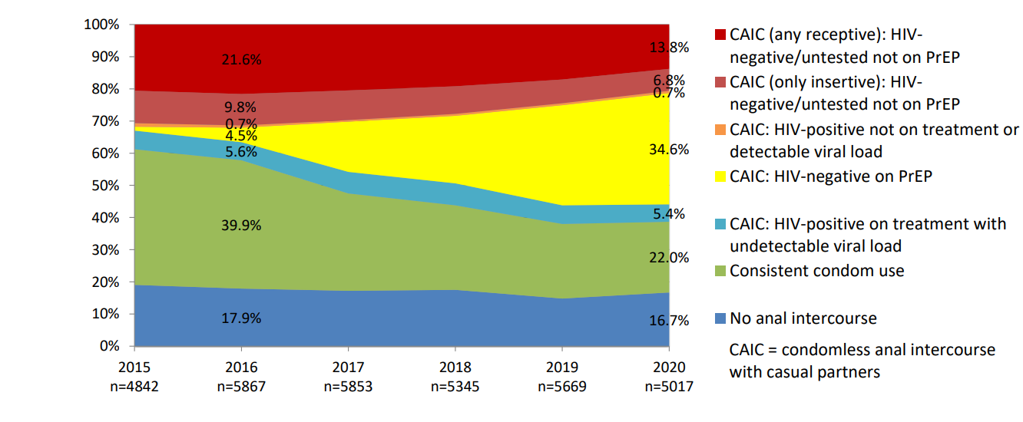
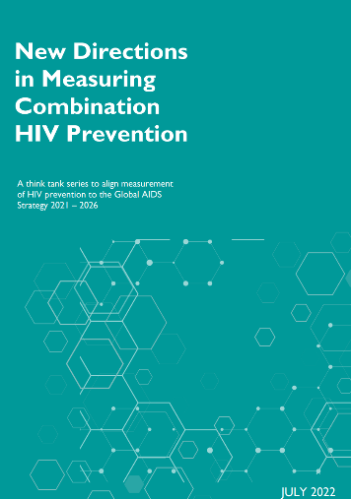
Go beyond single intervention approaches and metrics
Source: University of New South Wales, Australia

Slide 41
People-centred precision prevention
For the right people
In the right locations
With the right interventions
At the right time
In the right way
At the right cost
The right combination and balance

Slide 42
Basic factors for value for money
Three factors are essential to understand cost-effectiveness of HIV prevention:
HIV incidence (by age, by location, by sub-population, individual factors)
Unit costs of different packages (intensity)
Effectiveness of interventions
EXAMPLE:
A district/population with baseline HIV incidence of 0.4 in 100 PY (high HIV incidence category)
1 million USD spent at a unit cost of 100 USD per person/year
30% effectiveness of the programme in reducing incidence
RESULTS WILL BE:
10,000 young women reached
Among whom 40 new HIV infections would have occurred in a year
Of which 12 new HIV infections will be averted
Do not cite

Slide 43
Analyze Value for Money
Illustrative example (DO NOT CITE)

Slide 44
What will be the effect of investing 1 million USD in prevention?
Do not cite
Legend:
Impact of USD 500 million (in % of global new HIV infections among adults averted)
IMPORTANT TO NOTE:
Several limitations to be
considered in such basic
reasoning – this analysis
only provides a broad
direction

Slide 45
People-centred precision prevention
For the right people
In the right locations
With the right interventions
At the right time
In the right way
At the right cost
The right combination and balance

Slide 46
National prevention reviews: How analytical tools fit together
1. Overview & synthesis
Start with synthesis available in GPC scorecards and understand gaps towards global targets
Global HIV Prevention Coalition Scorecards
STEWARDSHIP
Strategy, management, systems
(Road map survey)
POLICIES
Policies, structural barriers
(NCPI)
OUTPUTS
Program coverage
(GAM, program & survey data)
OUTCOMES
Prevention service use, behaviour
(GAM, surveys)
IMPACT
HIV incidence
(HIV estimates, PHIA …)
2. Analyze progress along the results chain & inequities
Further examine data sources, disaggregate, analyze inequities in progress
3. Estimate prevention needs
Understand detailed needs of populations and for key intervention areas
Key population size estimates & prevention denominators
Estimates of girls & women at higher risk of HIV and associated factors
Estimates of boys & men at higher risk of HIV, VMMC decision-making tool
Condom needs estimation tool
PrEP target setting tools
4. Granular program analysis
Through prevention self-assessment tools (PSATSs) for the 5 pillars
Key population PSAT
Adolescent girls & young women PSAT
Boys & men /VMMC
PSAT
Condom
PSAT
ARV-based prevention /PrEP
PSAT
5. Other cross-cutting analytics
Dig deeper based on country needs
Prevention cascade analyses, qualitative ‘audits’ of new infections, program evaluations, …

Slide 47
Prioritization is unavoidable in any HIV prevention response
Beyond cost-effectiveness: For full value for money considerations: Important to consider equity, non-HIV benefits and other factors
BUT – avoiding prioritization is not possible in any public health response
The attempt to avoid explicit prioritization is likely to lead to implicit prioritization, which typically more inequity and lower impact
Various modelling tools available to support cost-effectiveness and resource allocation analyses (GOALS, AEM, Optima …)

Slide 48
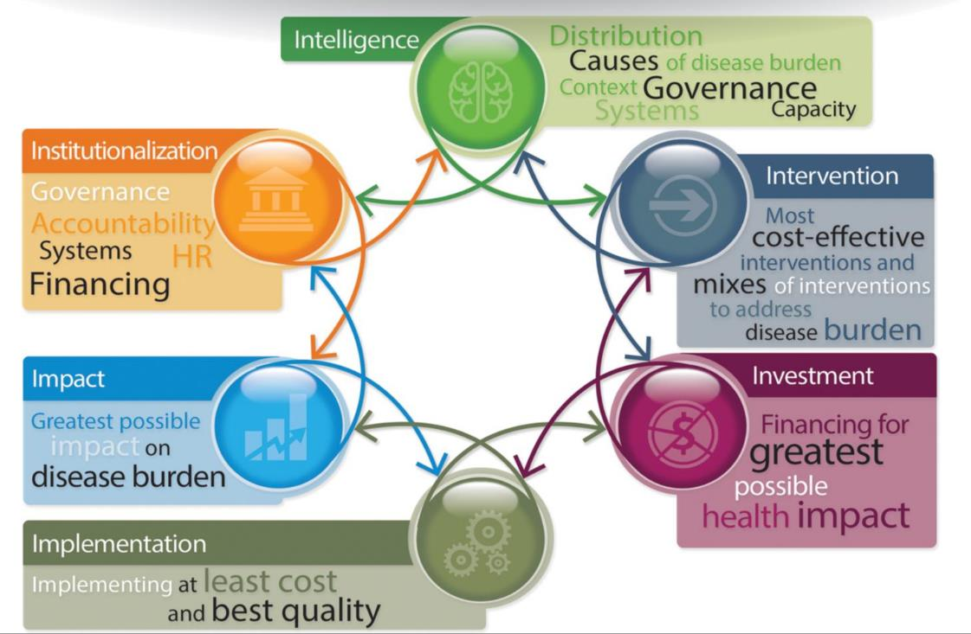
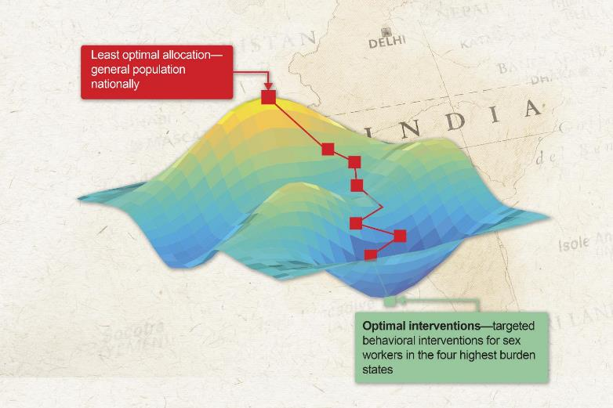
Decision and delivery sciences and models can support decision-making
Formal mathematical optimization algorithms
Source: World Bank

Slide 49
People centred precision prevention is not about focusing on very few, but about the right intensity aligned to people’s needs
People-centered
  Precision in design at community-level but avoid invasive screening of individuals
    Platforms that reach people most in need – not disclosure of key population identities or excluding people who demand prevention
  Co-create, life-style choices, local design
Precision: Need a mix of
  intensive prevention for populations with highest HIV incidence (key populations and adolescent girls, boys, women and men in very few locations, mostly in southern Africa, some few in eastern Africa) – this includes PrEP and regular community outreach/empowerment plus all basic prevention & treatment options)
  basic lower cost prevention options at scale (condoms, VMMC where applicable, testing & treatment plus basic demand generation using cost-efficient channels) for other settings with moderate HIV incidence
-> To achieve optimal prevention outcomes and reductions in HIV incidence

Slide 50


THANK YOU
THANK YOU! benediktc@unaids.org

